Slide 1
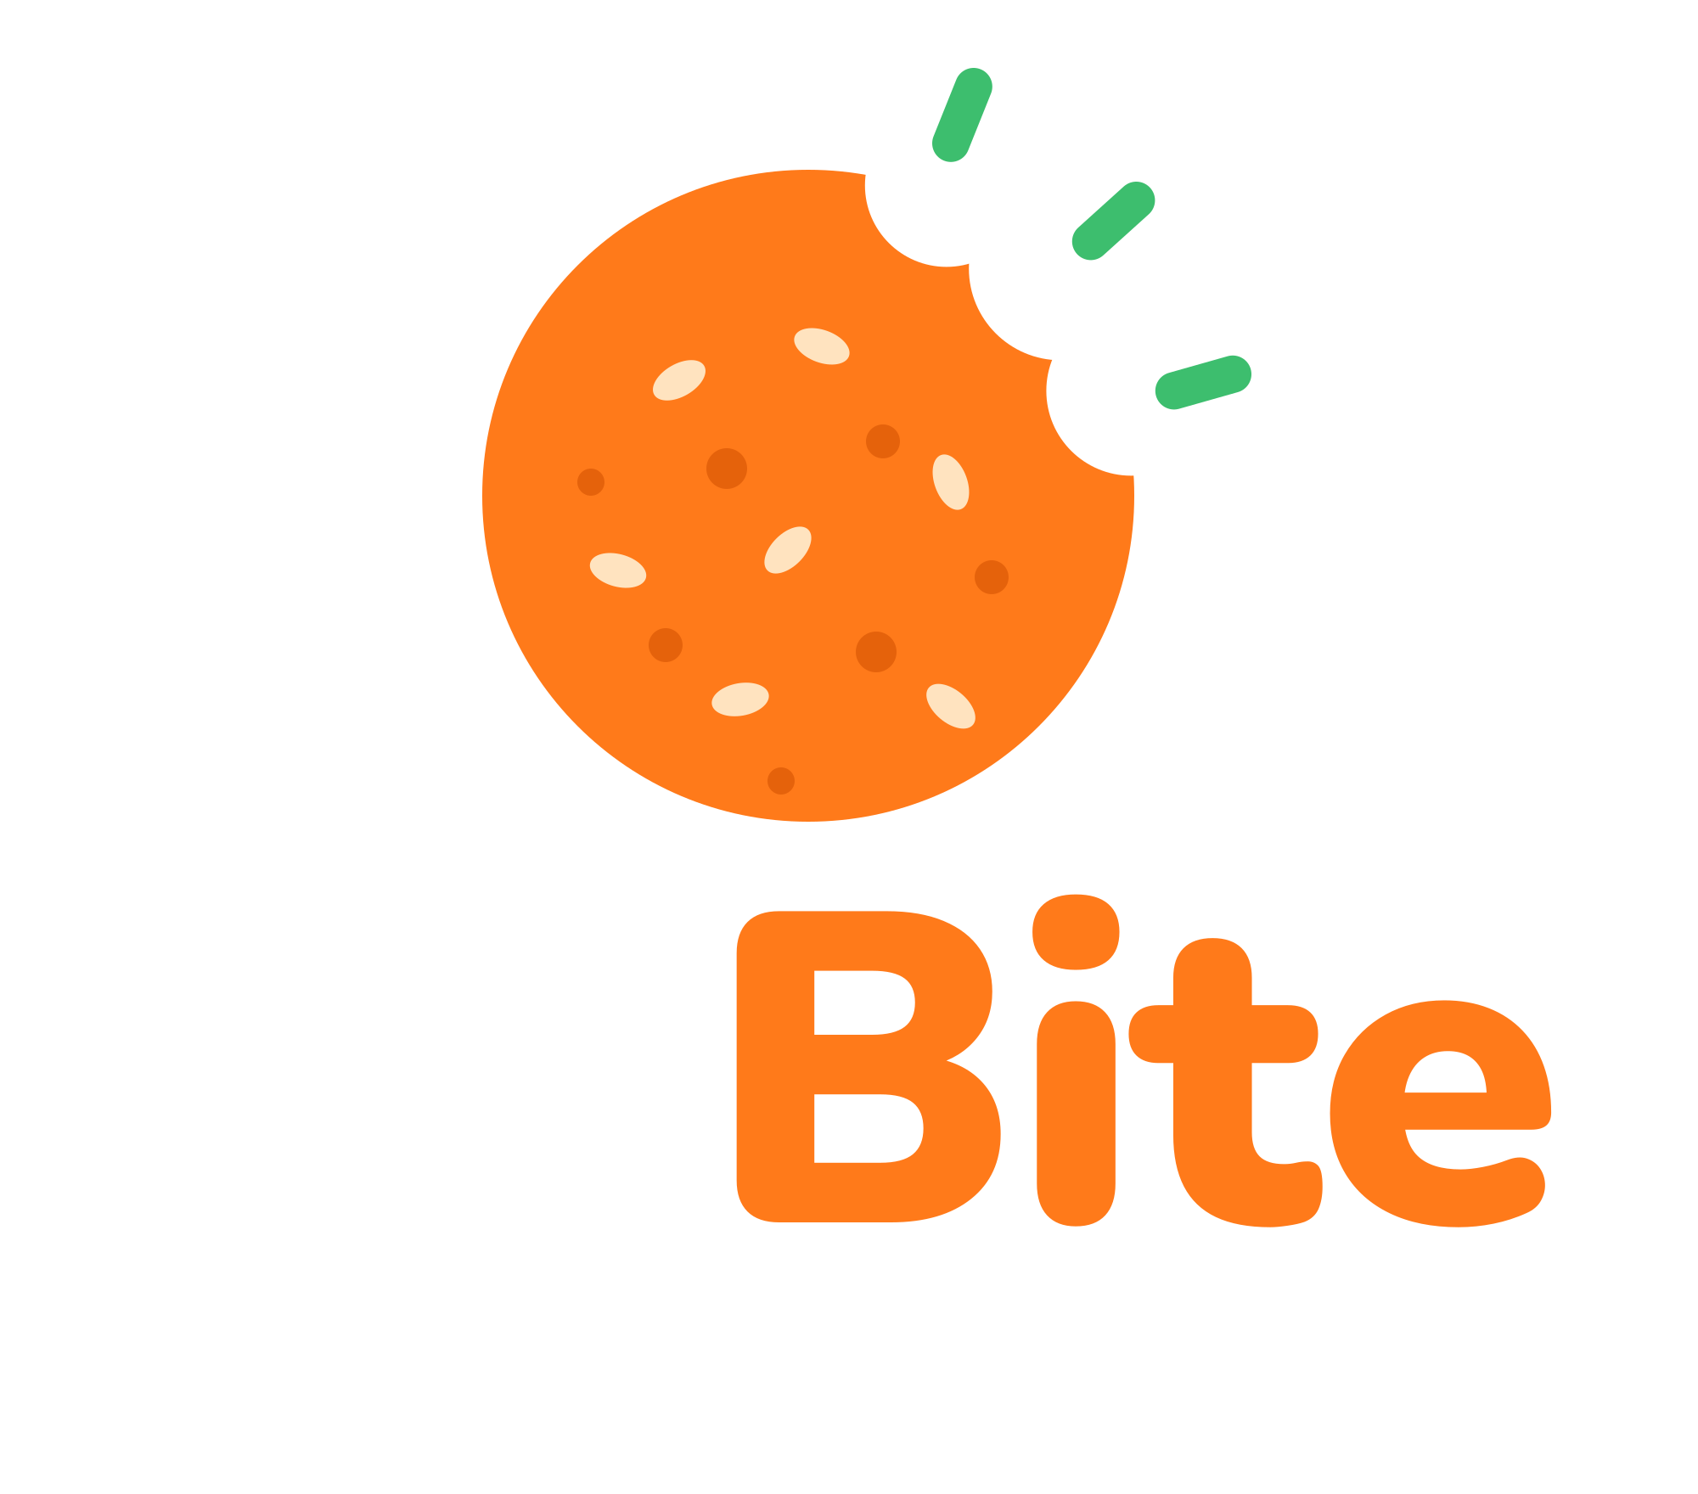
EXECUTIVE BRIEFING
Marketing Strategy
FitBite Healthy Snack
“Great Taste, Convenient Energy, Ready for Your Day!”
Notes:
Welcome. This briefing walks through the FitBite marketing strategy: what the product is, who it is for, how we will price, place and promote it, and how we will keep customers coming back.

Slide 2




FitBite at a glance
EXECUTIVE SUMMARY
A locally made, affordable snack designed around a real customer need, and launched with penetration pricing, free sampling and a loyalty program.
1,000 SDG
≈ 33% lower
Ages 16–35
3 cities
Introductory price per pack
Than the estimated 1,500 SDG competitor price
Students and employees with low to middle incomes
Khartoum, Omdurman and Bahri at launch
HOW WE WIN
Built on real customer needs: the Marketing Concept
Penetration pricing plus free samples on campus and at gyms
Loyalty that rewards habit: buy 9 packs, get 1 free
1
2
3
Notes:
The headline: FitBite is a low-cost, locally familiar snack for students and young employees. It enters at 1,000 Sudanese pounds against roughly 1,500 for competitors, which is about a third cheaper. We start in Khartoum, Omdurman and Bahri. We win by building around customer needs, pricing for penetration, sampling heavily, and rewarding repeat purchases.

Slide 3
What we will cover
AGENDA
01
02
03
Product and orientation
Competition
Segmentation
What FitBite is and why we lead with customer needs
Who we compete with and where we win
Four ways we divide the market
04
05
06
Target market
Marketing mix
Customer relationships
Who we serve first, and meet Ahmed
Product, Price, Place and Promotion
How we turn first bites into loyalty
Notes:
Six parts, then the plan on one page. Each section has its own colour, and the dot next to each slide's label tells you which section you are in.

Slide 4









A familiar snack built for busy days
01 · PRODUCT AND ORIENTATION
Nutritious local ingredients in a small, easy-to-carry pack, designed for busy students and employees.
CORE VALUE
WHAT'S INSIDE
Great taste
Made from familiar, popular local ingredients
Convenience
Dates
Peanuts
Oats
Sesame
A small pack that is easy to carry anywhere
Small, convenient pack with product information, expiry date and allergen warnings
Affordability
Only 1,000 SDG per pack
A brand that reflects an active, convenient lifestyle
Notes:
FitBite is made from dates, peanuts, oats and sesame seeds: ingredients that are familiar and nutritious. The pack is small and practical. The core value combines great taste, convenience and affordability at 1,000 Sudanese pounds.

Slide 5

A fair exchange that pays back twice
01 · PRODUCT AND ORIENTATION
Money: 1,000 SDG per pack
Valuable customer feedback
Customers
FitBite
Students and employees
Energy, nutrition and taste
The company
Customers get a snack that delivers on taste, energy and price. FitBite earns revenue and the feedback it needs to keep improving.
Notes:
The exchange is simple. Customers pay money and receive energy, nutrition and taste. The company receives revenue and, just as important, customer feedback that shapes the product.

Slide 6




We lead with the Marketing Concept
01 · PRODUCT AND ORIENTATION
THE ALTERNATIVES WE SET ASIDE
OUR CHOICE
Production Concept
Focus Efficiency and distribution.
Risk May overlook customer preferences.
Marketing Concept
Product Concept
Focus
Understand and satisfy customers' needs and wants.
Focus Quality and performance.
Risk Can lead to excessively high prices.
Why it fits FitBite
The product was developed after identifying a real need: Ahmed, a student who needs an affordable, nutritious snack.
Selling Concept
Focus Aggressive promotion and sales.
Risk Little long-term customer loyalty.
Notes:
We chose the Marketing Concept: start from what customers need and want. FitBite came out of a real need, represented by our persona Ahmed. The alternatives each carry a risk: the Production Concept can ignore preferences, the Product Concept can push prices too high, and the Selling Concept leans on aggressive promotion rather than loyalty.

Slide 7

We compete for every snack break
02 · COMPETITION
Direct competitors
Indirect competitors
4 brands
5 alternatives
Products with similar benefits that serve the same purpose: energy bars and snack products.
Alternatives customers may buy instead to satisfy their hunger.
Tiger Bar
Break Bar
Royal biscuits
Captain Majid chips
Abu Auf
Datto
Cadbury chocolate
Bakery products
Fresh fruits
Notes:
Direct competitors offer similar benefits for the same purpose: Tiger Bar, Break Bar, Abu Auf and Datto. Indirect competitors are anything else people buy to satisfy hunger: Royal biscuits, Captain Majid chips, Cadbury chocolate, bakery products and fresh fruit.

Slide 8


Three advantages set FitBite apart
02 · COMPETITION
Familiar local ingredients
Ingredients that are familiar and popular among Sudanese consumers.
Convenient packaging
A small, practical pack that is easy to carry and eat anywhere.
Affordable price
1,000 SDG, compared with about 1,500 SDG for many competing products.
About one-third cheaper. The competitor price is an estimate.
Notes:
Our three advantages: ingredients Sudanese consumers already know and like, a pack that is easy to carry, and a price of 1,000 pounds versus about 1,500 for many competitors. That is roughly a third cheaper. The competitor price is an estimate.

Slide 9


Four lenses on the market
03 · SEGMENTATION
Demographic
Geographic
Ages 16 to 35, especially students and employees with low to middle incomes.
Khartoum, Omdurman and Bahri, near universities, gyms and other places our customers visit.
Psychographic
Behavioral
People who prefer convenient, familiar and affordable snacks that fit an active lifestyle.
Regular snack buyers who need a quick refreshment during breaks and respond to discounts, offers and multipacks.
Notes:
We segment on four dimensions. Demographic: 16 to 35, students and employees on low to middle incomes. Geographic: Khartoum, Omdurman and Bahri, near universities and gyms. Psychographic: people who want convenient, familiar, affordable snacks for an active life. Behavioral: regular snack buyers who need quick refreshment and respond to discounts and multipacks.

Slide 10




Students first, then gyms and professionals
04 · TARGET MARKET
Why this market is attractive
PRIMARY TARGET
University students aged 18 to 30
Repeat sales
Students buy snacks regularly.
Need affordable, tasty and convenient snacks during their studies and daily activities.
Affordable reach
TikTok, Instagram and word of mouth among students.
SECONDARY TARGET
Gym members and busy professionals
To verify: the assumption that this market is more than 40% of the total market needs market research before it is presented as a confirmed figure.
Need a quick snack during their daily routines.
Notes:
Our primary target is university students aged 18 to 30. Secondary: gym members and busy professionals. Students buy snacks regularly, which means repeat sales, and they are cheap to reach through TikTok, Instagram and word of mouth. One caution: the idea that this market is more than 40 percent of the total is an assumption and must be checked with market research.

Slide 11



Meet Ahmed, the customer we designed for
04 · TARGET MARKET
What Ahmed needs
Affordable
Tasty
A snack that fits a student budget
Something he enjoys eating
Ahmed
22 years old · University student
Nutritious
Portable
Limited budget
Energy and nutrition for a busy day
Fits in his backpack, eaten between lectures
Notes:
Ahmed is 22, a university student on a limited budget. He needs a snack that is affordable, tasty and nutritious, that fits in his backpack and that he can eat between lectures. FitBite was designed for exactly this need.

Slide 12


Product and Price: an easy first purchase
05 · MARKETING MIX
The four Ps work together to attract students and employees and create competitive value.
Product
Price: market penetration
Familiar local ingredients: dates, peanuts, oats and sesame seeds
Small pack with product information, expiry date and allergen warnings
A brand that reflects an active, convenient lifestyle
1,000 SDG
1,500 SDG
FitBite introductory price
Estimated competitor price
Student discounts and multipack discounts
Goal: encourage first-time purchases and build market share
“Great Taste, Convenient Energy, Ready for Your Day!”
Notes:
Product: local ingredients, a small pack that carries product information, expiry date and allergen warnings, and a brand built around an active lifestyle. The message is: Great Taste, Convenient Energy, Ready for Your Day. Price: market penetration. We enter at 1,000 pounds against an estimated 1,500, with student and multipack discounts, to drive first purchases and build share quickly.

Slide 13







Place and Promotion: be where students are
05 · MARKETING MIX
Place
Promotion
Social media advertising
Free samples at universities and gyms
Local grocery stores and supermarkets
University cafeterias
Influencers review and promote the product
Posters and materials at points of sale
Gyms and fitness centers
Online: Facebook, Instagram and TikTok
Satisfied customers recommend us to friends and family
Notes:
Place: grocery stores and supermarkets, university cafeterias, gyms and fitness centers, and direct online sales through Facebook, Instagram and TikTok. Promotion: social media ads, free samples at universities and gyms, influencer reviews, point-of-sale posters, and word of mouth from satisfied customers.

Slide 14



Turning first bites into loyal customers
06 · CUSTOMER RELATIONSHIPS
STEP 1
STEP 2
LOYALTY PROGRAM
Satisfaction
Repeat purchases
Buy 9, get 1 free
Good quality at affordable prices keeps customers happy.
Special offers encourage customers to buy regularly.
FREE
STEP 4
STEP 3
Feedback
Loyalty
Every tenth pack is on us. It builds trust and keeps customers coming back.
We listen to improve the product and introduce new flavors.
Trust built through the loyalty program.
Notes:
Customer relationships run as a cycle. Good quality at affordable prices drives satisfaction. Special offers drive repeat purchases. A loyalty program, buy nine packs and get one free, builds trust. And we listen to feedback to improve the product and add new flavors, which feeds back into satisfaction.

Slide 15



Five moves to launch FitBite
THE PLAN ON ONE PAGE
01
02
03
04
05
Launch where students are
Enter at 1,000 SDG
Drive trial
Reward loyalty
Validate and improve
Universities, gyms and stores in Khartoum, Omdurman and Bahri.
Penetration pricing, with student and multipack discounts.
Free samples, influencer reviews and social media advertising.
Buy 9, get 1 free, plus special offers for regular buyers.
Confirm market size with research. Use feedback for new flavors.
Notes:
To bring it together, five moves. Launch where students are. Enter at 1,000 pounds with discounts. Drive trial through free samples, influencers and social media. Reward loyalty with buy nine, get one free. And validate the market-size assumption with research while using feedback to develop new flavors.

Slide 16
Great Taste, Convenient Energy, Ready for Your Day!
Thank you · Questions and discussion
Notes:
Thank you. Happy to take questions.

