Slide 1
Let’s start! But be patient !
You want to start writing programs!
But Before that you need some background.
What is a Program ?
Computers are not useful unless we give them some instructions.
Simply, this set of instructions is called a program.
You already know that Programs are
Step by step instructions
They Achieve a particular task

Slide 2
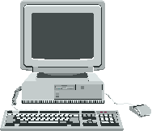
Computer Programming
Communication between a human and a computer
Print Hello
Hello

Slide 3
Programming Language
Humans have Natural Languages
Computer has a language of its own
To be able to Communicate with the computers we need to translate our requirements and instructions into a form that the computer understands.
Thus in order to communicate with computers, users needs to have a language that is understood by the computer.
Such a Language is known as programming language.
E.g C/C++,Python,VB,C# , Pascal, COBOL etc.

Slide 4
Types of Programming Languages
Basically all the programming languages are divided into two categories :
Low Level Languages
Machine Language
Assembly language
High Level Language

Slide 5
Low Level Language
Machine languages
Lowest and most elementary type level
First type of programming language
The only form of language that computers can understands
Made up of 0’s and 1’s
Very Hard to Learn by humans
Example:
0100001001

Slide 6
Programming Languages
Assembly language
uses alphanumeric symbols instead of 0’s and 1’s to represent the operations.
These symbols are known as mnemonics (e.g. Add, Start, Sub etc) .
Operation Vs Operand
Example:
LOAD PRICE
ADD TAX
STORE COST

Slide 7
Programming Languages
High-level languages
Give format close to English language
Enable people to program easily
Uses English words and mathematical symbols instead of mnemonics .
Example:
Cost = Price + Tax
C/C++ is high level language ☺

Slide 8
Translators
Before discussing translators we should know the following
Computers only understands Machine language (0’s and 1’s )
High level languages are to facilitate Humans but any instructions written in that must be translated into machine language in order to achieve a specific task for which the program was written.

Slide 9
Translators …
Source Program/Code
A Program written in non-machine language but some other programming language such as C/C++, Java etc
Object Program /Code
When the source program is translated into machine language and is ready to be used by the computer.

Slide 10
Translator
Translator
“So translator is a program that converts a source program into its equivalent object program”
OR
“it is program that converts an instruction in High level language or assembly language into machine language”
Object Code
(0’s & 1’s)
Source Code
Translator

Slide 11
Translators
Source code
Object code
Source Code
Translator
Object Code

Slide 12
Types of Translators
Basically there are three types of Translators
Assemblers
Interpreters
Compilers

Slide 13
Assembler
Converts the code written in Assembly language into machine language.
Since computers can only understand the machine language, therefore, the program written in assembly language must be converted into machine language to enable computer to execute it.
The whole program is first typed into Assembly language and is then translated to machine language by “Assembler”

Slide 14
Compliers
Coverts a program written in High level language into machine language.
A compiler takes an Entire “Source program” and translate it into “Object Program”.
This is known as “Compilation”
Once Compiled the program (Object Program) can be stored and can be executed again and again without requiring the repeated use of compilation.
Compilation is only needed again when changes are made to the source program.

Slide 15
Library Routines : The functionalities used in program that are not the part of the code but these functionalities are provided by either operating system or other utility programs.
Example : When you want to read some data from the Disk in your program you don’t need to write separate instruction for that ,instead in your program , you request Operating system to use its own procedures and do it for you. These procedures or routines were not part of you program code but they were present in the operating system and your program code has asked for them.

Slide 16
Linking
The process by which your complier combines different parts of your programs and link your program code with the Library routines.
The part of the compiler that do it for you is called a Linker.

Slide 17
Compilation Process
Source code
Object code
Executable
Program
Loader
Compiler
Linker
Running program
Libraries and
other pre-compiled components

Slide 18
Interpreter
Another type of translator used to translate high level language into machine language.
It translates the code one Instruction at a time
No Object code is saved for future
The next time the instruction is used , it must once again be interpreted and translated into machine language.
It is therefore slower than compilers.

Slide 19
Memory Organization
In the lowest level, computers understand only 0's and 1's.
Computer memory stores a sequence of 0's and 1's.
Each such storage unit is called a bit.
Eight bits are grouped together to form a larger storage unit called a byte.

Slide 20
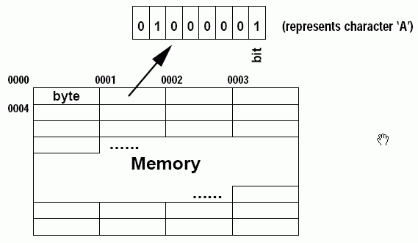
Memory Organization (con't)
Each byte has a unique address for identification.
Computer memory can thus be viewed as a series of bytes.

Slide 21
Variables
Any thing whose value can be changed (or keeps on changing).
Variables are the most common way to tackle a problem in mathematical languages.
It is a common practice that we convert a word problem into variables and equations and then solve the problem !

Slide 22
Example :
Calculate the Tax on salary if the tax is @ 2.5 % of the salary
We approach this problem
Tax = salary * (2.5/100)
Where Tax and Salary are variables They can have any value e;g for Salary =Rs.1000 , the Tax = Rs.250.
So variables are the powerful way to solve the problems.
since we use programming for problem solving therefore, variables are the core part of any Programming Language.

Slide 23
Variables : in Terms of C++
A variable is space in computer’s memory, set aside for certain kind of data and Given a Name for easy reference.
A C++ variable can hold a number or other type of data e.g. character data ‘ABCD’ etc.
A C++ variable is implemented as a memory location. Information stored is binary -- 0s and 1s.
Every variable has a name, a type, a size and a value.
Whenever a new value is placed into a variable it replaces (and destroys) previous value
Reading variables from memory does not change them

