Slide 1
Human Activity Recognition Final Project Python Analysis
Ibrar ARIF – A5 – PROMO 2020

Slide 2
Problem Statement
Analysing smartphone sensors data of human activities to draw insights and predict the activity using Machine Learning.
Classification of human activities using the given data collected using Smartphones sensors.

Slide 3
Why study Human Activities?
Human activity recognition deals with the problems generated in the integration of sensing and reasoning to provide context aware data.
The context aware data confers the personalized support across an application
The potentials of study of Human Activities can be exploited to scenarios such as activity classification, monitoring persons for signs of fatigue, distinguishing one individual from another , with possible deployment in highly sensitive and secure workplaces etc
Human Activity Recognition has broad range of applications in human survey systems, medical research and health systems.

Slide 4
Dataset Overview
Human Activity Recognition using Smart Phones Available in UCI Machine Learning repository.
Data collected from 30 volunteers and released to public domain by researchers.
Data is collected from accelerometer and gyrometer sensors of Smartphones.
Signal Processing and Noise reduction using techniques like median filter, Butterworth filter. Signals mapped into frequency domain using FFT
561 features are extracted in total
6 activities : Stand, Sit, Walk, Lay Down, Walk Upwards, Walk Downwards

Slide 5
Dataset Understanding
The features selected for this database come from the accelerometer and gyroscope 3-axial raw signals tAcc-XYZ and tGyro-XYZ.
Accelerometer: It is an electromechanical device used to measure acceleration forces. Such forces may be static, like the continuous force of gravity or, as is the case with many mobile devices, dynamic to sense movement or vibrations.
Gyroscope: A gyroscope is a device used for measuring or maintaining orientation and angular velocity.
Each pattern’-XYZ’ is used to denote 3-axial signals in the X, Y and Z directions.

Slide 6
Methodology
Data Preprocessing
Exploratory Data Analysis
ML Modeling
Saving best model

Slide 7
Data Preprocessing
Checked the feature object types
Checked the statistical summary of train and test datasets
Checked for Missing Values, Duplicate Values and Class imbalance.
No missing values found.
No duplicate values found.

Slide 8
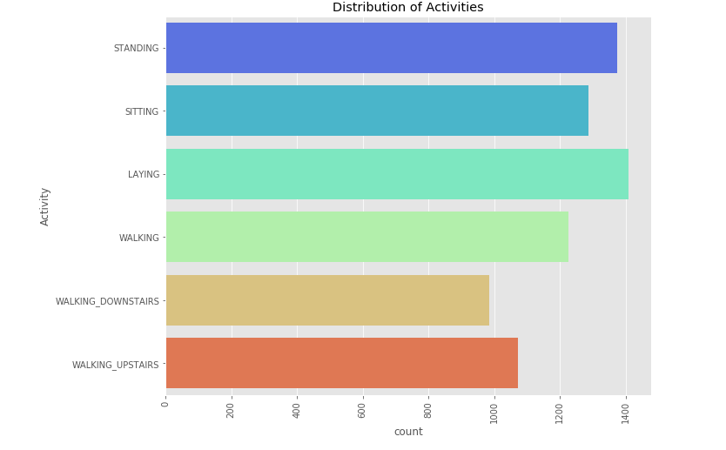
Exploratory Data Analysis - Class distribution

Slide 9
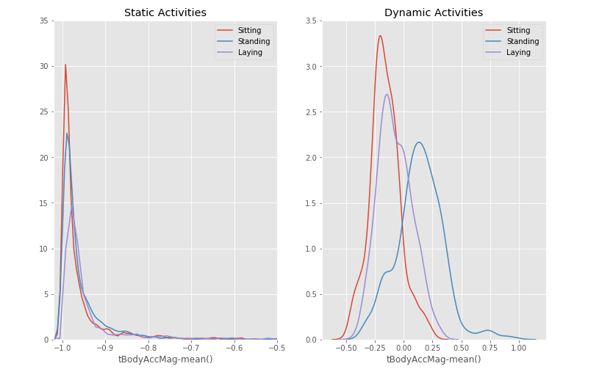
Exploratory Data Analysis - Variance

Slide 10
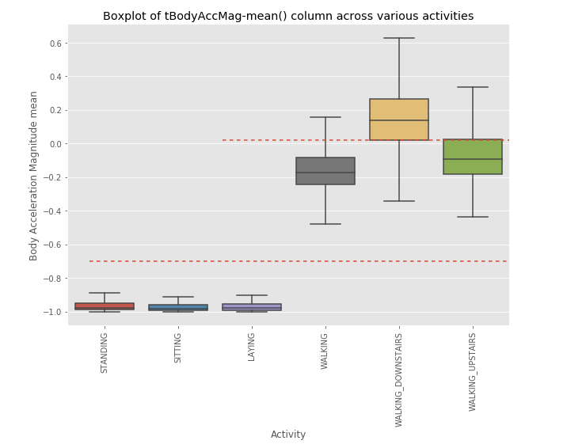
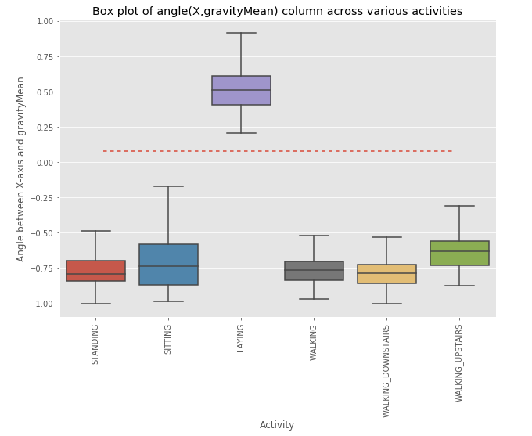
Exploratory Data Analysis - Variance

Slide 11
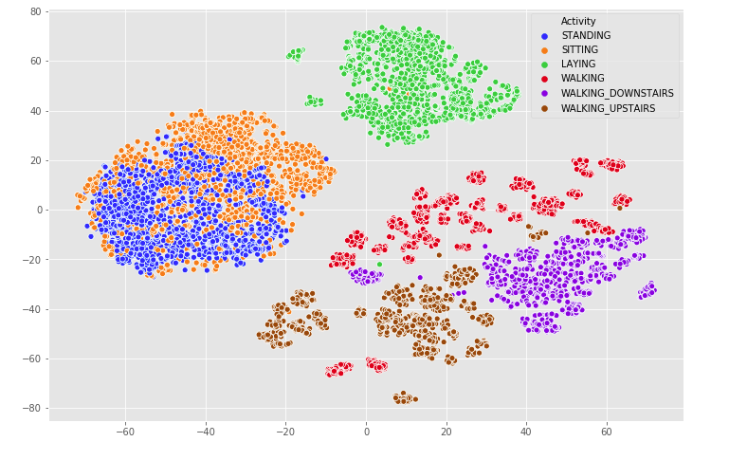
Exploratory Data Analysis - Separability

Slide 12
ML Modeling
Models Used:
Logistic Regression
Support Vector Machine: Linear and Kernel
Decision Tree Classifier
K-Nearest Neighbor
Random Forests

Slide 13
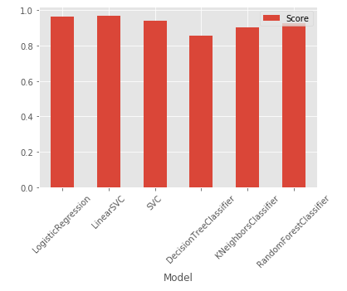
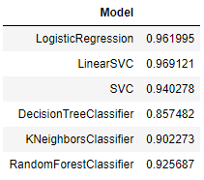
ML Modeling (Results with Default Parameters)
*
* Accuracy score

Slide 14
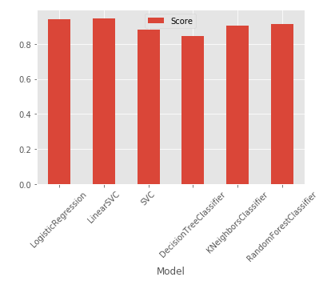
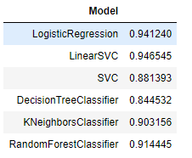
ML Modeling(Results with Hyperparameter tuning)
*
* Cross-validation score

Slide 15
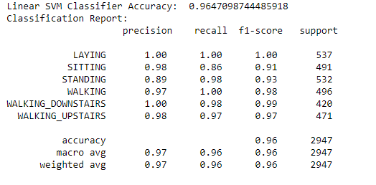
ML Modeling(Model results with tuned Parameters)

Slide 16
Reflection
The difficulty in application of machine learning is defining a problem accurately, this dataset was well labelled and defined the problem as classification problem.
Due to large number of features, it was difficult to find out what feature contributed to the performance of activity recognition.
Hyperparameter of models is without any doubt a tricky part in optimizing your model for dataset with such large features.

Slide 17
Conclusion
In this project, Human Activities were classified using various machine learning algorithms.
Human activity recognition dataset provided by UCI ML repo was explored and then modeled.
In terms of performance, the linear svm and logistic regression stood out on top with and without hyperparameter tuning.

