Slide 1
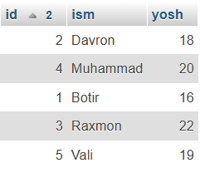
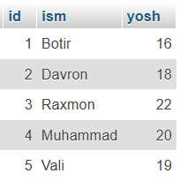
SELECT * FROM talaba
ORDER BY MOD(id, 2), id;

