Slide 1
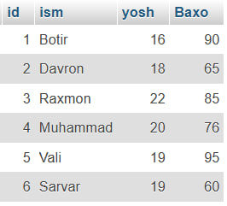
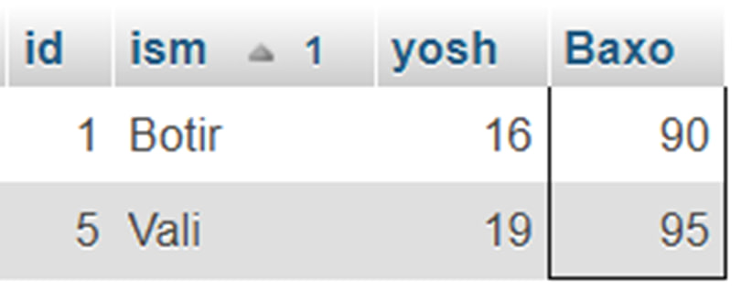
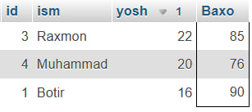
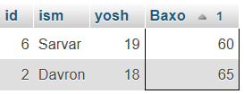
SELECT * FROM talabajon
WHERE Baxo BETWEEN 90 AND 101
ORDER BY ism ASC;
Asosiy Jadval
SELECT * FROM talabajon
WHERE Baxo BETWEEN 60 AND 70
ORDER BY Baxo ASC;
SELECT * FROM talabajon
WHERE Baxo BETWEEN 70 AND 90
ORDER BY yosh DESC;

