Slide 1
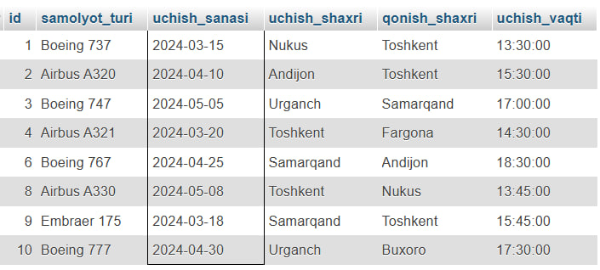
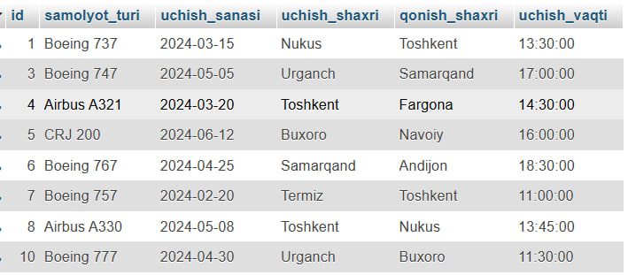
SELECT * FROM AEROPORT
WHERE MONTH(uchish_sanasi) IN (3, 4, 5);
Asosiy Jadval

