Slide 1
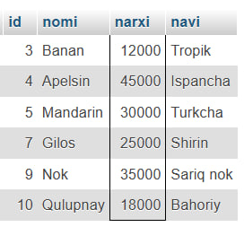
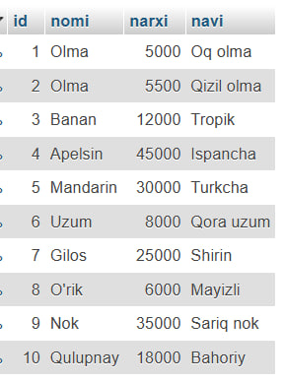
1-sorov
SELECT * FROM Meva
WHERE narxi BETWEEN 10000 AND 50000;
Asosiy Jadval

Slide 2
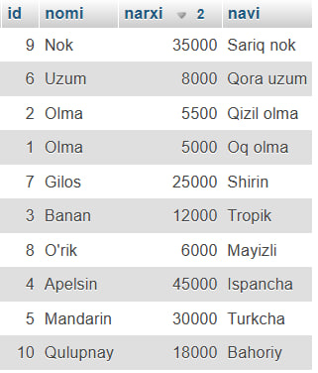
2-sorov
SELECT * FROM Meva
ORDER BY LENGTH(nomi), narxi DESC;

