Slide 1



hr_analytics
View in Power BI
Last data refresh:
5/8/2024 12:38:25 PM UTC
Downloaded at:
5/8/2024 12:43:35 PM UTC

Slide 2
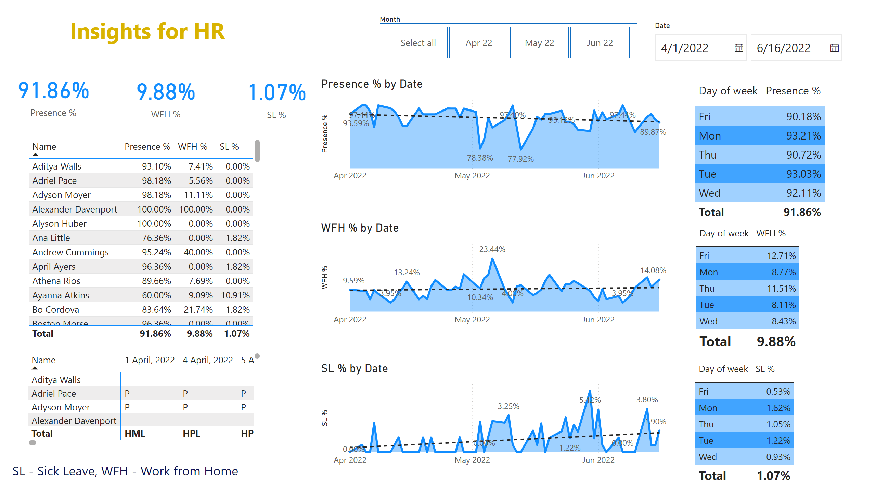
HR Analytics 1
Notes:
card
No alt text provided
slicer
No alt text provided
card
No alt text provided
card
No alt text provided
tableEx
No alt text provided
textbox
No alt text provided
textbox
No alt text provided
pivotTable
No alt text provided
areaChart
No alt text provided
areaChart
No alt text provided
areaChart
No alt text provided
tableEx
No alt text provided
tableEx
No alt text provided
tableEx
No alt text provided
slicer
No alt text provided
textbox
No alt text provided

