Slide 1
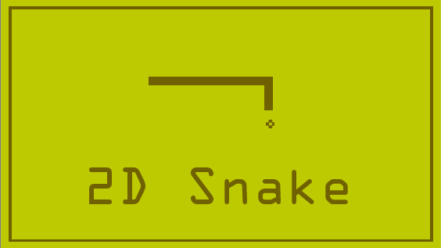
Computer Graphics Final Project
Ibtihal Ferwana & Aya Akeel
Apr. 22nd, 2018
Notes:
In 1978 firstly programmed in a personal computer

Slide 2
Outline
Implementation
Snake Head & Body
Snake Movements
Food Appearance
Collision Detection
Demo

Slide 3
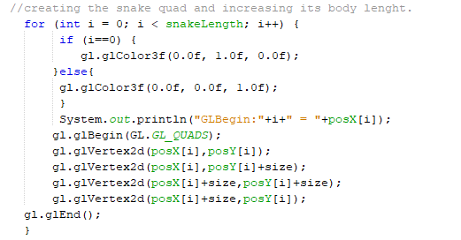
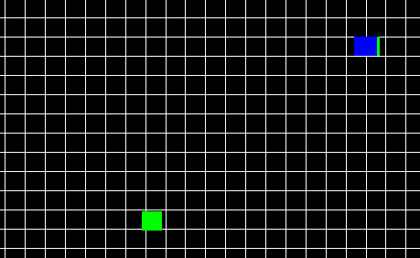
Snake Head & Body
Data structure: Arrays

Slide 4
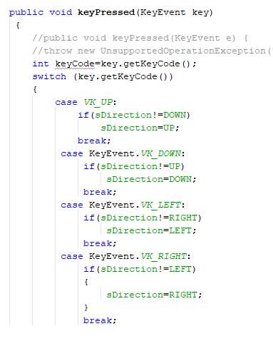
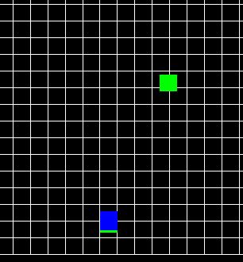
Snake Movements
Notes:
If it goes up it will not go down, if it goes right it cannot go left and so on.

Slide 5
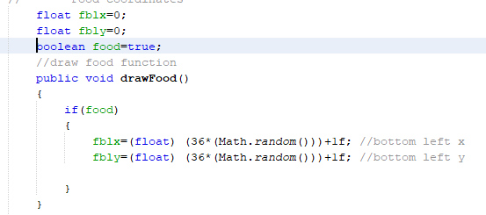
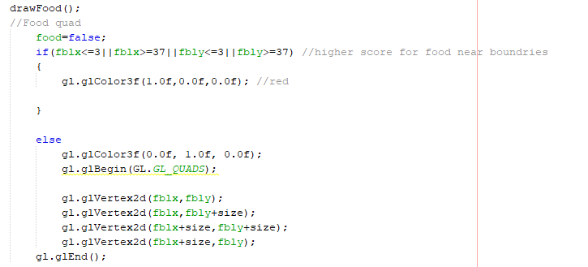
Food Appearance
Randomness
Controlling Appearance; a boolean

Slide 6
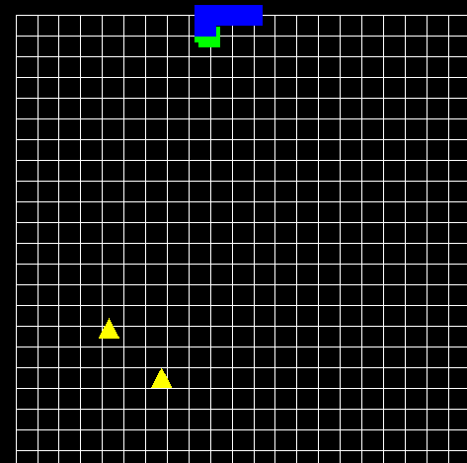
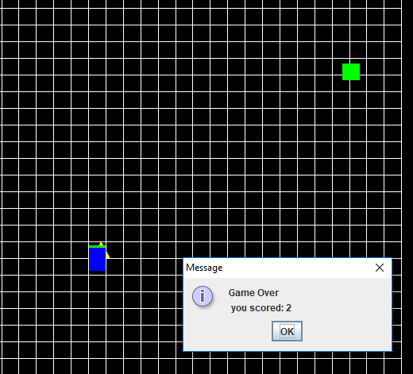
Collision Detection
Food Detection
Obstacle Detection

Slide 7
Features Added
Obstacles that kills (ends the game)
Food at boundaries have higher score
Speed increases by achieving higher scores

Slide 8
References
The Pentamollis Project (2016, Oct 24). OpenGL & C++ game programming tutorial (2D). [Video File] Retrieved from https://www.youtube.com/watch?v=6Miai_t_ksw&index=1&list=PLWzp0Bbyy_3gXc0YBxiIR9Tb5KfmLSL_C
Nexuson (2000 June). Two Objects Overlap Each Other. OpenGL Forum. Retrieved from https://www.opengl.org/discussion_boards/showthread.php/125008-two-objects-overlap-each-other
Keegan. P (2018). Packaging and Deploying Desktop Java Applications. NetBeans Docs & Support. Retrieved from https://netbeans.org/kb/articles/javase-deploy.html

