Slide 1
Give Me Some Credit - Measuring a Person’s Creditworthiness
Nathan Kruse and Ibur Rahman

Slide 2
The Data
Kaggle Competition (kaggle.com/c/GiveMeSomeCredit)
Training Set (150,000 observations)
10 explanatory variables
Number of times 30 days late, 60 days late, 90 days late
Number of children
Age
Income
Etc.
1 binary response variable
Serious delinquency in the last two years (~93% = No)
Test Set (101,503 observations)

Slide 3
The Challenge
Predict who had serious delinquencies in the last two years
Evaluating results by error/accuracy rate is problematic
Guessing 0 for every observation gives ~93.3% accuracy
Instead the “Area Under the Curve” (AUC) method was used

Slide 4
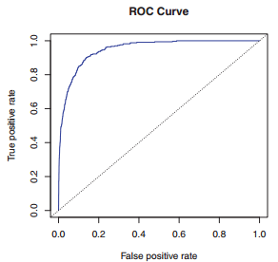
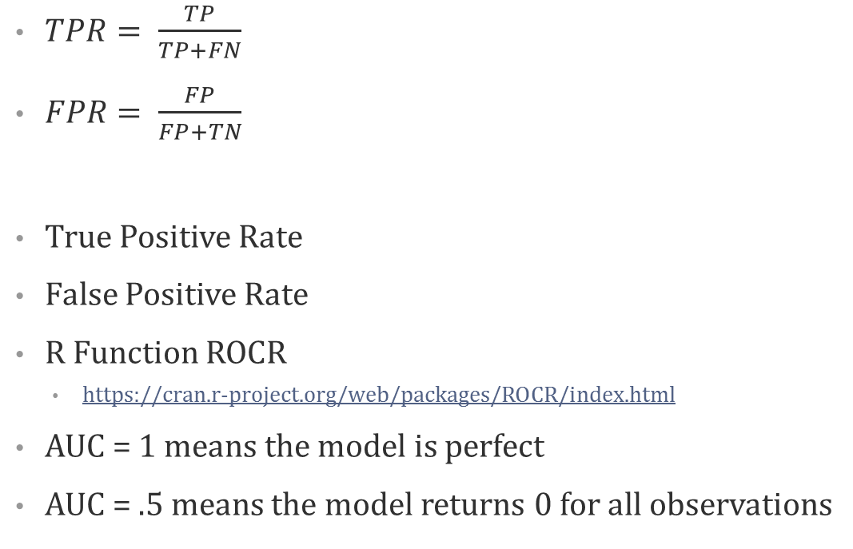
Area Under the Curve Method
$TPR= \frac{TP}{TP+FN}$
$FPR= \frac{FP}{FP+TN}$
True Positive Rate
False Positive Rate
R Function ROCR
https://cran.r-project.org/web/packages/ROCR/index.html
AUC = 1 means the model is perfect
AUC = .5 means the model returns 0 for all observations
 | Class0 | Class1
Class0 | TP | FN
Class1 | FP | TN

Slide 5
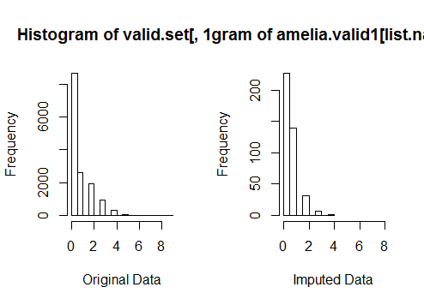
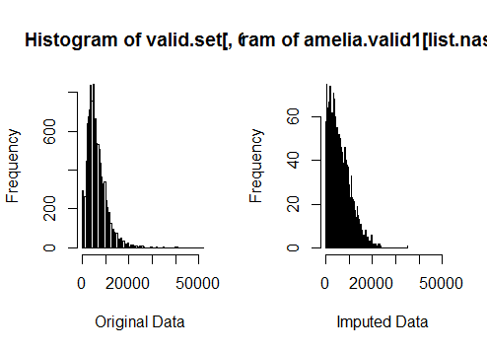
Data Cleaning
Many NA cells
Used R Function Amelia to impute values
https://cran.r-project.org/web/packages/Amelia/index.html
Uses bootstrapping to impute values for NA cells
Assumes data are normally distributed (much of ours was not)
But still works relatively well if data are not normally distributed

Slide 6
Models
Tried several models with several combinations of variables
Logistic Regression
LDA
QDA
Random Forest
Ridge
Deep Learning (h2o)
Boosting

Slide 7
Results

Slide 8
Best Models
Deep Learning (h2o)
All 10 explanatory variables
3 hidden layers
28 nodes each
Rate = .5
Loss = Cross entropy
Activation = RectifierWithDropout
AUC = .8474

Slide 9
Best Models
Logistic Regression Model
All 10 explanatory variables
29 pairwise interactions
11 triple interactions
1 quadruple interaction
AUC = .8488

Slide 10
Best Models
Linear Discriminant Analysis
All 10 explanatory variables
29 pairwise interactions
8 triple interactions
AUC = .8512

Slide 11
How Did Our Submissions Compare?
Kaggle competition winner AUC = .8696
.0184 better than ours
Our submission only beat about half of the submissions
3 out of 4 submissions had an AUC of at least .8

Slide 12
Questions?

