Slide 1
SC6109 BLOCKCHAIN SCALABILITY · OPTION 5
When does parallel EVM execution pay?
5.6×
independent, compute-heavy
A Block-STM engine over real EVM bytecode — three schedulers, twenty workloads, and the cases where parallelism makes things slower.
0.43×
one NFT mint, one dependency chain
Block-STM, 6 performance cores, vs. sequential
Notes:
Blockchains execute transactions one at a time, even though most transactions in a block never touch the same state. Our project asks the question from the brief directly: when does executing them in parallel actually help, and when does it not? We built a parallel execution engine on real EVM bytecode, with three different schedulers, and measured it on twenty workloads. The two numbers on the right are the answer in miniature: five and a half times faster when transactions are independent and do real work, and less than half the speed of plain sequential execution when every transaction depends on the one before it.

Slide 2
THE QUESTION
The dependency bound says 1,000×. We measured 1.4×.
Take 2,000 ETH transfers between random accounts in a large population. Almost none of them touch the same account: the longest chain of dependencies is two transactions long, so in principle they could run a thousand ways in parallel.
On six cores, Block-STM runs that block 1.4 times faster than sequential. It runs a block of ERC-20 transfers 2.8 times faster, compute-heavy calls 5.6 times faster — and an NFT mint at less than half speed.
The gap between the bound and the measurement is the subject of this project.
1,000×
dependency ceiling for independent transfers
1.4×
measured, ETH transfers
2.8×
measured, ERC-20 transfers
0.43×
measured, NFT mint
Block-STM at 6 threads on an Apple M3 Pro, 2,000-transaction blocks. Ceiling = block size ÷ critical path.
Notes:
Here is the puzzle that frames everything. A block of two thousand transfers between random accounts has almost no dependencies — the dependency bound says it could run a thousand times faster. We measured one point four. ERC-20 transfers do better, compute-heavy calls much better, and an NFT mint is actually slower than running it sequentially. Explaining that gap — where the missing speedup goes — is what the rest of the talk is about.

Slide 3
WHAT WE BUILT
One execution path, three schedulers, every read recorded
revm 41
real EVM, embedded as a library
Why it is shaped this way
Block-STM is only correct if every read is re-checked. A read the recorder misses is a silent bug that appears on one seed in hundreds.
So reads are captured in one place, by construction — and the sequential baseline goes through the same path, so it is never quietly cheaper than what it is compared against.
ReadRecorder
the only DatabaseRef in the crate — no read reaches the EVM unlogged
MVView · SimpleView
multi-version memory for the parallel engines · plain state for the baseline
BaseState
pre-block snapshot: accounts, storage, compiled contract code
Rust · revm 41.0.0 · rayon · Solidity 0.8.28 via Foundry
Notes:
Everything runs through one execution path. The EVM is revm, embedded as a library, running bytecode compiled from Solidity. Between the EVM and state sits a read recorder — the only type in the code base that the EVM can read through — so every read is logged. That matters because optimistic parallel execution is only correct if every read is re-checked; a read that slips through is a bug that shows up on one run in a few hundred. Below that sit two views of state: multi-version memory for the parallel schedulers, and plain state for the sequential baseline.

Slide 4
THREE WAYS TO FIND PARALLELISM
Speculate in rounds, collaborate, or declare up front
1
M2a
2
M2b
3
M3
Round-based optimistic
Block-STM
Static, EIP-7928 style
Run every pending transaction at once, validate all, re-run the failures, repeat.
Workers share execution and validation tasks; a read of an aborted write parks the reader until the writer finishes.
Derive every transaction's access set as a block builder would, then run conflict-free levels in parallel.
+ Simple; provably ends within n rounds.
+ Degrades gracefully under contention.
+ No speculation, no aborts; fastest when conflicts are rare.
− On a dependency chain, re-runs everything above each fix: quadratic.
− Pays for versioning and validation even when nothing conflicts.
− One barrier per level of the chain; needs the access list first.
Notes:
We built three schedulers, because the interesting question is not just whether parallelism helps but which kind. The first runs everything optimistically in rounds: execute all, validate all, re-run what failed. It is simple and provably terminates, but on a chain it re-runs everything above each fix. The second is Block-STM, the scheduler behind Aptos: workers share execution and validation tasks, and a transaction that would read a value about to change is parked until it is ready. The third is static: it derives every transaction's access set the way a block builder would under Ethereum's proposed block access lists, EIP-7928, and runs conflict-free groups in parallel with no speculation at all.

Slide 5
DECIDING WHAT CONFLICTS
A conflict is a changed value — not a touched account
1
Read set: every location the EVM loaded
Granularity is a choice
Balances, nonces, code hashes, storage slots — captured at the database boundary, each with the version it resolved to. Validation compares versions, not values.
Per storage slot: two ERC-20 transfers between different holders are independent.
Per account: every ERC-20 balance lives in the token contract's account — so every transfer conflicts with every other.
We implemented both and measured the difference (slide 11).
2
Write set: only what actually changed
Calling a contract touches its account without changing it. Counting touched as written made every call to one contract conflict with every other — a bug our benchmarks exposed.
3
The fee recipient is an accumulator
Every transaction pays the block beneficiary. Fees add up in any order, so they are kept out of conflict detection and summed at commit.
Notes:
Conflict detection is where correctness and performance meet. A transaction's read set is everything the EVM loaded; its write set is only what it actually changed. That distinction cost us a bug: at first we counted every account the EVM marked as touched, which made every call to the same contract look like a conflict. The block's fee recipient gets special treatment — every transaction pays it, but fees add up in any order, so they are summed at the end. And granularity is a design choice: per slot or per account. On ERC-20 that choice turns out to decide almost everything.

Slide 6
CORRECTNESS FIRST
Every parallel result is bit-identical to sequential — and checked
1,000
9 / 9
15
seeds per workload, every scheduler, 2–12 threads — slot-for-slot against an independent sequential engine
workloads where our sequential engine matches an Anvil node: balances, nonces, code, storage, reverts
bugs injected on purpose to test the tests — all caught, after two gaps in the tests were found and closed
Real bugs the tests found
Generated accounts landed on precompile addresses — 15% of a block silently called ecrecover instead of transferring.
Touched-but-unchanged accounts counted as writes — every contract workload serialised through its own contract.
A read race under account granularity let a stale nonce pass validation — appeared once in a full run, reproduced by a stress test in 0.5 s.
Notes:
Before trusting any speedup, we made sure the answers are right. Every parallel scheduler is compared slot for slot with an independent sequential engine on a thousand random blocks per workload. The sequential engine is itself checked against Anvil, a real Ethereum node, on nine workloads. And we tested the tests: we injected fifteen bugs on purpose; all are caught, though two initially slipped past, which is how we found holes in the tests. Along the way the tests caught three real bugs — including a race that appeared once in a full run and that a stress test then reproduced in half a second.

Slide 7
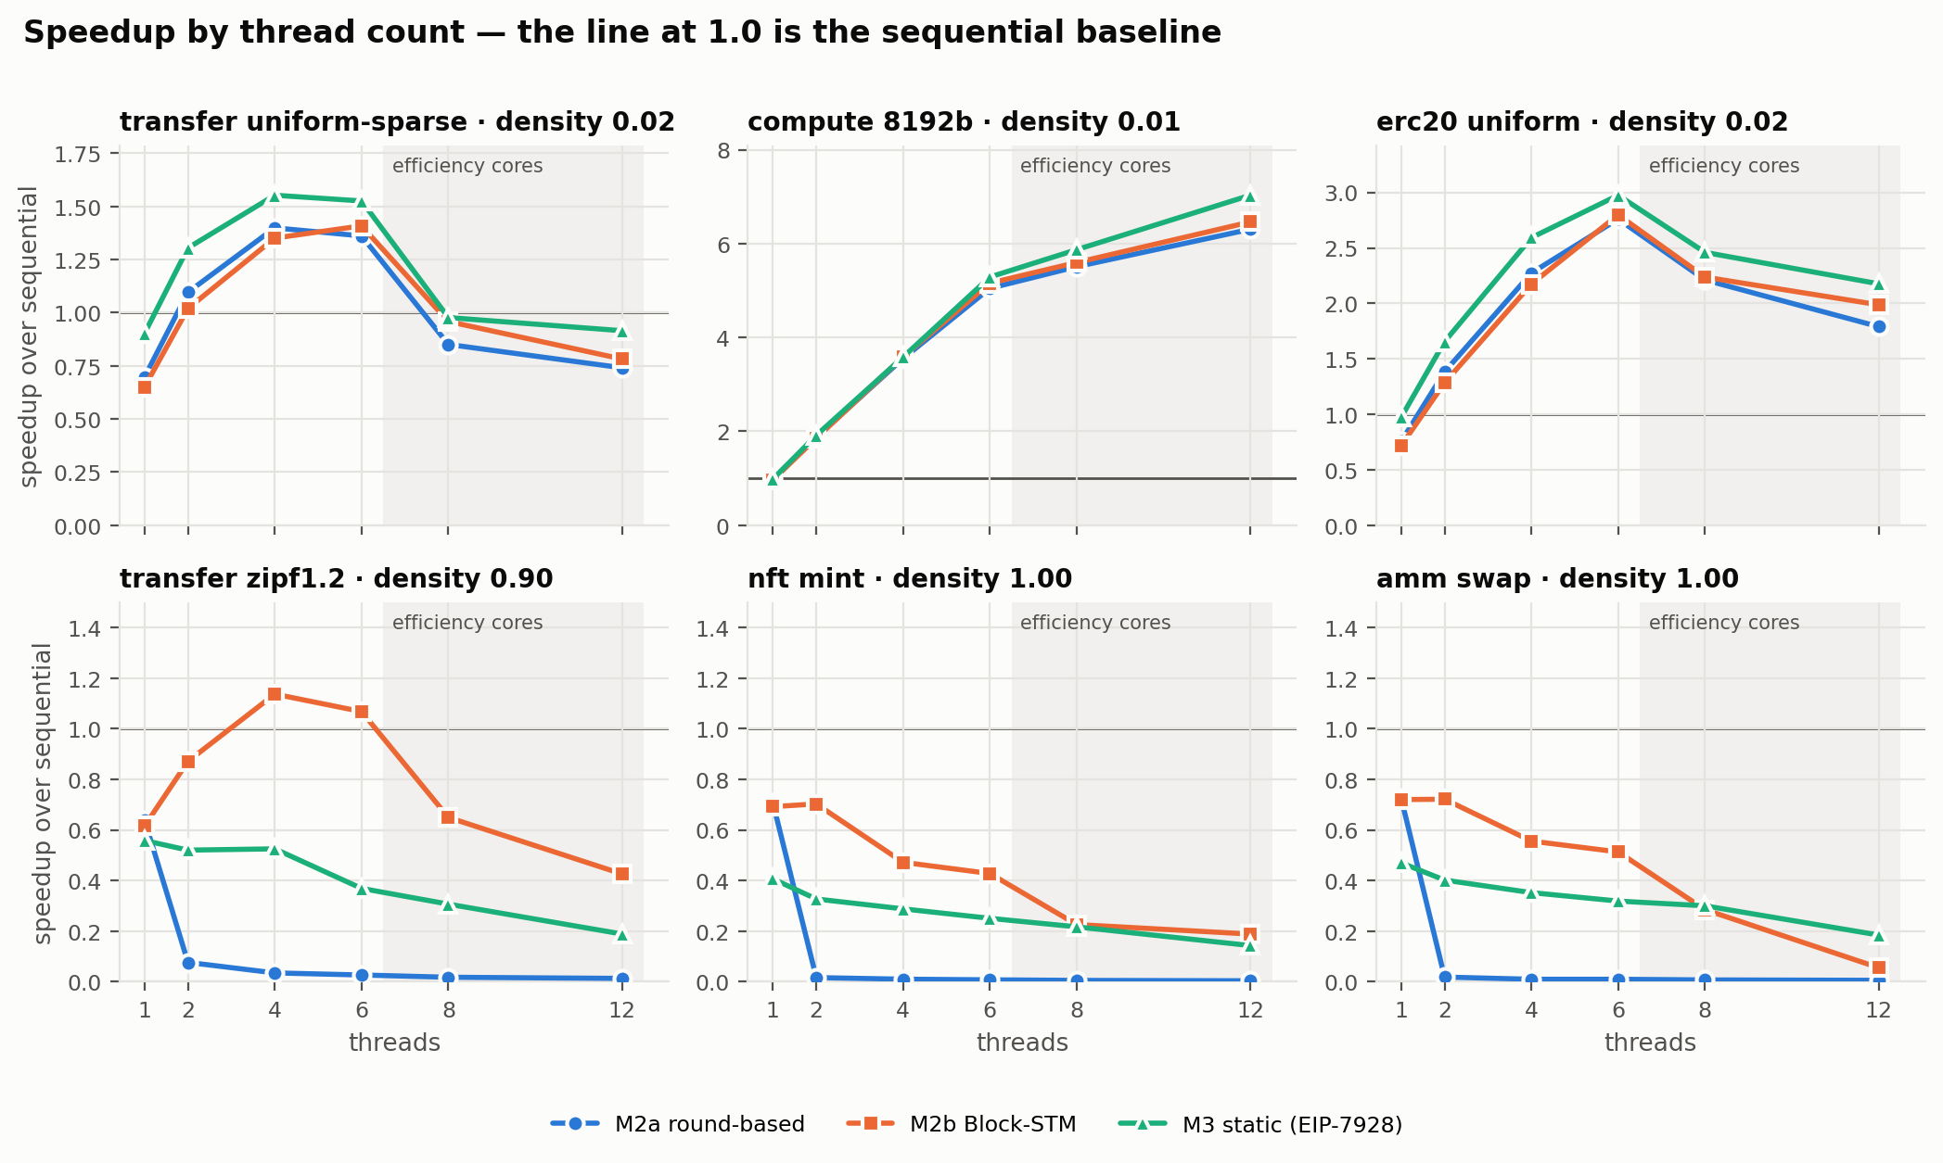
RESULT 1
Three regimes: scales, scales a little, gets slower
Independent and heavy
compute calls reach 5.2× at 6 threads and keep climbing onto efficiency cores.
Independent and light
ETH and ERC-20 transfers peak at 1.4–3.0× around 4–6 threads, then lose speed on efficiency cores.
Dependent
NFT mint and one AMM pool: every scheduler is slower than sequential.
Shaded: threads beyond the 6 performance cores. Median of 5 runs; every run verified.
Notes:
Here is speedup against thread count for six representative workloads. Three shapes appear. Independent, compute-heavy calls scale almost linearly — over five times on six cores. Independent but light transactions, like transfers, gain something up to about six threads, then get slower once work lands on the chip's efficiency cores. And dependent workloads — an NFT mint, swaps on one pool — are slower than sequential under every scheduler, at every thread count.

Slide 8
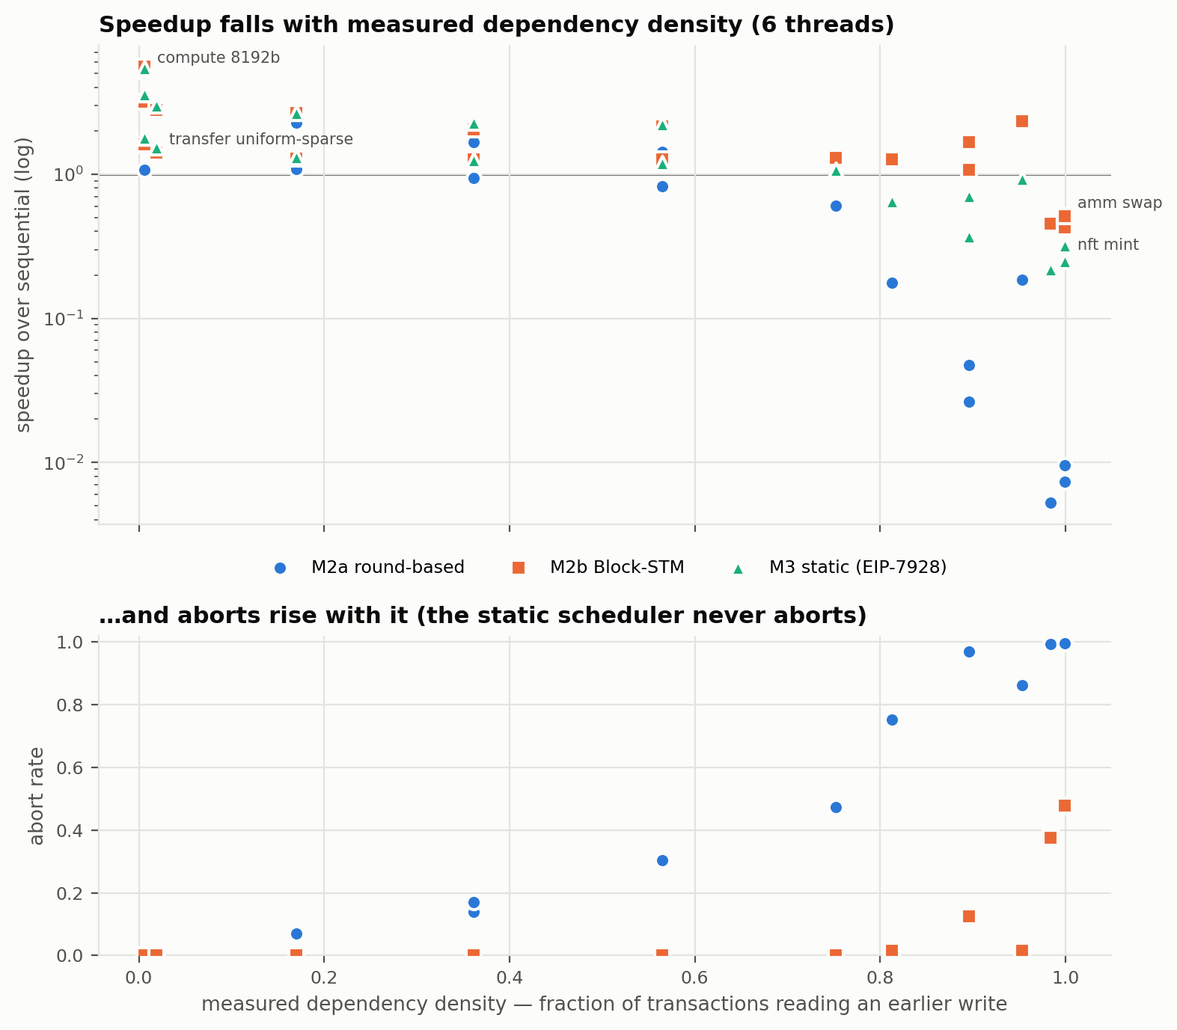
RESULT 2
Chain length kills speedup — not how many transactions conflict
Block-STM, 6 threads
Workload | Density | Chain | Speedup
transfers, r = 1 | 0.75 | 11 | 1.29×
transfers, Zipf 0.8 | 0.81 | 110 | 1.26×
transfers, Zipf 1.2 | 0.90 | 432 | 1.07×
ERC-20, Zipf 1.2 | 0.90 | 432 | 1.67×
transfers, Zipf 2.0 | 0.98 | 1,217 | 0.45×
NFT mint | 1.00 | 2,000 | 0.43×
Same chain, more work per transaction: ERC-20 gets 1.67× where transfers get 1.07×. Density alone does not describe a workload.
Density: fraction of transactions reading an earlier transaction's write, measured from a real execution.
Notes:
We placed every workload by its measured dependency density — the fraction of transactions that read something an earlier transaction wrote. Surprisingly, density is not what kills speedup. Blocks where three quarters of transactions depend on another still run at 1.3 times, because the chains are short. What matters is the length of the longest chain: at 432 Block-STM is still ahead; at 1,200 and at 2,000 it falls to under half of sequential speed. And look at the two rows with a chain of 432 — identical dependency structure, but ERC-20 transactions do more work, so they get 1.67 instead of 1.07.

Slide 9
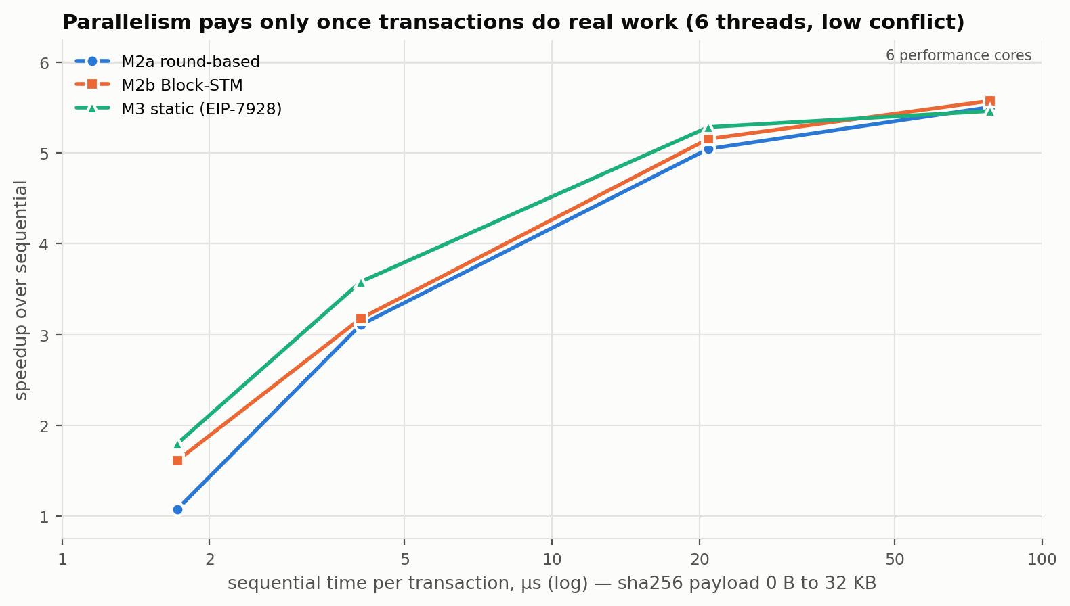
RESULT 3
A transaction has to do more work than it costs to coordinate
~40%
of sequential throughput lost to Block-STM's own machinery at one thread, on light transactions
92%
of linear on 6 cores once each transaction does ~78 µs of work
sha256 precompile calls with a growing payload; conflicts held near zero.
Notes:
To isolate the second factor we held conflicts at zero and varied how much work each transaction does, by hashing a growing payload. With almost no work — about a microsecond and a half — the speedup is only one and a half. With seventy-eight microseconds of work it is five and a half, ninety-two percent of the six cores. The reason is a roughly fixed cost per transaction for versioning and validation: at one thread Block-STM loses up to forty percent to its own machinery on light transactions. A plain payment is on the wrong side of this curve no matter how independent the block is.

Slide 10
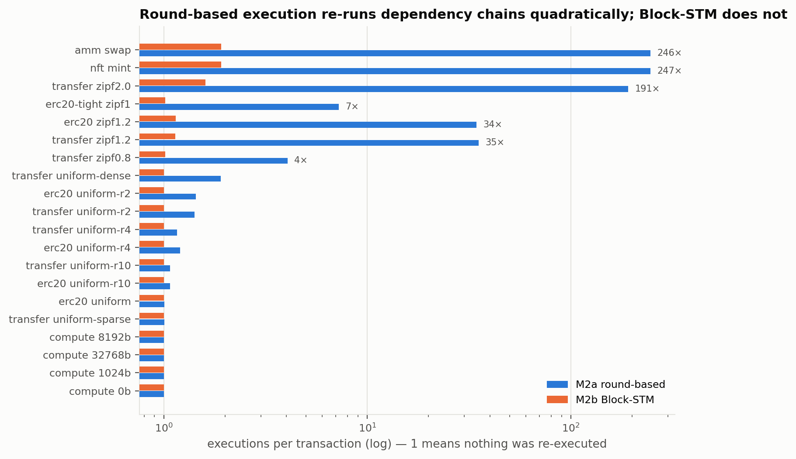
RESULT 4
The scheduler matters as much as the workload
247×
executions per transaction on an NFT mint under round-based execution — speedup 0.01×
1.9×
under Block-STM on the same block — parking waiting transactions instead of re-running them
6 threads. At low density both run each transaction about once.
Notes:
Same blocks, different schedulers. On a dependency chain, round-based execution confirms one more transaction per round and re-runs everything above it — two hundred and forty-seven executions per transaction on the NFT mint, and a speedup of one hundredth. Block-STM runs each transaction fewer than twice, because a transaction that would read a value about to change is parked until it is ready instead of being run anyway. That single mechanism is what makes optimistic execution survivable under contention. It is also a correctness mechanism: we removed it on purpose and the results went wrong.

Slide 11
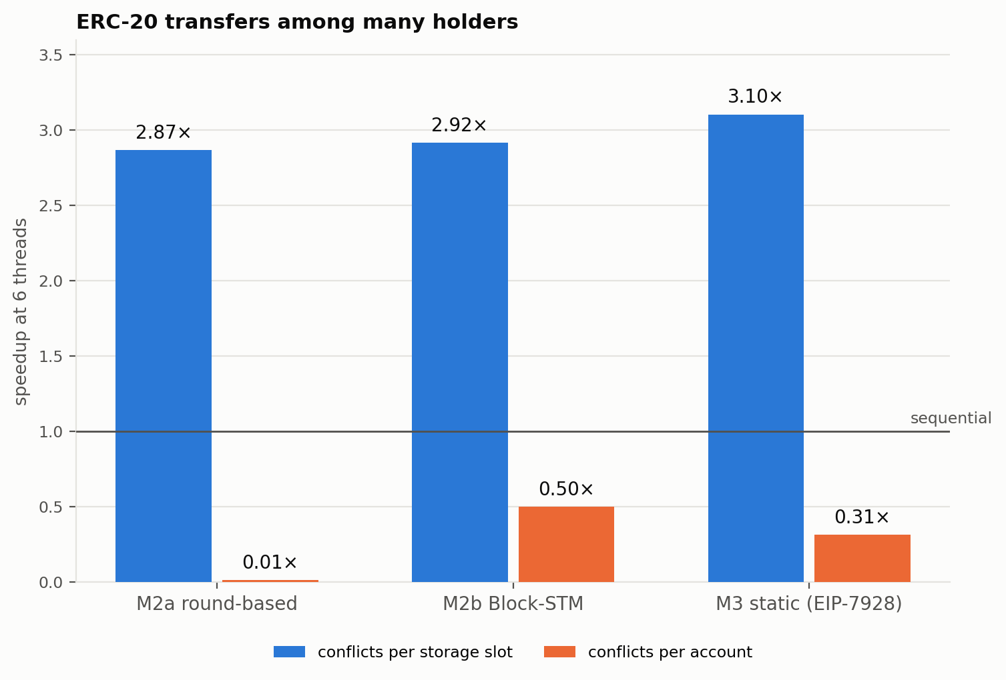
RESULT 5
Per-account conflict detection throws ERC-20 parallelism away
Why
Every ERC-20 balance is a storage slot in the token contract. Per slot, transfers between different holders never collide. Per account, they all collide in one account — the token.
So what
An access-list design is only as good as its granularity. EIP-7928 lists storage keys; an account-level list would not work for contracts. Plain ETH transfers — accounts without storage — are identical under both, as they should be.
Notes:
Granularity turned out to be decisive. Every ERC-20 balance is a storage slot inside the token contract. If conflicts are tracked per slot, transfers between different holders are independent and all three schedulers get about three times. If they are tracked per account, every transfer collides in the token contract's account and the speedup disappears. That is exactly why Ethereum's proposed block access lists record storage keys, not just accounts.

Slide 12
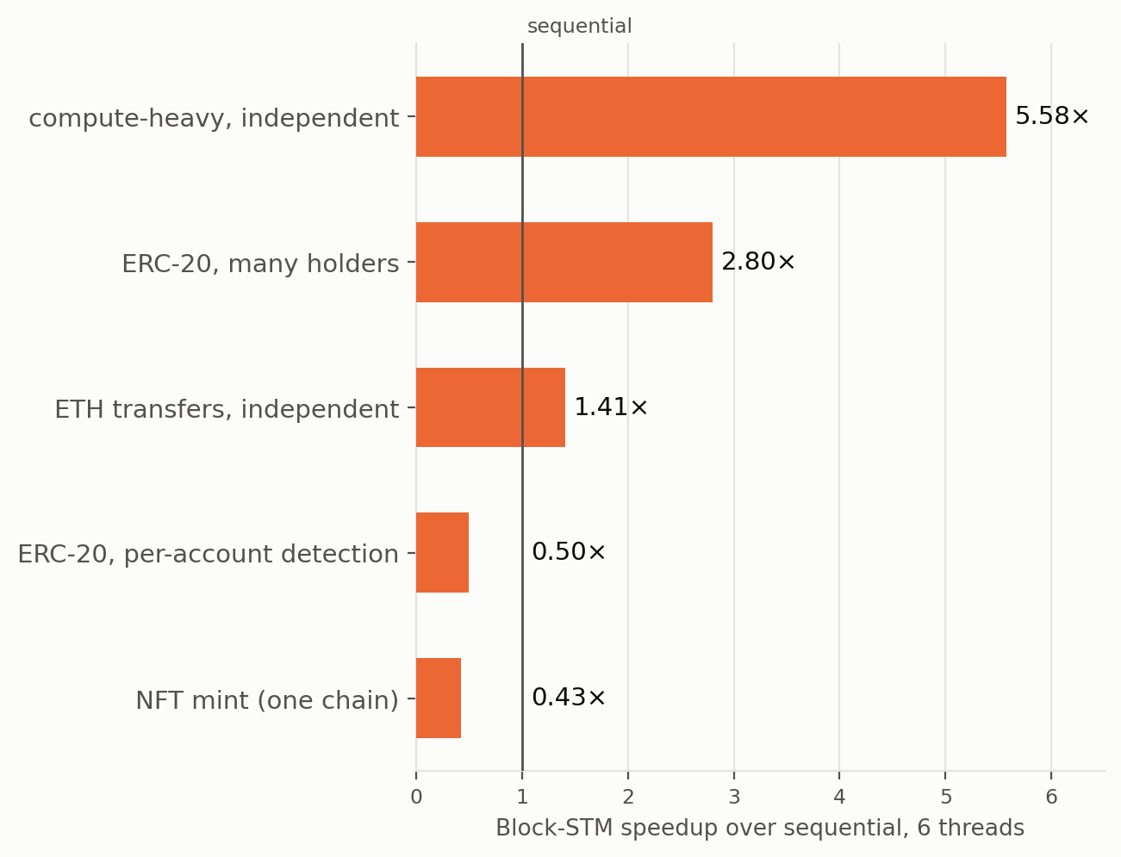
THE ANSWER
Parallel execution pays only when all three hold
1
Short dependency chains
A hot contract is a ceiling no engine removes — only the application can shard it.
2
Real work per transaction
Coordination costs a roughly fixed amount; light transactions never earn it back.
3
Fine-grained conflicts, real cores
Per-slot detection, and no more threads than performance cores for light work.
Notes:
So, when does parallel execution help? Only when three things hold at once. Chains must be short — a single hot contract is a ceiling no execution engine can remove. Transactions must do real work, enough to pay for coordinating them. And conflicts must be tracked finely, on cores that are really there. Lose the first and parallel execution is actively slower than sequential. In practice that means big gains for busy chains with diverse contract activity, and little or nothing for a block dominated by one popular mint or one busy pool — which is often exactly what congestion looks like.

Slide 13
IN CONTEXT
How this maps onto production systems
Aptos · Block-STM
Our M2b follows the Block-STM paper on EVM bytecode instead of Move, and shows the same shape: large gains at low contention, graceful degradation, no collapse.
Solana · Sealevel
Transactions declare the accounts they touch. On the EVM that is account-level detection — which our ERC-20 result shows discards most of the parallelism.
Ethereum · EIP-7928
Builders publish block access lists with storage keys, so validators can schedule statically. Our M3 is that validator; its list costs a full execution, paid once by the builder.
ERC-4337 bundles
Many users' operations in one transaction through one EntryPoint — concentrating state, which is the unfavourable case for parallel execution.
Notes:
Finally, how this connects to real systems. Our Block-STM follows the scheduler Aptos uses, on EVM bytecode, and we see the same shape. Solana's model — declaring the accounts a transaction touches — corresponds on the EVM to account-level detection, and our ERC-20 result shows how much that throws away. Ethereum's EIP-7928 proposes block access lists with storage keys; our static scheduler is what a validator could do with them, while the builder pays the cost of producing the list. And account-abstraction bundles concentrate many users into one transaction and one contract, which is the unfavourable case.

Slide 14
LIMITS AND NEXT STEPS
What we would do next
Replay real mainnet blocks
A homogeneous machine
Emit EIP-7928 lists
Our workloads span the conflict and work axes by design; real traffic would show where chains actually sit on them.
Results above six threads mix in efficiency cores; a server CPU would separate the scheduler from the chip.
Produce canonical block access lists, and measure the builder's side as well as the validator's.
Code, data, figures and the full report: github.com/IcantFind-a-username/sc6109-parallel-evm
Thank you
Notes:
Three things we would do next. Replay real mainnet blocks, to see where real traffic sits on the axes we measured. Run on a machine with uniform cores, so results above six threads measure the scheduler rather than the chip. And emit real EIP-7928 access lists, measuring the builder's side too. Everything — code, raw data, figures and the full report — is in the repository. Thank you.

