Slide 1
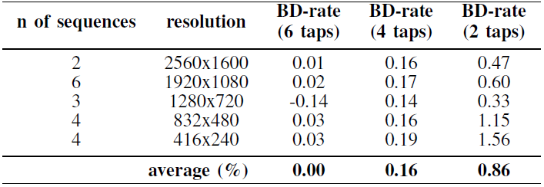
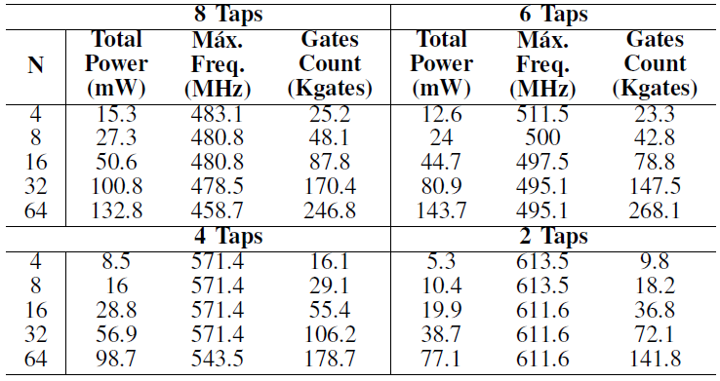
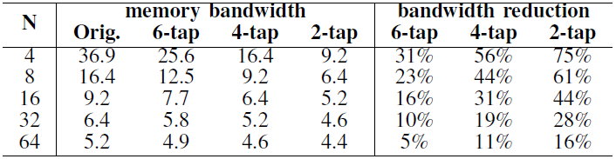



Approximate Interpolation Filters for HEVC Targeting High-Definition Encoding in Real Time
Rafael Silva, Ricardo Reis and Mateus Grellert
Approximate 4-tap filter proposed by MCM.
Introduction
A0
A0
A1
A2
A3
This work to developed a hardware architecture for the FME HEVC step;
The solutions presented used approximate interpolation filters using the Hcub multiplierless constant multiplication (MCM) algorithm was used to reduce number of the adders and to minimize the adder tree depth;
Three types of approximate interpolation filters purely combinational are proposed, which are sent to a block-matching search.
MCM₀
A0
MCM₀
MCM₁
MCM₂
MCM₃
<<3
<<3
<<2
Source: Google
-
+
+
F1₀
F2₀
F3₀
+
F1
>>6
Results
F1 out
Method
Top-level architecture of the FME interpolation unit.
Synthesis results for ASIC.
pixel row
8(N + 8)
10(N + 8)
10(N + 8)
inp_source
F1
F2
F3
N+1
10(N+1)
Proposed Architectures
Frac. Block buffer
Conclusion
Clipping
(0, 255)
read/write
Hardware designs approximate interpolation filters with approximate computing techniques;
The approximate designs reduce memory bandwidth by up to 75% with a tolerable loss in coding performance;
The interpolation filters presented shown a tolerable loss in BD-rate, ranging from a BD-rate gain of -0.14% to a BD-rate loss of 1.56%.
8(N+1)
N+1
output (to search step)
Approximate filters memory access reduction.
9th IEEE CAS Rio Grande do Sul Workshop – October 15-16, 2019 – Porto Alegre, Brazil

