Slide 1
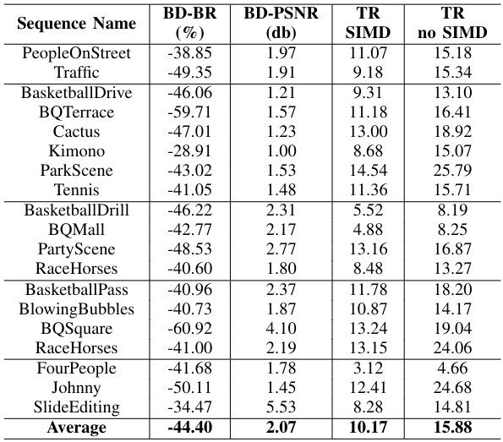

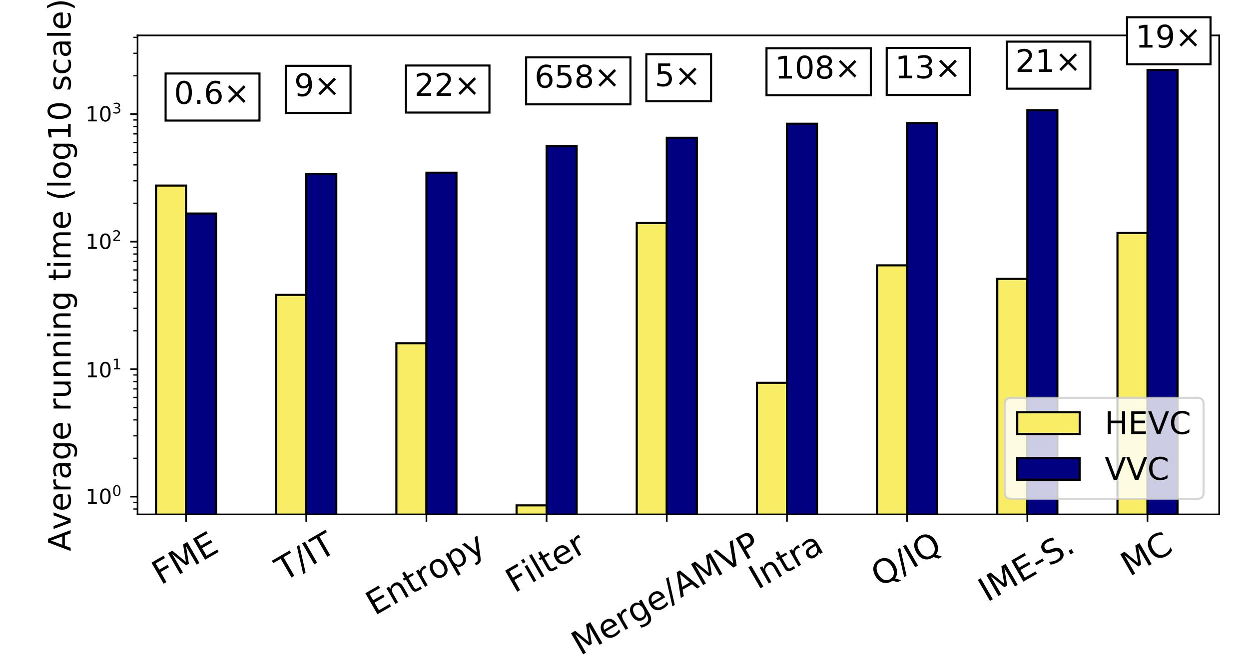
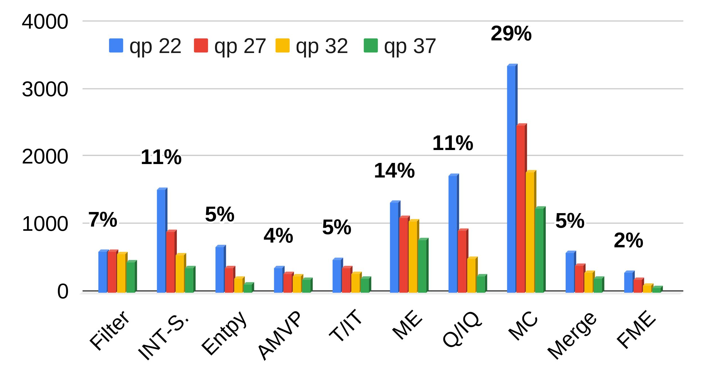


Rate-Distortion and Complexity Comparison of HEVC and VVC Video Encoders
Ícaro Siqueira and Mateus Grellert
Introduction
BD-BR/PSNR and complexity analysis
This work presents experimental results of a performance comparison of the HEVC and VVC encoders
The complexity was measured with processing time per module and of the complete encoding task, as well as compression/quality efficiency.
Method
1. MC increase due to the addition of new VVC tools
Complexity comparison per module
2
1
2. VVC supports SIMD optimizations, causing a large decrease in the FME complexity
Results
VVC average complexity for each QP.
Conclusion
VVC average bitrate savings of 44.4% for the same video quality
At same bitrate, VVC reaches a quality improvement of more than 2 db
VVC encoding is 10 to almost 16 times more complex than HEVC
Considerable increase in the intra search and filtering steps (ALF)
9th IEEE CAS Rio Grande do Sul Workshop – October 15-16, 2019 – Porto Alegre, Brazil

