Slide 1
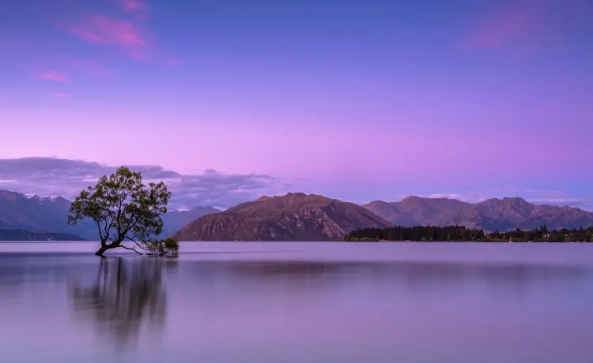

10:30 AM
Random Day
Welcome to icaro OS
Start

Slide 2





10:30 AM
Random Day

Slide 3

10:30 AM
Random Day
IOV
Icapad
Wel
Cre

Slide 4
10:30 AM
Random Day
IOV
Icapad
Wel
Cre
Shutdown
Restart

Slide 5
Error: you corromped your system now you need to restart to re-install all your system
Restart

Slide 6
10:30 AM
Random Day
Icaro Browser
Search here...

Slide 7
10:30 AM
Random Day
Icaro Browser
Sorry but you dont have a wifi, you can’t search here...

Slide 8
10:30 AM
Random Day
Icaro Explorer
G:/Home/
Home
Documents
Musics & Videos
Images
Documents
Musics & ...
Images
G:/

Slide 9
10:30 AM
Random Day
Icaro Explorer
G:/Home/Documents/
Home
Documents
Musics & ...
Images
G:/

Slide 10

10:30 AM
Random Day
Icaro Explorer
G:/Home/Musics-&-Videos/
Home
Funked up
9mm
Documents
Musics & ...
Images
G:/

Slide 11
10:30 AM
Random Day

Slide 12
10:30 AM
Random Day
Sound:

Slide 13
10:30 AM
Random Day
No notifications

Slide 14
10:30 AM
Random Day
Sound:

Slide 15
10:30 AM
Random Day
IcaroOS v1.4 oficial release

Slide 16
10:30 AM
Random Day
Icapad
You can’t write here...

Slide 17
10:30 AM
Random Day
Icaro Explorer
G:/Home/Images/
Home
Documents
IcaOSicon
Musics & ...
Images
G:/

Slide 18
10:30 AM
Random Day
IcaOSicon

Slide 19
10:30 AM
Random Day
Welcome to icaroOS!
IcaroOS is a simple OS made in libreoffice impress, this OS is limited, and all things here will work only in libreoffice impress, like, interactivity and sounds
If you want to create your own libreoffice impress OS, you can use this UI or other things

Slide 20
10:30 AM
Random Day
Icaro Explorer
G:/
Home
Home
Boot
Documents
Musics & ...
Images
G:/

Slide 21

10:30 AM
Random Day
Icaro Explorer
G:/Boot/
Home
Documents
StartScrenn.ica
StartMenu.ica
DelAppsBar.ica
InitAppsBar.ica
Musics & ...
Images
ErrorScreen.ica
Credits.ica
G:/

Slide 22
10:30 AM
Random Day

Slide 23
10:30 AM
Random Day
Icaro Explorer
G:/Boot/
Home
Documents
StartScrenn.ica
StartMenu.ica
DelAppsBar.ica
InitAppsBar.ica
Musics & ...
Warning!
DelAppsBar.ica is a super danger icaroProgram file, please, dont open this!
Images
ErrorScreen.ica
Credits.ica
Dont open
Open anyway
G:/

Slide 24
10:30 AM
Random Day
Credits
OS idea: Me
OS design: Me
OS icons: Me and Google
OS functions: Me
OS musics: libreoffice and Spotify

Slide 25
10:30 AM
Random Day
IOV
Icapad
Wel
Cre

