Slide 1
UIOP
First Sprint Presentation
Team 13
Jiabei He
Shuli Xia
Ke Xie

Slide 2
UIOP Team 13
Scenario 1
Need to share files easily
No bluetooth
No Airdrop
No USB

Slide 3
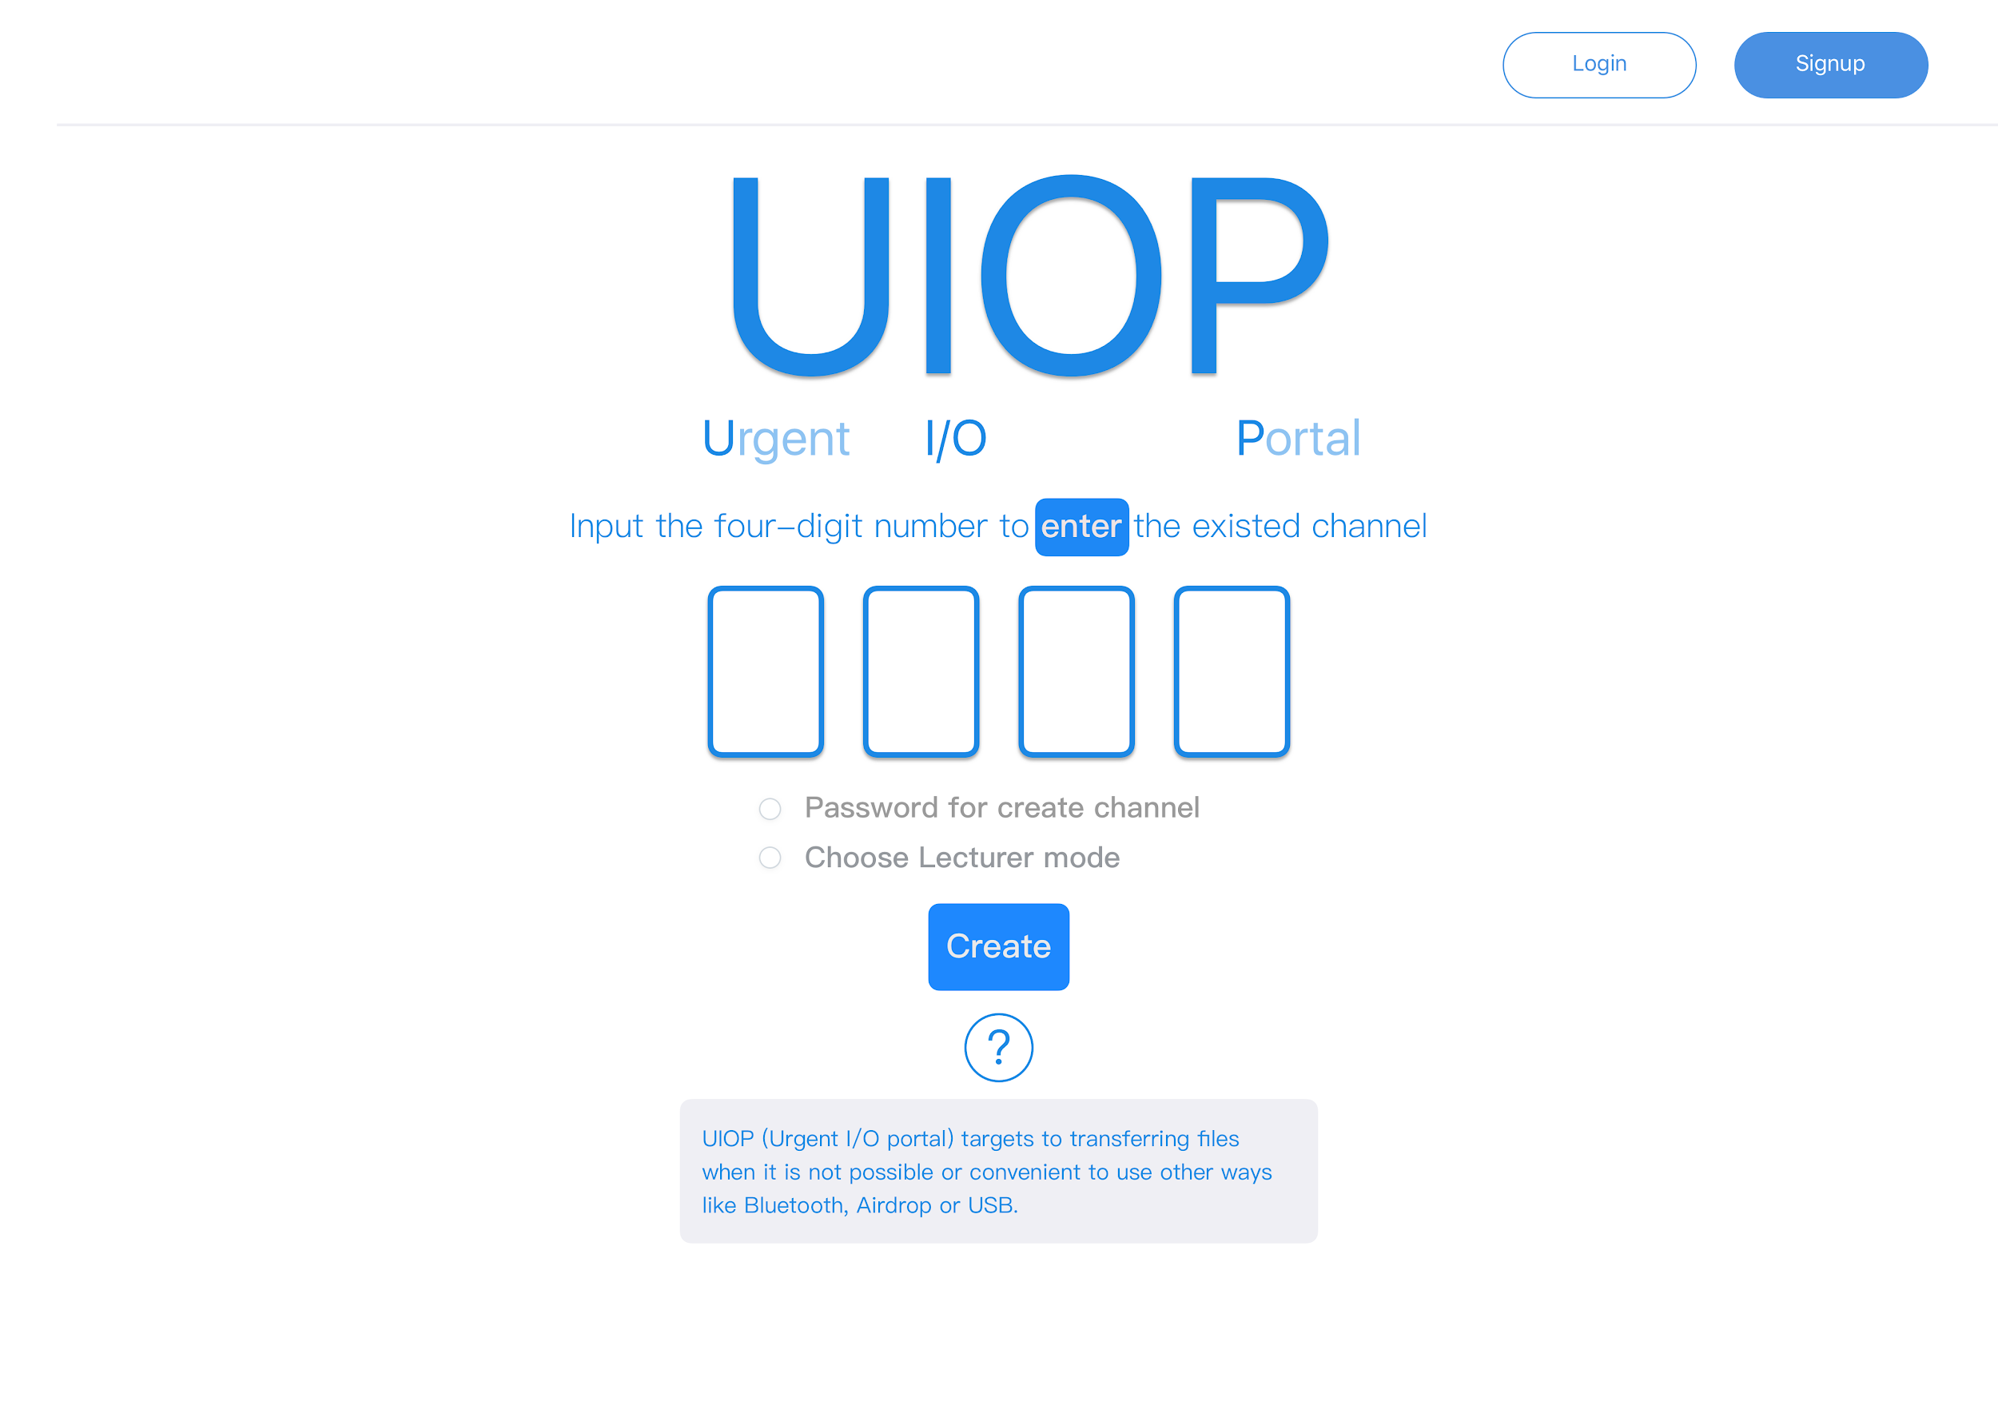
UIOP Team 13

Slide 4
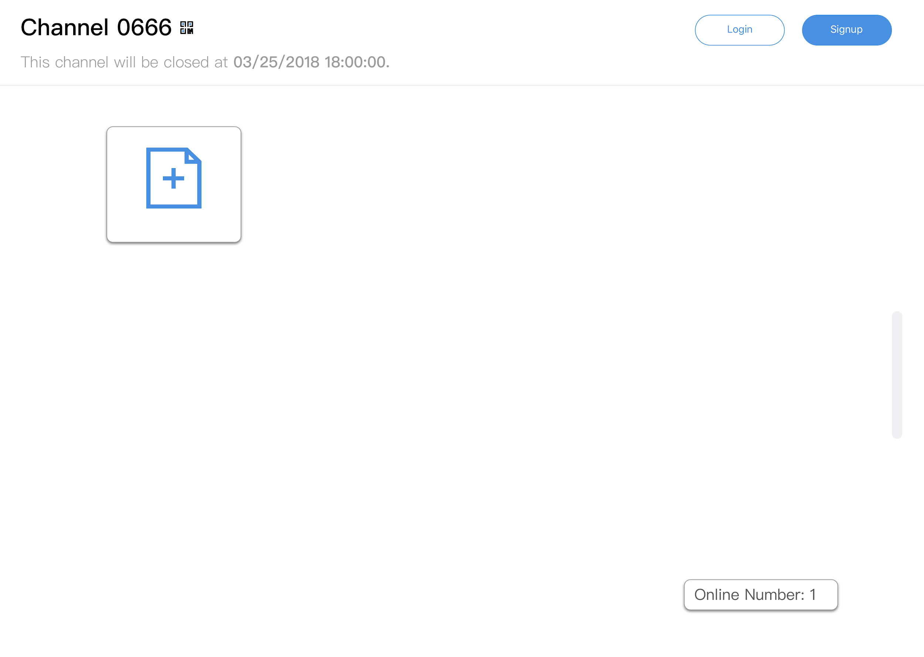
UIOP Team 13

Slide 5
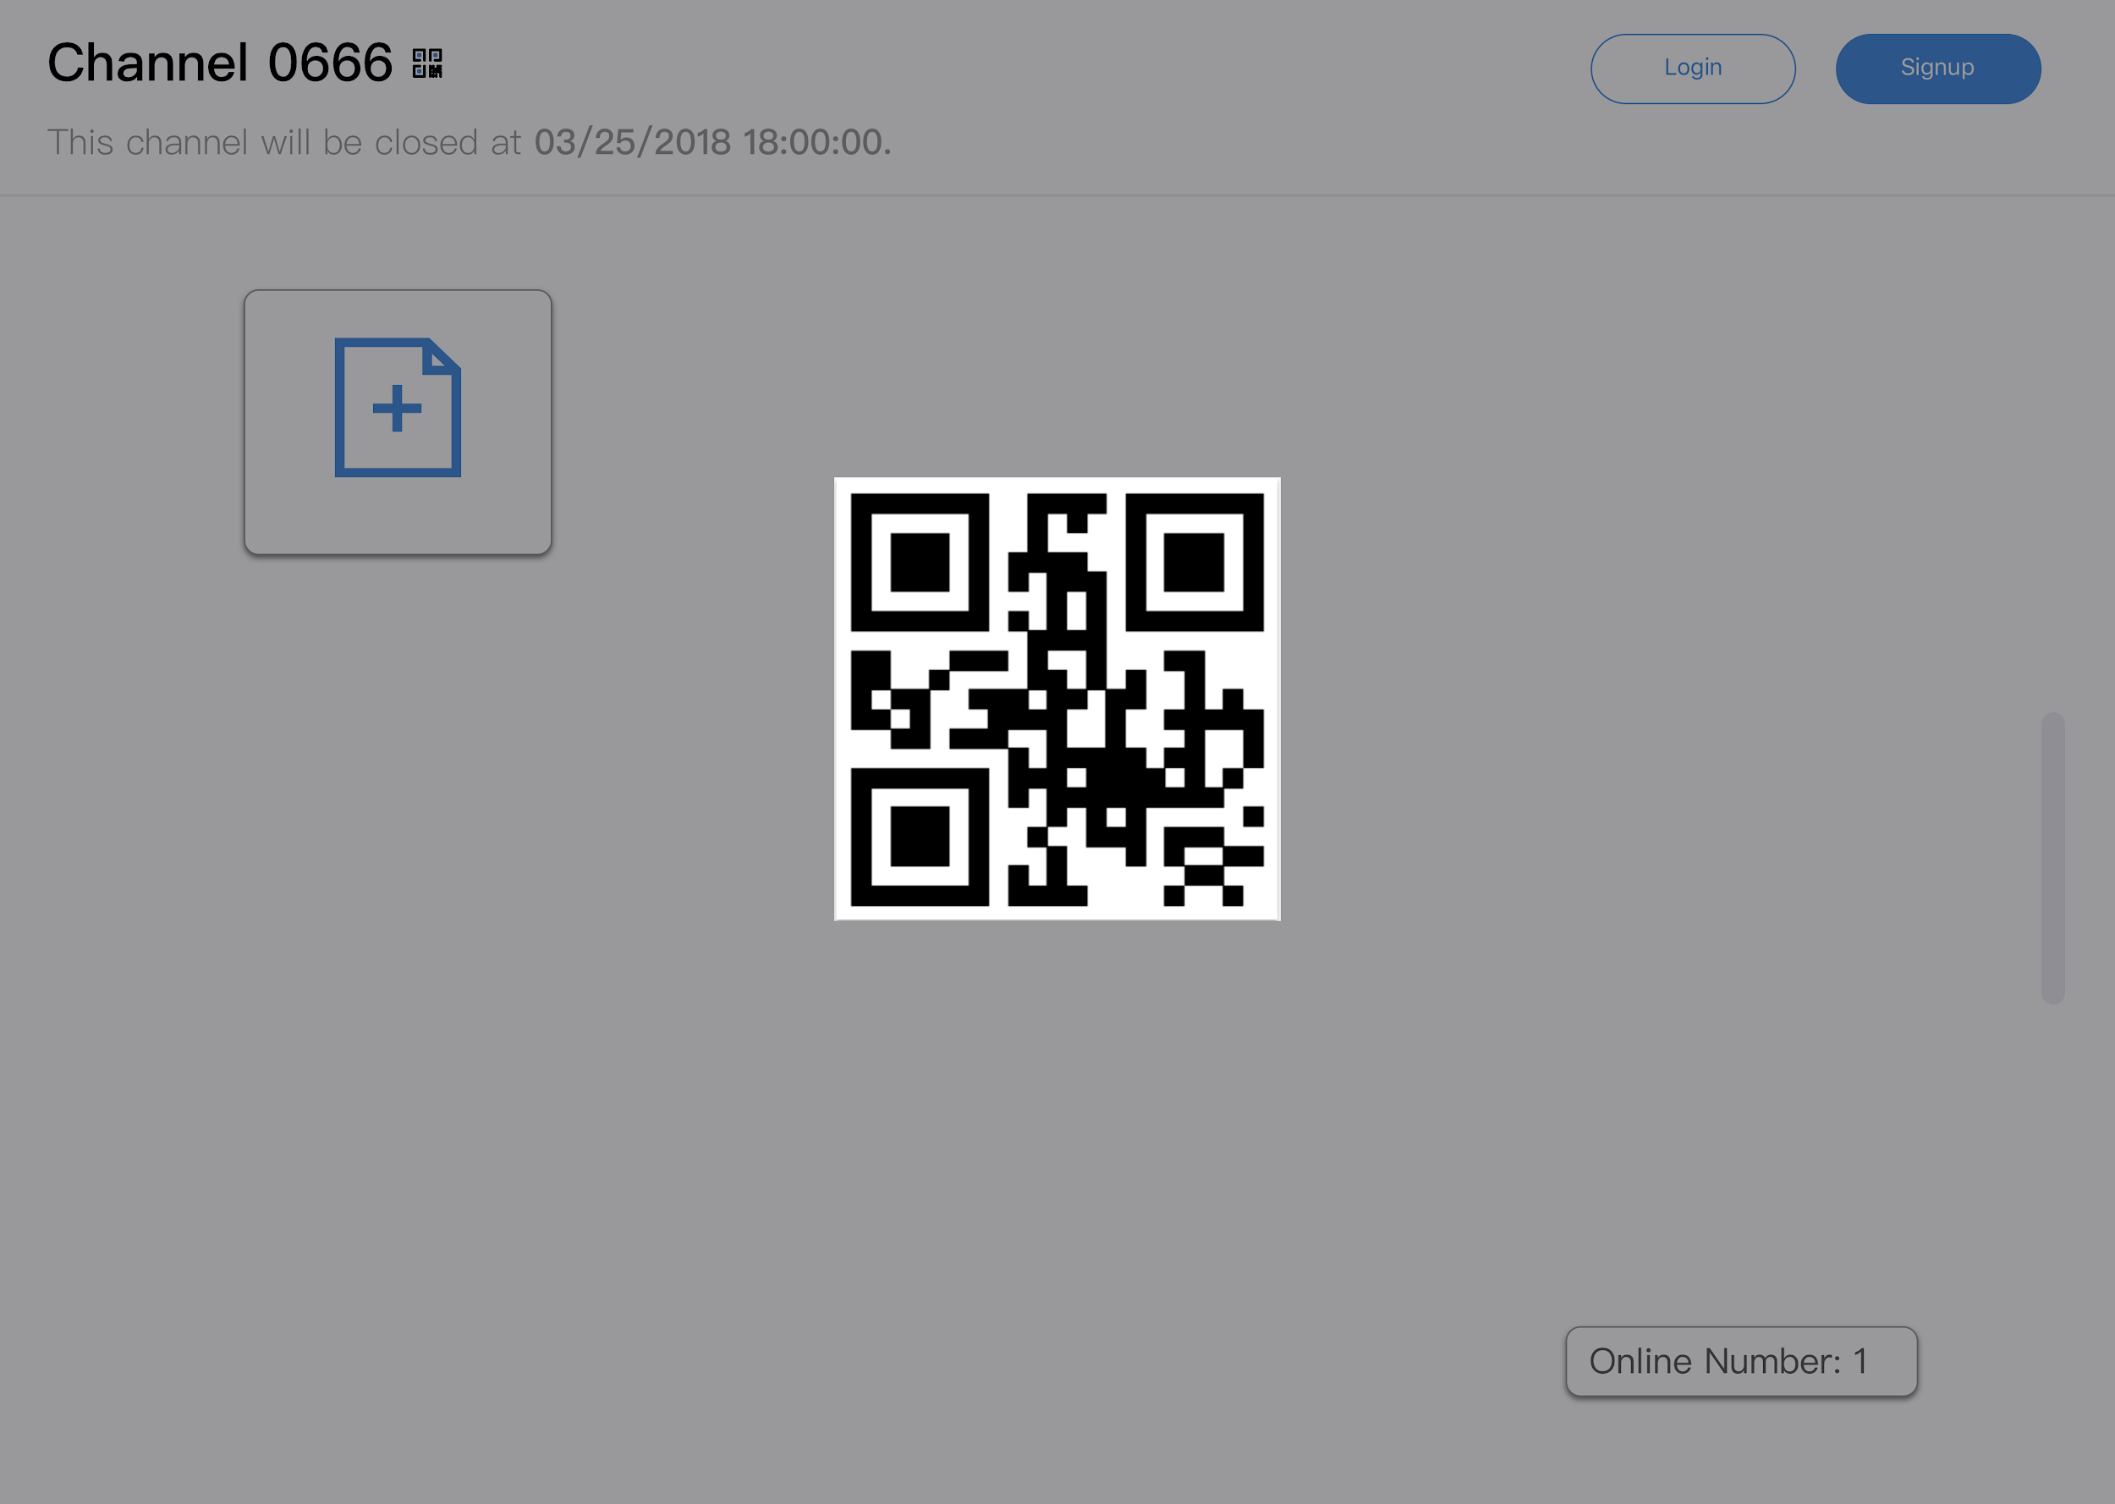
UIOP Team 13

Slide 6
UIOP Team 13
Scenario 2
Don’t want others access the channel
Don’t want files stored in the server anymore
In a lecture, only the lecturer can upload a file
The channel need to exist for more than 30 min

Slide 7
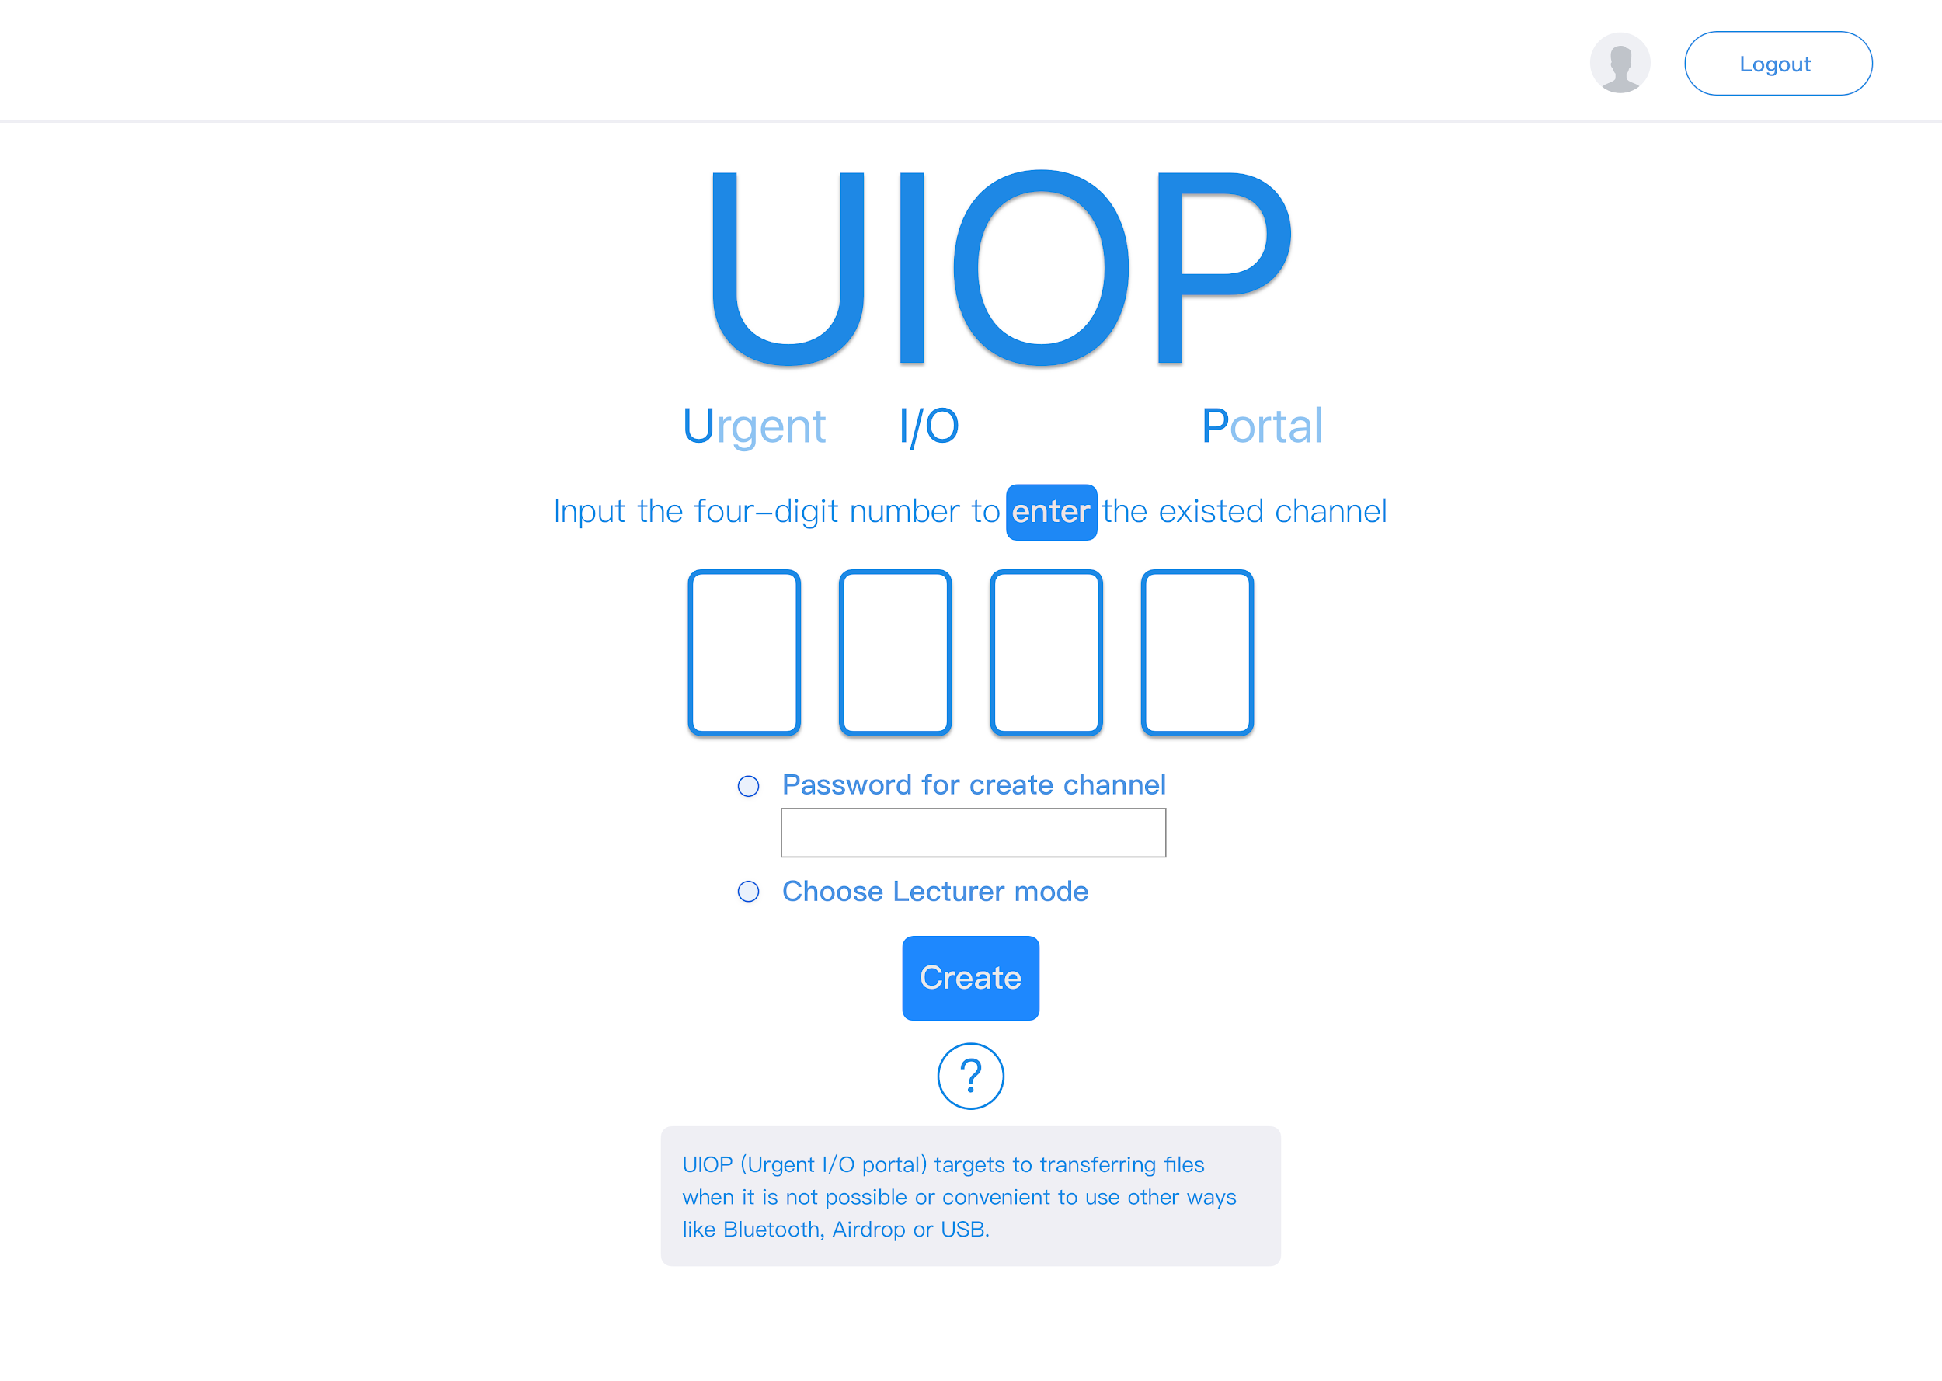
UIOP Team 13

Slide 8
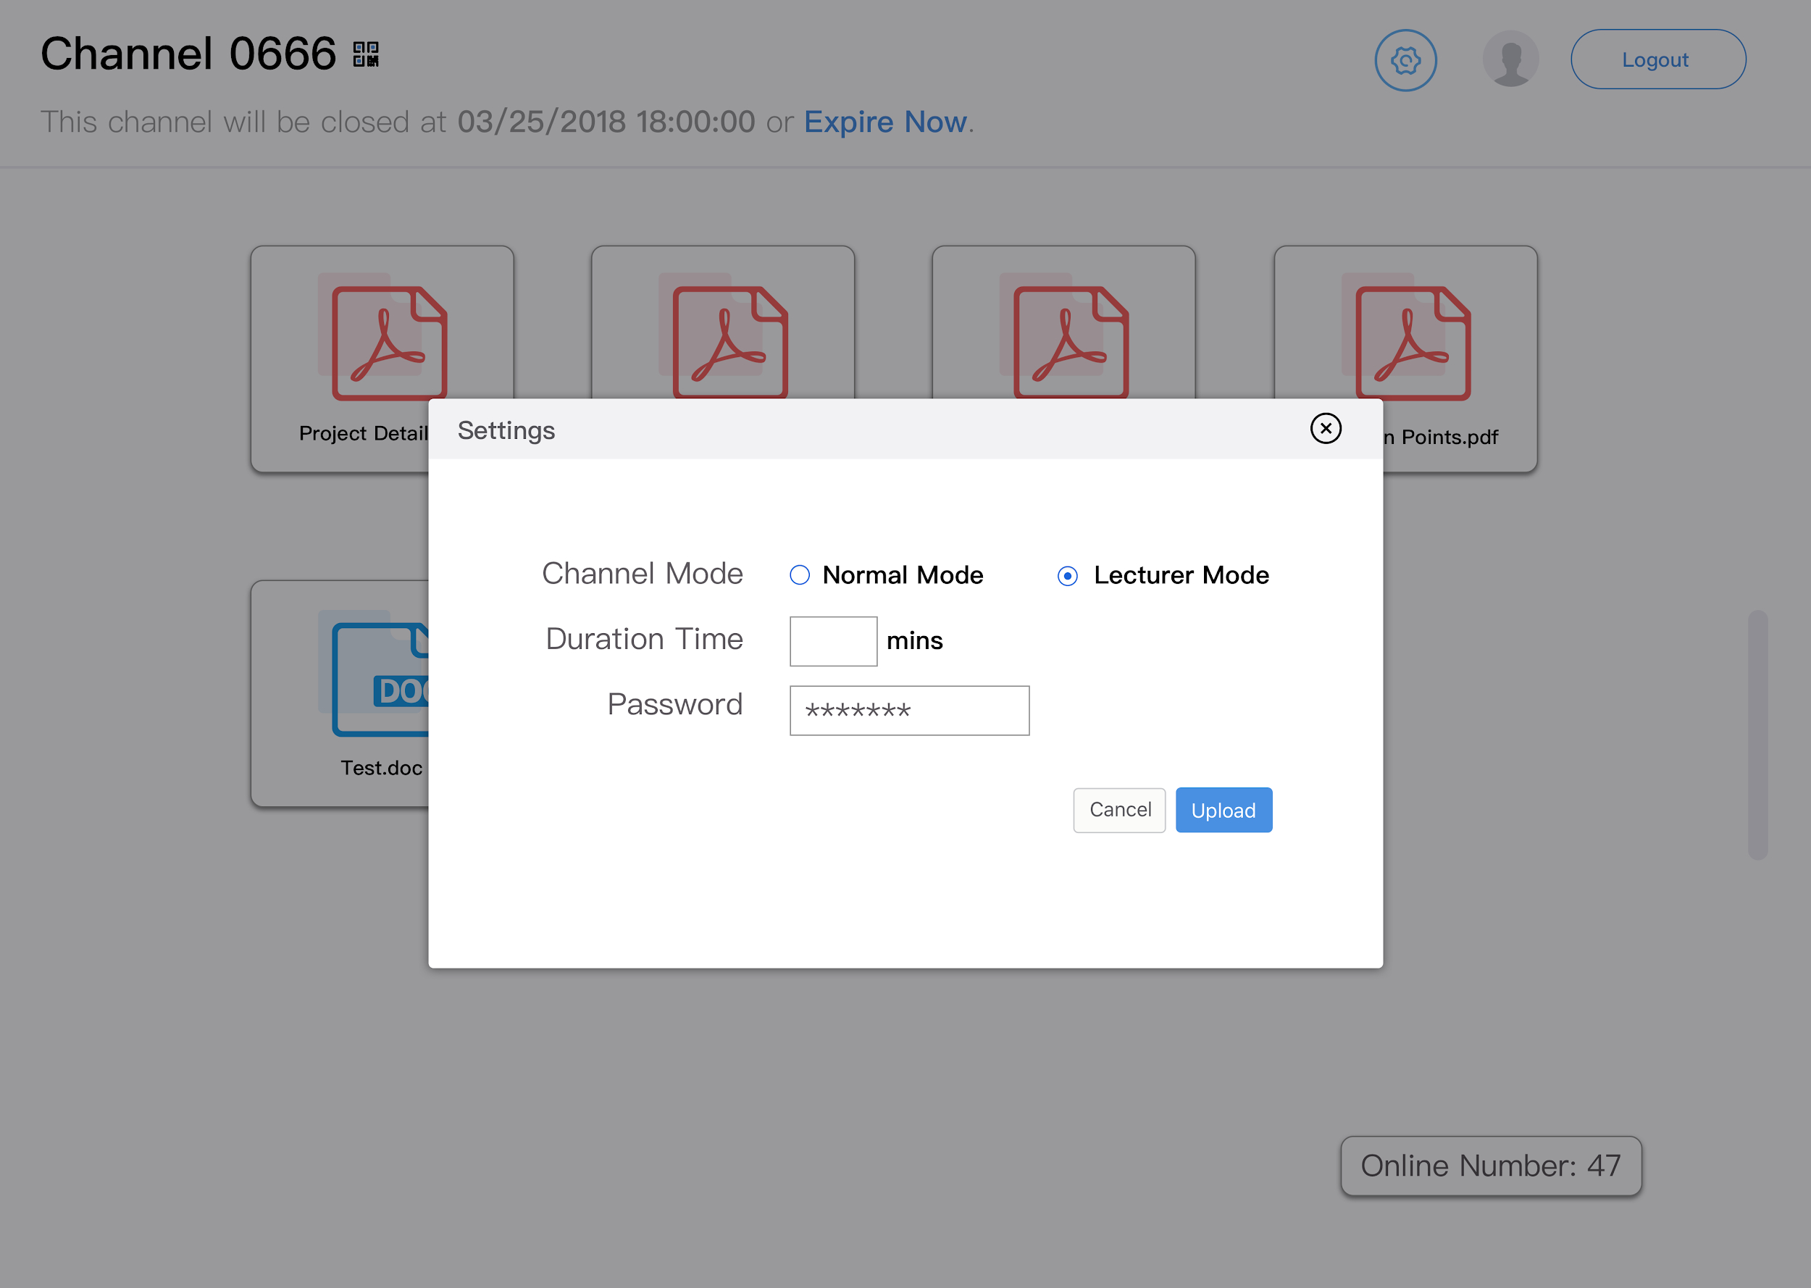
UIOP Team 13

Slide 9
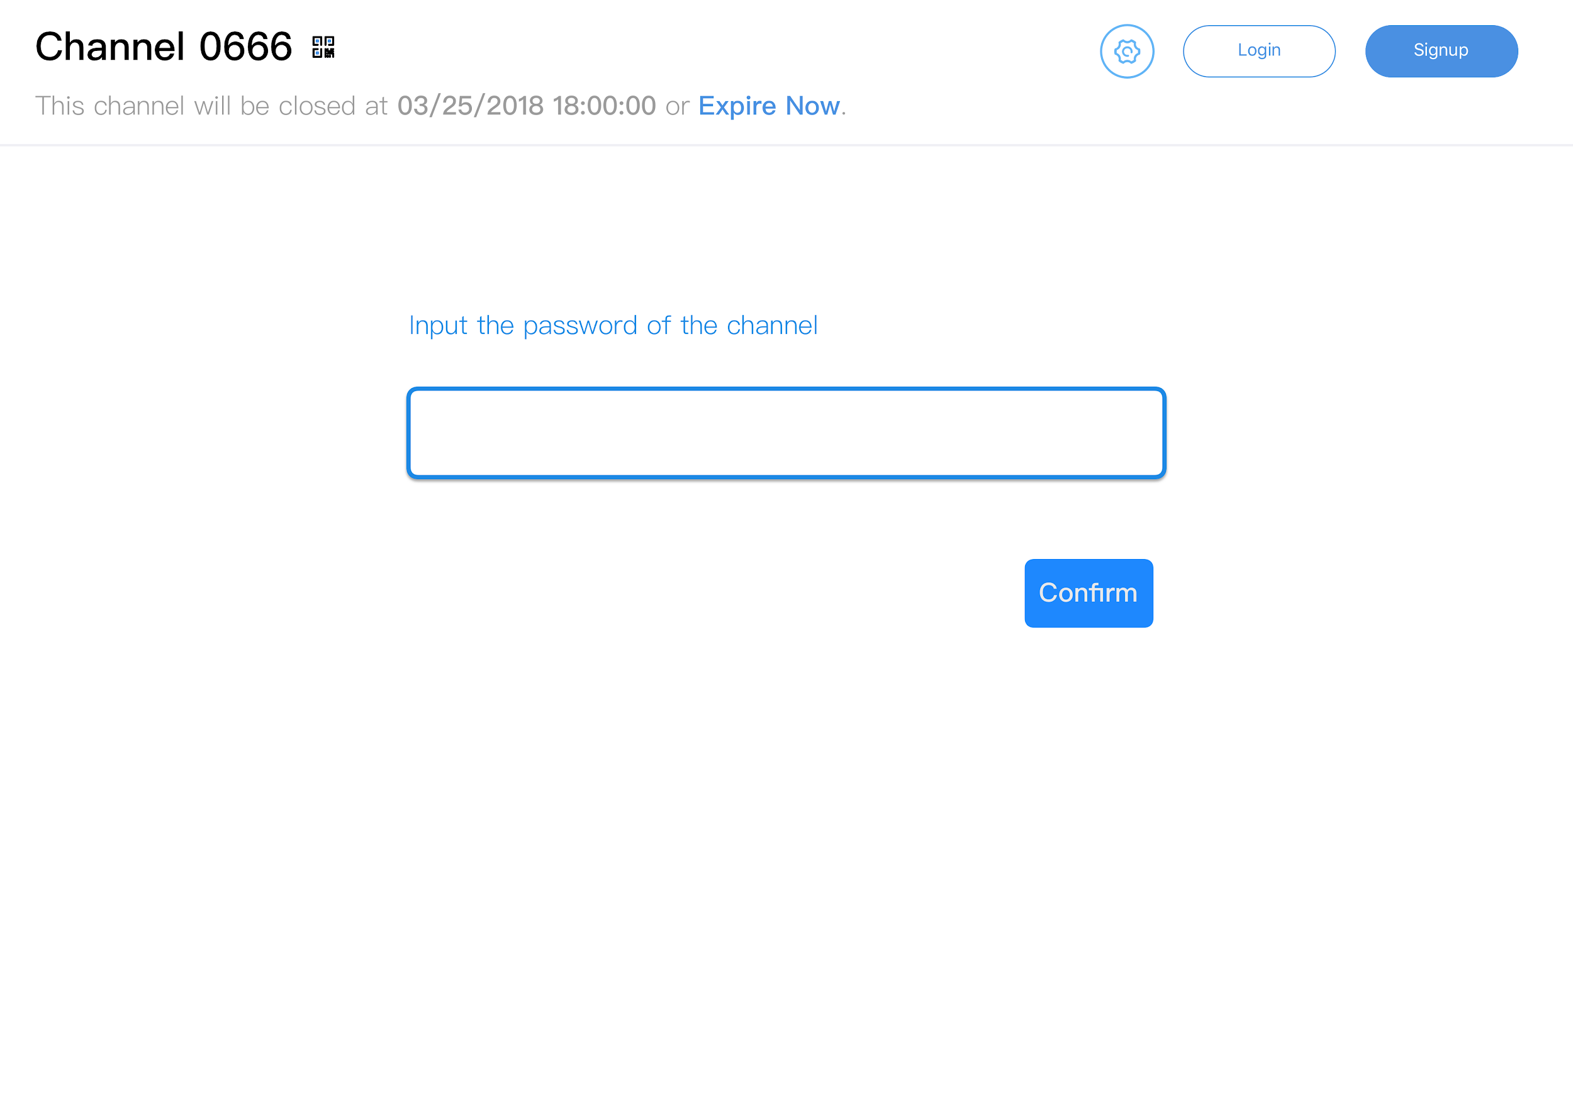
UIOP Team 13

Slide 10
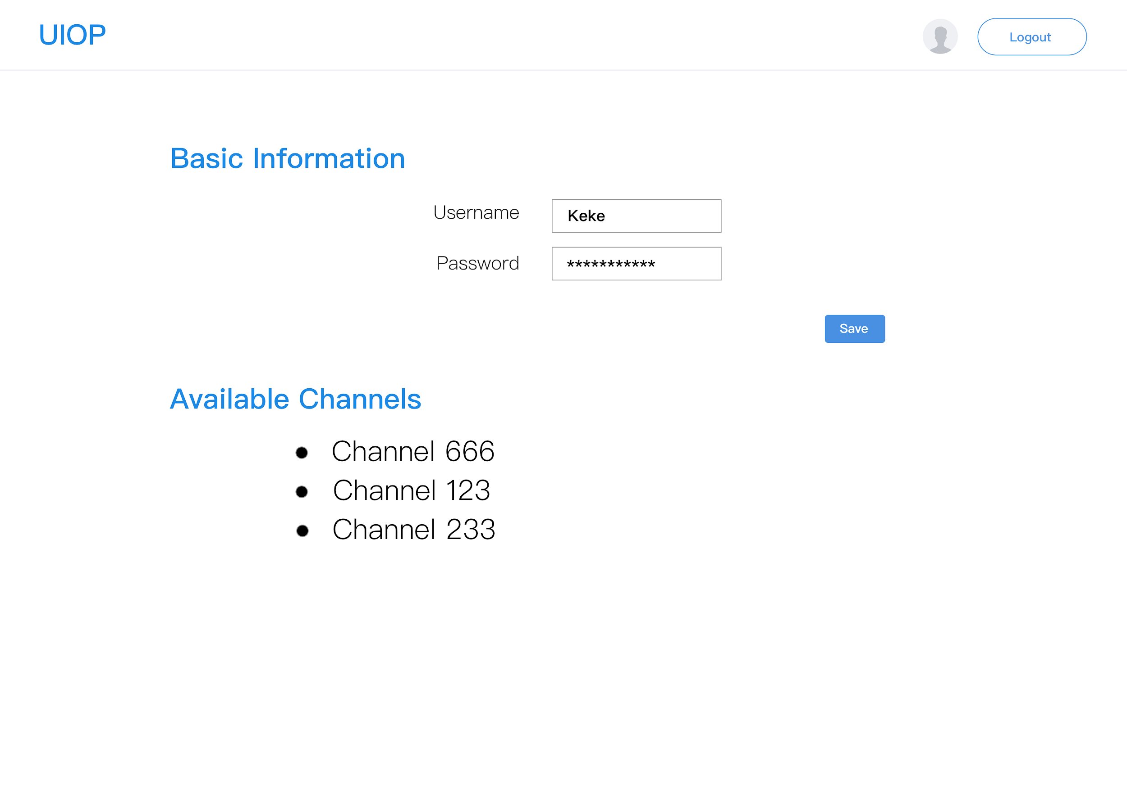
UIOP Team 13

Slide 11
UIOP Team 13
ID | Name | User Story | Estimate | Priority
1 | [Login] | As a user, I want to log in to the system so I can use extra channel functions. | 1 | 9
2 | [Register] | As a new user, I want to register the system so I can use extra channel functions. | 1 | 8
3 | [Create a new channel] | As a user, I want to create a new channel in the web application so that I can share files with other users. | 2 | 3
4 | [Enter channel] | As a user, I want to enter an existed channel so that I can share files with others. | 4 | 4
5 | [Input channel password] | As a user, I need to input the channel password to enter a channel with a password. | 2 | 11
6 | [Add channel password] | As a logged-in channel creator, I want to add a password for my channel to keep my channel more private. | 2 | 12
7 | [Upload file] | As a user, I want to upload my files to share with other users in the channel. | 6 | 1
8 | [Download file] | As a user, I want to download the files that other users share in the channel. | 4 | 2
9 | [Generate QR code] | As a channel, it should generate QR code for users to easily come in. | 2 | 13
10 | [Get channel information] | As a channel, it should update the files in it periodically. | 4 | 6
11 | [Modify duration] | As a channel creator, I want to modify the duration time to manage the channel. | 1 | 15
12 | [Set lecturer mode] | As a logged-in channel creator, I want to set the channel to lecturer mode, so that only I can upload files in the channel. | 1 | 14

Slide 12
UIOP Team 13
ID | Name | User Story | Estimate | Priority
13 | [Expire channel] | As a logged-in channel creator, I want to make the channel expire immediately, so that others won't access the files in that channel any more. | 1 | 16
14 | [Modify channel password] | As a logged-in channel creator, I want to modify the channel password | 1 | 14
15 | [Count user number] | As a channel, it should show how many people are in the channel. | 4 | 7
16 | [Get user basic information] | As a logged-in user, I want to get basic information of my account, including user name. | 2 | 18
17 | [Get user available channels] | As a logged-in user, I want to get all the channels I created that are not expired at the current time. | 1 | 20
18 | [Log out] | As a logged-in user, I want to log out. | 1 | 10
19 | [Modify user information] | As a logged-in user, I want to modify my user name or password. | 1 | 19
20 | [Check expired time] | As an application, it should check the created time, and when it exceeds the expired time, the application should delete all the files in the channel, and set the channel code unused. | 2 | 5
21 | [Archive] | As a user I want to archive the all the information in a channel. | 6 | 21

Slide 13
UIOP Team 13
Sprint 1 Plan
ID | Name | User Story | Estimate | Priority
1 | [Login] | As a user, I want to log in to the system so I can use extra channel functions. | 1 | 9
2 | [Register] | As a new user, I want to register the system so I can use extra channel functions. | 1 | 8
3 | [Create a new channel] | As a user, I want to create a new channel in the web application so that I can share files with other users. | 2 | 3
4 | [Enter channel] | As a user, I want to enter an existed channel so that I can share files with others. | 4 | 4
5 | [Input channel password] | As a user, I need to input the channel password to enter a channel with a password. | 2 | 11
6 | [Add channel password] | As a logged-in channel creator, I want to add a password for my channel to keep my channel more private. | 2 | 12
9 | [Generate QR code] | As a channel, it should generate QR code for users to easily come in. | 2 | 13
10 | [Get channel information] | As a channel, it should update the files in it periodically. | 4 | 6

Slide 14
UIOP Team 13
Sprint 2 Plan
ID | Name | User Story | Estimate | Priority
7 | [Upload file] | As a user, I want to upload my files to share with other users in the channel. | 6 | 1
8 | [Download file] | As a user, I want to download the files that other users share in the channel. | 4 | 2
13 | [Expire channel] | As a logged-in channel creator, I want to make the channel expire immediately, so that others won't access the files in that channel any more. | 1 | 16
14 | [Modify channel password] | As a logged-in channel creator, I want to modify the channel password | 1 | 14
16 | [Get user basic information] | As a logged-in user, I want to get basic information of my account, including user name. | 2 | 18
18 | [Log out] | As a logged-in user, I want to log out. | 1 | 10
19 | [Modify user information] | As a logged-in user, I want to modify my user name or password. | 1 | 19
20 | [Check expired time] | As an application, it should check the created time, and when it exceeds the expired time, the application should delete all the files in the channel, and set the channel code unused. | 2 | 5

Slide 15
UIOP Team 13
Sprint 3 Plan
Additional requirement and quality attribute
Archive the channel
Number of people in a channel
Higher performance
Large file

