Slide 1




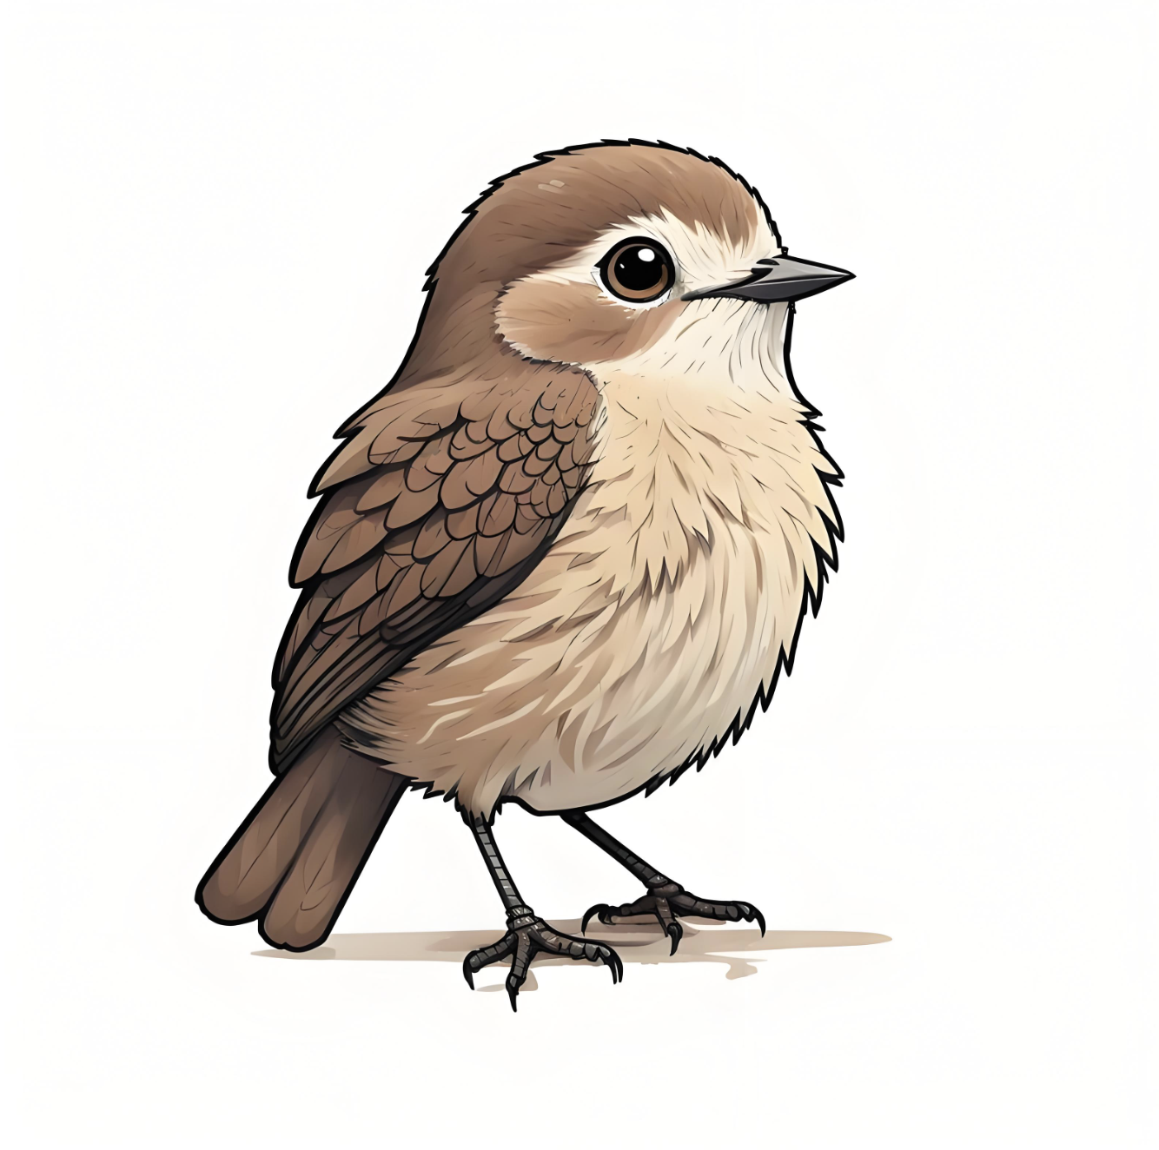
90% energy loss
90% energy loss
90% energy loss
10% energy flow
lizard
10% energy flow
10% energy flow
pest
eagle
10% energy flow
crop
10% energy flow
bird
90% energy loss

Slide 2
Natural Processes
Human Decisions
Removal of Herbicide
Current System
Weeps
Reaction-Diffusion Model
Introducing Bats
Crops
Pests
Tri-trophic Dynamic Model
Multi-Objective Optimization
Beneficial Insects
Economic Benefits
Revenue from Crop Harvests
Tri-trophic and Soil Vitality Model
Pesticide Costs
Soil
Soil Fertility (Soil Fertility Index)
Ecological Sustainability
Temperature & Rainfall (Beta Function)
Periodical Pesticide Usage
Biodiversity (Shannon Index)
SLSQP
NSGA-II
Reemergence of Species
Weighted Objective Optimization
Pareto Front
Lizard
Crop
10%
flow
10%
flow
10%
flow
Pest
Eagle
Bird
Energy Flow Model
One-page letter to farmers

