Slide 1
StudyBuddies
Where dreams come to live
CODE PLATEAU 3.0 SDG 4 GROUP

Slide 2
Key Problem
SLOW PROGRESS IN SCHOOL COMPLETION RATE.
CODE PLATEAU 3.0 SDG 4 GROUP

Slide 3
Statistics
Primary schools globally
In 2010 82% - In 2020 85%
Primary schools in Nigeria
In 2020 77%
Secondary schools globally
In 2010 46% - In 2019 53%
Secondary schools globally
In 2020 62.8%
School Completion Rate in Plateau State
“In Plateau State one out of two Plateau residents are illiterate, more that 55.5% of Plateau State residents are illiterate. We need to adopt modern management of human and material resources to get result”
Mrs. Chundung Shom (FCE Pankshin)
CODE PLATEAU 3.0 SDG 4 GROUP

Slide 4
Causes
1. Covid 19
2. Low level of family support for student
3. Inadequate study space and time
4. Learning disabilities
5. Unqualified teachers
6. Under-resourced learning enviroment
7. Indequate overall funding
8. Classroom size
9. Enviromental hostility, prejudice, bullying, violence or safety issues.
CODE PLATEAU 3.0 SDG 4 GROUP

Slide 5
Our Goals
1. To make sure proportion of children and young people
(a) in grades 2/3;
(b) at the end of primary; and
(c) at the end of lower secondary school should achieve at least a minimum proficiency level in
(i) reading,
(ii) mathematics and
(iii) other relevant subjects.
2. Increase the completion rate (primary education, lower secondary education, upper secondary eduction)
CODE PLATEAU 3.0 SDG 4 GROUP

Slide 6
Solution/Action Plan
1. BUILD “STUDYBUDDIES” APP
StudyBuddies is an app that dose the following;
i. Register volunteers,
ii. Accept donations and
Iii. Will also contain all the educational materials (curricullum) from primary school to secondary school.
2. AWARENESS CAMPAIGN
We will create and run an awareness campaign on all social media platforms and relevant broacasting outlet using compeling and attractive graphic and motion pictures to attract volunteers, donors and philanthropist.
CODE PLATEAU 3.0 SDG 4 GROUP

Slide 7
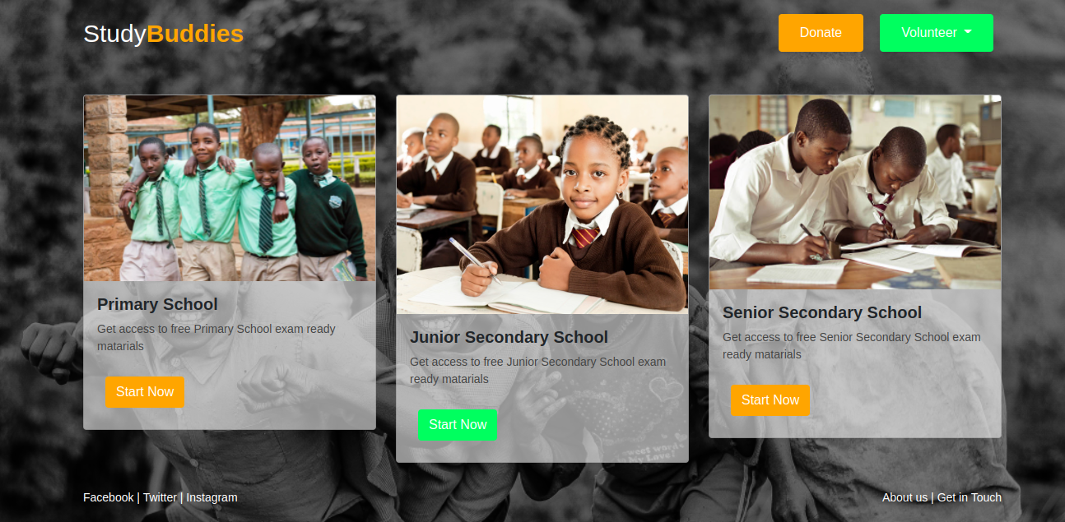
Proposed Application
CODE PLATEAU 3.0 SDG 4 GROUP

Slide 8
Thanks!
Any questions?
CODE PLATEAU 3.0 SDG 4 GROUP

