Slide 1

Analysis
by Iryna Krokhtiak

Slide 2

HR Analytics is the application that uses math, statistics and modeling to process related data in order to see and predict patterns.
It is used to make better decisions about all aspects of HR strategy with the goal of improving business performance.

Slide 3

The problem:
Predict whether an employee is going to leave the company.

Slide 4

Data:
This dataset is simulated. (https://www.kaggle.com/ludobenistant/hr-analytics/data)
Dataset contains about 12 000 answers to survey and labels whether the employee has left the company or not.

Slide 5

Survey:
Questions:
How would you rate your level of satisfaction on the current position?
How much time has passed since the last promotion?
How many projects you have completed on the current position?
How many hours do you work per week in average?
How many months have you been working in the current company?
Have you had an accidents at work?
Have you been promoted in the last 5 years?
Choose your department.
Choose your salary level.

Slide 6
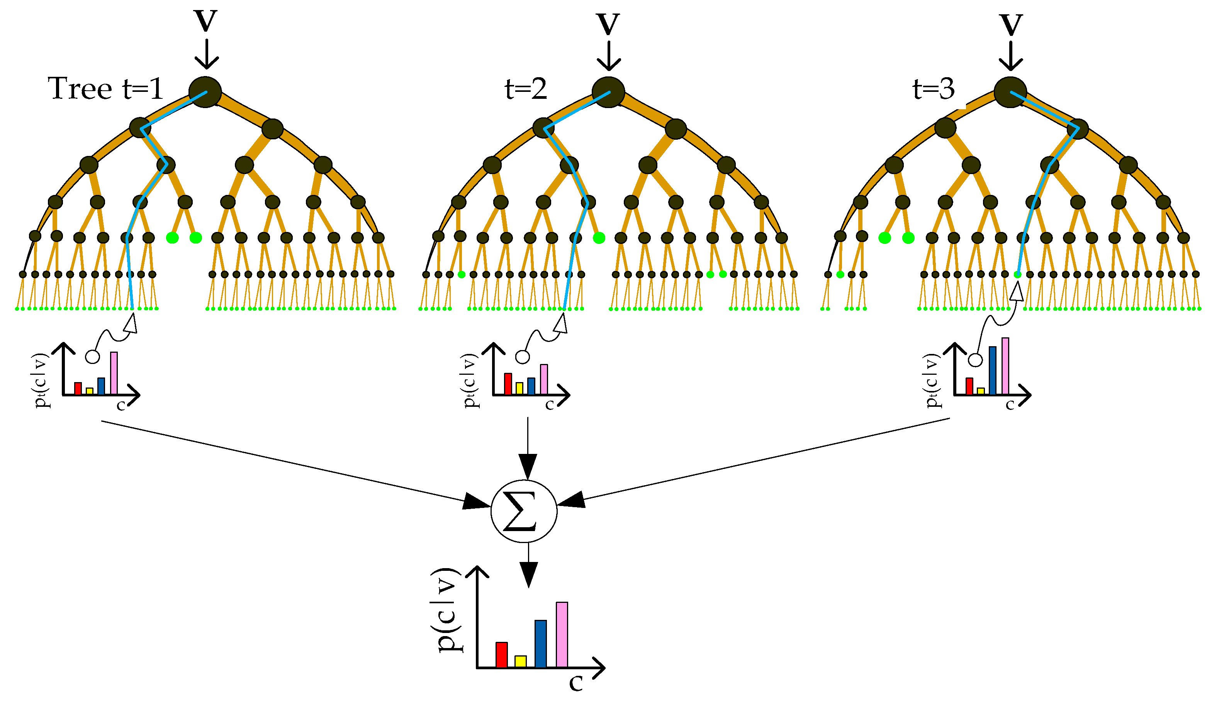
Model:
Random Forest Classifier.
(sklearn.ensemble)

Slide 7

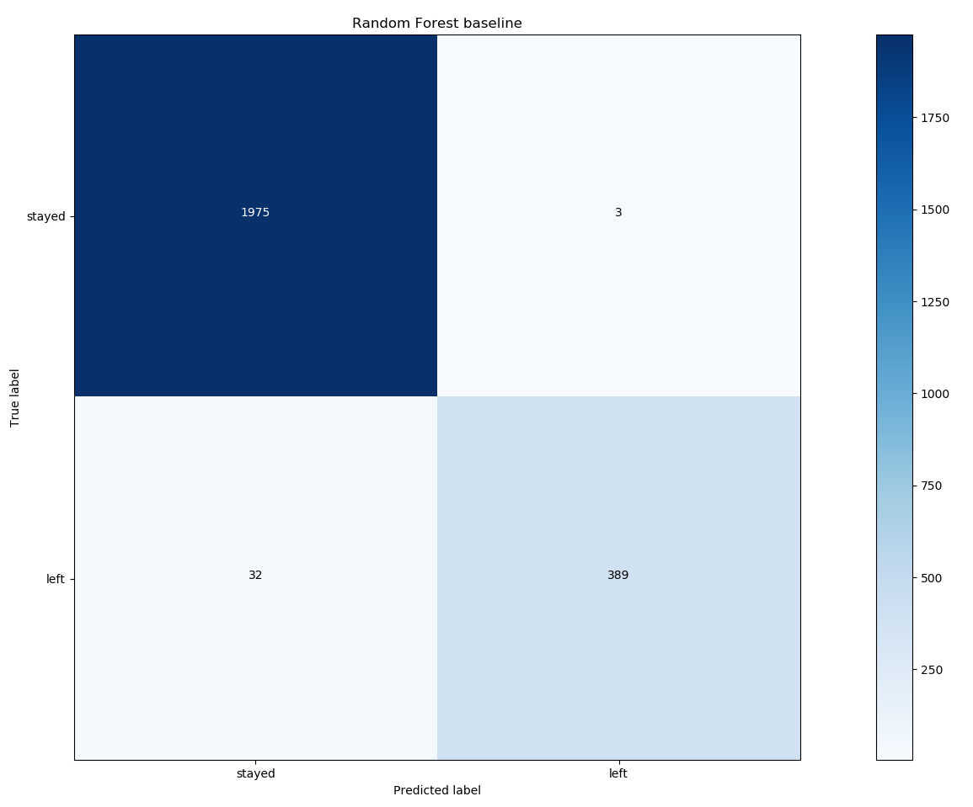
Classification report:
Confusion matrix
Accuracy score of the model is 98.51 %

Slide 8
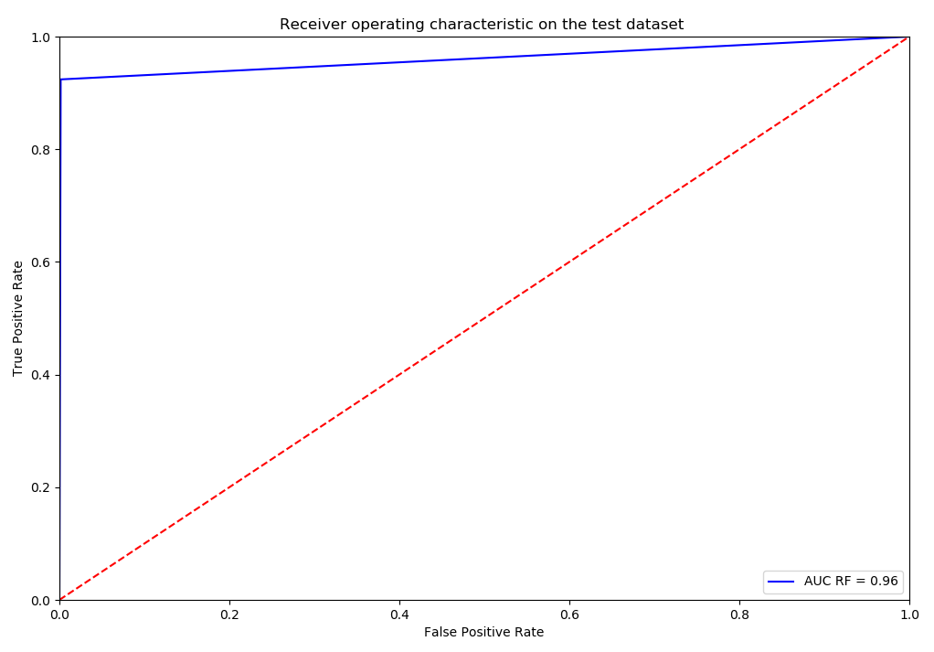
ROC curve

Slide 9
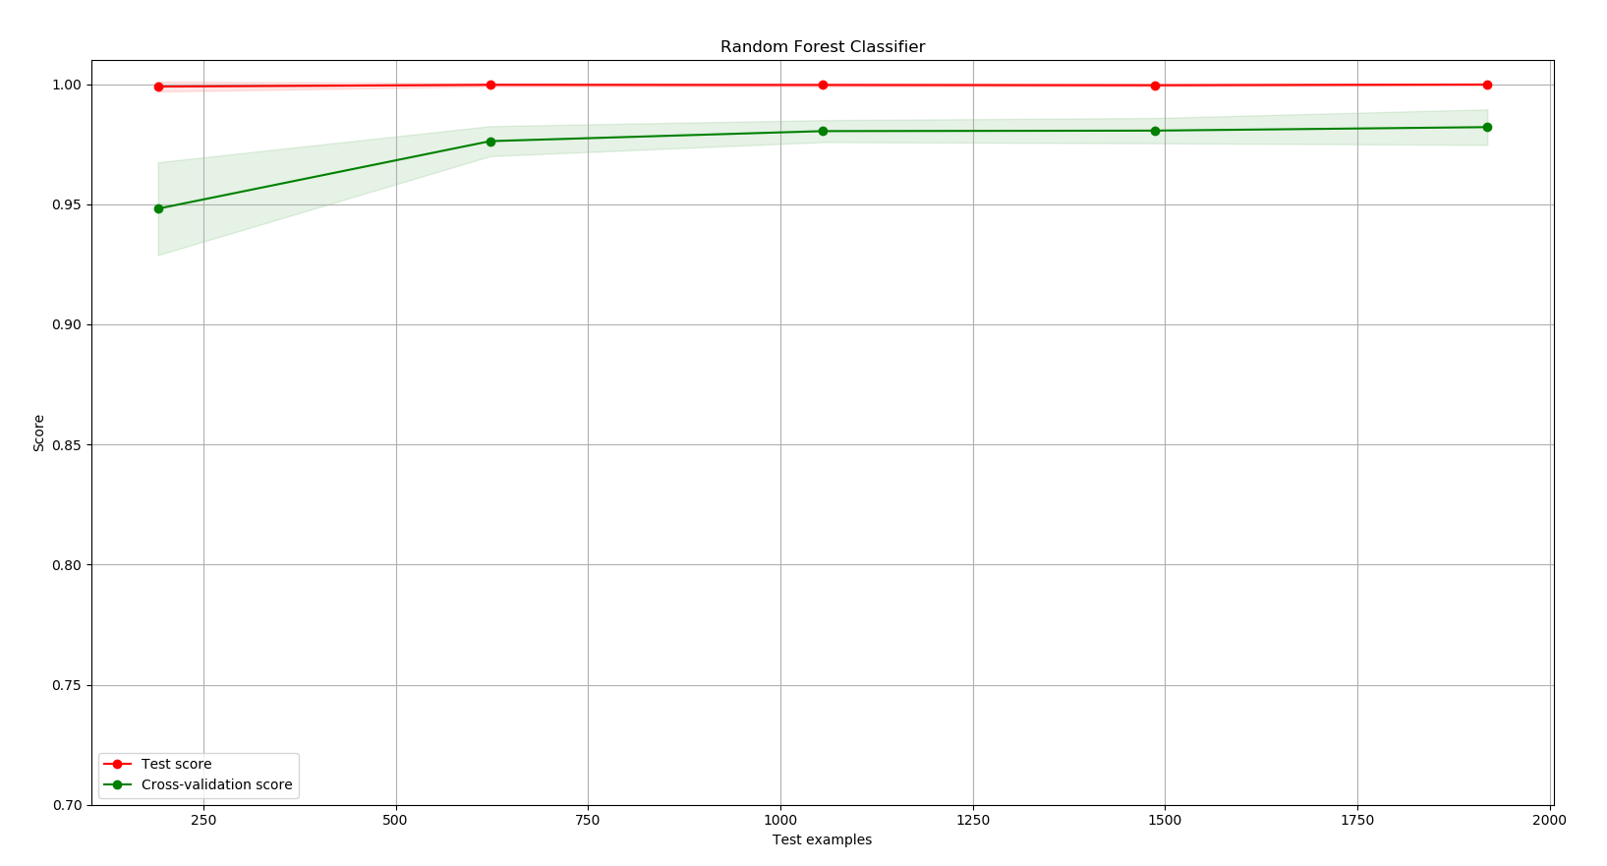
Learning Curves

Slide 10
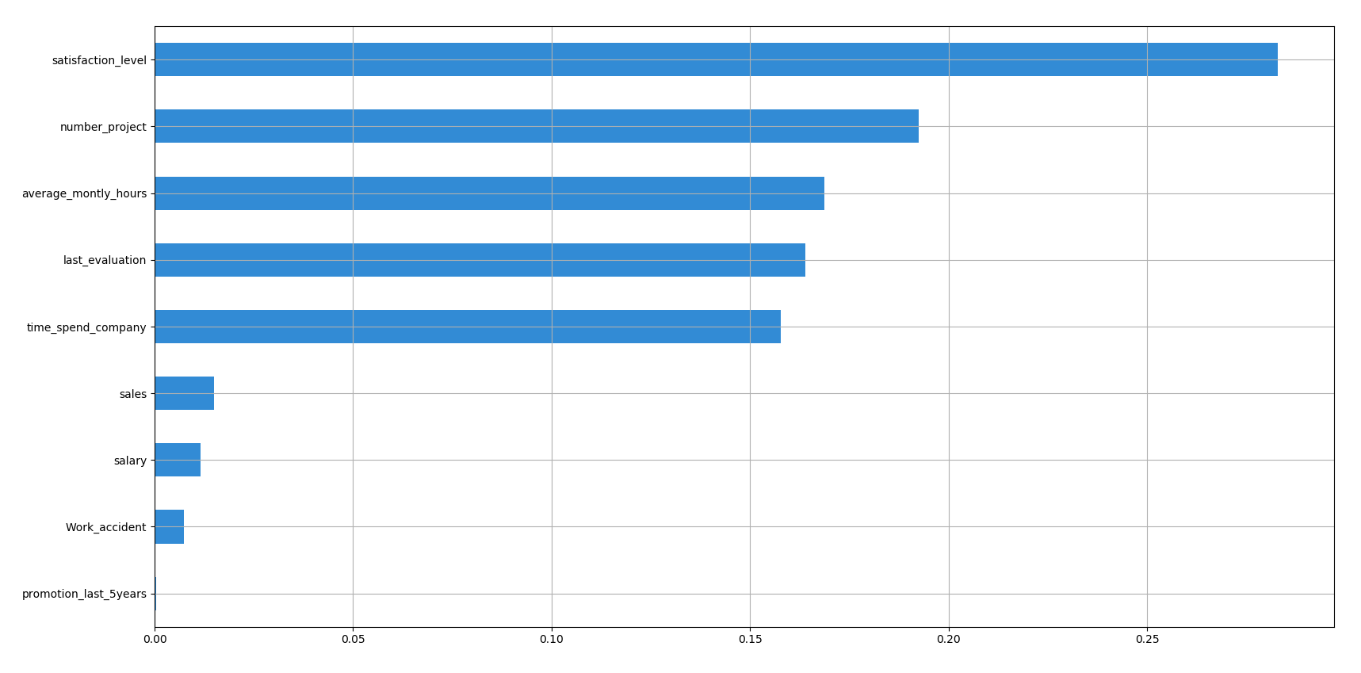
Important Features
(Computes feature importance of all features related to a model instance.)
28.18 %
19.29 %
16.96 %
16.42 %
15.72 %
1.5 %
1.15 %
0.73 %
0.04%

Slide 11

Interesting???
???
Simply visit the https://survey-for-hr-analys.herokuapp.com,
complete the survey and then find out what this model predicts for you.

Slide 12


