Slide 1
Cardiovascular disease risk prediction using automated machine learning: A prospective study of 423,604 UK Biobank participants
Ahmed M. AlaaID et al.

Slide 2
Aims
Introduce AutoPrognisis as new automated ML framework
Improve CVD risk prediction compared to traditional approaches (especially in sub-populations)
Test if consideration of non-traditional features in CDV risk prediction increases accurany
→ Results presented based on cohort from UK Biobank with 423,604 participants without history of CVD at baseline (outcome: 5-year risk of a CVD event)
Notes:
AutoPrognosis

Slide 3
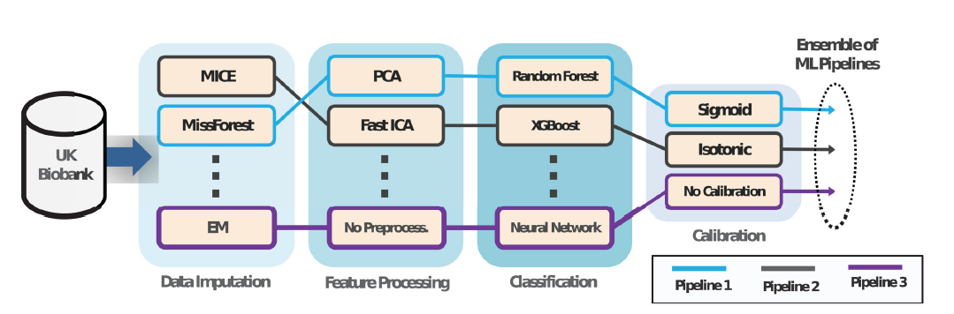
AutoPrognosis - Architecture
Notes:
AutoPrognosis automatically selects and tunes ensembles of ML modeling pipelines (comprising data imputation, feature processing, classification and calibration algorithms).
In Figure schematic for framework:
- Given the participants’ variables and CVD outcome, AutoPrognosis uses an advanced Bayesian optimization technique in order to (automatically) design a prognostic model made out of a weighted ensemble of ML pipelines.
- Each ML pipeline comprises design choices for data imputation, feature processing, classification and calibration algorithms (and their hyper parameters), Calibration = numerical outputs of a model correspond to the actual risk of a CVD event
- design space of AutoPrognosis contains 5,460 possible ML pipelines
Critic: just a short paragraph about autoprognosis, but this is a new developed tool → should be more explained!
Model training:
- 200 iterations of AutoPrognosis, each iterations explores new pipeline and tunes its hyperparameters
CV (10-fold stratified) used in each iterations for performance evaluation with AUC-ROC (AutoPrognosis as well as models for comparison)
AutoPrognosis learned 200 weighted ML pipelines + different combinations → strongest: MissForest data imputation, no feature selection, XGBoost ensemble classifier + sigmoid regression for calibration

Slide 4
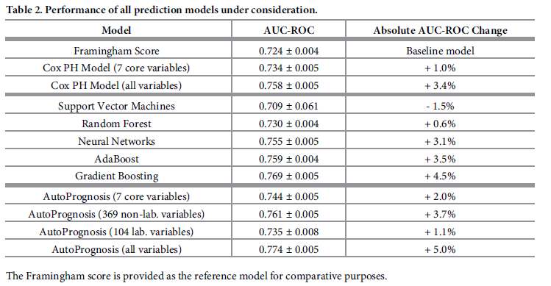
Notes:
- prediction accuracy of the different models under consideration evaluated at a 5-year horizon
AutoPrognosis all achieved a significantly higher AUC-ROC than baseline (Framingham) → automated ML system managed to automatically select and tune the “right” ML model
Critic: Paper included many tables with a lot of numbers, but no plots where one can see results better (visualization for the win!)
AutoPrognosis with different number of variables: To disentangle the “modeling gain” (more complex models) from “information gain” (more variables),
→ simpler version of AutoPrognosis (same 7 core risk factors (age, gender, systolic blood pressure, smoking status, treatment of hypertension, history of diabetes, and BMI) used by the existing prediction algorithm

Slide 5
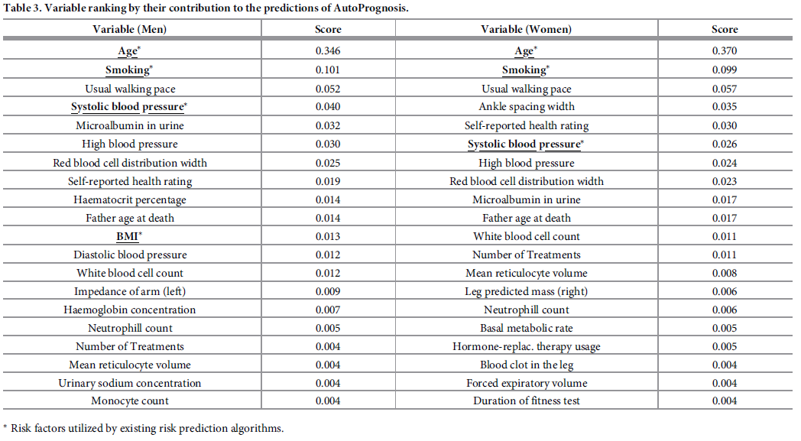
Notes:
- Table: Variable ranking → contribution to predictions of AutoPrognosis, via post-hoc approach (fitting a random forest model with the participants’
variables as the inputs, and the predictions of our model as the outputs → assigning variable importance scores using standard permutation method)
Critic: name of the standard permutation method?
result: features related to physical activity + information on blood measurements more important that conventional risk factors (for women: “ankle spacing width”, linked to symptoms of poor blood circulation → predictive of future CVD events)

Slide 6
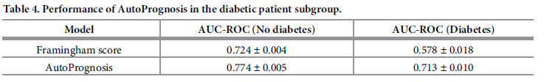
Sub-population: diabetes
Notes:
Performance of AutoPrognosis and the Framingham score validated separately on a testing cohort of diabetic
patients (1,790 participants), and a testing cohort of non-diabetic patients (40,570 participants) via 10-fold crossvalidation.
AutoPrognosis was trained using the entire training cohort that combines both diabetic and non-diabetic
individuals (381,244 participants).
Also risk predictors were evaluated

Slide 7
Conclusions
AutoPrognosis improved accuracy of CVD risk prediction (compared to well-established scoring systems)
Discovery of new predictors of CVD risk (including non-laboratory features → easy to collect)
AutoPrognosis uncovered complex interaction effects between different characteristics of an individual → recognition of risk predictors specific to certain sub-populations (existing guidelines provides unreliable predictions

Slide 8
From Real-World Patient Data to Individualized Treatment Effects Using Machine Learning: Current and Future Methods to Address Underlying Challenges
Iona Bca et al.
Notes:
Paper adresses issue with randomized control trials:
-For new drugs: dose adjustment + indentification of patient population required → RCTs, Problem: no real-world setting, external validity not possible → fail to generalize beyond study population
EHRs in USA: after FDA-approved, drugs given to a much varied population → each patient’s medical history + adverse/beneficial effects caused by spec. drug documented, EHRs less accpeted compared to RCTs (e.g. Problem: oberservational bias)
ML in this case: introduction of causal inference (low level explanation)

Slide 9
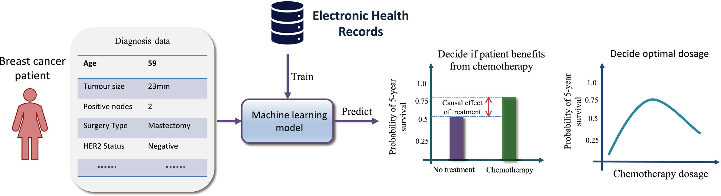
INDIVIDUALIZED TREATMENT RECOMMENDATIONS IN THE STATIC SETTING
Notes:
- Definition: Single treatment decision based on current patient features, use observational data to predict outcome of treatment and no treatment
Scenario: Causal inference models can be trained on observational patient data from EHRs → estimate individualized patient outcomes under possible treatment options, here illustrate how estimates can be used to decide at diagnosis time the chemotherapy is beneficial and the optimal dosage for the patient.
Challenges:
RCTs treatment assigned randomly, observational data: treatment based on patient’s clinical characteristics → treatment selection bias
Assumptions for causal inference: overlap (a.k.a. positivity) + unconfoundness (all confounders – all bls affecting treatment assignment + outcome observed) → not testable, domain knowledge necessary
Paper named different scenarios of usage of causal inference in static setting
Critic: Paper just give overview of theoretical background, but no comparison of mentioned methods

Slide 10
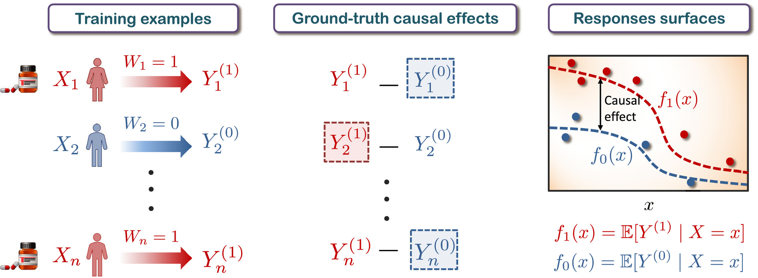
INDIVIDUALIZED TREATMENT RECOMMENDATIONS IN THE STATIC SETTING
Notes:
Using observational patient data to estimate individualized causal effects:
training data contains information about patient features X , factual treatment W and factual outcome Y
ground truth causal effect of the treatment is defined as the difference between receiving the treatment and not receiving the treatment
factual outcomes only oberservable; the counterfactual one (indicated by dotted lines) is never observed
The observational data points for patients that have received treatment (red) and patients that have not received the treatment (blue) can be used to learn response surfaces (supervised manner using two separate models for different treatments → allows outcome-specific hyperparamters) for each treatment option and thus estimate the causal effect of the treatment.

Slide 11
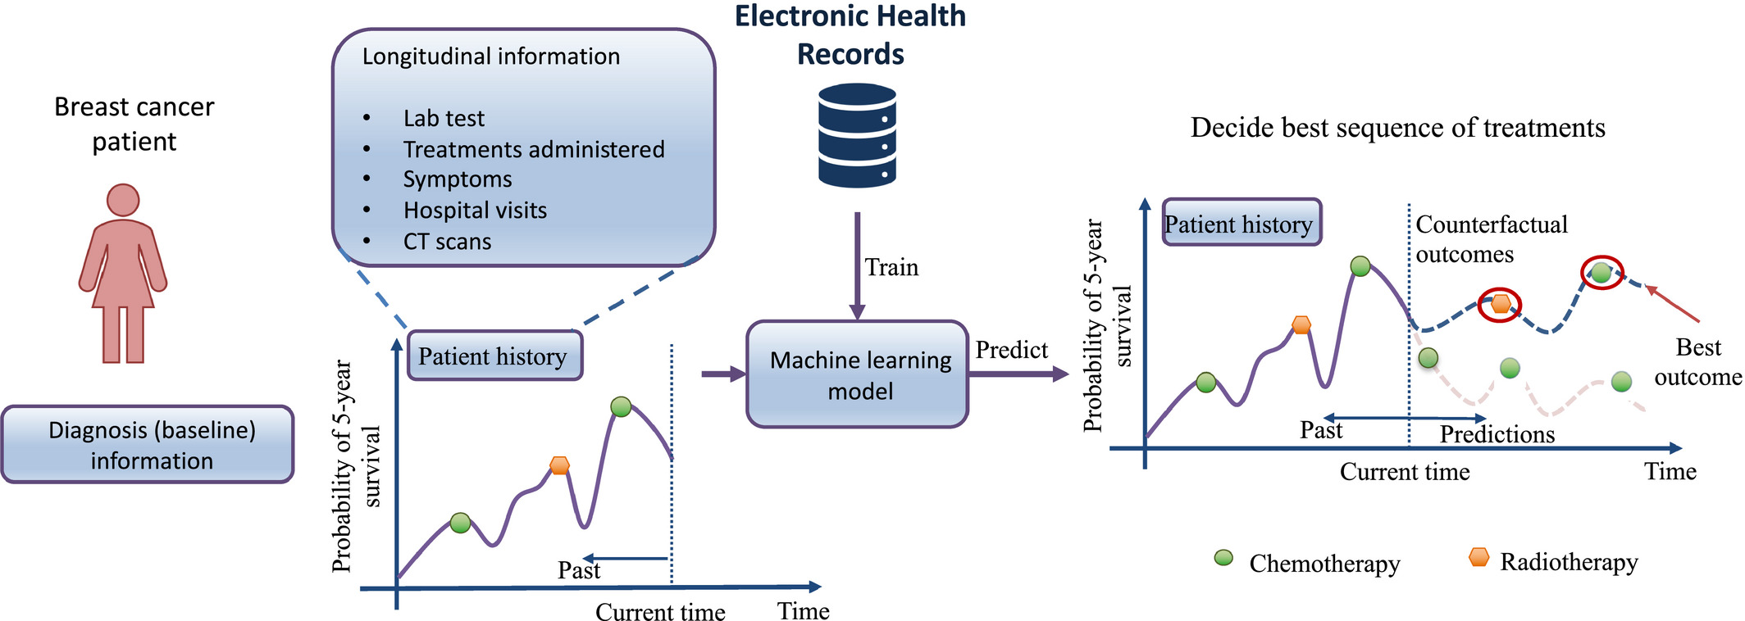
INDIVIDUALIZED EFFECTS OF TIME-DEPENDENT TREATMENTS
Notes:
In this setting: patient history + treatment timing play a role
Causal inference mehods for estimating individualized effects of time-dependet treatments need model the patient’s history in order make counterfactual predictions of potential outcomes for possible sequences of future treatments (e.g. decide over the best timing and order of treatment of chemotherapy and radiotherapy treatments for a patient with breast cancer)
Overlap (at each timestep assume that each treatment option has non-zero prob of being administered) + unconfoundedness (at each timepoint all vlbs affecting patient’s treatment + outcome observed) must hold again
Modeling choices in the estimation of treatment effects over time involve:
handling the time-dependent confounding bias
handling discrete-time or continuous-time interventions
modeling the progression of one or multiple patient covariates of interest

Slide 12
Limitations
Incorporating ML models into clinical decision support systems entails challenges of its own:
Domain knowledge critical for providing assurance that the unconfoundedness assumption actually hold
Counterfactuals never observed → expert knowledge always needed to validate the model’s estimates of the treatment effects
Must ensure that the patient population used to train the model is representative of the patient population the model is to be deployed on
Notes:
My opinion in the paper:
Good overview when starting with causal inference in EHRs, gives overview over different setups of usage and challenges to consider (question: does two main assumptions: overlap + unconfoundedness hold in my dataset?)
Methods to use mentioned, not evaluated or compared to each other → so pro: reader can make his own opinion but have to go into details of advantages + disadvantages each method have
Workflow of individual treatment effect estimation is given!
Not to much technical details or how to incorporate RCT data into EHR data, but I think the target group were not applied ML researchers, since paper was published in Clinical Pharmacology & Therapeutics (no to deep technical journal)

Slide 13
Discovery and Clinical Decision Support for Personalized Healthcare
Jinsung Yoon ET al.
Notes:
In general: for a smart clinical decision support systems + diagnosis decision support systems necessary:
extract only relevant information about particular patient + relevant clinical decisions previously used for similar patients among the wealth of available information (using irrelevant features leads to a performance decrease)
large literature has used data-driven approaches to developing representative rather than personalized healthcare decision support systems
smaller literature is dedicated to developing personalized CDSS
Problem:
representative guidelines + CDSS cannot be as good as individual, because impossible to include all individual relevant patient information
proposed CDSS focus on diagnosis recommendations and NOT on the equally important problem of treatment recommendations

Slide 14
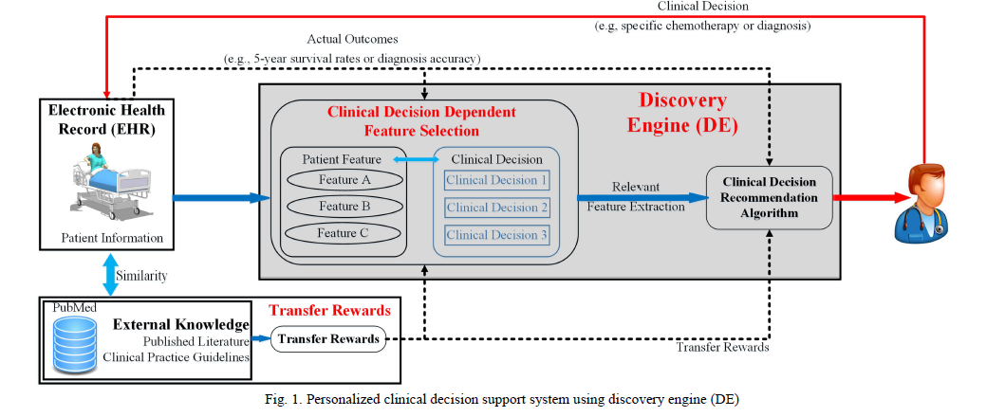
Personalized CDSS using discovery engine (DE)
Notes:
CDSS = clinical decision support system
figure issues personalized clinical recommendation to physician about certain patient
Gaol of DE: discover the relevant features of each clinical decision a + recommend the optimal clinical decision that corresponds to the discovered relevant patient information
Actual outcome of certain clinical decisions are used as a reward to train the DE
It consists of two algorithms:
clinical decision dependent feature selection algorithm (CDFS) – DE identifies different relevant features for different clinical decisions,
very different from existing feature selection algorithms which focus on the patients’ characteristics and not on how these characteristics distinctively impact different clinical decisions
clinical decision recommendation algorithm
Algo described in details in paper with lot of bad explained formulas (one critic point on the paper: Introduced variabl names not properly as they used them a lot in the paper, would be helpful, also reduce number of formulas and explain the more in detail, that the reader has a chance to understand them)
Both algos work also robust with missing data

Slide 15
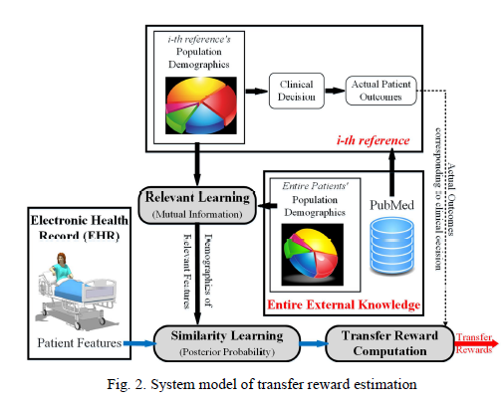
Transfer Reward Estimation
Notes:
most valuable rewards: actual patient outcomes, very difficult to obtain in practice
- Solving approach: proxy for outcomes based on external knowledge (literature + clinical practice guidelines)

