Slide 1
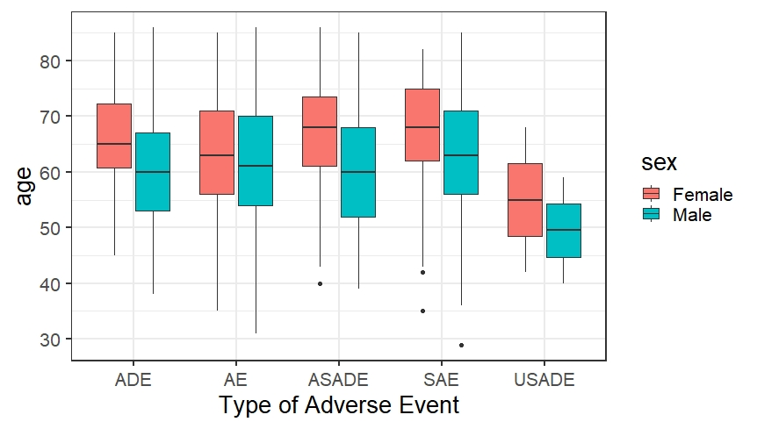
Adverse Events
AE – Adverse Event SAE – Serious Adverse Event ADE – Adverse Drug Event USADE - Unanticipated Serious Adverse Device Effects ASADE - Anticipated Serious Adverse Device Effects

Slide 2
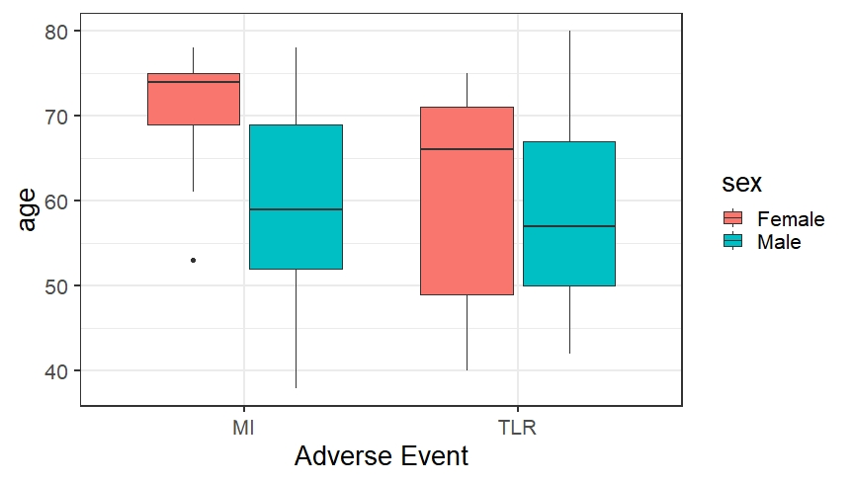
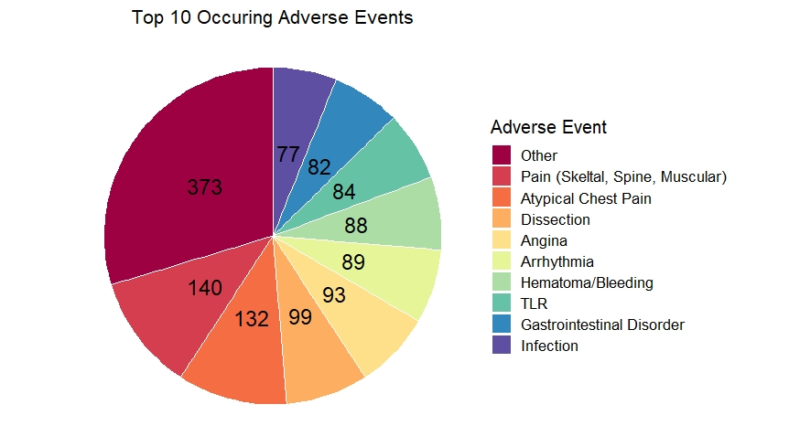

Slide 3
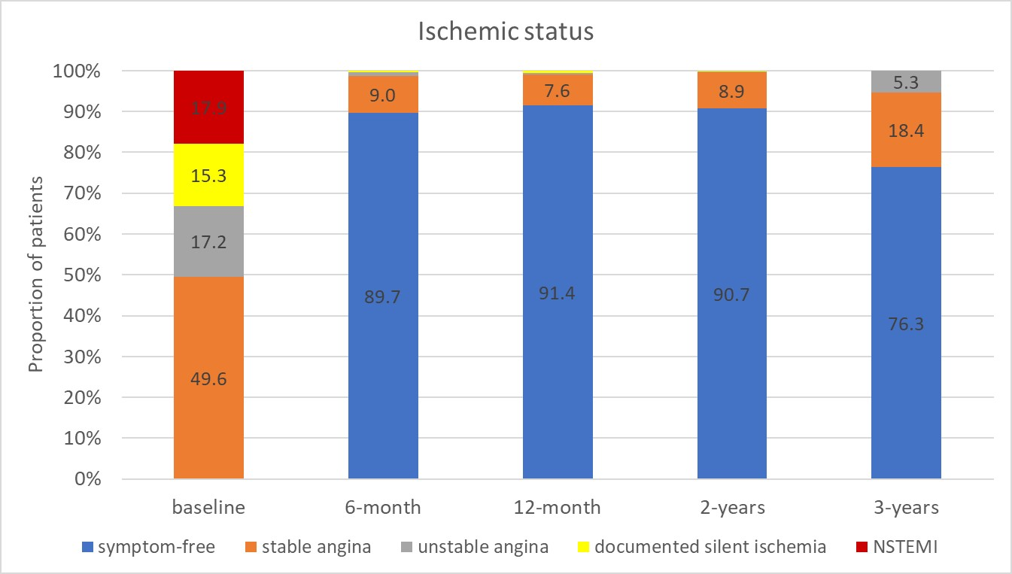
Ischemic status

Slide 4
Kaplan-Meier estimates of Clinical Outcomes up to 3 years (n=1770) vs 12 months (n=400)

Slide 5
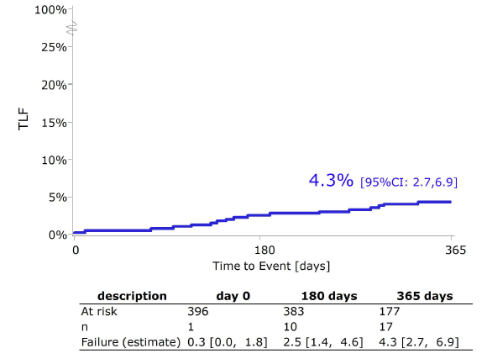
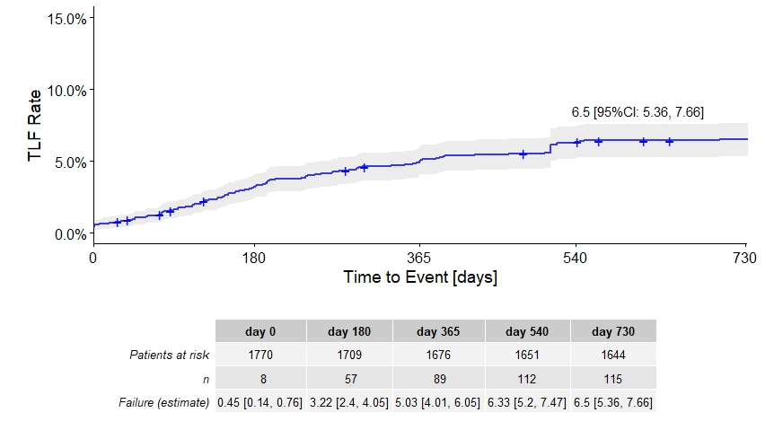
N = 400
N = 1770
Question1: How is TLR defined in BIOSOLVE IV (used for plot defintion of https://bmjopen.bmj.com/content/bmjopen/7/7/e016236.full.pdf)
Question2: In the 12-month outcomes of the first 400 patients enrolled – Kaplan-Meier estimates: how does sharp dop of patients at risk from 6 month to 12 month explainable?

Slide 6
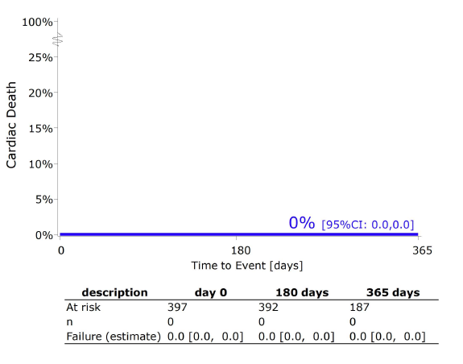
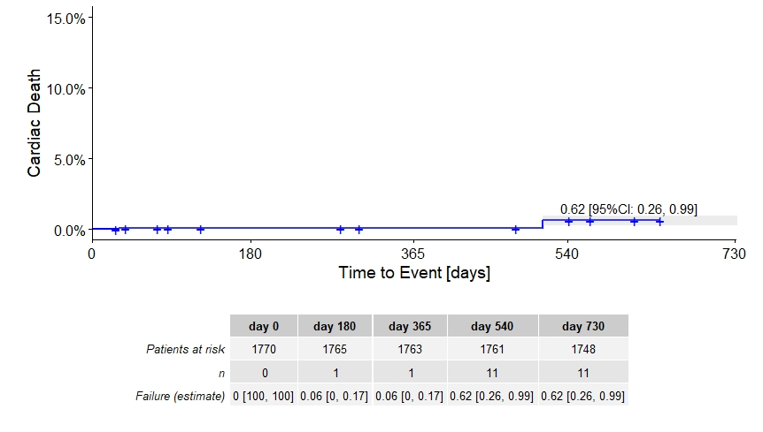
N = 400
N = 1770

Slide 7
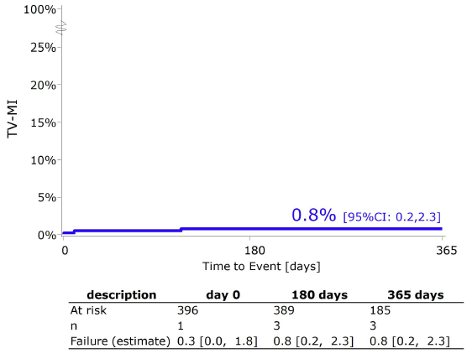
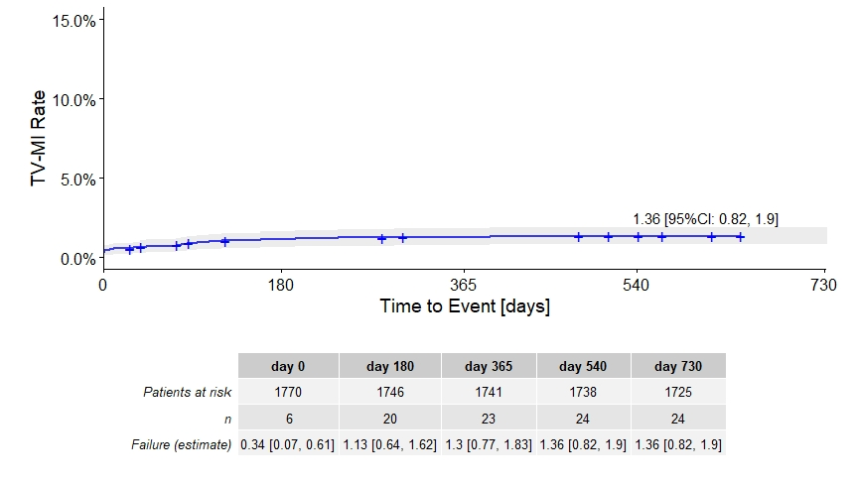
N = 400
N = 1770

Slide 8
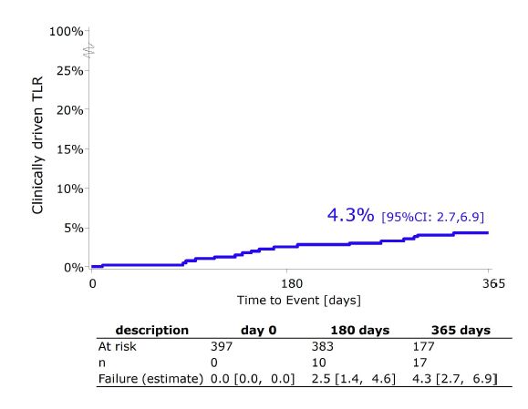
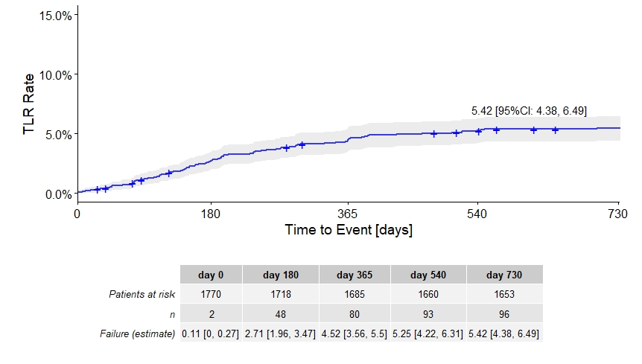
N = 400
N = 1770
Question1: How is TLR defined in BIOSOLVE IV (used for plot defintion of https://bmjopen.bmj.com/content/bmjopen/7/7/e016236.full.pdf)
Question2: In the 12-month outcomes of the first 400 patients enrolled – Kaplan-Meier estimates: how does sharp dop of patients at risk from 6 month to 12 month explainable?

