Slide 1
First Data Insight

Slide 2
Baseline Variables
Procedure Information
Postoperatively Information
Follow Up Information
Background information before procedure
Variables:
Demographics
Diagnostic statistics
Medical History
Medication
Pre-existing illness
Risk factors
Quality of life
Information about the procedure (steps, etc.) + used materials (scaffold + balloon size, etc.)
Variables:
Adverse Events
Balloon specification
Device specification
Lesion description
Medication
Information about time between performed procedure and hospital discharge
Variables:
Adverse Events
Device Deficiency
Diagnostic Statistic
Lesion description
Medication
Information after hospital discharge
Variables:
Adverse Events
Device Deficiency
Lesion description
Medication

Slide 3
Baseline Variables - Questions
Which inclusion criteria must a patient fulfill?
Which exclusion criteria must be fulfilled to exclude a person from the clinical trial?
How to determine the actual number of participants? (Is it the number of enrolled patients n = 1770)?

Slide 4
Procedure Information (ImPlantation WITH 4P-guidelines)
According to: Adrian Wlodarczak, Luis Antonio Iñigo Garcia, et al., Magnesium 2000 postmarket evaluation: Guideline adherence and intraprocedural performance of a sirolimus-eluting resorbable magnesium scaffold,Cardiovascular Revascularization Medicine,Volume 20, Issue 12,2019,Pages 1140-1145
Pre-dilatation
Magmaris Scaffold Implantation
Post-dilatation
Mandatory
With a non-compliant balloon with a 1:1 balloon to artery ratio
Goal: residual stenosis <20%,
Recommend: With a non-compliant balloon (0.5 mm > implanted scaffold) at high pressure >16 mm
Goal: <20% final residual stenosis
optical coherence tomography is helpful to assess malappositions during the learning phase
Patient selection: Must have de novo lesions that are relatively close to the existing Magmaris sizes in terms of lesion length and reference vessel diameter
Proper sizing (Exclusion criteria for Magmaris implantation):
vessels <2.7 mm or >3.7 mm
if uncertain, quantitative lesion evaluation necessary via quantitative coronary angiography IVUS or optical coherence tomography

Slide 5
Question
Has procedure changed from CIP 1.0 to CIP 2.0 + 3.0?
For which patients were the 4P-Guidelines used?
Variables used at the before shown procedure are repeated in the table “Repeated Angiography/Intervention?“ → Is pre-& post-dilatation + stenting done in the same steps as the first procedure? → Why isn‘t there explicitly used Magmaris as stent all the time?
What is decisive for deciding which step is carried out for which patient?

Slide 6
Primary Outcomes
Target Lesion Revascularisation (TLR) Rate
Myocardial Infarction (e.g. Target Vessel driven MI) → Which MI definition should be used for analysis?
Cardiac Death
Target Lesion Failure (TLF) Rate → How is it exactly defined? „The composite of clinically driven TLR, MI or cardiac death related to the target vessel. “[Huntley AL, Chalder M, Shaw ARG, et al. A systematic review to identify and assess the effectiveness of alternatives for people over the age of 65 who are at risk of potentially avoidable hospital admission. BMJ Open 2017;7:e016236. doi:10.1136/ bmjopen-2017-016236]
For all outcomes of interest: What is more accurate/important? AE’s file or adjudicated AE’s from CEC?

Slide 7
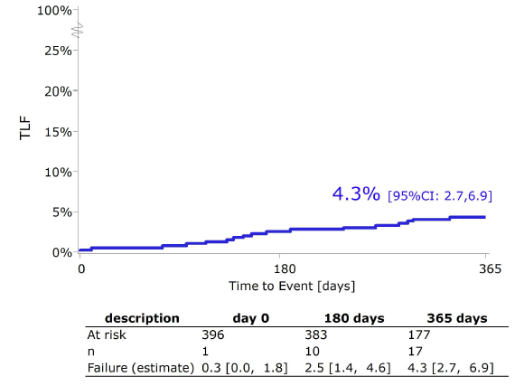
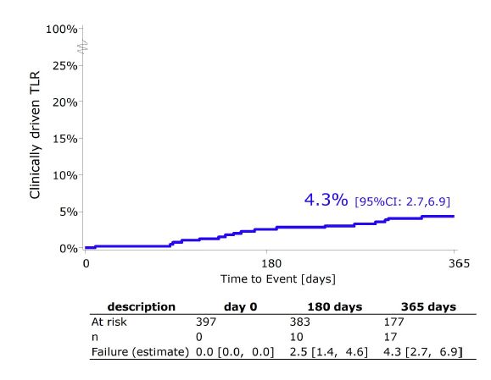
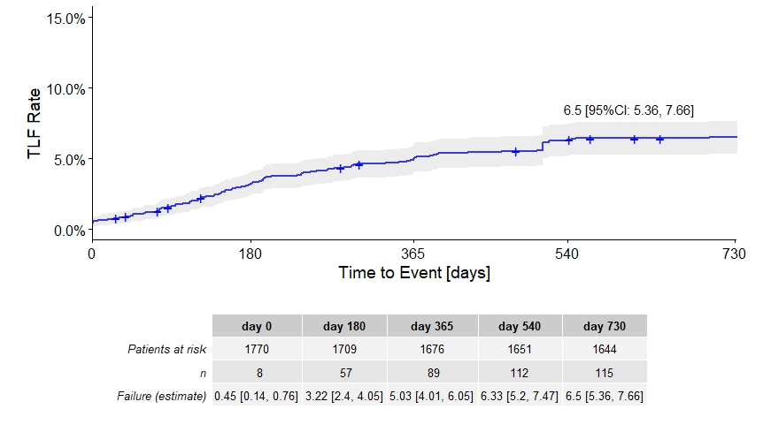
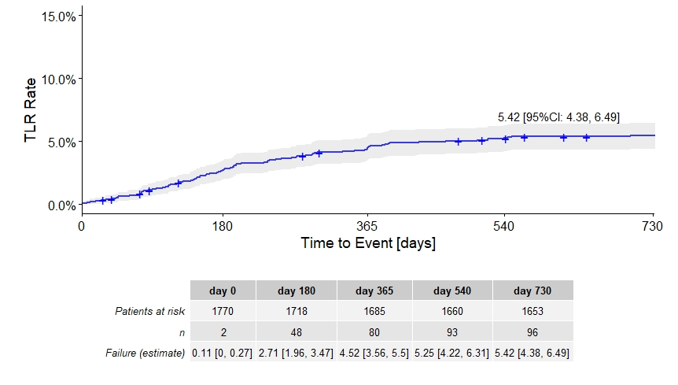
N = 400
N = 1770 (number of complete enrolled patients)
Verheye S et al., Safety and performance of a resorbable magnesium scaffold under real-world conditions: 12-month outcomes of the first 400 patients enrolled in the BIOSOLVE-IV registry. EuroIntervention 2019; Jaa-513 2019, doi: 10.4244/EIJ-D-18-01058
Question: In the 12-month outcomes of the first 400 patients enrolled – Kaplan-Meier estimates: How does sharp dop of patients at risk from 6 month to 12 month explainable? → Death of patients? early leaving of study?

