Slide 1


Prediction of Outcome for Angioplasty Surgery Patients
Pachl, Elisabeth 23rd July 2020
Notes:
In cooperation with Biotronik (one of the world's leading manufacturers of cardiovascular medical technology )

Slide 2
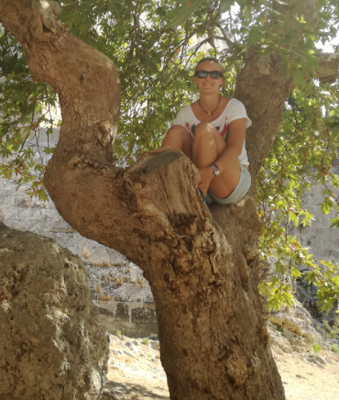
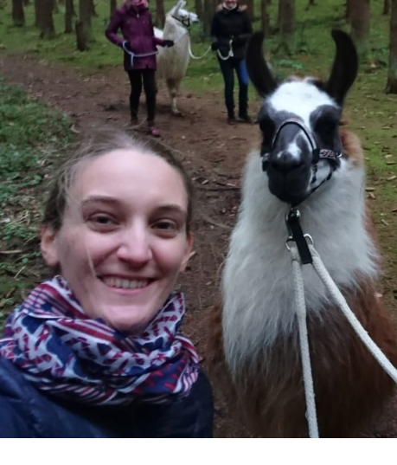
My life
1996, Munich
2015, High School
2018, BSc Bioinformatics
2020, MSc Bioinformatics
2021, Surprise?
Notes:
I was born and raised here in Munich. I studied bioinformatics in both the Bachelor and the Master. I’ll be finish at the end of the year and let’s see what comes next.
If I‘m not in front of a screen, i like all different kind of outdoor activities like go hiking with lamas. It‘s very relaxing.

Slide 3
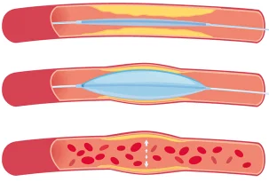
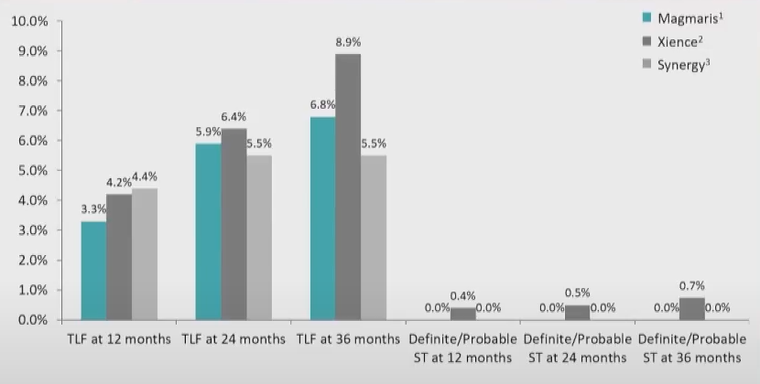
Background - Motivation
Risks of stent implantation:
Stent thrombosis
Restenosis
Target Lesion Failure (TLF)
“4th generation“ stents:
Bioresorbable Stents (e.g. Biotronik‘s Magmaris)
Notes:
To come back to my project some background information: Angioplasty is needed when the hearts arteries are narrowed. Stents are placed in the blocked area and left there to keep the artery open. With stent implantation come a few risks: Stent thrombosis, Restenosis and TLF (a summary term for different types of adverse outcomes associated with an implanted stent with fatal consequences, for example myocardial infarction or cardiac death).
Bioresorbable stents are the 4th generation stents (for example Biotronik’s Magmaris). They fully support the artery during healing, and then resorb from the body when they are no longer needed. In theory this should overcome some of the risks. But in practice for example the TLF rate is overall the same for Magmaris in comparison to two “older” stents. So far, doctors have no idea what exactly triggers TLF. Individual risk assessment for each patient regarding for example TLF before stent implantation helps physicians to make appropriate actions earlier to reduce the number and consequences of adverse outcome. Here I hope to be able to make my contribution and come up with an algorithm that can be used for this kind of risk assessment.
If heart’s arteries become blocked by plaque, a blood clot can suddenly form and completely block the blood flow, leading to a heart attack.
DES’s:
Stent coated antiproliferative drug → leading to a significant reduction of restenosis rate. They can’t overcome the issue of late (>30 days) and very late (>12 month) stent thrombosis
#Limitations:
thrombosis: acute thrombotic occlusion of an artery within an implanted stent which occurs suddenly → potentially life-threatening event
Restenosis: Re-narrowing of the vessel
TLF = composite of different adverse outcomes(e.g. cardiac death, Myocardial Infarction, CABG)

Slide 4
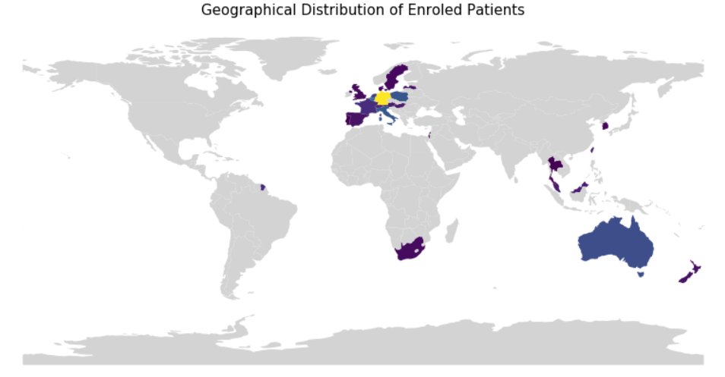
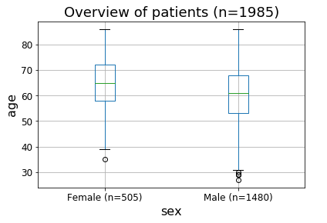
Data and Cohort
Study Start
Study Completed
2016
2020
2025
Enrolment Finished
(~2000 patients)
Sex
Age
Medical History
Medication
Risk Factors
Concomitant Medication
Adverse Event Reporting
Device Deficiencies
Enrolment
Procedure
Discharge
6 M FUP
12 M FUP
Annually
Procedural Information
Adverse Event Reporting
Device Deficiencies
Follow-Up Assessment
Adverse Event Reporting
Device Deficiencies
input features
Derive Label
Notes:
We are working with patient data from Biotroniks BIOSOLVE IV study. The study started with the first enrolment of patients in 2016, by the end of the year approx. 2000 patients will be enrolled. In 2025 the results will be complete due to 5 year follow-up for each patient. The study aims to investigate the clinical performance and long-term safety of Magmaris in a real world setting with patients from all over the world. Patients can be any gender and age.
Study Design: After patients enrolment some baseline information are reported like age, sex, medical history. Few days before procedure the patient comes to the hospital for some blood tests. The procedure itself is documented very closley. After discharge the patient comes back after 6 and 12 month and then annullay up to 5 years. Between follow-up assessments any happend adverse event is repoted. From that we can derive our labels. There are different angles to look at it.

Slide 5
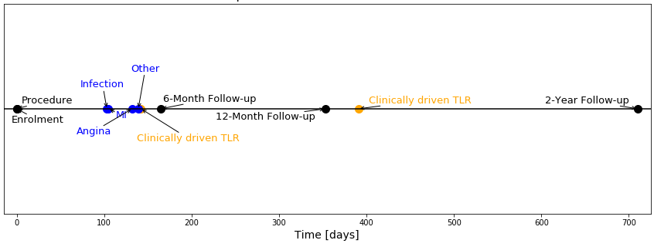


Labels and “Point-of-View”
How to find patients with risk for TLF?
label matrix
time to event
TLF
TLF
TLF causing events
Supervised Binary Classification
Thalassemia Project (Theresa)
Problem: Imbalanced classes (1:15)
Time-to-Event Analysis
→ FlatIron Project (Hugo)
Notes:
Here we can see a example time line for a patient having a TLF causing event (in orange). Blue are other reported adverse events. I try to address the question of how to find patients with high risk for TLF? For that i derive a label matrix consisting of the different TLF causing events (reminder: TLF is just a summary term) and TLF itself. The value of the label is the time to even after procedure. In the example above: 150 days. We can encode from that a classical fully supervised binary classification problem and use the knowledge the team gained from Theresas thalassemia project with the problem to solve of imbalanced classes with a ratio of 1:15 or use the time itself for a time-to-event analysis and use the expertise from Flatiron project from Hugo.

Slide 6
Background - Motivation
Risks of stent implantation:
Stent thrombosis
Restenosis
Target Lesion Failure (TLF)
“4th generation“ stents:
Bioresorbable Stents (e.g. Biotronik‘s Magmaris)
Region | Implanted Stents/ 100.000 population
Europe | 191
Germany | 624
Notes:
Some background information: Angioplasty tries to open blocked heart arteries and to restore the normal blood flow. Stents may be placed in this blocked area and left there to help keep the artery open. With stent implantantion come a few risks: Stent thrombosis, Restenosis and TLF (a summary term for different types of adverse outcomes associated with a stent). This will be the main focus of my project.
There are different stent technologies on the market, for the example the 4th generation stents, so called “bioresorbable stents”. One example is Biotronik’s Magmaris. Bioresorbable stents fully support the vessel during the critical period of vessel healing, and then resorb from the body when it is no longer needed. In theory this should overcome the issues with stent thrombosis and restenosis. But in practice, there are not the answer to everything.
With the increasing number of implanted stents, the number of patients suffering from different adverse outcomes due to angioplasty also increases. The 4th generation stents are not the answer to everything. For example: The TLF rate of Magmaris (as example of a BRS) in comparison to two non-BRS stents is not so much lower. TLF rate overall is estimated to be approximately 6%. In Germany 624 stents per 100.000 population are implanted per year. This corresponds to around 38 patients who suffer from a TLF event every year, which often has fatal consequences. Doctors have no idea what exactly triggers TLF in connection with implanted stents. The big goal is to lower the TLF rate at Magmaris. For this, a risk assessment should be made possible individually for each patient before the implantation. Here we hope to be able to make our contribution.
If heart’s arteries become blocked by plaque, a blood clot can suddenly form and completely block the blood flow, leading to a heart attack.
DES’s:
Stent coated antiproliferative drug → leading to a significant reduction of restenosis rate. They can’t overcome the issue of late (>30 days) and very late (>12 month) stent thrombosis
#Limitations:
thrombosis: acute thrombotic occlusion of an artery within an implanted stent which occurs suddenly → potentially life-threatening event
Restenosis: Re-narrowing of the vessel
TLF = composite of different adverse outcomes(e.g. cardiac death, Myocardial Infarction, CABG)

Slide 7
Dataset
> 150 features
Label
Patient 1
…
Patient 1985
Baseline Information
~ 55 features
Procedural Information
~ 100 features
TLF
Supervised clustering algorithm
Input 1
Input 2

Slide 8
Study Question + Clinical Impact
How to find patients with high risk for TLF?
Baseline
Baseline + Procedural Information
TLF
TLF
Find better fitting therapy
Make appropiate actions earlier
→ reduce number of adverse outcomes (e.g. TLF)
Supervised classification methods and “time to event” prediction (Survival Analysis)

