Slide 1


Prediction of Outcome for Angioplasty Surgery Patients
Pachl, Elisabeth 23 July 2020
Ahmidi Lab
Notes:
Introduce myself,
Talk short about project:
- In cooperation with Biotronik (one of the world's leading manufacturers of cardiovascular medical technology (e.g. first German pacemaker, first implantable defibriliators, developed today's “gold standard” stent in the treatment for CAD))

Slide 2
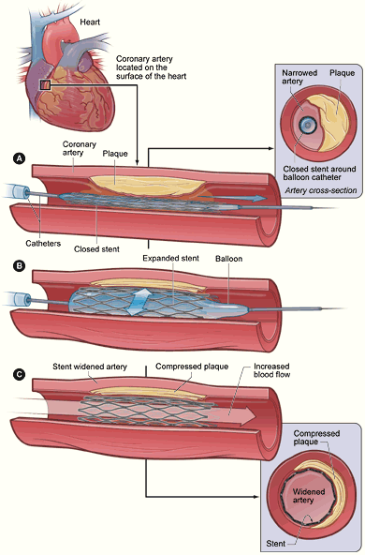
Medical Background - Angioplasty
Limitations and risks of angioplasty:
Bleeding/Infected insertion site
Stent thrombosis
Restenosis
Target Lesion Failure (TLF)
“Gold Standard“- Stents: Drug-Eluting Stents
“4th Generation“-Stents: Bioresorbable Stents (e.g. Biotronik‘s Magmaris)
Notes:
Your heart’s arteries can become blocked or narrowed from a buildup of cholesterol, cells or other substances (plaque). This can reduce blood flow to your heart and cause chest discomfort. Sometimes a blood clot can suddenly form or get worse and completely block blood flow, leading to a heart attack.
Angioplasty opens blocked arteries and restores normal blood flow to your heart muscle by inflating the baloon catheter. A stent may then be placed in this blocked area along with the balloon catheter. It expands when the balloon is inflated. The stent is left there to help keep the artery open.
Limitations:
thrombosis: acute thrombotic occlusion of an artery within an implanted stent which occurs suddenly → sudden circulatory disorder and is therefore a potentially life-threatening event
Restenosis: Re-narrowing of the vessel (procedure without success)
TLF = composite of cardiac death, target vessel Myocardial Infarction, CABG and clinically driven Target Lesion Revascularization
DES’s:
Stent coated antiproliferative drug → leading to a significant reduction of restenosis rate. They can’t overcome the issue of late (>30 days) and very late (>12 month) stent thrombosis
BRS:
Studies have shown that the most critical period of vessel healing is largely complete by approximately three to nine month. Therefore, the goal of a bioresorbable or “temporary” stent is to fully support the vessel during this critical period, and then resorb from the body when it is no longer needed.

Slide 3
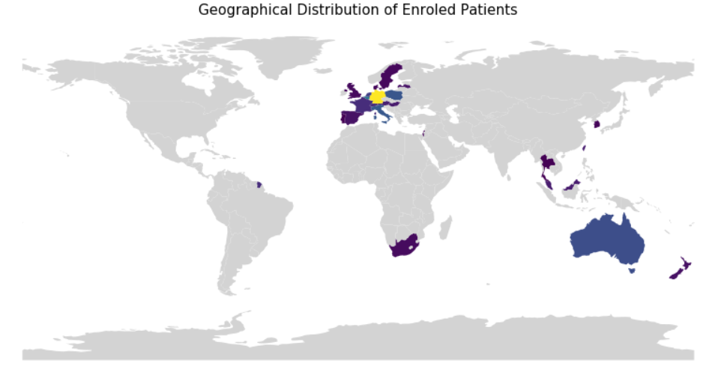
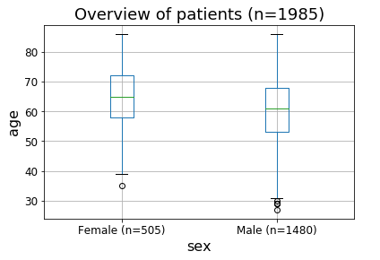
Data and Cohort
Study Start
Study Completed
2016
2020
2025
Enrolment Finished
Concomitant Medication
Adverse Event Reporting
Device Deficiencies
Enrolment
Medical History
Medication
Risk Factors
Start
Procedure
Discharge
6 M FUP
12 M FUP
Annually
Procedural Information
Adverse Event Reporting
Device Deficiencies
Follow up assessments
Adverse Event Reporting
Device Deficiencies

Slide 4


Dataset
> 150 features
Label
Patient 1
…
Patient 1985
Baseline Information
~ 55 features
Procedural Information
~ 100 features
TLF
Supervised clustering algorithm
Input 1
Input 2
Notes:
We are working with patient data from Biotroniks BIOSOLVE IV study. The third study regarding Biotroniks bioresorbable stent Magmaris. CE certified since June 2016, but not widley used at the moment because of negative results of an BRS from another company → uncertainity regarding safety and peformance of BRS in general. Phyisians could use Magmaris, but there is a recommendation not to do it.
Biosolve IV:
prospective, single-arm, multi-centric, open label registry
Study started with the first enrolment of patients in 2016, by the end of the year ~2000 patients will be enrolled (goal reached nearly), 5-year follow-up for each patient -> in 2025 study finished
Aims to investigate the clinical performance and long-term safety of Magmaris in a real world setting with patients having symptomatic coronary artery disease and individual de novo native coronary artery lesions.
The study is open for male and female subjects which are at least 18 years old (mainly older adults enrolled, female (~1/3) mean-age = 65, male ~ 2/3, mean-age ~ 61). 1985 enrolled by now, Patients from all over the world.

Slide 5
Study Question + Clinical Impact
Early markers in the trajectory of the patient that leads to TLF?
New Input 1 (Baseline)
New Input 2
(Baseline + Procedural Information)
TLF
TLF
Find better fitting therapy
Make appropiate actions earlier
→ redurce number of adverse outcomes (e.g. TLF)

Slide 6
Future Work
So far done:
Define Problem
Define Outcome
Data Cleaning
Next steps:
Different clustering appraoches on baseline data
Find metric for informativ validation
TODO: FIND MORE PRECISE FORMULATION

