Slide 1
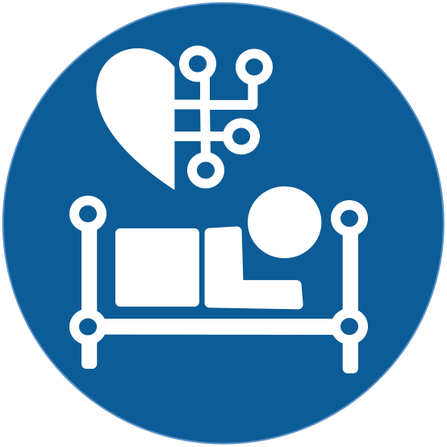

Prediction of Outcome for Angioplasty Surgery Patients
Pachl, Elisabeth 23 July 2020
Ahmidi Lab
Notes:
Introduce myself,
Talk short about project:
- In cooperation with Biotronik (one of the world's leading manufacturers of cardiovascular medical technology (e.g. first German pacemaker, first implantable defibriliators, developed today's “gold standard” stent in the treatment for CAD))

Slide 2
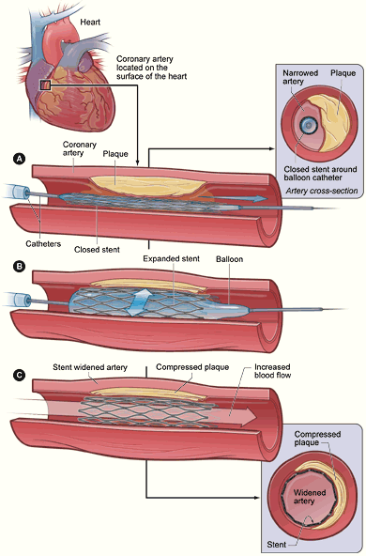
Medical Background - Angioplasty
Limitations and risks of angioplasty:
Bleeding/Infected insertion site
Stent thrombosis
Restenosis
Target Lesion Failure (TLF)
“Gold Standard“- Stents: Drug-Eluting Stents
“4th Generation“-Stents: Bioresorbable Stents (e.g. Biotronik‘s Magmaris)
Notes:
Your heart’s arteries can become blocked or narrowed from a buildup of cholesterol, cells or other substances (plaque). This can reduce blood flow to your heart and cause chest discomfort. Sometimes a blood clot can suddenly form or get worse and completely block blood flow, leading to a heart attack.
Angioplasty opens blocked arteries and restores normal blood flow to your heart muscle by inflating the baloon catheter. A stent may then be placed in this blocked area along with the balloon catheter. It expands when the balloon is inflated. The stent is left there to help keep the artery open.
Limitations:
thrombosis: acute thrombotic occlusion of an artery within an implanted stent which occurs suddenly → sudden circulatory disorder and is therefore a potentially life-threatening event
Restenosis: Re-narrowing of the vessel (procedure without success)
TLF = composite of cardiac death, target vessel Myocardial Infarction, CABG and clinically driven Target Lesion Revascularization
DES’s:
Stent coated antiproliferative drug → leading to a significant reduction of restenosis rate. They can’t overcome the issue of late (>30 days) and very late (>12 month) stent thrombosis
BRS:
Studies have shown that the most critical period of vessel healing is largely complete by approximately three to nine month. Therefore, the goal of a bioresorbable or “temporary” stent is to fully support the vessel during this critical period, and then resorb from the body when it is no longer needed.

Slide 3
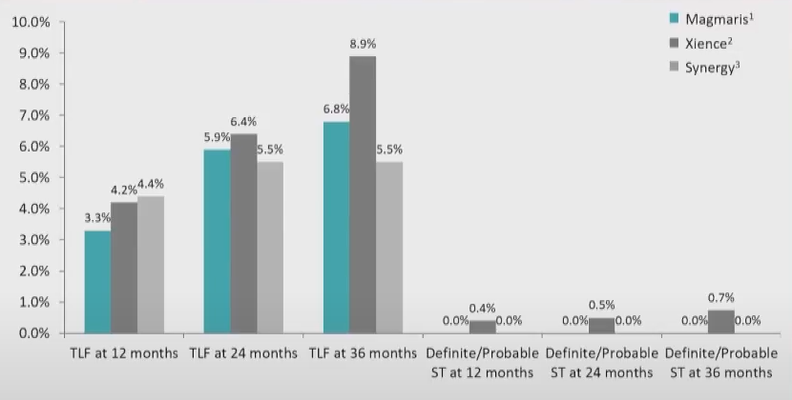
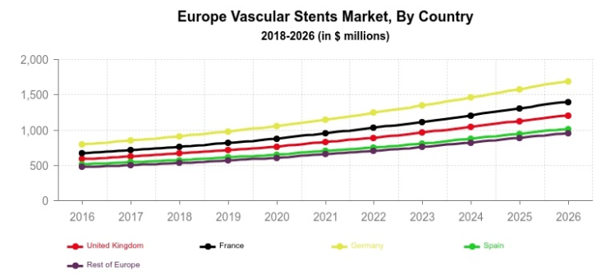
Region | Implanted Stents/100.000 population
Europe | 191
Germany | 624
Notes:
There is an increased number of heart diseases among the people, and to treat them surgeons prefer minimally invasive procedures rather than open heart surgeries as they provide improved life quality and less pain. This has propelled the demand for vascular stents in the European region. The types of vascular stents provided by the regulatory agencies in the region are drug-eluting and bioabsorbable stents. This is proliferating the availability of these stents and is also increasing their sales in the region.
As the number of patients with implanted stents increases, the number of patients suffering from different adverse outcomes due to angioplasty. There is no stent technology/product in the field at the moment lowering all of the risks. For example TLF rate of Magmaris, Xience and Snyergy is in the same range as well as scaffold thrombosis. In Europe per year ca 191 stents implantet per 100.000 population, in Germany the number with 624 is 3.3 times higher. TLF rate is estimated to be approximately 6% (average of all conventional stents from different clinical studies). In Germany, this corresponds to around 38 patients who suffer from a TLF event every year, which often has fatal consequences. Doctors have no idea what exactly triggers TLF in connection with implanted stents. The big goal is to lower the TLF rate at Magmaris. For this, a risk assessment should be made possible individually for each patient before the implantation. Here we hope to be able to make our contribution.

Slide 4
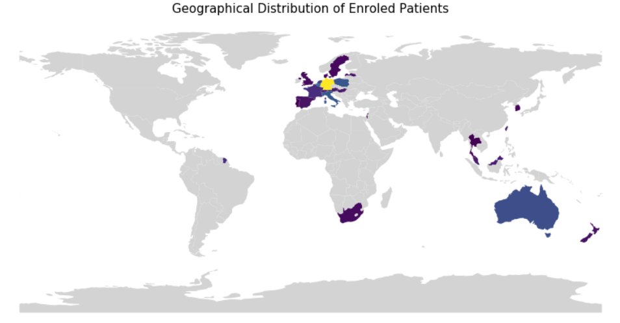
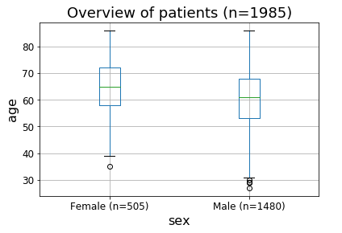
Data and Cohort
Study Start
Study Completed
2016
2020
2025
Enrolment Finished
(~2000 patients)
Concomitant Medication
Adverse Event Reporting
Device Deficiencies
Enrolment
Medical History
Medication
Risk Factors
Start
Procedure
Discharge
6 M FUP
12 M FUP
Annually
Procedural Information
Adverse Event Reporting
Device Deficiencies
Follow-Up Assessment
Adverse Event Reporting
Device Deficiencies
input features
Derive Label
Notes:
We are working with patient data from Biotroniks BIOSOLVE IV study. The third study regarding Biotroniks bioresorbable stent Magmaris. CE certified since June 2016, but not widley used at the moment because of negative results of an BRS from another company → uncertainity regarding safety and peformance of BRS in general. Phyisians could use Magmaris, but there is a recommendation not to do it.
Biosolve IV:
prospective, single-arm, multi-centric, open label registry
Study started with the first enrolment of patients in 2016, by the end of the year ~2000 patients will be enrolled (goal reached nearly), 5-year follow-up for each patient -> in 2025 study finished
Aims to investigate the clinical performance and long-term safety of Magmaris in a real world setting with patients having symptomatic coronary artery disease and individual de novo native coronary artery lesions.
The study is open for male and female subjects which are at least 18 years old (mainly older adults enrolled, female (~1/3) mean-age = 65, male ~ 2/3, mean-age ~ 61). 1985 enrolled by now, Patients from all over the world.
Study Design:
Patient is enroled and before the procedure, some baseline information are given like Medical History, Risk Facorts (e.g. Smoking Habit).
Procedure is documented very closely (duration, given medication, every advers event is reported as well as if any device deficiens are happend)
For each follow-up the same things are reported → issues with device or other adverse events

Slide 5


Dataset
> 150 features
Label
Patient 1
…
Patient 1985
Baseline Information
~ 55 features
Procedural Information
~ 100 features
TLF
Supervised clustering algorithm
Input 1
Input 2

Slide 6
Study Question + Clinical Impact
How to find patients with high risk for TLF?
Baseline
Baseline + Procedural Information
TLF
TLF
Find better fitting therapy
Make appropiate actions earlier
→ redurce number of adverse outcomes (e.g. TLF)
Supervised classification methods and “time to event” prediction (Survival Analysis)

Slide 7
Future Work
Supervised Classification
(main focus)
Time-to-Event Analysis
Feature Selection
Feature Scaling
MinMaxScaler
RobustScaler
Quantile Transformer
Classifiers + Hyperparameter Optimization
K-Nearest Neighbors
Random Forest
Support Vector Machine
Gaussian Process
Imbalanced Data
Under-/ Oversampling
Generating Synthetic Data
Explore Data
Nelson-Aalen Cumulative Hazard estimate as failure rate
KM with different values → distinctions on failure in the patients
Evaluation Metrics
C-index
Brier Score
Models
Cox Model

