Slide 1


Prediction of Outcome for Angioplasty Surgery Patients
Pachl, Elisabeth 10th Sep 2020
Notes:
In cooperation with Biotronik (one of the world's leading manufacturers of cardiovascular medical technology )

Slide 2
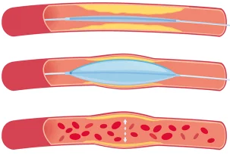
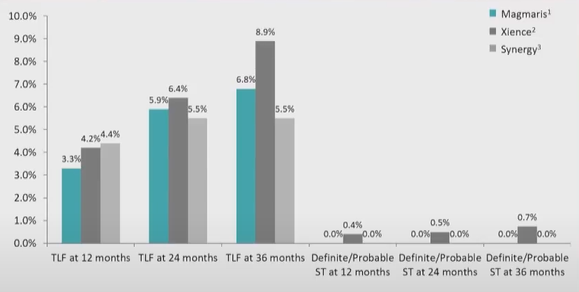
Background - Motivation
Risks of stent implantation:
Stent thrombosis
Restenosis
Target Lesion Failure (TLF)
“4th generation“ stents:
Bioresorbable Stents (e.g. Biotronik‘s Magmaris)
Notes:
Angioplasty is needed when the hearts arteries are narrowed. Stents are placed in the blocked area and left there to keep the artery open. With stent implantation come a few risks: Stent thrombosis, Restenosis and TLF (a summary term for different types of adverse outcomes associated with an implanted stent with fatal consequences, for example myocardial infarction or cardiac death).
Bioresorbable stents are the 4th generation stents (for example Biotronik’s Magmaris). They fully support the artery during healing, and then resorb from the body when they are no longer needed. In theory this should overcome some of the risks. But in practice for example the TLF rate is overall the same for Magmaris in comparison to two “older” stents. So far, doctors have no idea what exactly triggers TLF. Individual risk assessment for each patient regarding for example TLF before stent implantation helps physicians to make appropriate actions earlier to reduce the number and consequences of adverse outcome.

Slide 3
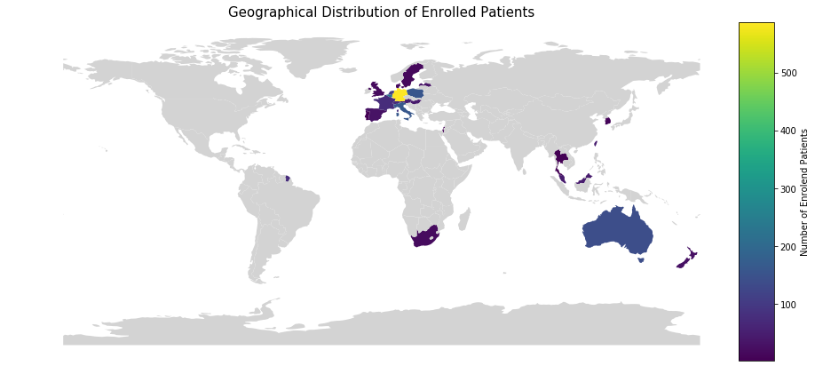
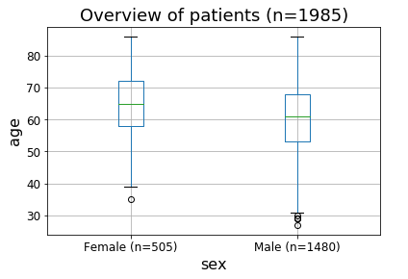
Data and Cohort
Study Start
Study Completed
2016
2020
2025
Enrolment Finished
(~2000 patients)
Sex
Age
Medical History
Medication
Risk Factors
Concomitant Medication
Adverse Event Reporting
Device Deficiencies
Enrolment
Procedure
Discharge
6 M FUP
12 M FUP
Annually
Procedural Information
Adverse Event Reporting
Device Deficiencies
Follow-Up Assessment
Adverse Event Reporting
Device Deficiencies
input features
Derive Label
Notes:
We are working with patient data from Biotroniks BIOSOLVE IV study. The study started with the first enrolment of patients in 2016, by the end of the year approx. 2000 patients will be enrolled. In 2025 the results will be complete due to 5 year follow-up for each patient. The study aims to investigate the clinical performance and long-term safety of Magmaris in a real world setting with patients from all over the world. Patients can be any gender and age.
Study Design: After patients enrolment some baseline information are reported like age, sex, medical history. Few days before procedure the patient comes to the hospital for some blood tests. The procedure itself is documented very closley. After discharge the patient comes back after 6 and 12 month and then annullay up to 5 years. Between follow-up assessments any happend adverse event is repoted. From that we can derive our labels. There are different angles to look at it.

Slide 4
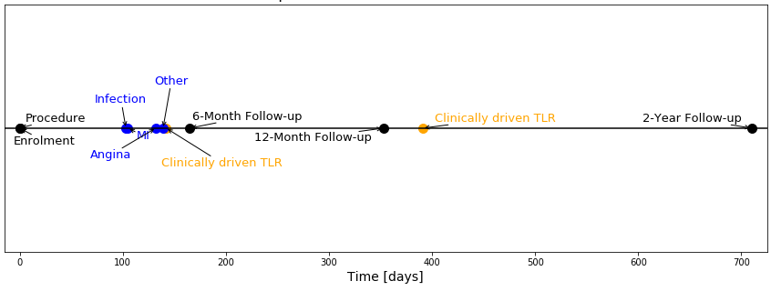


Labels and “Point-of-View”
How to find patients with risk for TLF?
label matrix
time to event
TLF
TLF
TLF causing events
Fully Supervised Binary Classification
Time-to-Event Analysis
Notes:
Here we can see a example time line for a patient having a TLF causing event (in orange). Blue are other reported adverse events. I try to address the question of how to find patients with high risk for TLF? For that i derive a label matrix consisting of the different TLF causing events (reminder: TLF is just a summary term) and TLF itself. The value of the label is the time to evet after procedure. In the example above: 150 days. We can encode from that a classical fully supervised binary classification problem use the time itself for a time-to-event analysis.

Slide 5
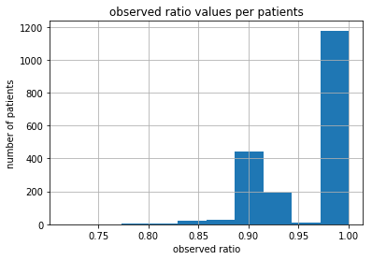
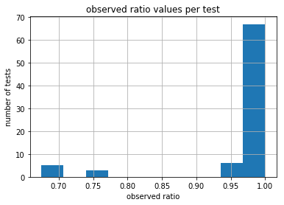
Population Characteristics
Patient characteristics
 |  | TLF (n=123) | no TLF (n=1761) | total (n=1884) | pVal | missigness [%]
Age (years) |  | 59.92± 10.92 | 61.8±10.44 | 61.68± 10.48 | 0.054 | 0
Male |  | 99 (80%) | 1296 (74%) | 1395 (74%) | 0.092 | 0
Smoking |  | 73 (60%) | 1049 (60%) | 1122 (60%) | 0.365 | 0.4
Diabetes |  | 28 (23%) | 372 (21%) | 400 (21%) | 0.893 | 0
Ischemic status pre-procedure | STEMI | 0 (0%) | 4 (0.2%) | 4 (0.2%) | 0.017 | 0.1
 | NSTEMI | 34 (27.6%) | 309 (17.5%) | 343 (18%)
Lesion Characteristics
Moderate/Severe Calcification |  | 7 (5.7%) | 130 (7.3%) | 137 (7.3%( | 0.88 | 0.1
Lesion length [mm] |  | 15.2± 5.1 | 14.8±3.9 | 14.8±4 | 0.189 | 0.1
Reference vessel diameter [mm] |  | 3.2±0.3 | 3.2±0.3 | 3.2±0.3 | 0.449 | 0.2
Stenosis pre-procedure in % |  | 83.5± 10.6 | 82.1± 10.7 | 82.2± 10.7 | 0.168 | 0.05
Device Details
Total magmaris scaffold length [mm] |  | 21.2± 7.1 | 20±4.9 | 20±5 | 0.011 | 1.6
Magmaris scaffold diameter [mm] |  | 3.25± 0.25 | 3.25± 0.25 | 3.25± 0.25 | 0.4322 | 1.6
Notes:
The first thing after finisishing data pre-processing was looking at descriptive stats and distribution of each feature. Categorical features are presented as absolute numbers and percentages, whereas continous variables as mean ± standard deviation. The shown pValue is from univariate analysis using chi-square test, point biserial correlation test and Z-test. With this i wanted to find evidence of what features are more important. The presented features are just a short excerpt from all 75 features. These are predictors for TLF suggested in literature. Only two of them have a significant pValue – ischemic status pre-procedure and total stent length. All other features show quite high pValue, which gives reason to believe that
the data contains weak to no signals.
The table and the missigness plots show the proportion of missingness of each feature and sample. It is not really high, so resolving missigness is not the main issue here. Speaking of challenges. The rate of TLF is about 5%, leading to an imbalanced data set with a ratio of 1:15. The question is how to resolve imbalance in context of classification properly.

Slide 6
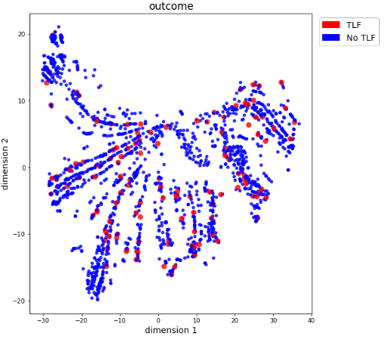
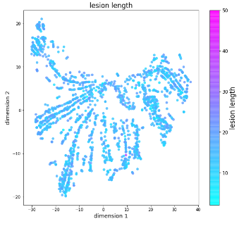
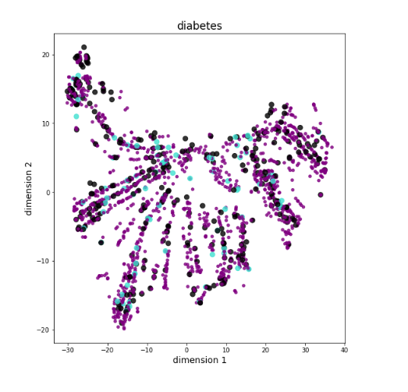

tSNE
Notes:
I used tSNE to visualize the data. It was normalized before plotting, because tSNE is sensitive to outliers and noisy data. The goal of applying tSNE was to visualise the data with all it‘s dimensions to see maybe first distinguishable cluster in the data space and to find sub-cohorts that are less confusing than the complete cohort. Plots are coloured based on label and other features obtained from literature (often listed as predictors for TLF) like diabetes or the total lesion length. Features that were used for colouring are not used in dimensionality reduction. Based on the plots, I can conclude that dimensionality reduction cannot pick up a signal for POS/NEG case distinction (visually optimization is fair enough here) and that none of the presented predictors in literature seems to be an important feature, since dimensionality reduction can‘t pick any signal for these too.
There are a few limitations to tSNE. It relies on visual evaluation, since no objective measurement is done and even so only tendencies can be observed. Many more hyperparameters are available for optimization, but due to not promising results not further investigated.

Slide 7
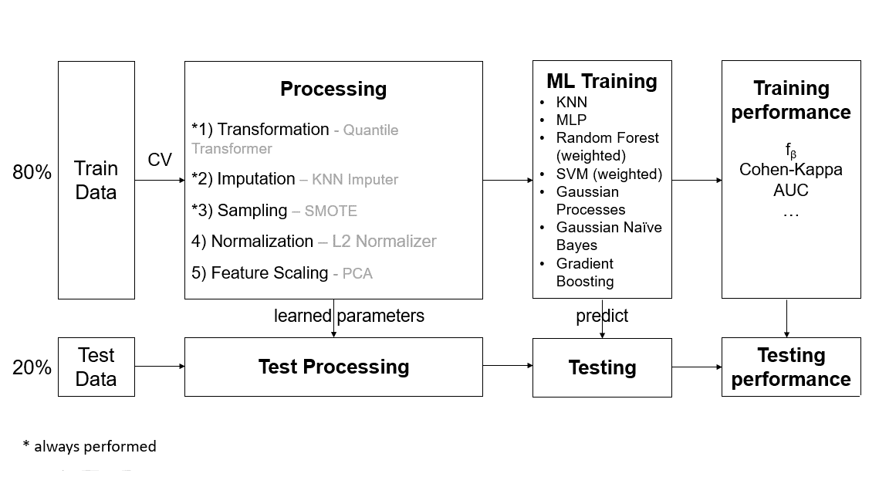
Supervised Classification Pipeline
Notes:
This pipeline architecture should be familiar. In the first place I tried as many different combinations as possible as I don’t know what would work on that particular dataset. I adapted the pipeline from Alireza to fit more to my data. I included the SMOTE algorithm after imputation to deal with imbalance and changed training performance to f1 score or cohen kappa score as refit score in hyperparamter tuning, because of its robustness regarding imbalance. Stratification of data into 80% traingng and 20% test set was done by label. Training was based on a 5-fold cross validation. Training set went through processing. Transformation, imputation and upsamling of minor class using SMOTE was mandatory. Normalization and feature scaling were optional. In the second step different classifiers were trained alongside with their specific hyperparameters using RandomSearch based on a wide parameter grid. Model evaluation was done with the hold-out test set.

Slide 8
Results (1st round of selection with f1 score)
Pipeline | Train Score (f1) | Validation Score (f1) | Test Score (f1)
quantile_trans|KNN_imp|smote|l2_norm|no_feature_selector|KNN | 0.1642±0.002 | 0.1404±0.0252 | 0.1315±0
MLP
quantile_trans|KNN_imp|smote|no_normalizer|no_feature_selector|RF | 0.2931±0.0182 | 0.1619±0.0316 | 0.1132±0
quantile_trans|KNN_imp|smote|l2_normalizer|PCA|SVM | 0.1714±0.008 | 0.1546±0.0247 | 0.1441±0
quantile_trans|KNN_imp|smote|l2_normalizer|no_feature_selector|GP | 0.2759±0.0103 | 0.174±0.0509 | 0.1154±0
quantile_trans|KNN_imp|smote|l2_normalizer|no_feature_selector|GNB | 0.1924±0.0123 | 0.1428±0.0327 | 0.0938±0
quantile_transf|KNN_imp|smote|no_normalizer|no_feature_selector|GBM | 0.2901±0.0258 | 0.1811±0.0388 | 0.0968±0
quantile_transf|KNN_imp|smote|no_normalizer|no_feature_selector|ERT | 0.2759±0.0196 | 0.1614±0.0443 | 0.101±0
Notes:
These are the results from the latest run of the pipeline. We double checked the correctness of code and the order of processing steps to rule out a bug in the code. The used hyperparameter grid is quite big. The idea behind it was to narrow down the search space by multiple runs with RandomSearch and take the best parameters settings for an exhaustive GridSearch. But this is not possible, since the models seems to overfit/underfit and therefore further analysis regarding hyperparameter tuning and setting is necessary (started with that yesterday). Best pipeline per classifier is not chosen automatically. I chose the one with the smallest ration of train/validation score, because difference between train/test is what gives you a clue regarding overfitting/underfitting phenomena.
Generally speaking, all possible classifiers have very low validation and test scores. It ranges between 13 and 17%, which is almost the worst possible outcome. I tried different amount of input features, for example using just medical history of the patient or baseline + lesion characteristics, but the scores never changed significantly. Another strange behaviour I could observe in my tests in nearly all classifiers was a strange behaviour regarding the influence of an increasing training score on the evaluation score. The trainings score increased, but the validation score stayed the same all the time. With these first results the impression solidifies that data includes randomness at least there is no signal to grasp.
Hyperparameters per pipeline (from latest pipeline run:)
KNN: - `sampling__k_neighbors`: `1`
- `imputer__weights`: `distance`
- `imputer__n_neighbors`: `24`
- `feature_selector__whiten`: `True`
- `classifier__weights`: `uniform`
- `classifier__n_neighbors`: `10`
MLP (Multi Layer Perception):
- `sampling__k_neighbors`: `3`
- `imputer__weights`: `uniform`
- `imputer__n_neighbors`: `36`
- `classifier__hidden_layer_sizes`: `(30, 50)`
- `classifier__epsilon`: `0.01`
- `classifier__alpha`: `1e-07`
- `classifier__activation`: `tanh`
RF:
- `sampling__k_neighbors`: `8`
- `imputer__weights`: `distance`
- `imputer__n_neighbors`: `3`
- `classifier__n_estimators`: `161`
- `classifier__min_samples_leaf`: `91`
- `classifier__max_features`: `log2`
SVM:
- `sampling__k_neighbors`: `8`
- `imputer__weights`: `uniform`
- `imputer__n_neighbors`: `7`
- `classifier__kernel`: `sigmoid`
- `classifier__gamma`: `1`
- `classifier__C`: `1`
GP (Gaussian Processes):
- `sampling__k_neighbors`: `1`
- `imputer__weights`: `uniform`
- `imputer__n_neighbors`: `12`
GNB (Gaussian Naïve Bayes):
- `sampling__k_neighbors`: `7`
- `imputer__weights`: `distance`
- `imputer__n_neighbors`: `3`
- `feature_selector__whiten`: `True`
GBM (Gradient Boosting):

Slide 9
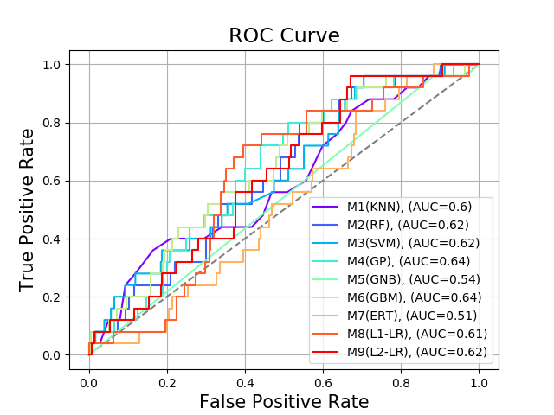
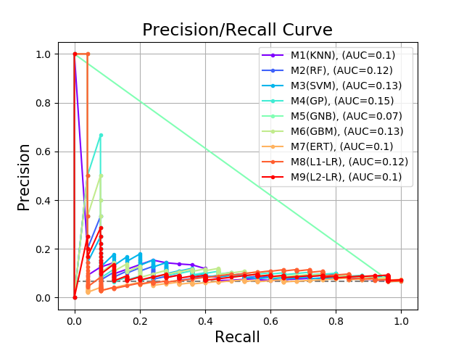
Results (Vizualisation)
Notes:
Short example how evaluation of final chosen pipelines will look like. We see – expected from the low scores – ROC curve near the random line and prec/rec curve just a little better than no skill (= prevalence of disease, in my case TLF = 5%)

Slide 10
F-Test
H0: There is no difference between the classifiation accurancies: pi:H0=p1=p2=⋯=pL
Models | F-Statistic | P-Value
All | 248.88 | <0.0001
Accept H0
no differences in model accurancies
Models can be exchanged at will, statistically seen there will be no difference regarding results.
Notes:
http://rasbt.github.io/mlxtend/user_guide/evaluate/ftest/ """ In the context of evaluating machine learning models, the F-test by George W. Snedecor [1] can be regarded as analogous to Cochran's Q test that can be applied to evaluate multiple classifiers (i.e., whether their accuracies estimated on a test set differ) as described by Looney [2][3]. More formally, assume the task to test the null hypothesis that there is no difference between the classification accuracies [1]: pi:H0=p1=p2=⋯=pL. After computing the F-value, we can then look up the p-value from a F-distribution table for the corresponding degrees of freedom or obtain it computationally from a cumulative F-distribution function. In practice, if we successfully rejected the null hypothesis at a previously chosen significance threshold, we could perform multiple post hoc pair-wise tests -- for example, McNemar tests with a Bonferroni correction -- to determine which pairs have different population proportions
References:
[1] Snedecor, George W. and Cochran, William G. (1989), Statistical Methods, Eighth Edition, Iowa State University Press.
[2] Looney, Stephen W. "A statistical technique for comparing the accuracies of several classifiers." Pattern Recognition Letters 8, no. 1 (1988): 5-9.
[3] Kuncheva, Ludmila I. Combining pattern classifiers: methods and algorithms. John Wiley & Sons, 2004.

Slide 11
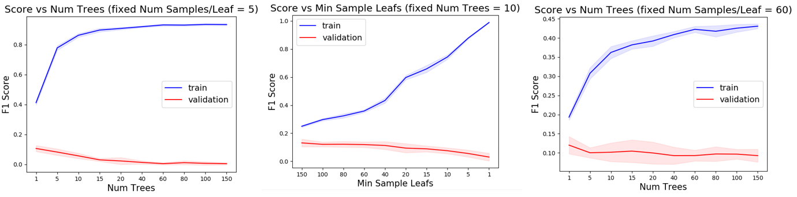
Hyperparameter checking (ongoing process)
Analyse score plots for each classifier, compare to normal healthy train/test score plot
Notes:
To proceed with the project and to be able to present tangible results, I have to be 100% sure about the chosen pipelines/methods. I have to somehow clearifiy which one is the best under the failing ones. This is important so that nobody can argue that I’ve made a mistake in hyperparameter tuning and missed the model fitting to the data.
For that I have to identify for each used classifier the hyperparameters which influences the model complexity and thus controls under / overfitting. Then set one parameter to a fix value to make score graphs for the other variable hyperparameters and decide:
- What is the point where adding more complexity, does not increase train score anymore?
- What is the point where train + validation score start to diverge?
If “unhealthy” behaviour observed, plot can be seen as one more example of randomness of data.
Example with RandomForest: Hyperparameters responsible for model complexity are the number of trees in the forest and the depth of each tree, namely the number of samples required to be at a leaf node. First, I set parameter min_sample_leaf to 5 and plottet the score graph for number of trees in the forest. The number of trees do not seem to play a big role in under/overfitting, but I would choose 10 for the parameter, because as going higher no significant improvement seen. The next step was to set the number of trees to 10, based on previos results, and plot now the score graph for the number of samples needed to be at a leadf node. This parameter seem to play a role in under/overfitting. Show more of a healthy train/test score behaviour. 80 is an optimal value for this parameter. Validate behavoir of num trees with another fixed value of min_sample leafs, shows the same tendency.
In this way I want to set each parameter to a optimal value to be sure to work with the best possible pipeline/method.

Slide 12
Superlearner + confidence layer
Find sub-populations/samples easy to predict with „confidence layer“ as 2nd layer to established pipeline
Decision Matrix M
GT
Pipeline
Predictions of best clf 1 model (M1)
Sample 1
1
Input: patient data, label: TLF
0
Predictions of best clf 2 model (M2)
.
.
.
.
.
.
.
.
.
Predictions of best clf 8 model (M8)
Sample n
M1
M2
M8
Prediction layer
Confidence layer
Notes:
The general cohort seems to be very confusing for classifiers, but there are samples that are predicted correctly, even if the sumber is very low. This could be by chance or they are easier to predict. If so, it is interesting to see what makes the different from other patients with TLF.
To tackle this problem, we intend to add a second layer to already used pipeline – the so called confidence layer. From the originial pipeline 8 models with different classifiers will be derived. Their individual decisions over each sample will be put tohether into a decision matrix M. From that a confidence label Y is gernerated based on majority vote for each sample. Newly generated M + Y are input and label for a second round with the pipeline to see confidence in predictions.

Slide 13

Input
Patient Data
Label: TLF
Decision Matrix M
GT_{TLF}
Y‘_{TLF}
GT_{conf}
Predictions of clf_1 (M1)
Sample 1
1
1
1
TLF_Pipeline
Sample 2
1
0
0
Sample 3
0
1
0
Predictions of clf_2 (M2)
.
.
.
.
.
.
.
.
.
Predictions of clf_9 (M9)
Sample n
1
1
1
M1
M2
M9
M_TLF
Conf_Pipeline
Label: Y_{conf}
M_Conf
Output
Notes:
The general cohort seems to be very confusing for classifiers, but there are samples that are predicted correctly, even if the sumber is very low. This could be by chance or they are easier to predict. If so, it is interesting to see what makes the different from other patients with TLF.
To tackle this problem, we intend to add a second layer to already used pipeline – the so called confidence layer. From the originial pipeline 9 models with different classifiers will be derived. Their individual decisions over each sample will be put tohether into a decision matrix M. From that a confidence label Y is gernerated based on majority vote for each sample. Newly generated M + Y are input and label for a second round with the pipeline to see confidence in predictions.
Y_conf created out of XNOR gate between GT and Y‘ (y_prime) with GT = ground truth (actual label taken from patient data), Y‘ = majority vote of 9 weak classifiers

Slide 14
Architecture at Use
Input
1
0
Y‘_{TLF}
new patient data
.
.
.
0
M1
M2
M9
M_TLF
Q1
Q2
Y_{conf}
predict TLF
Q3
Q4
M_Conf
Exclusion Matrix Q
predict confidence
Notes:
Architecture in use:
A new patient should be tested for high risk of TLF or not. Firstly, the patient features X will be used with the pre-trained M_TLF to generate the second database – the decision matrix M for each weak classifier. Secondly, decision Matrix will be used as input for pre-trained M_conf to predict Y_conf. If the prediction says that new patient has zero confidence than this patient belongs to the noise sample (with confidence of F1 score of M_conf) and can‘t be further analysed by this algorithm. If the patient is signal sample (y_conf prediction = 1), then the patient can be further analysed. If the majority vote (MJ) of all weak classifiers in assigns new patient to class 0, then the confidence that this patient will not get TLF is high. If MJ assignes patient to class 1, then the cofidence that this patient should be closer monitored because of high risk for TLF is high.

Slide 15
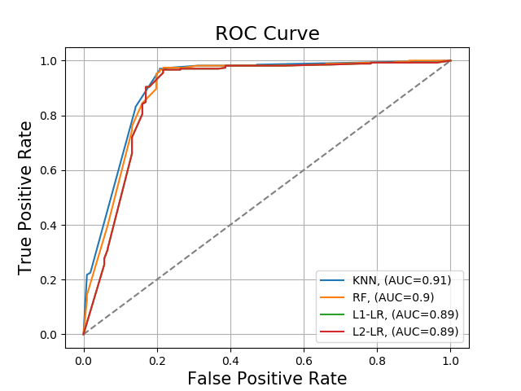
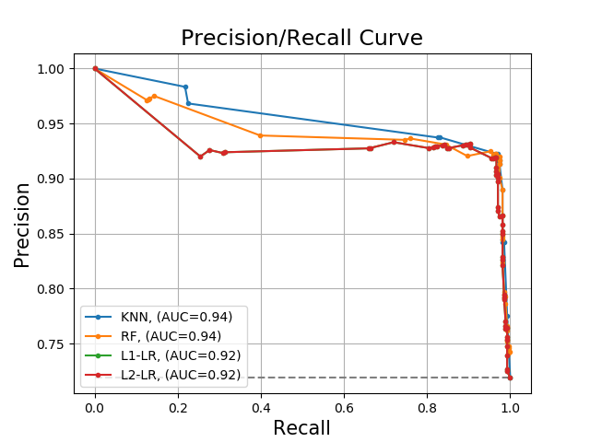
Results (Visualization)
Notes:
Short example how evaluation of final chosen pipelines will look like. We see – expected from the low scores – ROC curve near the random line and prec/rec curve just a little better than no skill (= prevalence of disease, in my case TLF = 5%)

