Slide 1


Prediction of Outcome for Angioplasty Surgery Patients
Pachl, Elisabeth 10th Sep 2020
Notes:
In cooperation with Biotronik (one of the world's leading manufacturers of cardiovascular medical technology )

Slide 2
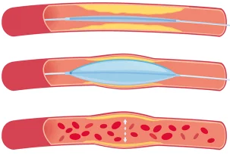
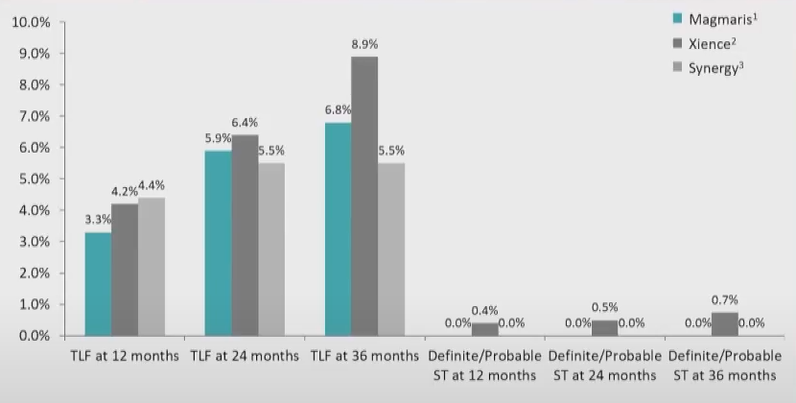
Background - Motivation
Risks of stent implantation:
Stent thrombosis
Restenosis
Target Lesion Failure (TLF)
“4th generation“ stents:
Bioresorbable Stents (e.g. Biotronik‘s Magmaris)
Notes:
Angioplasty is needed when the hearts arteries are narrowed. Stents are placed in the blocked area and left there to keep the artery open. With stent implantation come a few risks: Stent thrombosis, Restenosis and TLF (a summary term for different types of adverse outcomes associated with an implanted stent with fatal consequences, for example myocardial infarction or cardiac death).
Bioresorbable stents are the 4th generation stents (for example Biotronik’s Magmaris). They fully support the artery during healing, and then resorb from the body when they are no longer needed. In theory this should overcome some of the risks. But in practice for example the TLF rate is overall the same for Magmaris in comparison to two “older” stents. So far, doctors have no idea what exactly triggers TLF. Individual risk assessment for each patient regarding for example TLF before stent implantation helps physicians to make appropriate actions earlier to reduce the number and consequences of adverse outcome and to reduce the therapeutic effort for a patient.

Slide 3
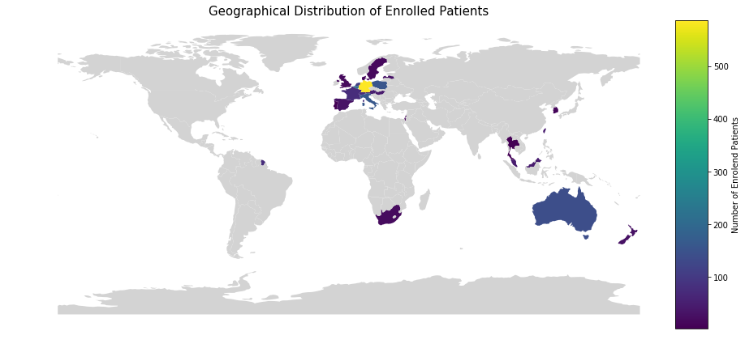
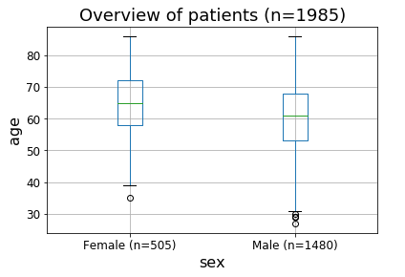

Data and Cohort
Study Start
Study Completed
2016
2020
2025
Enrolment Finished
(~2000 patients)
Sex
Age
Medical History
Medication
Risk Factors
Concomitant Medication
Adverse Event Reporting
Device Deficiencies
Enrolment
Procedure
Discharge
6 M FUP
12 M FUP
Annually
Procedural Information
Adverse Event Reporting
Device Deficiencies
Follow-Up Assessment
Adverse Event Reporting
Device Deficiencies
input features
Derive Label (TLF$∈\{0,1\}$)
Notes:
We are working with patient data from Biotroniks BIOSOLVE IV study. The study started with the first enrolment of patients in 2016, by the end of the year approx. 2000 patients will be enrolled. In 2025 the results will be complete due to 5 year follow-up for each patient. The study aims to investigate the clinical performance and long-term safety of Magmaris in a real world setting with patients from all over the world. The study is open for male and female patients who are at least 18 years old.
Study Design:
Baseline clinical examination data will be collected from allsubjects enrolled for BIOSOLVE-IV. It includes but is not limited to a review of inclusion and exclusion criteria, demographics, physical examination and relevant medical history,previous medication. During procedure, lesion characteristics and actual implantation are documented. Between the end of the procedure and hospital dis-charge, concomitant medication, in accordance with the hospital standard of care, needs to be reported. After the procedure, all enrolled subjects who received the Magmaris scaffold will be followed through hospital discharge, and they will undergo follow-up evaluations at six months, 12 months, and annually thereafter up to five years. All procedural and post-procedural complications and adverse events will be recorded and reported as required. From the follow-up information we derived our label of interest: if a patients developed a TLF-causing event or not. We used a binary label. A TLF-causing event is either CABG, CD, TV-MI or TLR.

Slide 4
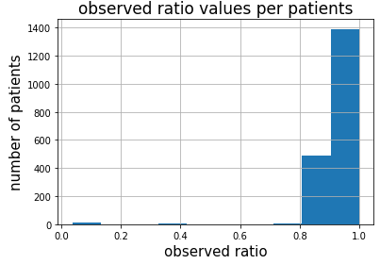

Feature Characteristics
Patient characteristics
 |  | TLF (n=123) | no TLF (n=1761) | total (n=1884) | pVal | missigness [%]
Age (years) |  | 59.92± 10.92 | 61.8±10.44 | 61.68± 10.48 | 0.054 | 0
Male |  | 99 (80%) | 1296 (74%) | 1395 (74%) | 0.092 | 0
Smoking |  | 73 (60%) | 1049 (60%) | 1122 (60%) | 0.365 | 0.4
Diabetes |  | 28 (23%) | 372 (21%) | 400 (21%) | 0.893 | 0
Ischemic status pre-procedure | STEMI | 0 (0%) | 4 (0.2%) | 4 (0.2%) | 0.017 | 0.1
 | NSTEMI | 34 (27.6%) | 309 (17.5%) | 343 (18%)
Lesion Characteristics
Moderate/Severe Calcification |  | 7 (5.7%) | 130 (7.3%) | 137 (7.3%( | 0.88 | 0.1
Lesion length [mm] |  | 15.2± 5.1 | 14.8±3.9 | 14.8±4 | 0.189 | 0.1
Reference vessel diameter [mm] |  | 3.2±0.3 | 3.2±0.3 | 3.2±0.3 | 0.449 | 0.2
Stenosis pre-procedure in % |  | 83.5± 10.6 | 82.1± 10.7 | 82.2± 10.7 | 0.168 | 0.05
Device Details
Total Magmaris scaffold length [mm] |  | 21.2± 7.1 | 20±4.9 | 20±5 | 0.011 | 1.6
Magmaris scaffold diameter [mm] |  | 3.25± 0.25 | 3.25± 0.25 | 3.25± 0.25 | 0.4322 | 1.6
Notes:
We could not use all enrolled patients in our analysis. For some patients not all necessary information was reported leading to a high missingness rate withing these patients. Since we mainly wanted to work with ML algorithms in this project, patients with many missing features are nothing to rely on. Since we could not find any correlation between missing features and the outcome, we assumed that the features are missing at MCAR. Therefore, we have removed all patients with a missingness rate higher than 50% from the cohort. That were 20 patients. None of them presented TLF. In the reduced cohort we had 1884 patients in total. The TLF cases were 123 (which is 6.5%).
We looked at the feature characteristica. The most important once are shown here. The shown pValues are from bivariate analysis using chi-square test for nominal and ordinal features and point biserial correlation for continuous features. We used the bivariate anaylsis to evaluate the incidence of TLF predictors withing the target group of Magmaris. With this i wanted to find evidence of what features are more important. The presented features are just a short excerpt from all 75 features. These are predictors for TLF suggested in literature. Only two of them have a significant pValue – ischemic status pre-procedure and total stent length.
Other risk predictors found in cohort include some patient-related features like the NYHA class of congestive heart failure, the type of the most recent MI (STEMI/NESTEMI) or documented silent ischemia, but also lesion-related features like the vessel location. Some procedural-related features were significant, e.g., the number of used pre-dilatation balloons, the inflation time of the Magmaris, or the total scaffold length. We calculated for all features a correlation coefficient to evaluate the strength of the association between feature and outcome. For all significant features the correlation coefficient was around 0 indicating a weak relationship. Therefore we do not expect outstanding results concerning the prediction of TLF with classification algorithms based on patient data, because these can only work well if there is some predictive power inside the training data.

Slide 5
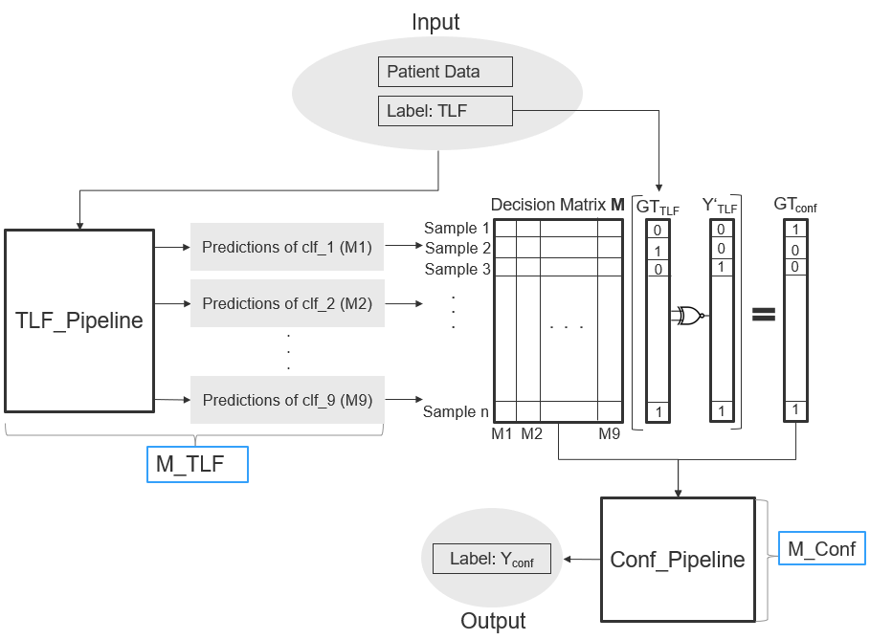
Algorithm‘s Architecture
Notes:
To achieve the goal to predict (1) TLF, based on clinical patient‘s input features and (2) the confidence of TLF predictions, we developed an ML-based algorithm consisting of two classificationlayers: The TLF layer and the confidence layer. With confidence we mean if the ensemble label, based on the decision of several independ classifiers, matches the ground truth. Input for MTLF includes patient data and TLF label. It consists of nine different TLFpipelines. Each TLF pipeline is composed of various data preprocessing steps and aclassifier. We used outer 5-fold cross-validation (CV) to construct the decision matrix M.For each sample in M a consensus TLF label was derived using a majority vote. Ensemble TLF label and the ground truth about TLF, known from patient data, combined into anXNOR gate delivered the new confidence label GTconf. Gtconf and decisions matrix M served as input for Mconf, which predicts the confidence label based on the voting pattern in M.
We used both predicted label - Yconf and Y‘TLF - to categorize patients into sub-groups and calculate TLF risk score for these sub-groups.
This whole algorithm is integrated into an automated pipeline, which many possibilites for changing setup and testing new methods.

Slide 6
Algorithm‘s Architecture
Notes:
For the first part of the project, we focused on the first layer: The TLF pipeline.

Slide 7
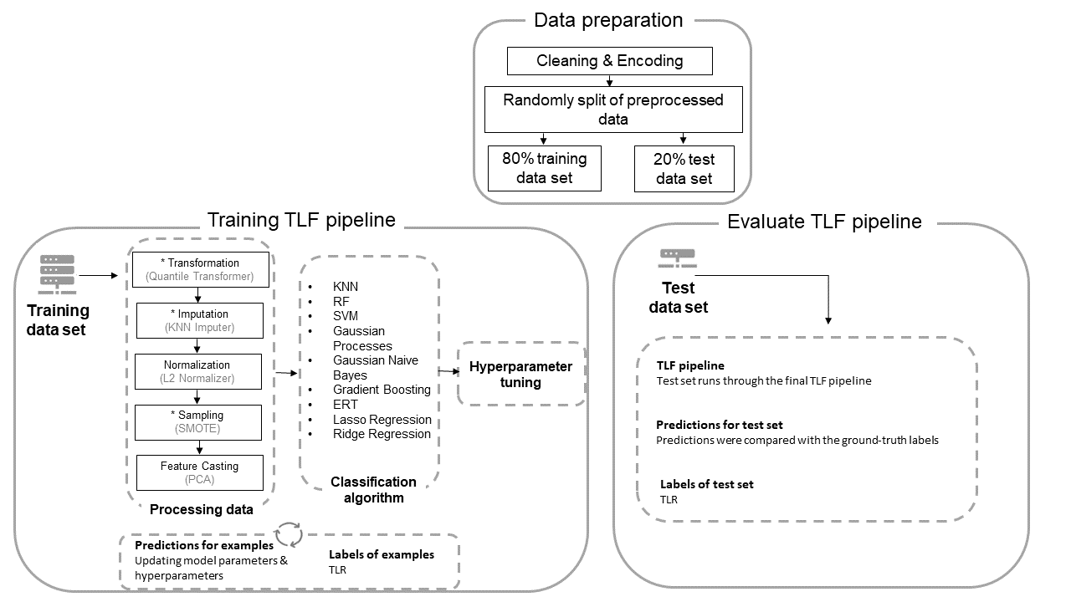
TLF Pipeline Architecture
Notes:
To predict TLF based on patient data, we tried in the first place as many different combinations as possible as we don’t know what would work on that particular dataset. These are the phases we followed to build a TLF pipeline. We randomly divided the complete dataset into 20% training set to train the model, and 80% test set to assess how well the model performs. We used the labels for stratification. We developed the TLFpipeline, including pro-processing steps, training different classifiers, and applying 5-fold CV. Pre-processing steps were applied in the following order: transformation, imputation,(optional) normalization, sampling with SMOTE, and (optional) feature casting. he hyperparameters were chosen through a hyperparameter-tuning phasewith an exhaustive grid search to improve the training algorithm further. Finally, the test set was run through the final TLF pipeline to estimate its performance in a real-world scenario.

Slide 8
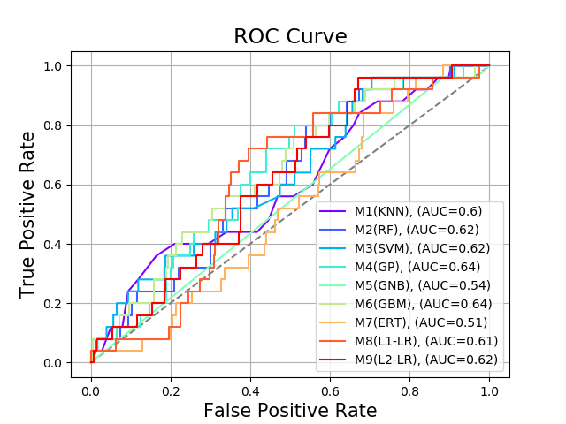
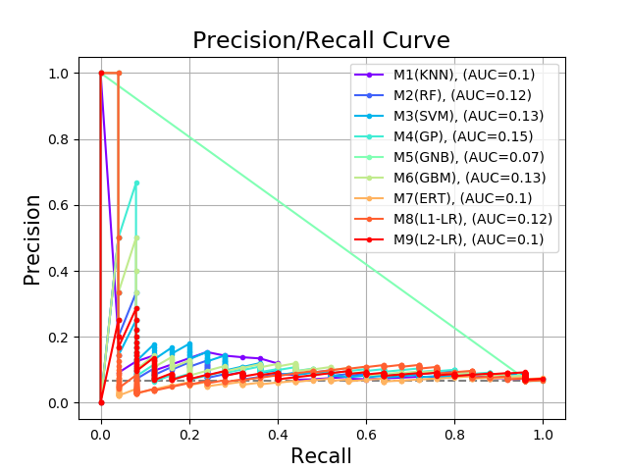
TLF Pipeline - Results
Notes:
All TLF pipelines differ in the pre-processing steps performed and the classifier used. They were all individually trained with a new randomly split of data. All TLF pipelines performed equally with an AUC-PR ranging from 0.06 to 0.15 andAUC-ROC ranging from 0.51 to 0.64. Considering that the PR curve in an imbalanced datasetlike ours gives a more accurate picture of the model’s performance, its interpretationis essential. The PR curve shows a weak prediction capacity compared with the 0.065AUC-PR expected under chance alone, which corresponds to the 6.5% of the patientspresenting with TLR in our dataset.
We applied the F-test to evaluate whether the performances estimated on a test set differ significantly. The F-statistic for all none classifiers was ~250 with significant p-Value around 0. All cassifiers would score similar in external validation. Therefore, we can use all TLF pipelines for Mconf.
We learned from this experiment that there are many unknown factors to consider inapplied ML. There is no state-of-the-art classification algorithm capable of learning thefull decision boundary or pattern inside the data. Therefore we have to think out of thebox to create an algorithm that uses the already learned parts to find patients for whichthe TLF pipelines agree on.

Slide 9
Results (1st round of selection with f1 score)
Pipeline | Train Score (f1) | Validation Score (f1) | Test Score (f1)
quantile_trans|KNN_imp|smote|l2_norm|no_feature_selector|KNN | 0.1642±0.002 | 0.1404±0.0252 | 0.1259±0.008
quantile_trans|KNN_imp|smote|no_normalizer|no_feature_selector|RF | 0.2931±0.0182 | 0.1619±0.0316 | 0.0724±0.0419
quantile_trans|KNN_imp|smote|l2_normalizer|PCA|SVM | 0.1714±0.008 | 0.1546±0.0247 | 0.1714±0.008
quantile_trans|KNN_imp|smote|l2_normalizer|no_feature_selector|GP | 0.2759±0.0103 | 0.174±0.0509 | 0.1388±0.0592
quantile_trans|KNN_imp|smote|l2_normalizer|no_feature_selector|GNB | 0.1924±0.0123 | 0.1428±0.0327 | 0.1215±0.0044
quantile_transf|KNN_imp|smote|no_normalizer|no_feature_selector|GBM | 0.2901±0.0258 | 0.1811±0.0388 | 0.1432±0.0798
quantile_transf|KNN_imp|smote|no_normalizer|no_feature_selector|ERT | 0.2759±0.0196 | 0.1614±0.0443 | 0.1142±0.0353
quantile_trans|KNN_imp|smote|l2_normalizer|PCA|L1-LR | 0.2453±0.0126 | 0.1562±0.0648 | 0.1124±0.0587
quantile_trans|KNN_imp|smote|l2_normalizer|no_feature_selector|L2-LR | 0.2135±0.0055 | 0.1719±0.036 | 0.1428±0.0261
Notes:
These are the results from the latest run of the pipeline. We double checked the correctness of code and the order of processing steps to rule out a bug in the code. The used hyperparameter grid is quite big. The idea behind it was to narrow down the search space by multiple runs with RandomSearch and take the best parameters settings for an exhaustive GridSearch. But this is not possible, since the models seems to overfit/underfit and therefore further analysis regarding hyperparameter tuning and setting is necessary (started with that yesterday). Best pipeline per classifier is not chosen automatically. I chose the one with the smallest ration of train/validation score, because difference between train/test is what gives you a clue regarding overfitting/underfitting phenomena.
Generally speaking, all possible classifiers have very low validation and test scores. It ranges between 13 and 17%. I tried different amount of input features, for example using just medical history of the patient or baseline + lesion characteristics, but the scores never changed significantly. Another strange behaviour I could observe in my tests in nearly all classifiers was a strange behaviour regarding the influence of an increasing training score on the evaluation score. The trainings score increased, but the validation score stayed the same all the time. With these first results the impression solidifies that data includes randomness at least there is no signal to grasp.
Hyperparameters per pipeline (from latest pipeline run:)
KNN: - `sampling__k_neighbors`: `1`
- `imputer__weights`: `distance`
- `imputer__n_neighbors`: `24`
- `feature_selector__whiten`: `True`
- `classifier__weights`: `uniform`
- `classifier__n_neighbors`: `10`
RF:
- `sampling__k_neighbors`: `8`
- `imputer__weights`: `distance`
- `imputer__n_neighbors`: `3`
- `classifier__n_estimators`: `161`
- `classifier__min_samples_leaf`: `91`
- `classifier__max_features`: `log2`
SVM:
- `sampling__k_neighbors`: `8`
- `imputer__weights`: `uniform`
- `imputer__n_neighbors`: `7`
- `classifier__kernel`: `sigmoid`
- `classifier__gamma`: `1`
- `classifier__C`: `1`
GP (Gaussian Processes):
- `sampling__k_neighbors`: `1`
- `imputer__weights`: `uniform`
- `imputer__n_neighbors`: `12`
GNB (Gaussian Naïve Bayes):
- `sampling__k_neighbors`: `7`
- `imputer__weights`: `distance`
- `imputer__n_neighbors`: `3`
- `feature_selector__whiten`: `True`
GBM (Gradient Boosting):
- imputer__weights: uniform
- imputer__n_neighbors: 13
- sampling_k_neighbors: 23
- classifier__criterion: friedman_mse
- classifier__learning_rate: 0.01
- classifier__n_estimators: 80
- classifier__min_samples_leaf: 60
classifier__max_features: sqrt
Logistic Regression with l1 regularization (L1-LR):
- imputer__weights: uniform
- imputer__n_neighbors: 3
- sampling_k_neighbors: 3
- feature_selector__whiten: False
- clf__solver: saga
- clf__penality: l1
- clf__C: 1
Logistic Regression with l2 regularization (L2-LR):
- imputer__weights: distance
- imputer__n_neighbors: 13
- sampling_k_neighbors: 3
- clf__solver: lbfgs
- clf__penality: l2
- clf__C: 0.1

Slide 10
Algorithm‘s Architecture
Notes:
For the second part of the project, we focused on the confidence pipeline. The pipeline itself is very easy in comparison to the TLF pipeline. Since the input is much easier, e.g. no missing values ​​or different ranges of features because everything is binary, we applied only classification methods to it without pre-processing steps.
We used the results of the weak classifiers from MTLF to create (1) an ensemble learner and (2) new input for Mconf, the confidence layer of the complete algorithm. We had two goals: find patients with high confidence predictions, e.g., patients with whom the weak classifiers agree on, and find a fitting ensemble learning algorithm to predict TLF better.

Slide 11
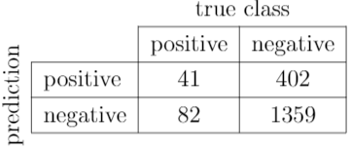
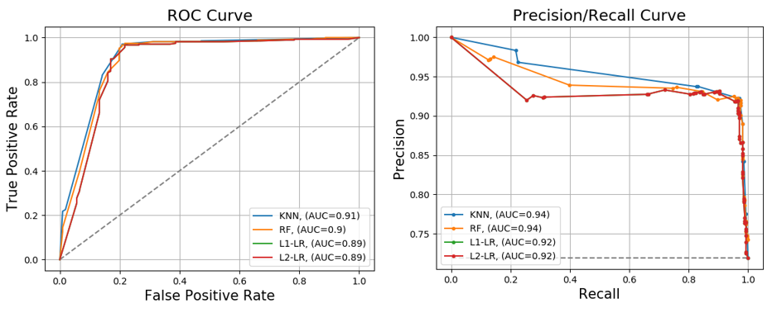
Conf Pipeline - Results
Confusion Matrix for Ensemble Learner (Y‘TLF)
F1 score: 0.145
Notes:
We evaluated the ensemble learner, which consisted of an unweighted majority vote. The achieved F1 score was with 0.145 within the same range of F1 scores achieved by the weak classifiers. The score and confusion matrix is for the complete cohort because we needed for all patients predictions for a post-analysis prediction.
We tried different classification algorithms for Mconf. KNN and RF had a slightly higher AUC-ROC value than the logistic regression algorithms. However, there was no significant difference between the classifiers according to the F-statistic of 36.08 and a p-Value≤0.0001. The PR curve shows a good prediction capacity compared with the 0.74 AUC-PR expected under chance alone, which corresponds to the 74% of the patients presenting a positive GTconf in decision matrix M.
From this experiment, we learned that a simple ensemble learner could not predict TLF significantly better than the weak classifiers M1-M9. We can infer that the unweighted majority vote does not fit the problem well. The learning of voting patterns, on the other hand, works very well according to prediction performance.

Slide 12
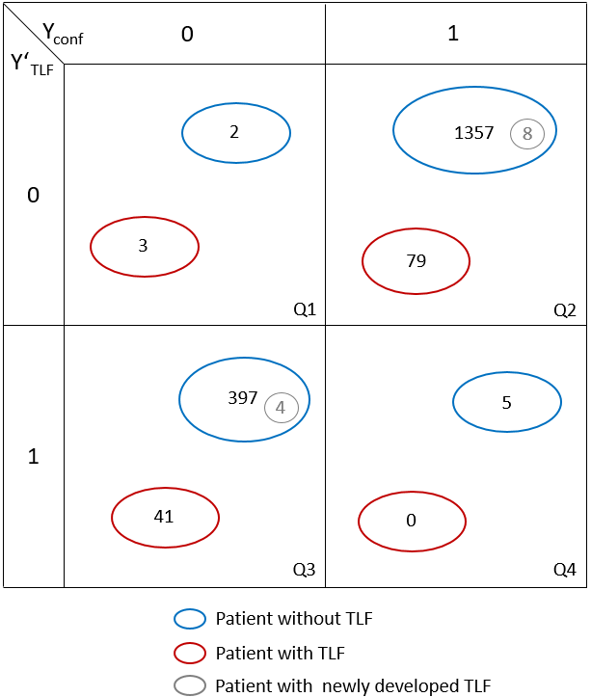
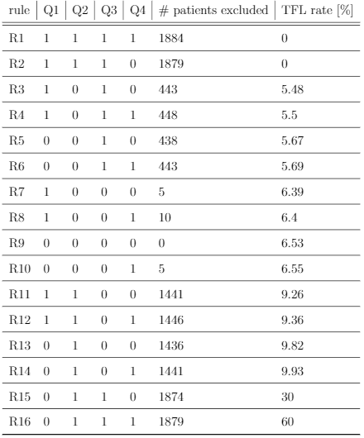


Post-Analysis of Algorithm
Notes:
We evaluated in a post-analysis how the predicted labels Y’TLFand Yconf can be used to divide patients into high and low-risk groups.
TODO:
Explain goal of post-analysis
Explain exlcusion matrix and what each quadrant stands for! We wanted to learn cohort-based excl rules regarding wich…. –> table
What are the best rules. Why? R3-R6 –> Q2 never in rules, therefore leave is as it is → high confidence predicitons for no TLF development
Q1 + Q4 to small for further analysis
→ closer look at Q3, even if confidence about prediction is low!

Slide 13
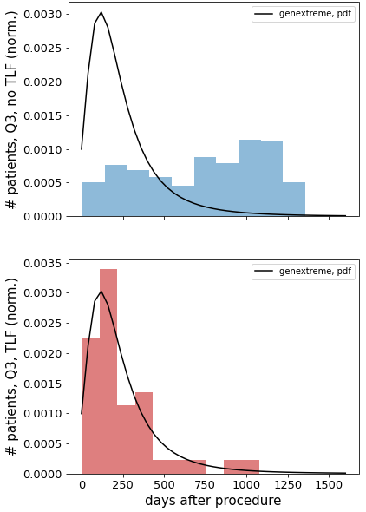
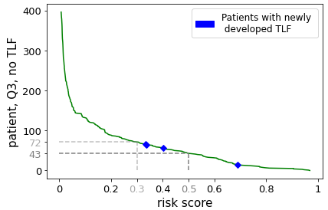
Post-Analysis of Algorithm – TLF Risk Score
α = time after Magmaris implantation
cdf_{D} = cumulative density function of the best-fitting distribution D
risk(α) = 1- cdf_{D}(α)
Notes:
TODO:
Explain goal of further analysis → TLF risk score
How risk score obtained: fit distirbuiont, kolmogorov smirnov test, etc (explain histogram)
GEV distribtuion best one
Risk score = 1-cdf_distr(days after proc) → presented in next plot
Tendency: the longer the magmaris implantation ago, the less the risk score for developing TLF in the future
External validation: how good is algo in picking up patients at high risk for TLF: 12 patients who developed TLF after time of data collection used for training –Y not presented to the algo during training, 4 of them fall into Q3 (marked with blue) → risk score of developing TLF at time of data used for training between 0.3 and 0.6, 8 into Q2
→ goal: mark as low patients at possible at risk for TLF because those should be closer monitored → the lower the risk score cutoff the less patients marked at risk for TLF, but the chance of missing some risk patients is there. To get all 4 external validation patients, the cutoff shoudl have been at least 0.3, meaning that every patient with a risk score higher than 0.3 should be closer monitored (n=72 in this case)

Slide 14
Findings
TODO: add findings
(1)
(2)
(3)

Slide 15
Contributions
TODO: add contributions
(1)
(2)
(3)

