Slide 1
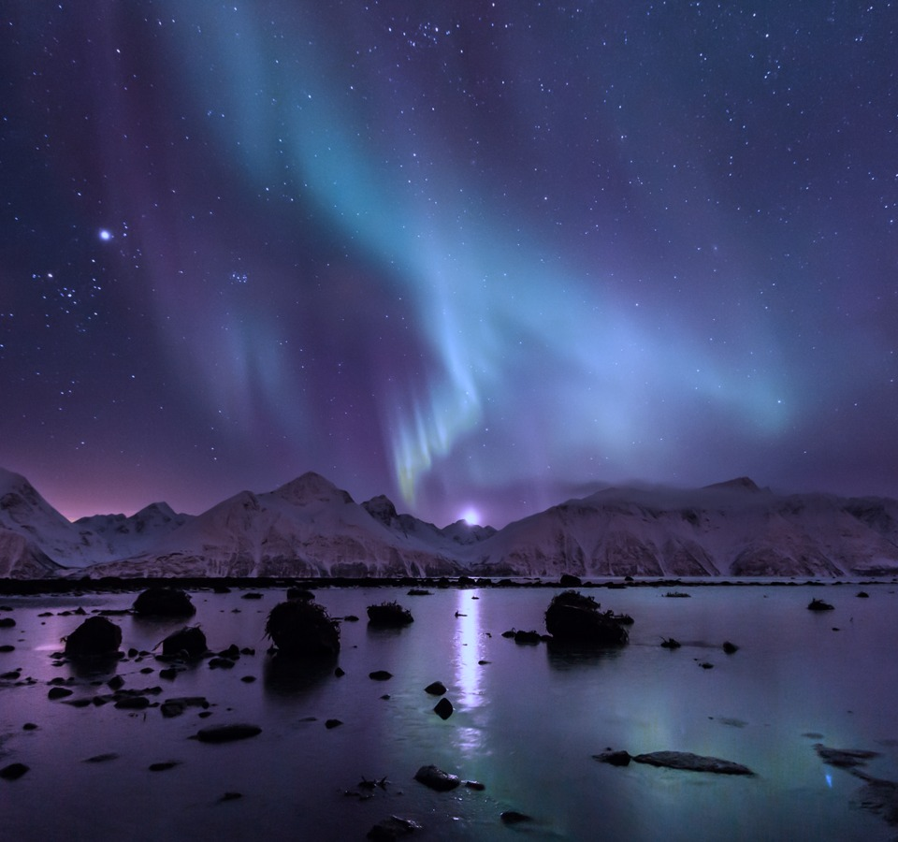
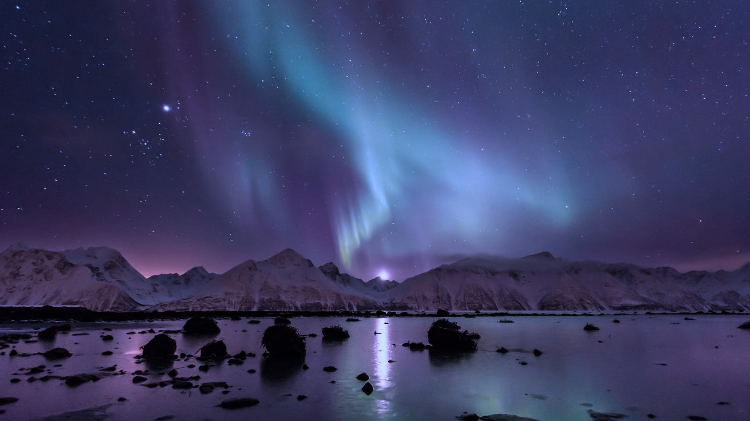
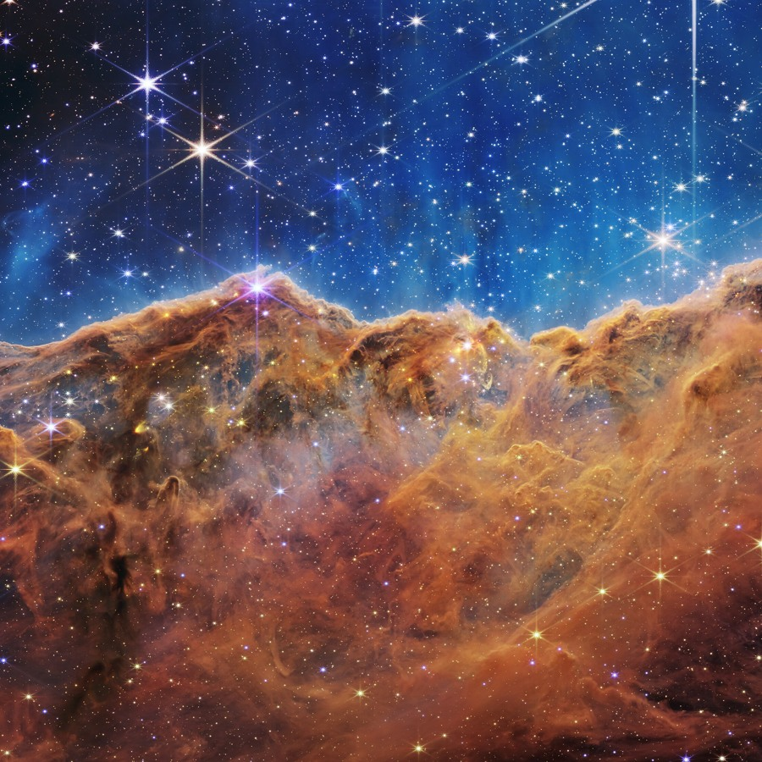
FIELD NOTES / THE NIGHT ISSUE
BEYOND
THE VISIBLE.
Follow the light.
A journey into the extraordinary.
POLAR SKIES / DEEP SPACE / NEW PERSPECTIVES
filens / 01

Slide 2
02 / AT THE EDGE OF NIGHT
CHASE THE LIGHT.
A winter horizon. A sky in motion. An entirely new point of view.
Photograph: Carsten / CC BY 2.0 / blue color grade

Slide 3
03 / THE COSMIC ATLAS
A universe
of detail.
01
LOOK CLOSER
Discover a new perspective in every file.
CARINA NEBULA / NASA, ESA, CSA, STScI
filens / 03

