Slide 1

Novel PRNG schemes (EC-based and/or parallel) and their automated testing
M. Gonçalves, S. Konchenko, L. Trestioreanu
Parallel and Grid Computing Projects
Master in Information and Computer Sciences (MICS),
University of Luxembourg (UL), Luxembourg
Lecturers: Dr S. Varrette, V. Plugaru and Prof. P. Bouvry

Slide 2


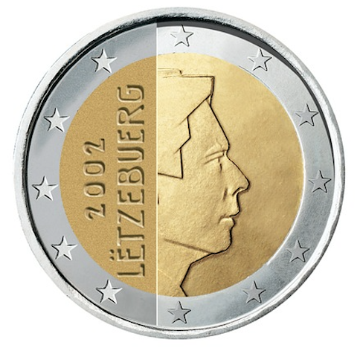
What is random number
Problem scope
Flip coin sequences of Head and Tails
P(‘heads’)=1/2:
{ H T H T H T H T H T H T H T H T H T H T }
{ H T H T T T H T H H H H H T H T T T H T }
Which sequence is random?
- subjective randomness

Slide 3
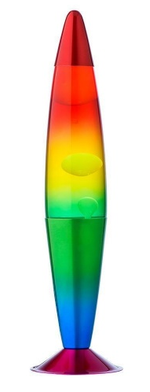
Random Number Generator
Problem scope
Two categories of RNG:
deterministic approaches (Pseudo-Random Number Generator PRNG)
a formula where the input completely determines the output
non-deterministic approaches (Hardware-based Random Number Generator HRNG)
flipping coins, rolling dice, keyboard latency, white noise, level of radioactivity and motion of lava lamps
Is it enough to use PRNG in most application?

Slide 4
Pseudo-Random Number Generator
Problem scope
Characteristics of PRNG
Efficient:
many numbers in a short time
Deterministic:
sequence can be reproduced if the starting point is known.
Periodic:
sequence will eventually repeat itself
What about testing PRNG?

Slide 5
Testing of PRNG
Problem scope
Two distinct group:
Theoretical Tests:
require knowledge of the PRNG structure
Empirical:
use generated sequence
Which PRNG testing suites are known?

Slide 6
Testing suites of PRNG
Problem scope
Knuth’s tests (1969)
Monte Carlo simulation of the 2D Ising model (1986)
Diehard suite (1995)
NIST Statistical Test Suite (2001)
Dieharder suite (2003)
TestU01 (2007)
Why we need parallel PRNG?

Slide 7
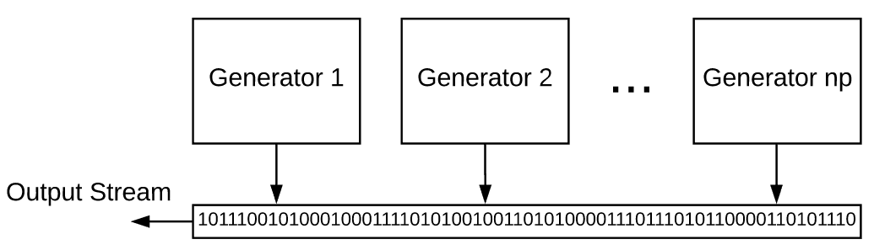
Sequential…
Improve PRNG Speed
…to parallel execution!
(OpenMPI)

Slide 8

Challenges to PRNG Parallelization
Seed choice - Random
Generator 2
Seed = ?
Generator 1
Seed = ?
Only moving the problem

Slide 9
Challenges to PRNG Parallelization
Seed choice - Incremental
Generator 1
Seed = 1000
Generator 2
Seed = 1001
Generator 3
Seed = 1002
Output:
97
94
95
Similar outputs…

Slide 10

Challenges to PRNG Parallelization
Seed choice - Multiplicative
Generator 1
Seed = 1000
Generator 2
Seed = 2000
Generator 3
Seed = 3000
Output:
5
42
11
Works!

Slide 11
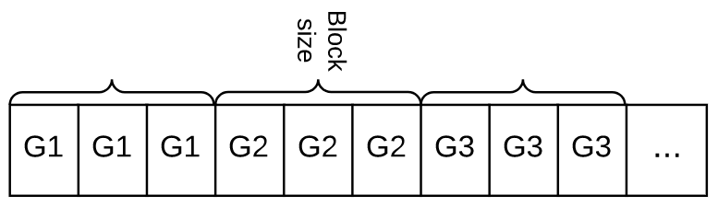
Challenges to PRNG Parallelization
Fixed seed with Block-splitting

Slide 12
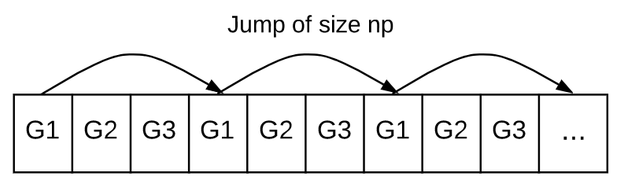
Challenges to PRNG Parallelization
Fixed seed with Leap-frogging

Slide 13
Challenges to PRNG Parallelization
Skipping ahead?
Generator
p1 = 51
p2 = 17
p3 = 180
…
pn = 2
102
53
1
95
12
222
3
76
Seed
Output:
42
, 37
No direct formula for parameter prediction

Slide 14
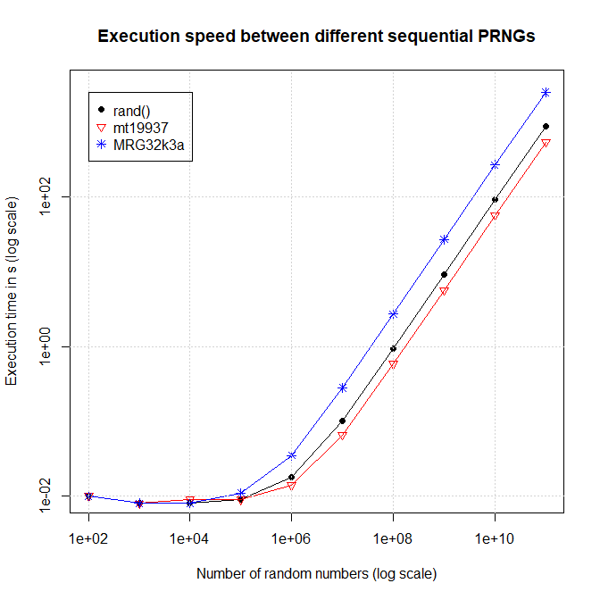
Experimental Results – Speed Benchmark

Slide 15
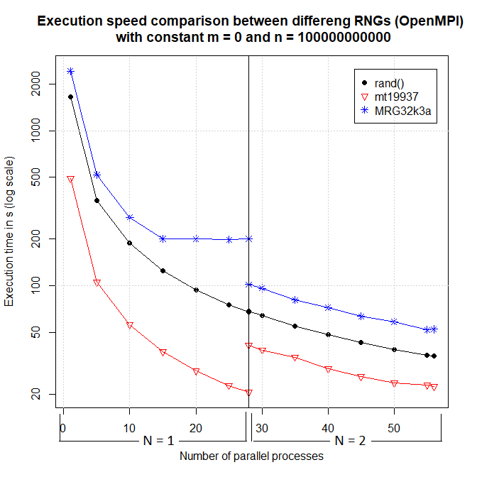
Experimental Results – Speed Benchmark

Slide 16
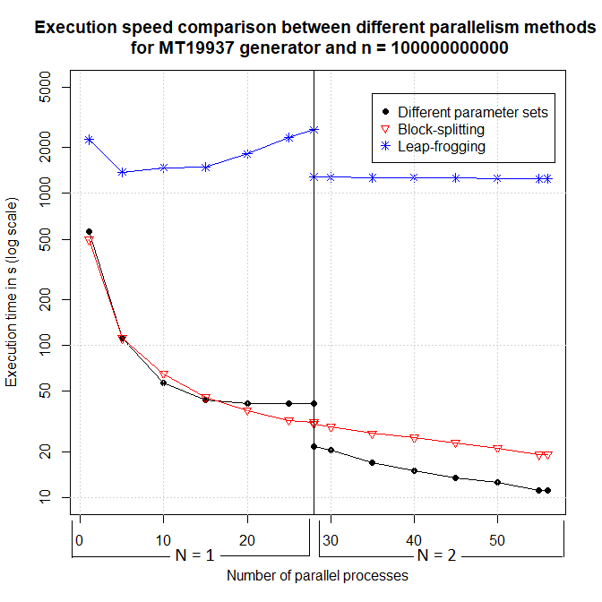
Experimental Results – Speed Benchmark

Slide 17


Experimental Results – Validation
Dieharder Tests & NIST Test Suite
std::rand
MT19937
MRG32k3a

Slide 18
Experimental Results – Validation
Dieharder Tests & NIST Test Suite
Seed choice
(Multiplication)
Block-splitting
Leap-frogging

Slide 19
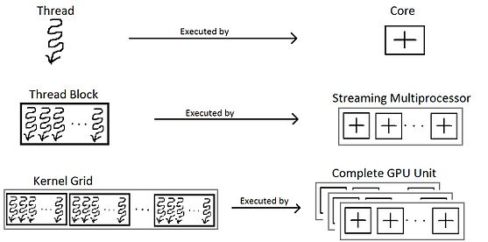
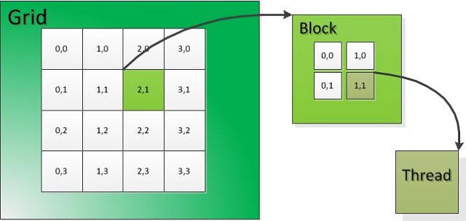

GPU accelerated PRNGs
Programmer vs hardware perspective [1]
Power of the crowd
sheer computing power built for repetitive tasks
many times more cores/threads than CPUs, can run in parallel

Slide 20
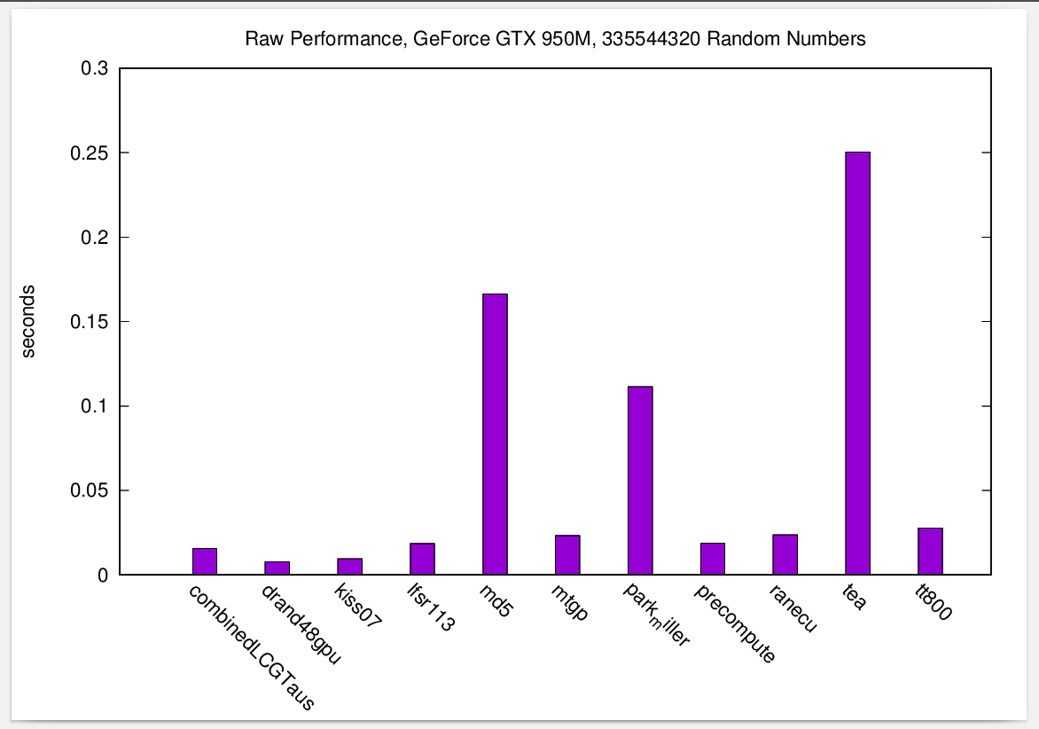
GPU accelerated PRNGs
Raw performance
10 program calls, 10 kernel calls, 16384 threads, 2048 rand numbers computed in each thread in each kernel call
335544320 (amount of random numbers per launch) = kernel_calls * num_threads * num_randoms_per_thread
GPU
- multiprocessor count: 5
- stream processor count: 128 (total 640)
- warp size: 32
- max threads per block: 1024
- max block dimensions: 1024 x 1024 x 64
- max grid dimensions: 2147483647 x 65535 x 65535

Slide 21
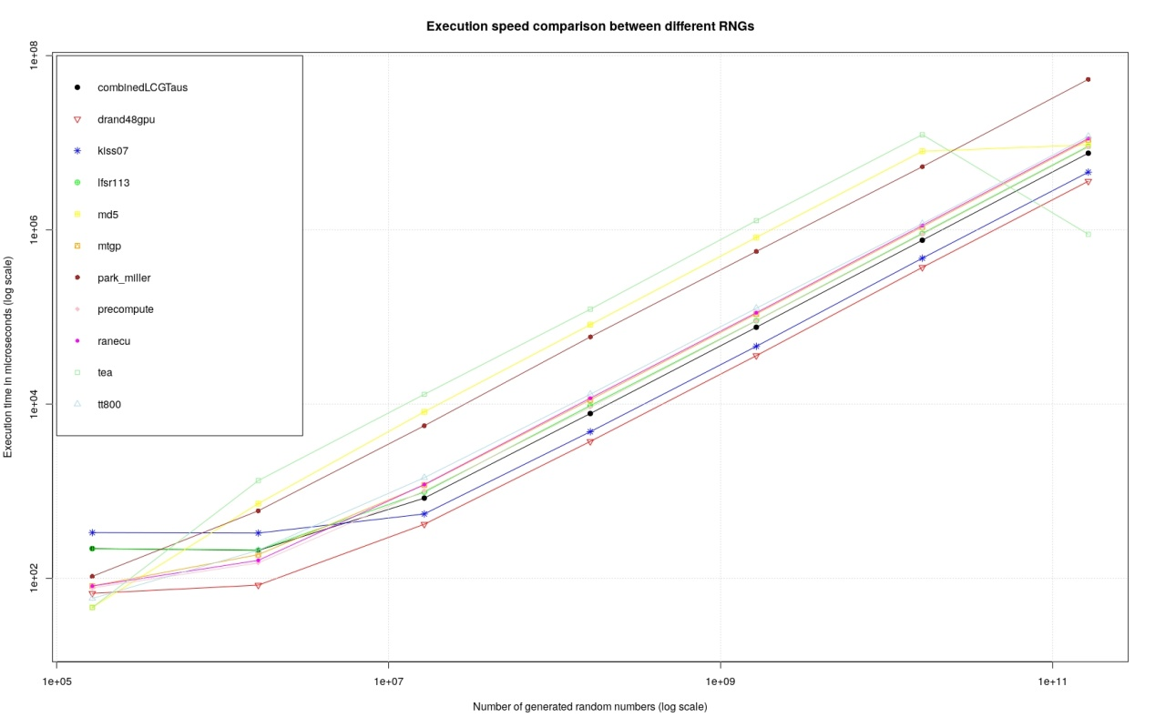
GPU accelerated PRNGs
Execution time versus the quantity of random numbers generated, for all studied RNGs.
163.840 to 163.840.000.000 rand numbers
drand48gpu
kiss07
combinedLCGTaus
precompute
lfsr113
mtgp (Mersenne twister)
ranecu
tt800
park_miller
md5
tea

Slide 22
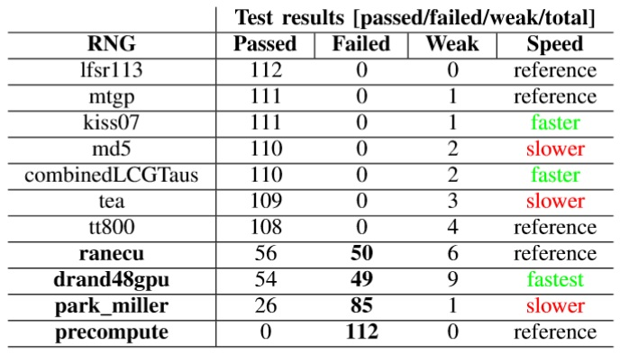
GPU accelerated PRNGs
Overview of the Dieharder and Raw Performance tests
Not necessarily the slower RNGs have the best quality and vice-versa

Slide 23

Conclusion - CPU
All three methods used yielded good results with “leap-frogging” performing slightly worse in terms of speed and scalability.
Using the same seeds for all generators will produce the same outputs. Thus, not using either block-splitting or leap-frogging will fail the statistical tests.
std::rand generator should not be used.
mt19937

Slide 24
Conclusion - GPU
Best performers:
“lfsr113“ – passed all tests
"mtgp“
"kiss07“ – second fastest
Should be avoided (systematically failed tests)
"Ranecu“
"drand48gpu“
"park_miller“
"precompute”

Slide 25
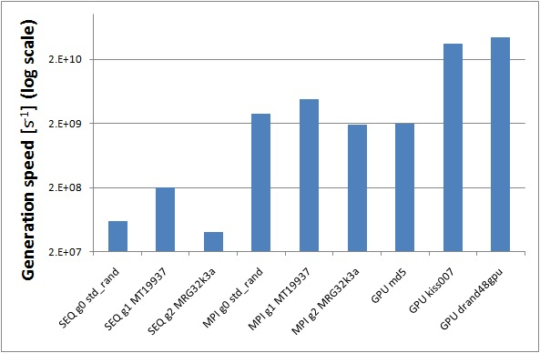
Conclusion - Speeds
GPU execution was faster than parallel CPU, which was faster than sequential CPU execution.

Slide 26

Questions?

