Slide 1

Novel PRNG schemes (EC-based and/or parallel) and their automated testing
M. Gonçalves, S. Konchenko, L. Trestioreanu
Parallel and Grid Computing Projects
Master in Information and Computer Sciences (MICS),
University of Luxembourg (UL), Luxembourg
Lecturers: Dr S. Varrette, V. Plugaru and Prof. P. Bouvry

Slide 2

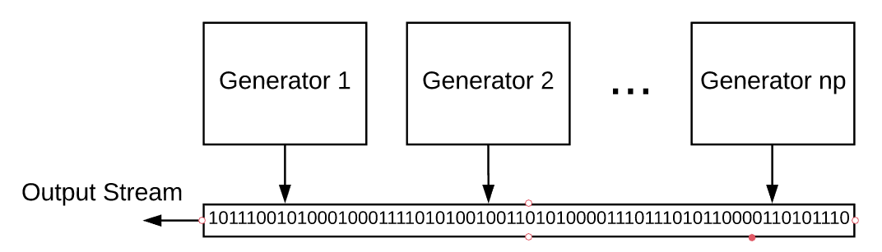
Sequential…
Improve PRNG Speed
…to parallel execution!
(OpenMPI)

Slide 3

Challenges to PRNG Parallelization
Seed choice - Random
Generator 2
Seed = ?
Generator 1
Seed = ?
Only moving the problem

Slide 4
Challenges to PRNG Parallelization
Seed choice - Incremental
Generator 1
Seed = 1000
Generator 2
Seed = 1001
Generator 3
Seed = 1002
Output:
97
94
95
Similar outputs…

Slide 5

Challenges to PRNG Parallelization
Seed choice - Multiplicative
Generator 1
Seed = 1000
Generator 2
Seed = 2000
Generator 3
Seed = 3000
Output:
5
42
11
Works!

Slide 6
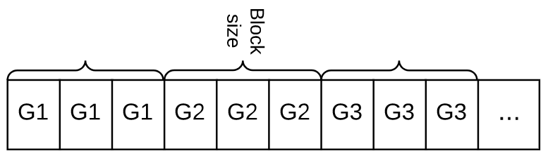
Challenges to PRNG Parallelization
Fixed seed with Block-splitting

Slide 7
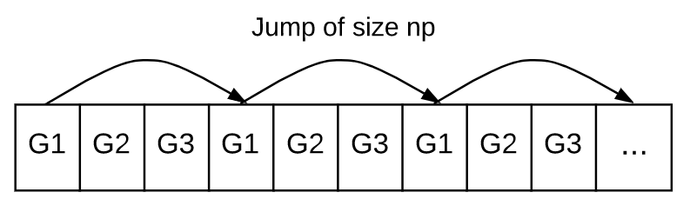
Challenges to PRNG Parallelization
Fixed seed with Leap-frogging

Slide 8
Challenges to PRNG Parallelization
Skipping ahead?
p1 = 51
p2 = 17
p3 = 180
…
pn = 42
Generator
102
43
1
95
12
222
3
76
Seed
Output:
55
, 37
No direct formula for parameter prediction

Slide 9
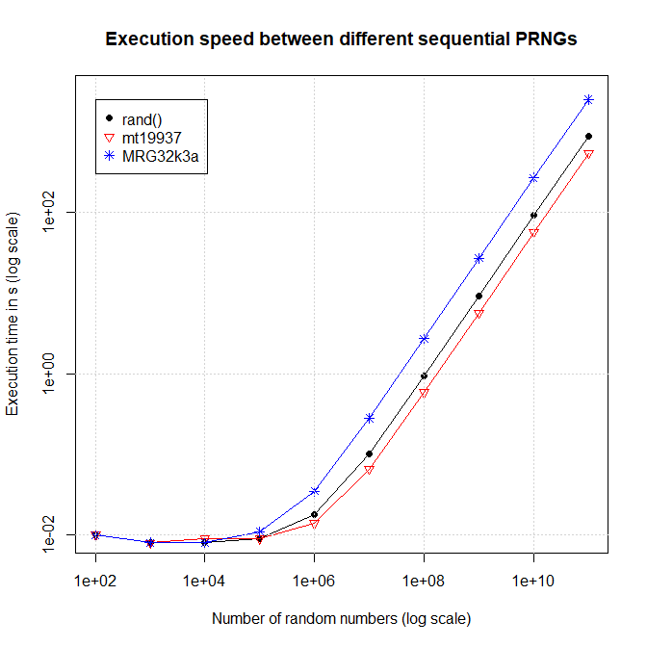
Experimental Results – Speed Benchmark

Slide 10
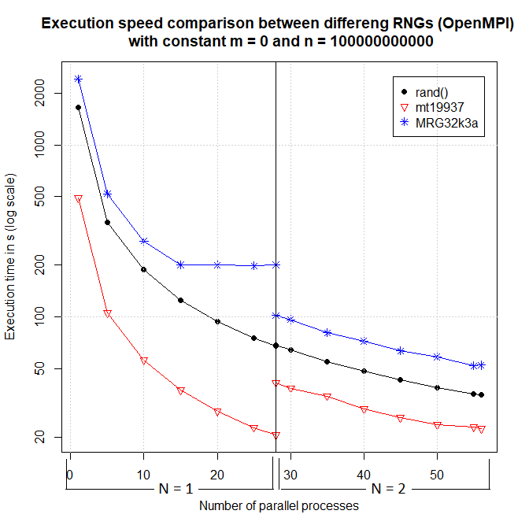
Experimental Results – Speed Benchmark

Slide 11
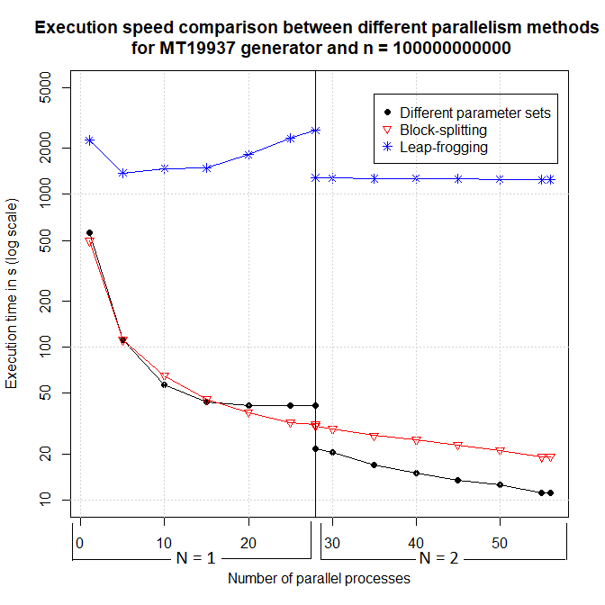
Experimental Results – Speed Benchmark

Slide 12


Experimental Results – Validation
Dieharder Tests & NIST Test Suite
std::rand
MT19937
MRG32k3a

Slide 13
Experimental Results – Validation
Dieharder Tests & NIST Test Suite
Seed choice
(Multiplication)
Block-splitting
Leap-frogging

Slide 14
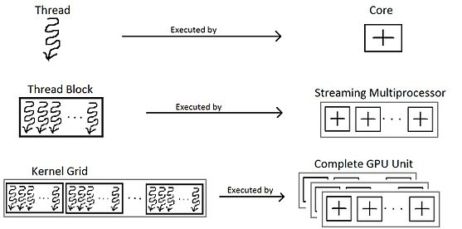
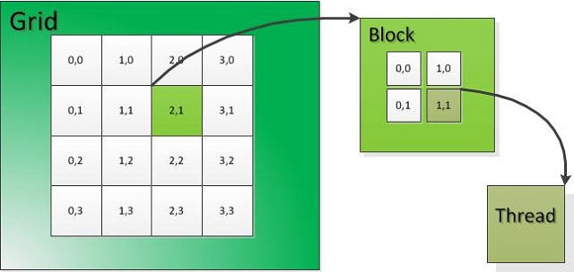

GPU accelerated PRNGs
Programmer vs hardware perspective [1]
Power of the crowd
sheer computing power built for repetitive tasks
many times more cores/threads than CPUs, can run in parallel

Slide 15
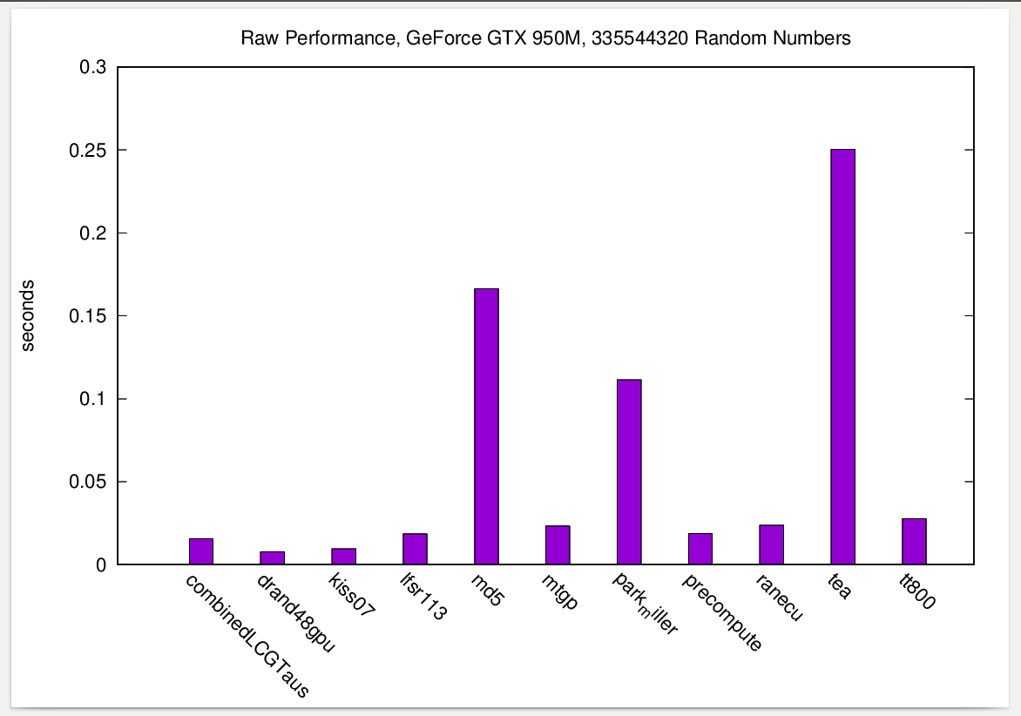
GPU accelerated PRNGs
Raw performance
10 program calls, 10 kernel calls, 16384 threads, 2048 rand numbers computed in each thread in each kernel call
335544320 (amount of random numbers per launch) = kernel_calls * num_threads * num_randoms_per_thread
GPU
- multiprocessor count: 5
- stream processor count: 128 (total 640)
- warp size: 32
- max threads per block: 1024
- max block dimensions: 1024 x 1024 x 64
- max grid dimensions: 2147483647 x 65535 x 65535

Slide 16
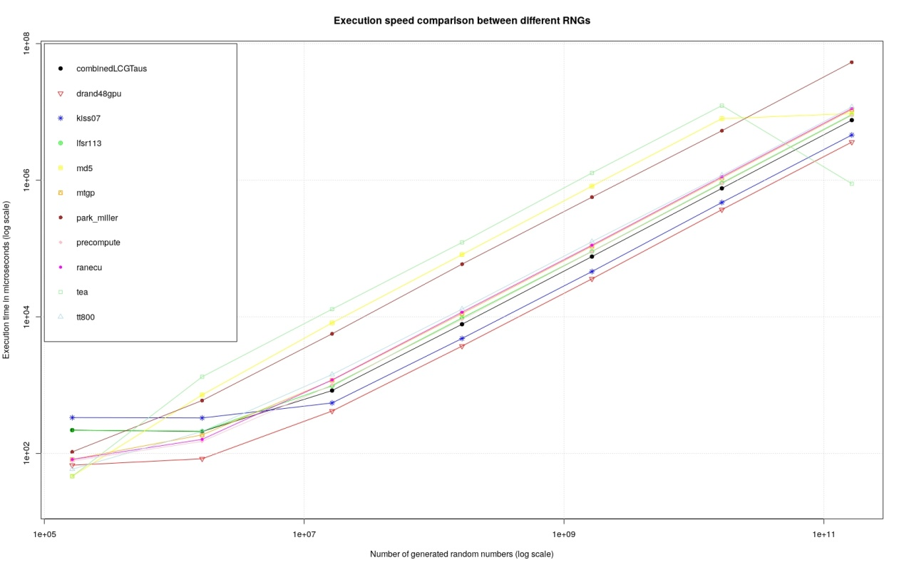
GPU accelerated PRNGs
Execution time versus the quantity of random numbers generated, for all studied RNGs.
163.840 to 163.840.000.000 rand numbers
drand48gpu
kiss07
combinedLCGTaus
precompute
lfsr113
mtgp (Mersenne twister)
ranecu
tt800
park_miller
md5
tea

Slide 17
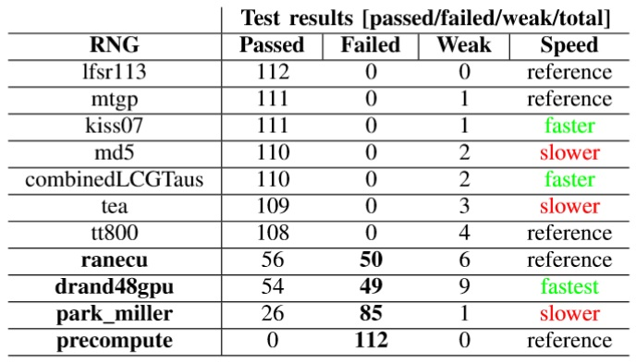
GPU accelerated PRNGs
Overview of the Dieharder and Raw Performance tests
Not necessarily the slower RNGs have the best quality and vice-versa

Slide 18

Conclusion - CPU
All three methods used yielded good results with “leap-frogging” performing slightly worse in terms of speed and scalability.
Using the same seeds for all generators will produce the same outputs. Thus, not using either block-splitting or leap-frogging will fail the statistical tests.
std::rand generator should not be used.
mt19937

Slide 19
Conclusion - GPU
Best performers:
“lfsr113“ – passed all tests
"mtgp“
"kiss07“ – second fastest
Should be avoided (systematically failed tests)
"Ranecu“
"drand48gpu“
"park_miller“
"precompute”

Slide 20
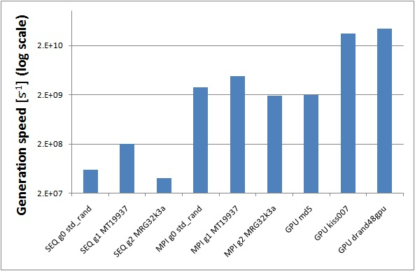
Conclusion - Speeds
GPU execution was faster than parallel CPU, which was faster than sequential CPU execution.

Slide 21

Questions?

