Slide 1
AIT-614 FINAL PROJECT TEAM 6

Slide 2
Health Trends and Mental Well-being Among Older Populations TEAM 6 Lakshmi Durga Teratipally, Shree Pallavi Vegesana, Anusha Goulla Dr Ben Duan George Mason University AIT – 614 – 002: Big Data Essentials April 27, 2024

Slide 3
Introduction
Our project involves the application of various data visualization techniques such as bar plots, line plots, and box plots, as well as machine learning algorithms like Linear Regression and Gradient Boosted Tree Regressor. Most papers, on the other hand, employs thematic analysis to combine, categorize, and codify findings from reviewed studies.
The aim is to discover trends and patterns of health factors among older adults from different geographic regions and demographic groups using exploratory data analysis and machine learning models.

Slide 4
Objective
How have certain health outcomes or metrics changed over time?
Are there geographic patterns in the data? For example, do certain regions exhibit higher or lower values for specific health-related metrics?
Which classes of health topics are most prevalent, and how do they differ across years or locations?
How does the distribution of various health-related data vary across different stratification categories (e.g., age, gender, race)?
Is it possible to predict certain outcomes (like Data_Value) based on other features in the dataset?

Slide 5
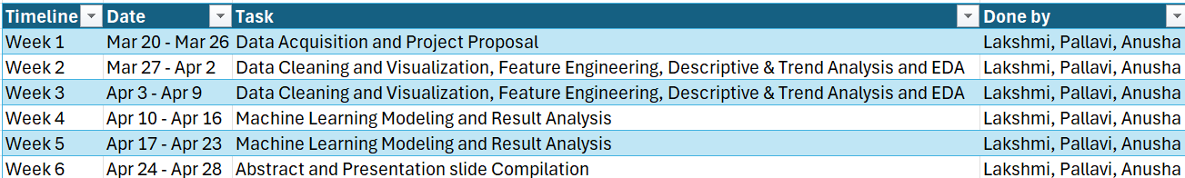
Summarized project timeline
Week 1: Preparation of the project proposal
Week 2: Data Acquisition, Pre-processing and Data Cleaning
Week 3: EDA, Descriptive and Trend Analysis
Week 4 and 5: Development of Predictive Models and analysis of results
Week 6 : Compilation of Abstract and Preparation for Presentation

Slide 6
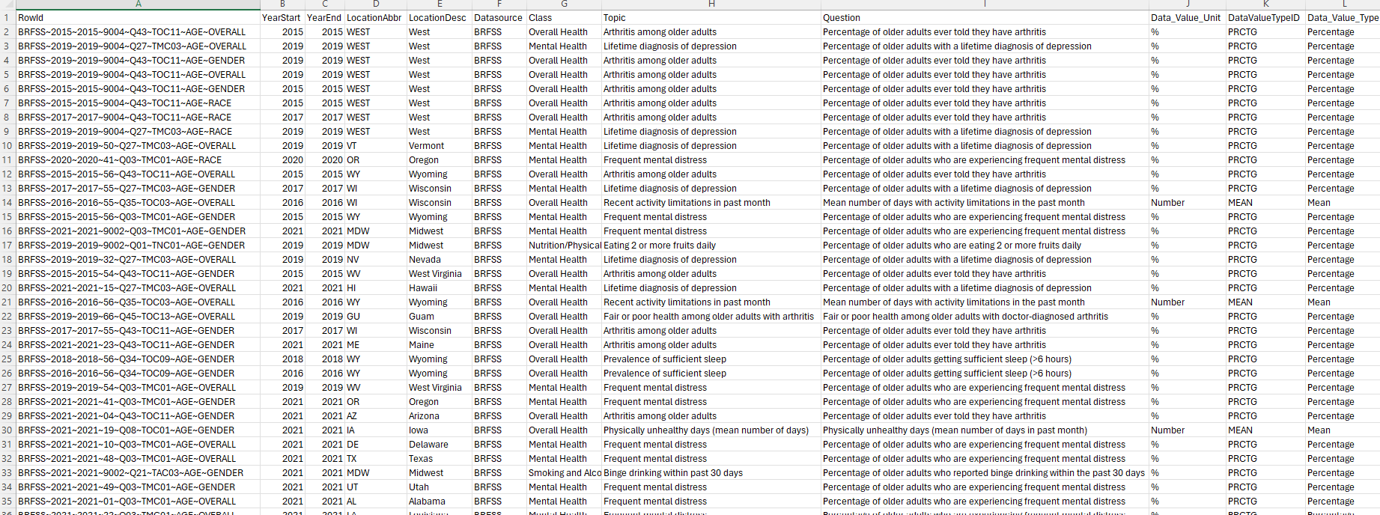
Selected dataset
The dataset is sourced from the Centers for Disease Control and Prevention (CDC) and Behavioral Risk Factor Surveillance System (BRFSS) focusing on diverse health indicators related to older adults across United Sates from 2015 – 2021.
The dataset covers over 250938 records and 31 distinct features.
The dataset includes attributes such as demographic information, health conditions (e.g., arthritis, depression), prevalence rates, and geographical data for different regions.

Slide 7
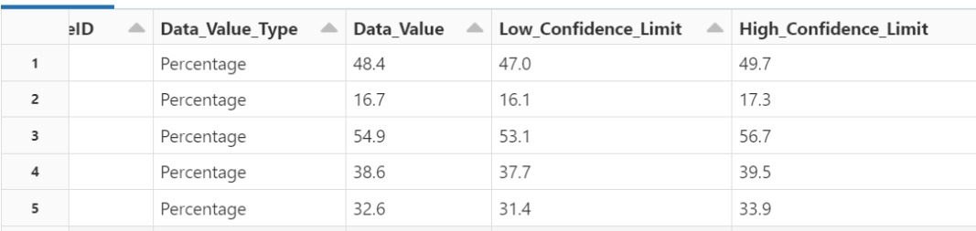
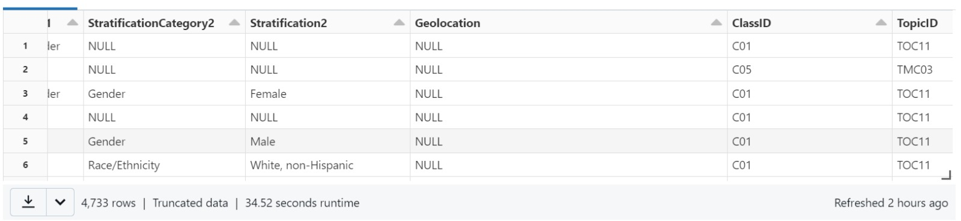
Data Preprocessing
The data cleaning process involves using PySpark to remove unnecessary columns and ensure that missing values are handled consistently for further analysis.
Columns which are not required for the analysis are dropped (Data_Value_Alt, Data_Value_Footnote_Symbol and Data_Value_Footnote).
Blank values in the columns “StratificationCategory2”, “Stratification2” and “Geolocation” are replaced with NULL.

Slide 8
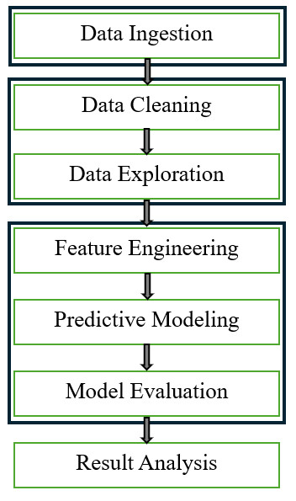
Architecture and Framework
Databricks DBFS
PySpark & MongoDB
Spark MLlib
Loading the csv file.
Removing unnecessary columns and ensuring that missing values are handled consistently.
Querying using MongoDB, Finding patterns and relationships between various parameters such as Health conditions, age group, gender, location through summary statistics and visualizations.
One hot encoding for categorical features.
Machine Learning Models (Linear Regression, Gradient Boosted Tree Regression)
Evaluating the performance of models employed – accuracy, RMSE, RSQ
Analyzing the findings.

Slide 9
SQL Queries
1) What is the total number of documents in the collection?
db.collection.count()

Slide 10
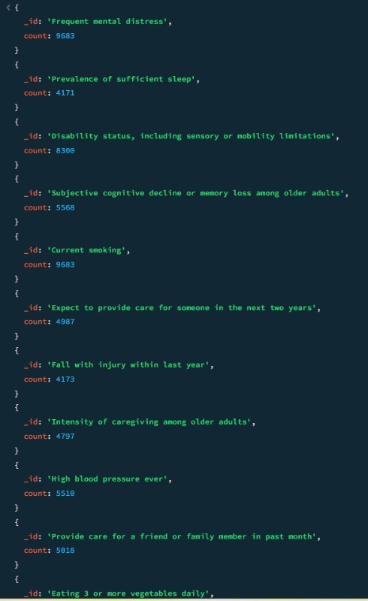
2) What is the distribution of documents in the
collection based on the 'Topic’?
db.collection.aggregate([ {
$group: {
_id: "$Topic",
count: { $sum: 1 }
}
}
])

Slide 11
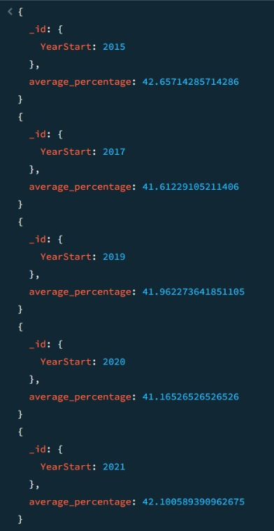
3) What is the average percentage of arthritis cases
among older adults annually, and how does it vary
over the years?
db.project.aggregate([
{
$match: {
Topic: "Arthritis among older adults"
}
},
{
$group: {
_id: {
YearStart: "$YearStart“
},
average_percentage: { $avg: "$Data_Value" }
}
},
{
$sort: {
"_id.YearStart": 1
}
}
])

Slide 12
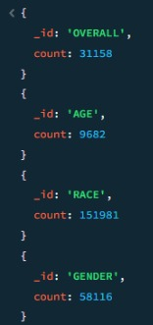
4) How does the distribution of data vary across different
categories like age, race and gender?
db.project.aggregate([
{
$group: {
_id: "$StratificationCategoryID2",
count: { $sum: 1 }
}
}
])

Slide 13
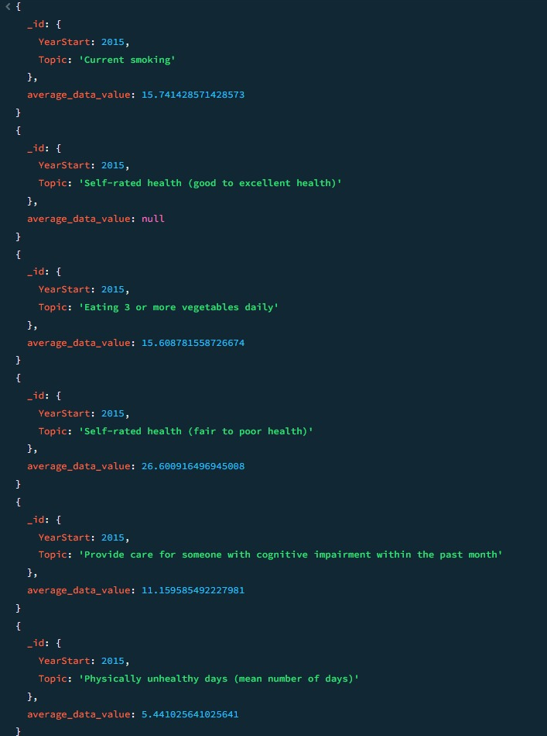
5) How does the average data value vary across
different combinations of starting year and topic,
and how does this variation change over time?
db.collection.aggregate
{
$group: {
_id: {
YearStart: "$YearStart",
Topic: "$Topic“
},
average_data_value: { $avg: "$Data_Value" }
}
},
{
$sort: {
"_id.YearStart": 1
}
}
])

Slide 14
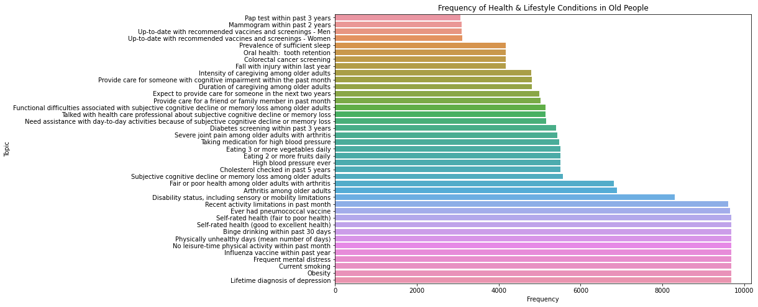
Exploratory data analysis and visualizations
What is the frequency of different health and lifestyle conditions related to Older people?

Slide 15
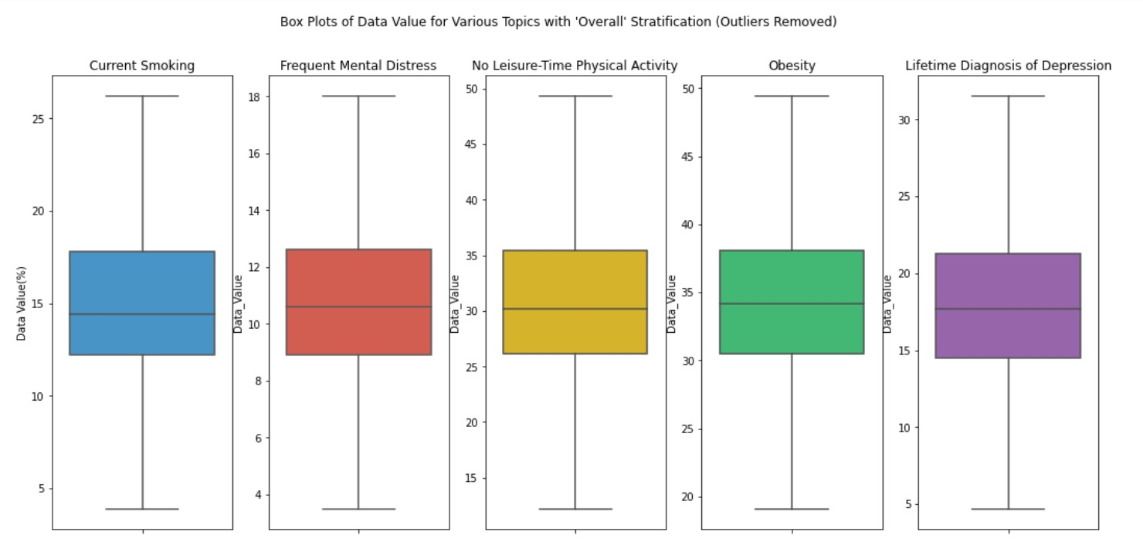
How do the distributions of data for different Health and Lifestyle conditions among older people compare with each other?

Slide 16
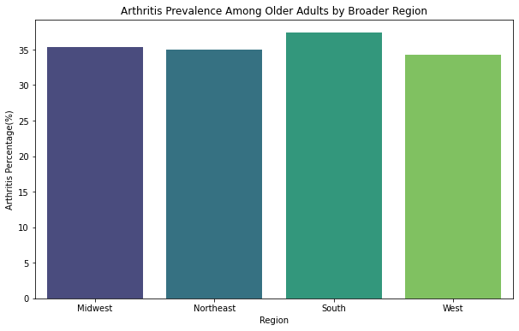
What is the prevalence of arthritis among older adults across different regions in 2020-2021?

Slide 17
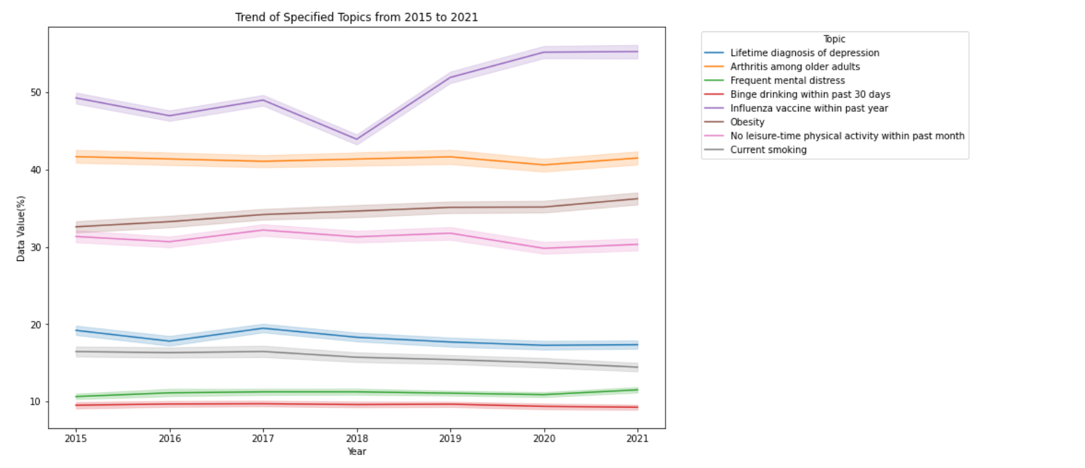
How have the different health-related topics changed over time from 2015 to 2021? Are there noticeable increases, decreases, or stable trends for each topic?

Slide 18
Machine learning using SparkMLib-overview
For the given dataset, machine learning models were applied using SparkMLlib: Linear Regression and Gradient Boosted Regression.
Linear Regression: Predictor variables (features): Class, Topic, Data Value Unit
Target variable (response): Data Value.
Gradient Boosted Tree Regressor: Predicting the data values

Slide 19
Feature Engineering
String Indexing: This converts categorical values into numerical indices.
One-Hot Encoding: Converts indexed categorical variables into binary (one-hot) vectors.
Min-Max Scaling: Scales features to a specified range, typically [0, 1].
Feature Interactions: Create new features by combining existing ones.
Vector Assembler: Combines multiple features into a single vector.
Imputation: Fill missing values with a specific strategy, like the mean or median.
Finally, combine all the feature engineering steps into a pipeline for ease of use in the model training process.

Slide 20
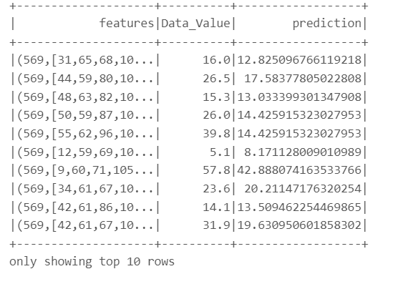

Gradient Boosted Tree Regressor
80 % training data – 20% testing data
The model is used to predict Data_Value
(% of older adults diagnosed with arthritis,
mental health issues and health related metrics).
The RMSE, MAE, and R-squared values give insight
into the accuracy and reliability of the model’s
predictions.
The columns selected for prediction are "LocationAbbr“,
"Class", "Topic", "Stratification1"

Slide 21
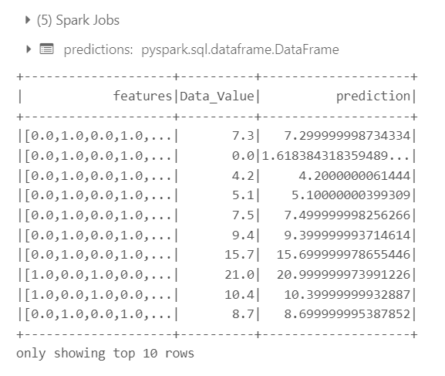
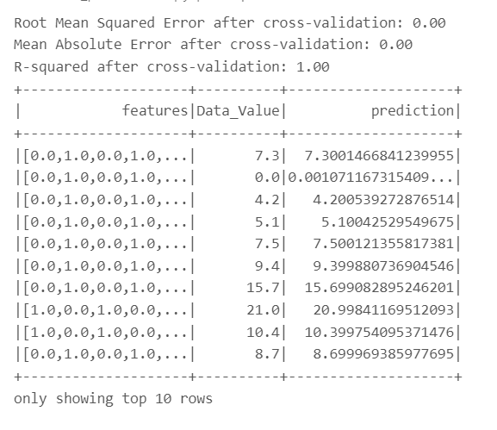
Linear Regression
80 % training data – 20% testing data
The model is used to predict Data_Value (% of older adults diagnosed with arthritis, mental health issues and health related metrics).
The topics considered "Class", "Topic", "Data_Value_Unit“.

Slide 22
Conclusions
There is a high prevalence of conditions such as depression, obesity and no leisure time and physical activity.
Mental health issues like depression and cognitive decline are significant but less frequent than some chronic physical conditions.
An upward trend in the percentage of people who take influenza vaccine up to 2020 indicating awareness among people towards influenza vaccine.
Health conditions can vary significantly by region, which may point to the influence of environmental factors, healthcare access, or lifestyle differences across regions.

Slide 23
Future Work
To improve this project, we could explore more complex feature engineering techniques, such as interactions between categorical variables or time-based trends. Experiment with advanced machine learning algorithms, like deep learning or ensemble models, to increase prediction accuracy. Additionally, implement robust cross-validation techniques to ensure model generalization across diverse data subsets. Finally, conducting a comprehensive error analysis would help identify model limitations and areas for refinement, paving the way for future iterations and enhanced predictive performance.

Slide 24
Acknowledgement
Professor Dr Ben Duan: For invaluable guidance, insightful lectures, and continuous support throughout the project.
Graduate Teaching Assistant (GTA) Rishiikeshwar Brindha Sivakumar: For his dedication in assisting with technical challenges and providing timely feedback.
Colleagues: For a collaborative learning environment and sharing constructive feedback that improved both our learning and this project.
Research Authors: Gratitude to the authors of the related work research papers which provided insights that guided our approach.

Slide 25
References
[1] Alzheimer’s Disease and Healthy Aging Data | Data | Centers for Disease Control and Prevention. (2024, April 24). https://data.cdc.gov/Healthy-Aging/Alzheimer-s-Disease-and-Healthy-Aging-Data/hfr9-rurv/about_data.
[2] GeeksforGeeks. (2024, April 25). Linear Regression (Python Implementation). GeeksforGeeks. https://www.geeksforgeeks.org/linear-regression-python-implementation/
[3] Bento, C. (2022, January 10). Random Forests Algorithm explained with a real-life example and some Python code. Medium. https://towardsdatascience.com/random-forests-algorithm-explained-with-a-real-life-example-and-some-python-code-affbfa5a942c
[4] Kim, E. S., Tkatch, R., Martín, D. I. B., MacLeod, S., Sandy, L. G., & Yeh, C. S. (2021). Resilient aging: Psychological Well-Being and Social Well-Being as targets for the promotion of healthy aging. Gerontology & Geriatric Medicine, 7, 233372142110029. https://doi.org/10.1177/23337214211002951
[5] Fulmer, T., Reuben, D. B., Auerbach, J., Fick, D. M., Galambos, C., & Johnson, K. S. (2021). Actualizing better health and health care for older adults. Health Affairs, 40(2), 219–225. https://doi.org/10.1377/hlthaff.2020.01470

Slide 26
Thank you!

