Slide 1
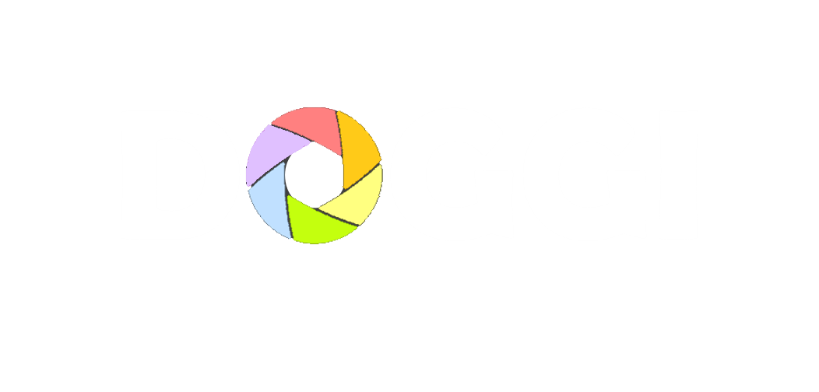
DESIGN & DEVELOPMENT REPORT

Slide 2
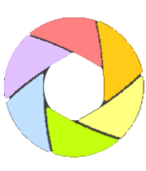
CONTENTS
INTRODUCTION 2
RESEARCH 4
DESIGN 7
MECHANICS 9
PROGRAM 12
ASSESSMENT & FUTURE 19
REFERENCE & APPENDIX 21
1/22

Slide 3




INTRODUCTION-DUTIES
PRODUCT
MANAGER
YU GANG
INDUSTRIAL
DESIGNER
XU YIZHI
XIANG YUTONG
MECHANICAL
ENGINEER
XU YIZHI
YU GANG
DEVELOPMENT
ENGINEER
XIANG YUTONG
2/22
Icon made by Freepik from www.flaticon.com

Slide 4



INTRODUCTION-BACKGROUND
It’s a pity that the camera guy is not in THE BIG PICTURE!
What frustration have you
experienced in photographing?
I hate selfie pod, it makes people look out of shape and stupid
I feel bored carrying this f**kingly heavy thing all day…
3/22
Icon made by Freepik & Dave Gandy & Icomoon from www.flaticon.com

Slide 5




RESEARCH-COMPETITORS
DJI PHANTOM 4 PRO
LOW DURATION
HIGH PRICE
HARD MAINTAINANCE
ZHIYUN SMOOTH 4
MANUAL OPERATION
LIMITED FUNCTION
360 SMART CAMERA
INMOBILITY
NON-PORTABILITY
Icon made by Freepik from www.flaticon.com
4/22

Slide 6
RESEARCH-USER REQUIREMENTS
61%
NECESSITY
88%
TOGETHER
-NESS
70+%
CASUALNESS
51%
DEVICE
5/22

Slide 7
RESEARCH-CONCLUSION
COMPETITIVE
INTELLIGENT
PHOTOGRAPHY
FULL-AUTOMATION
MULTI-SCENARIO
REAL & NATURAL
6/22

Slide 8




DESIGN-SCENARIO
FAMILY LIFE
PARENTS & KIDS
COUPLES
MEETING
EFFICIENT COMMUNICA-
TION
VIVIDO RECORDING
LABOR-SAVING
MULTI-COLLABORATION
CONFERENCE
Icon made by Freepik from www.flaticon.com
7/22

Slide 9
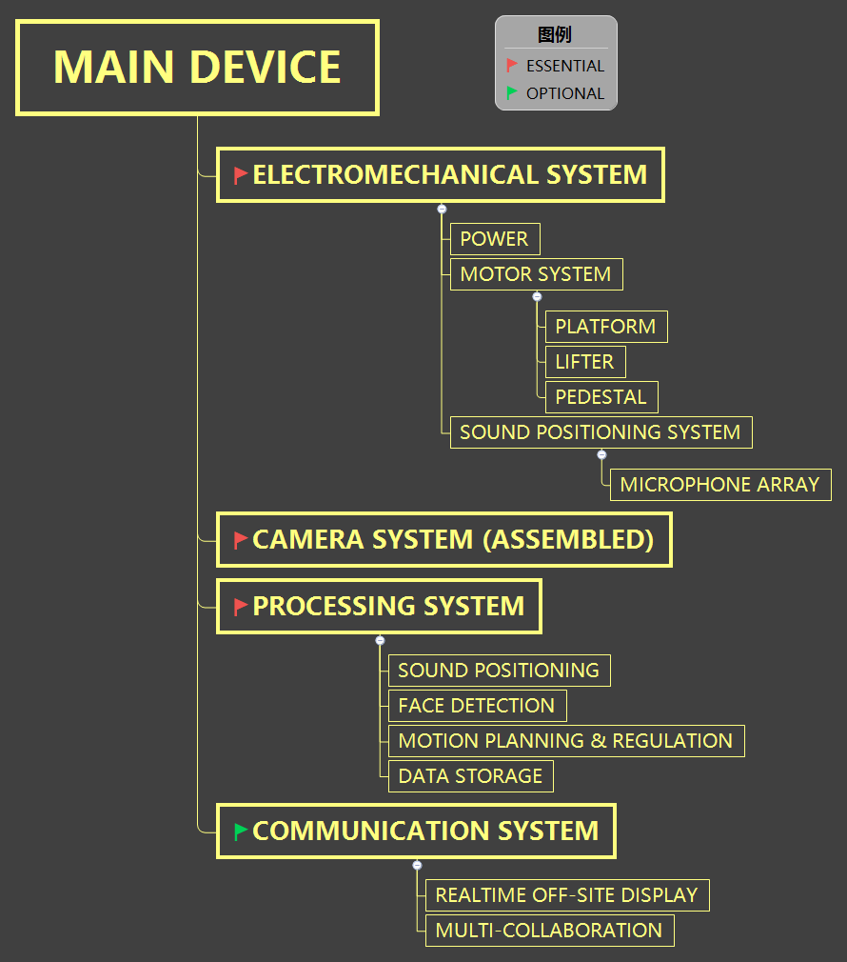
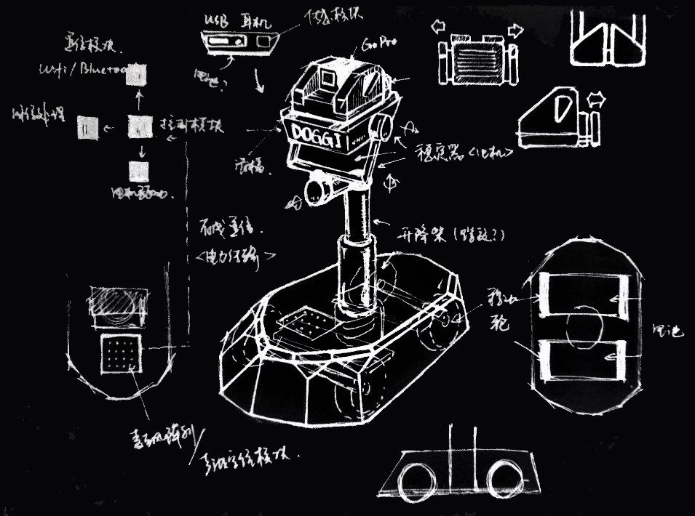
DESIGN-STRUCTURE
8/22

Slide 10

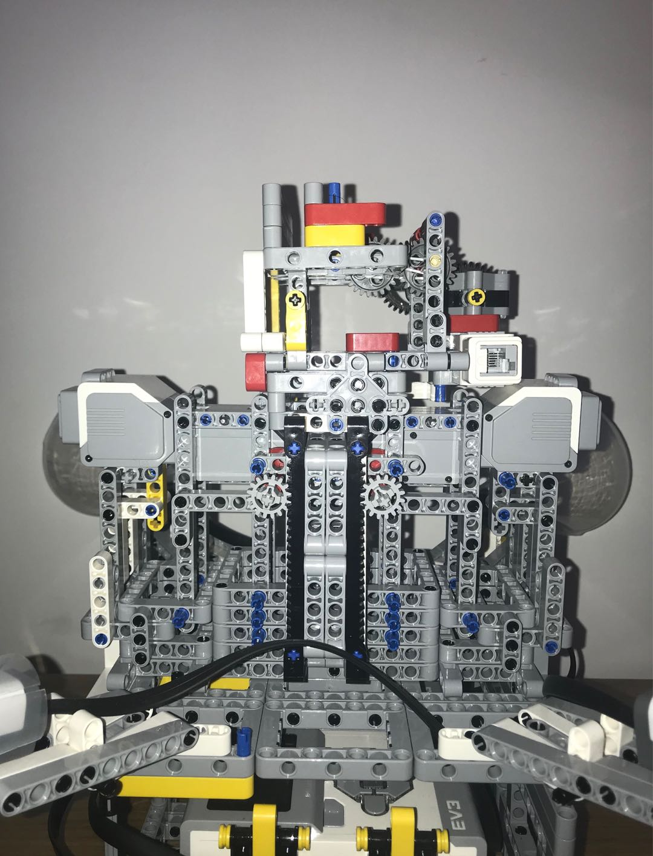
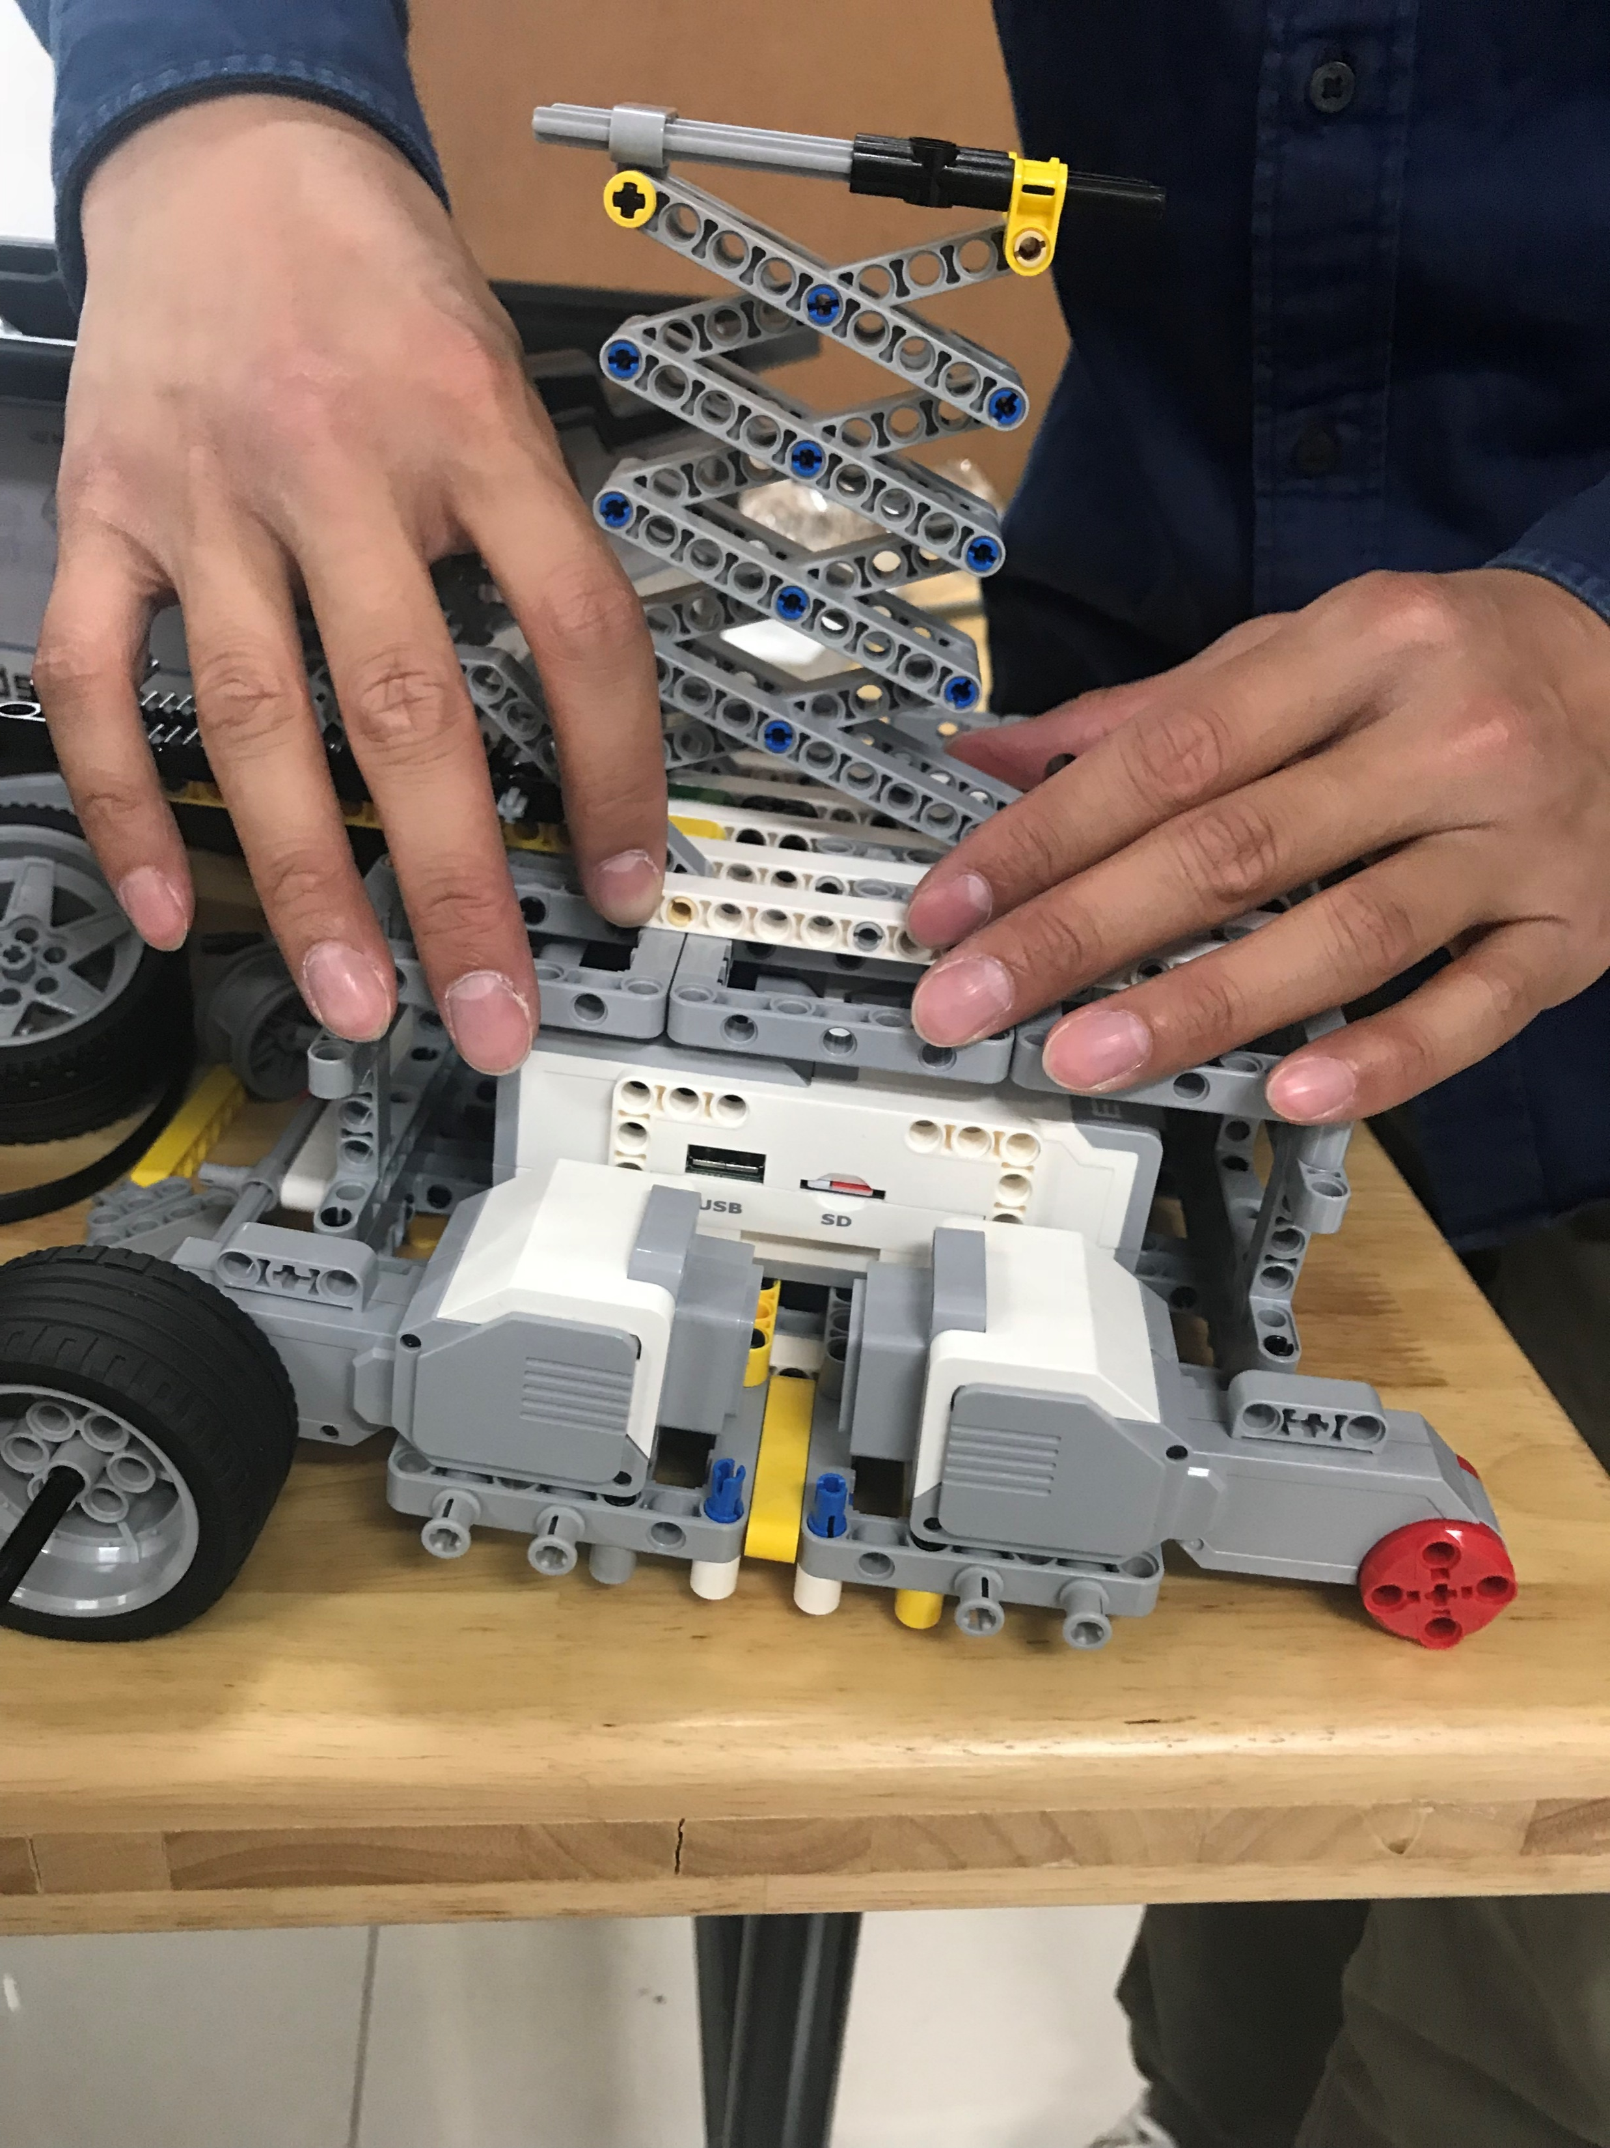
MECHANICS
Lifter
HAHA：
Simple structure
Single motor
HAHA：
Stable
Can carry heavy loadings
BUT：
Motor’s low power
Heavy camera
Unstable
BUT：
Two motors
Complex structure
9/22

Slide 11
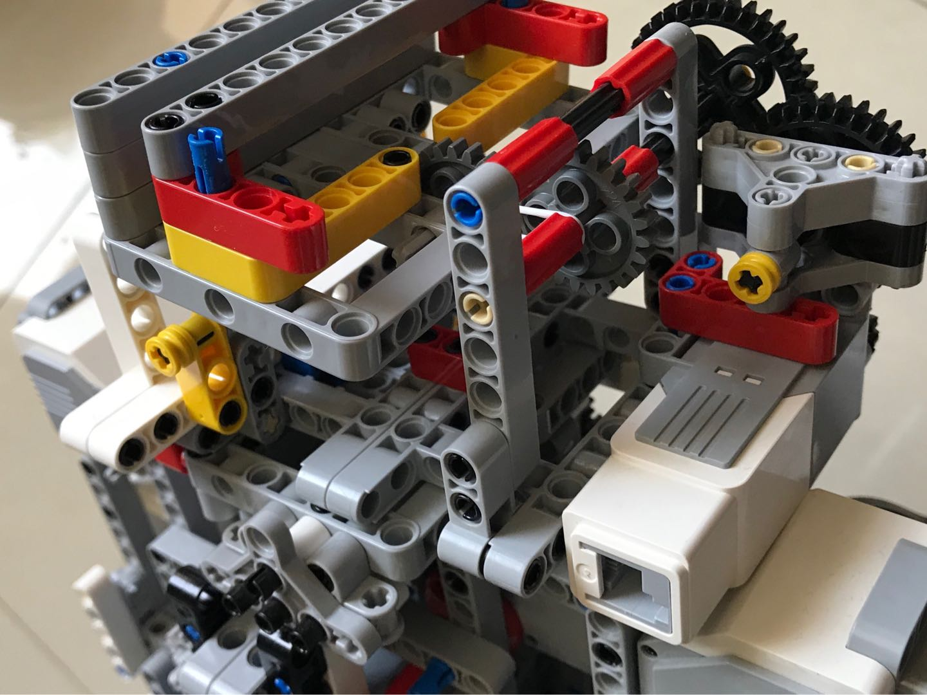
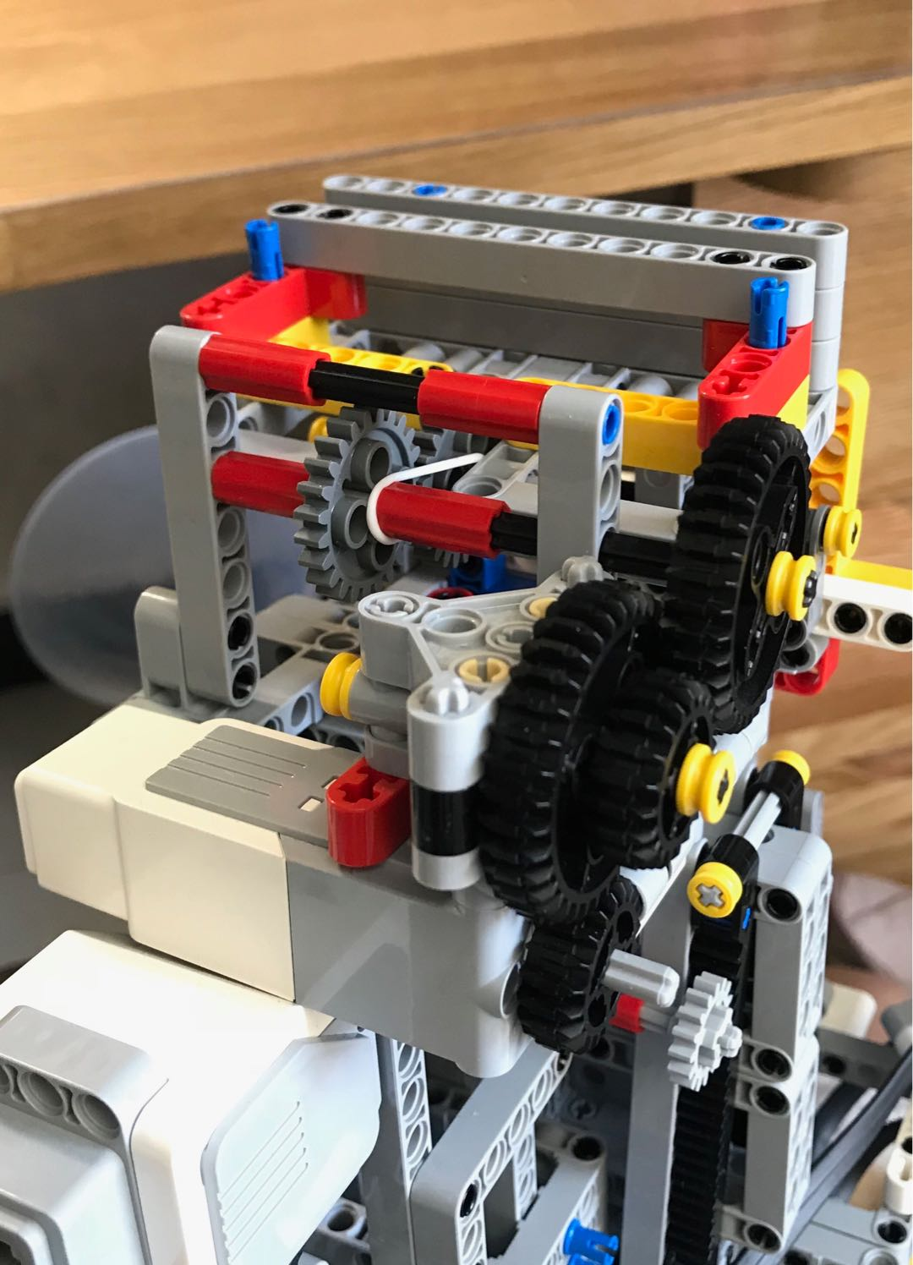
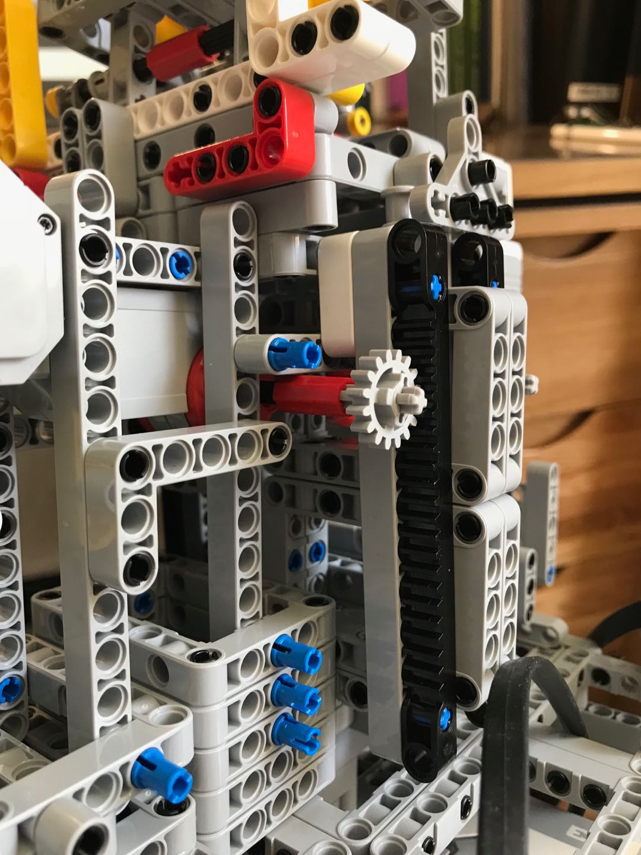
MECHANICS
Upper Lifter
10/22

Slide 12
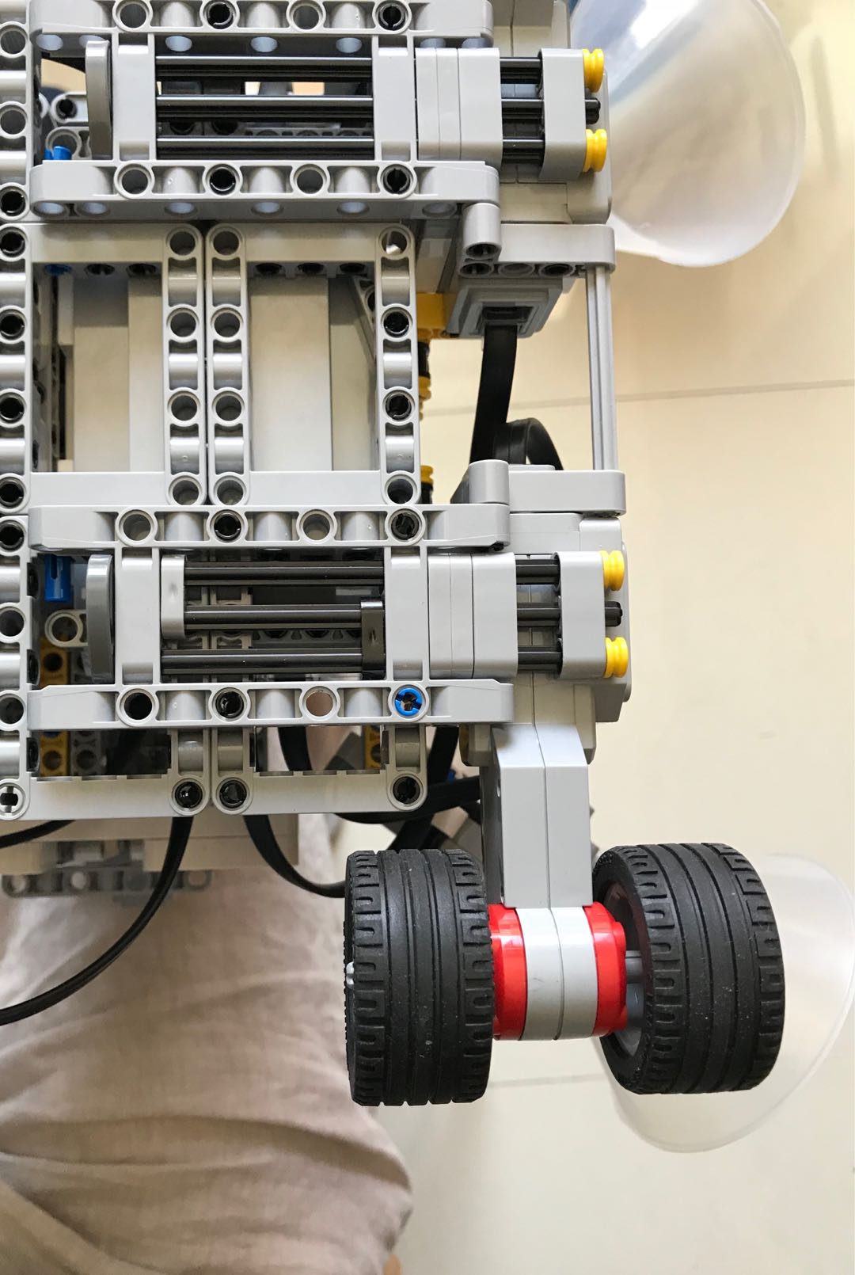
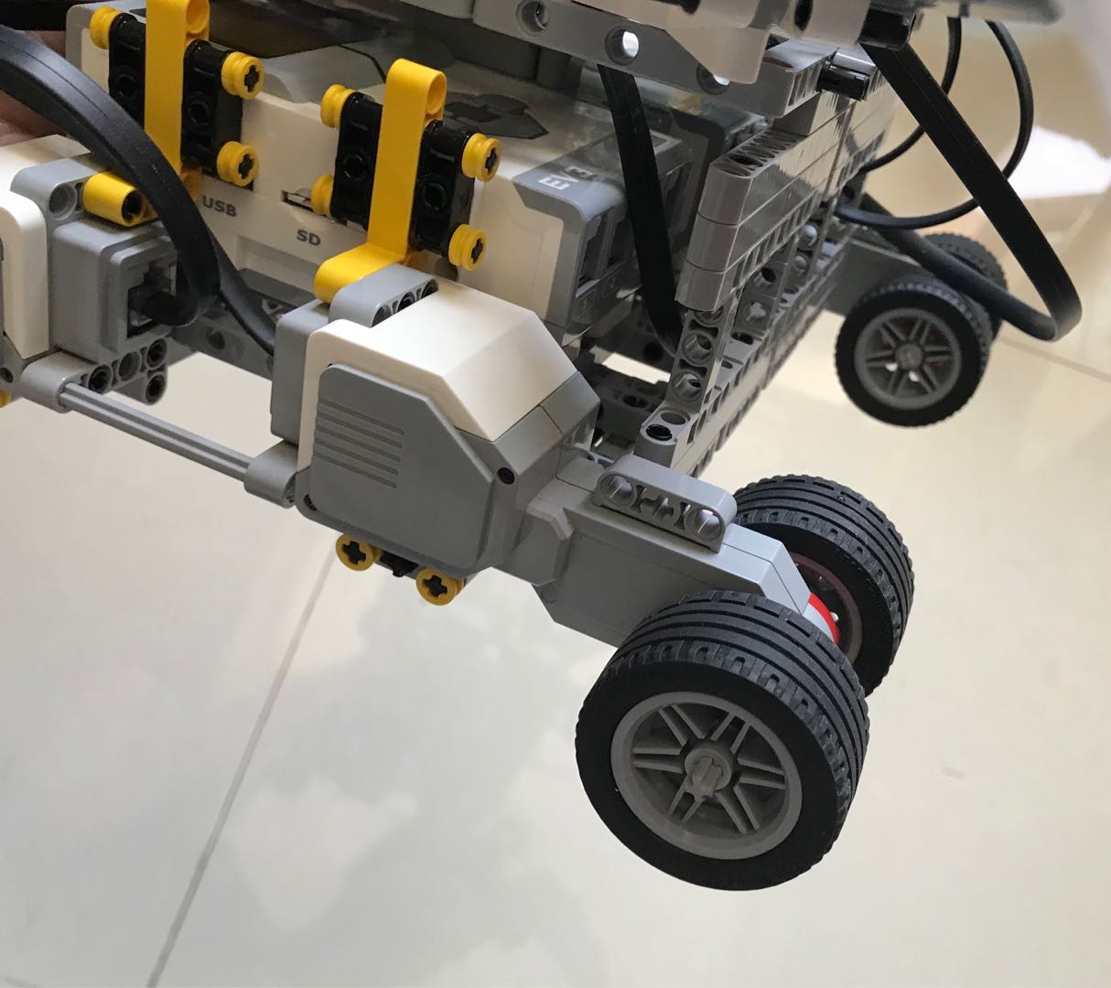
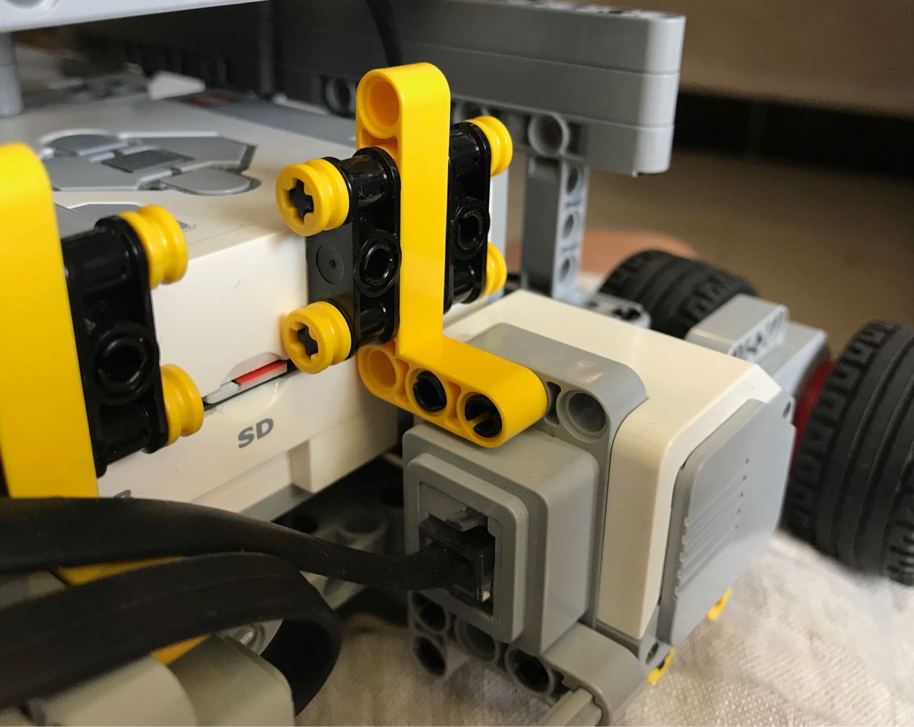
MECHANICS
Wheel and Motor
11/22

Slide 13

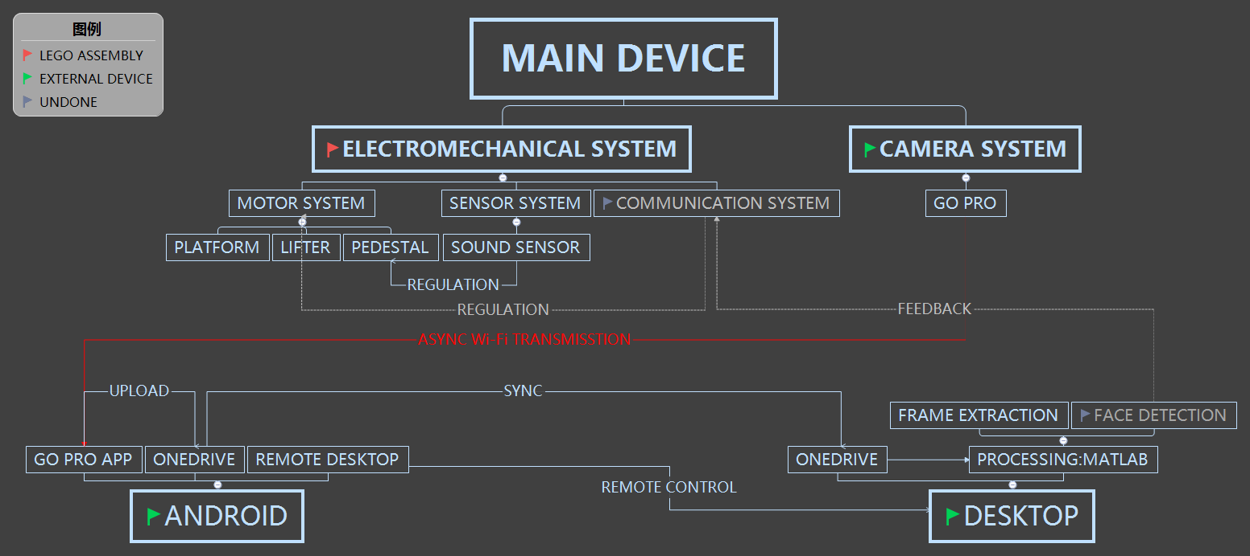
PROGRAM-ITERATIVE DEV-v 1.x
12/22

Slide 14
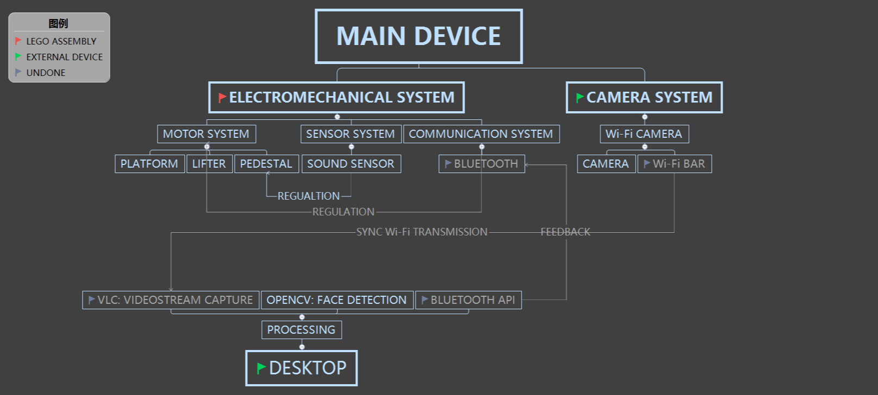
PROGRAM-ITERATIVE DEV-v 2.x
13/22

Slide 15
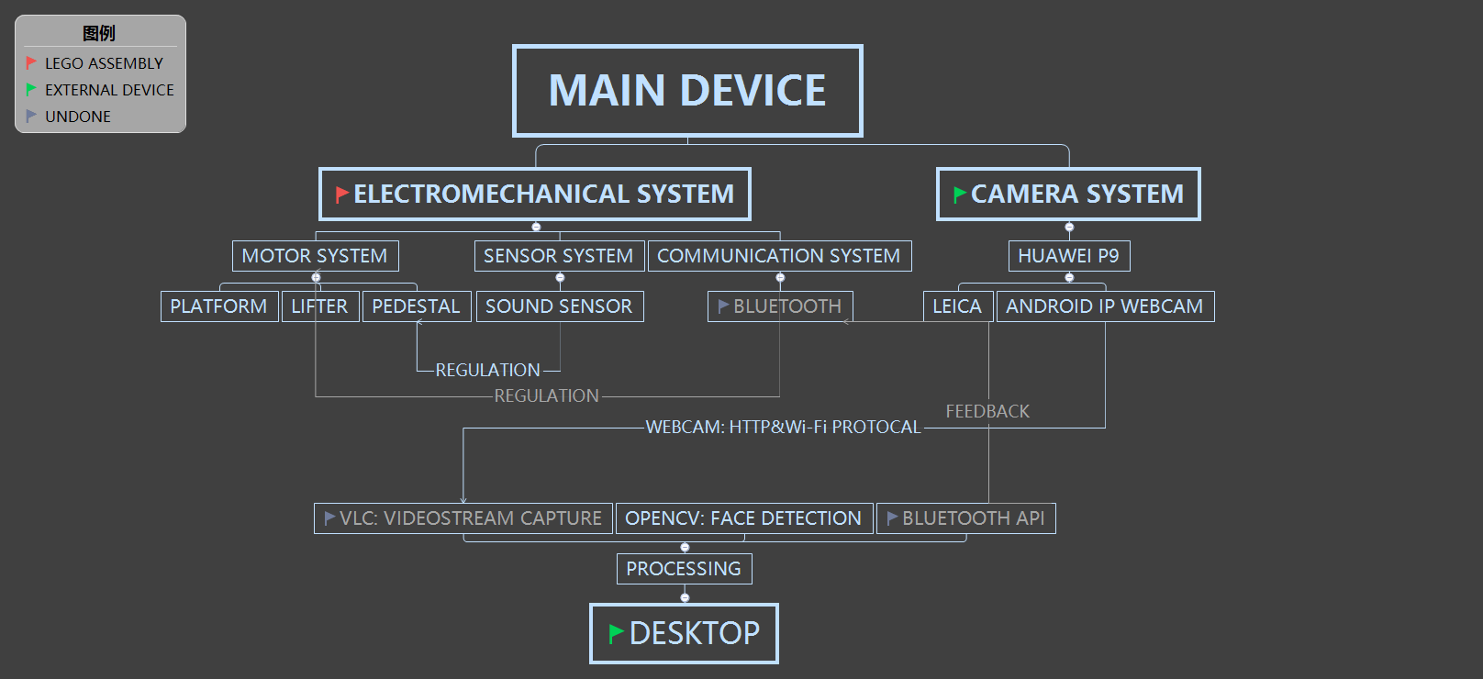
PROGRAM-ITERATIVE DEV-v 3.x
14/22

Slide 16
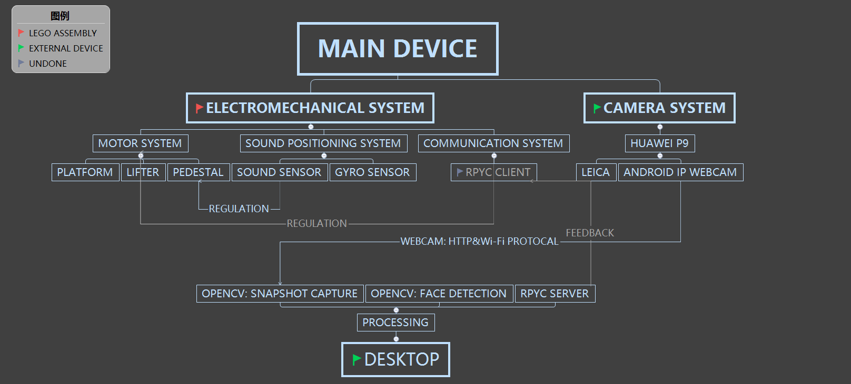
PROGRAM-ITERATIVE DEV-v 4.x
15/22

Slide 17


PROGRAM-SUPPORTIVE TECH(1)
RESOLUTION
MAX:1980$×$1020
ANDROID
IP WEBCAM
FORMAT
MOV/WebM/MKV/MP4
PROTOCOL
HTTP/RTSP
16/22

Slide 18

PROGRAM-SUPPORTIVE TECH(2)
WEAK
HAAR-LIKE FEATURE
CASCADE
CLASSIFIER
STRONG
GENTLE ADABOOST
ACCURATE
CASCADE
17/22

Slide 19
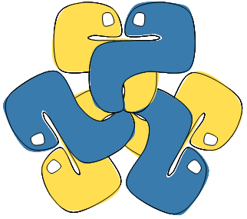
PROGRAM-SUPPORTIVE TECH(3)
TRANSPARENT
REMOTE→LOCAL
RPyC
LIBRARY
OPERATION
SYNC/ASYNC
PLATFORM
AGNOSTIC
18/22

Slide 20




ASSESSMENT
LIMITED & BIASED
DATA SOURCE
INACCURATE ANALYSIS
ANDROID DEV
CASCADE CLASSIFIER
SPECIFICATION
FURTHER DEMAND
MINING
19/22
Icon made by Linector & Freepik from www.flaticon.com

Slide 21



FUTURE
MICROPHONE ARRAY
UNIVERSALITY
EMBEDDED PROCESSOR
WIRELESS-SUPPORTED
MULTI-COLLABORATION
CASCADE CLASSIFIER
TRAINING
AUTONOMOUS NAVI-
GATION ALGORITHM
Icon made by @ rafael3334 & @ healy from www.onlinewebfonts.com
Icon made by Prosymbols from www.flaticon.com
20/22

Slide 22
REFERENCE
[1] 目标检测（Object Detection）原理与实现(五):
https://blog.csdn.net/marvin521/article/details/9173645
[2] Lienhart, R. Kuranov, A. Pisarevsky, V. (2002). Empirical analysis of detection cascades of
boosted classifiers for rapid object Detection [PDF file]. MRL Technical Report.
Available from http://www.lienhart.de/Prof._Dr._Rainer_Lienhart/Publications_files/MRL-TR
-May02-revised-Dec02_1.pdf
[3] Adaboost_百度百科：https://baike.baidu.com/item/adaboost
[4] Viola Jones Face Detector: http://www.cnblogs.com/hrlnw/p/3374707.html
[5] RPyC - Transparent, Symmetric Distributed Computing:
http://rpyc.readthedocs.io/en/latest/#
21/22

Slide 23
APPENDIX
[1] QUESTIONAIRE CONTENT：
https://www.wjx.cn/jq/22064800.aspx
[2] QUESTIONAIRE STATISTICS：
https://www.wjx.cn/report/22064800.aspx
[3] ALL RELATED FILES AVAILABLE @：
https://github.com/Iceblaze9527/Doggi_Fundamentals-of-Shaping
22/22

Slide 24
THANKS F R LISTENING
2018.05.28

