Slide 1

ExteriScan

Slide 2




Slide 3
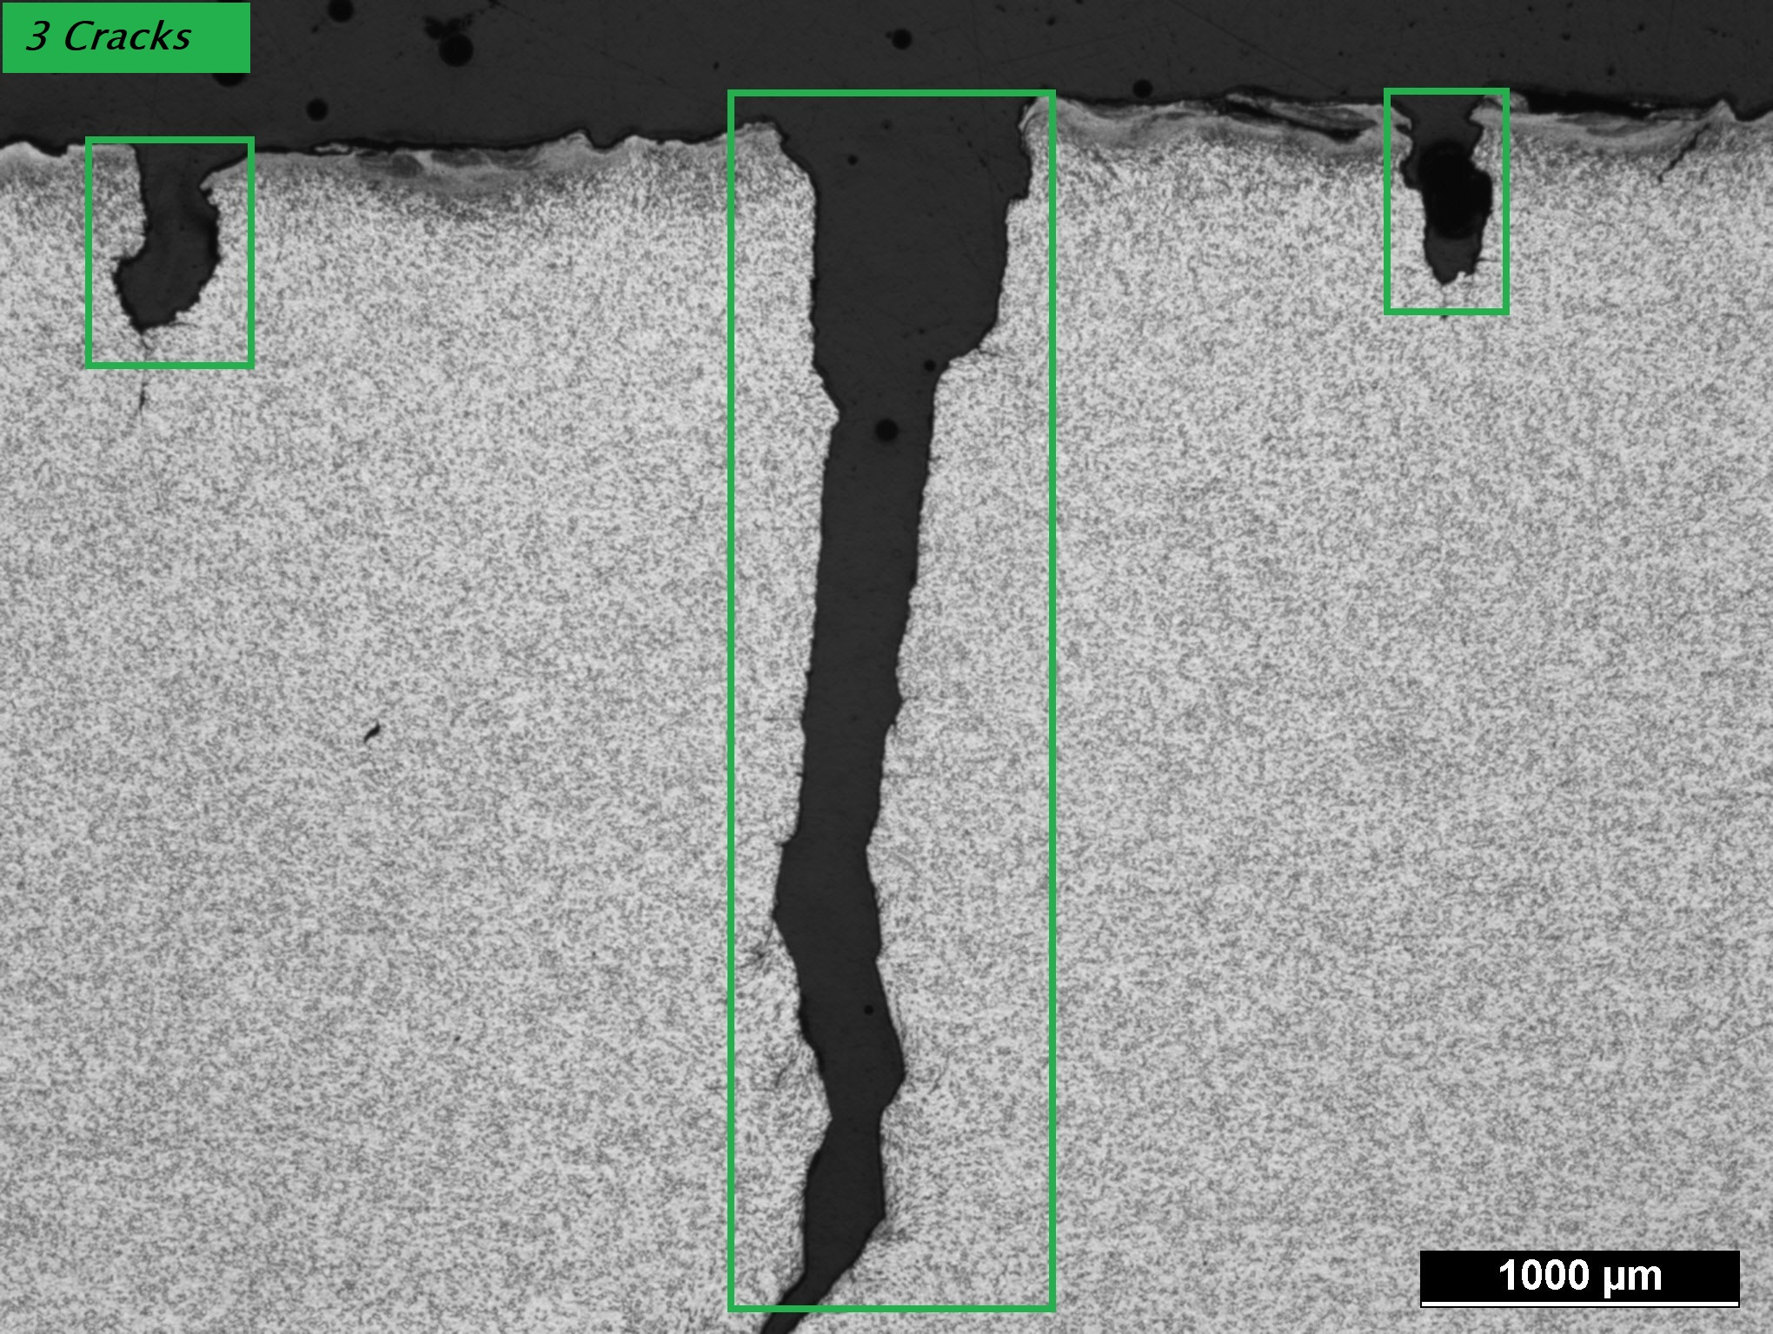

Slide 4
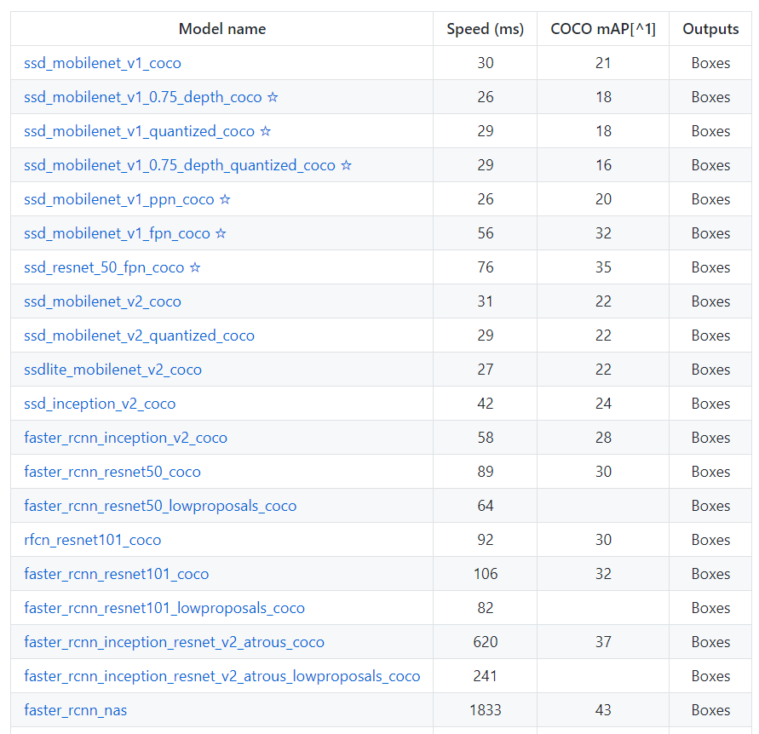
Single Shot Detector
MobilNet

Slide 5
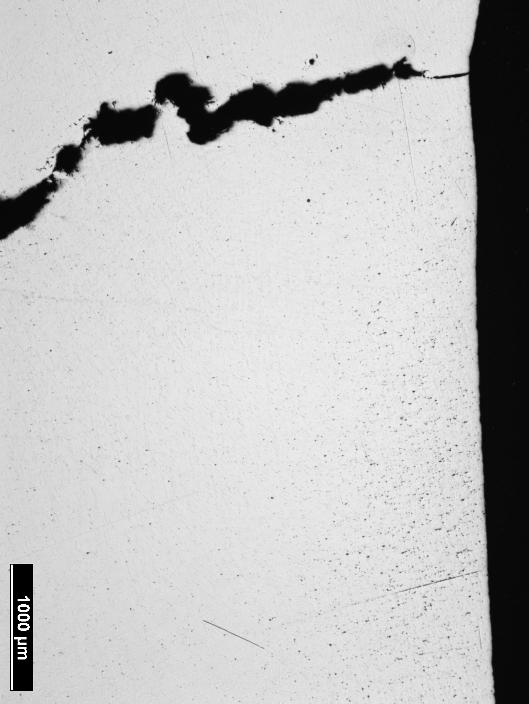
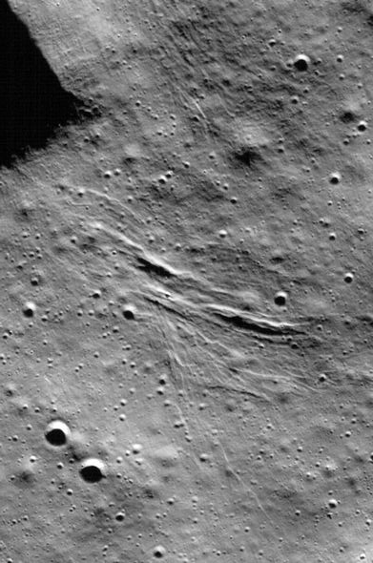
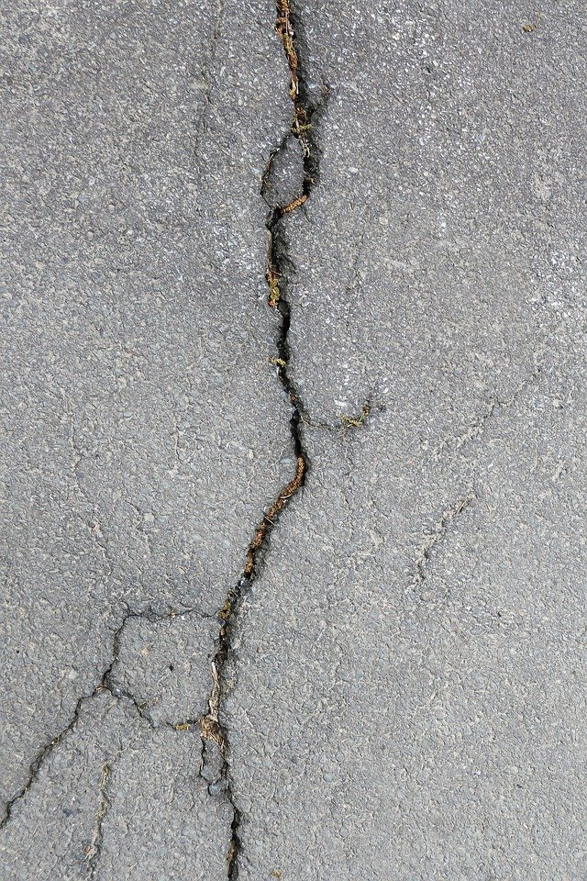

Slide 6
Thank you,
for hosting this amazing challenge

