Slide 1
Testing VAE Model_v0 2021-11-03
Structure ENCODER
encoder_inputs = keras.Input(shape=(cutout_size, cutout_size,n_bands))
x = layers.Conv2D(filter_1, kernel_size, activation="relu", strides=2,
padding="same")(encoder_inputs)
x = layers.Conv2D(filter_2, kernel_size, activation="relu", strides=2,
padding="same")(x)
x = layers.Flatten()(x) # to vector
x = layers.Dense(dense_size, activation="relu")(x) # linked layer
z_mean = layers.Dense(latent_dim, name="z_mean")(x)
z_log_var = layers.Dense(latent_dim, name="z_log_var")(x)
z = Sampling()([z_mean, z_log_var])
encoder = keras.Model(encoder_inputs, [z_mean, z_log_var, z],
name="encoder")

Slide 2
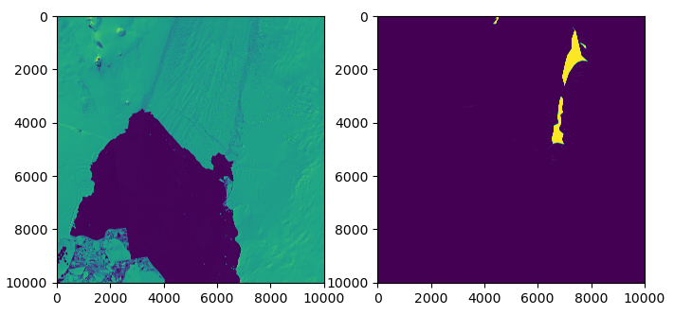
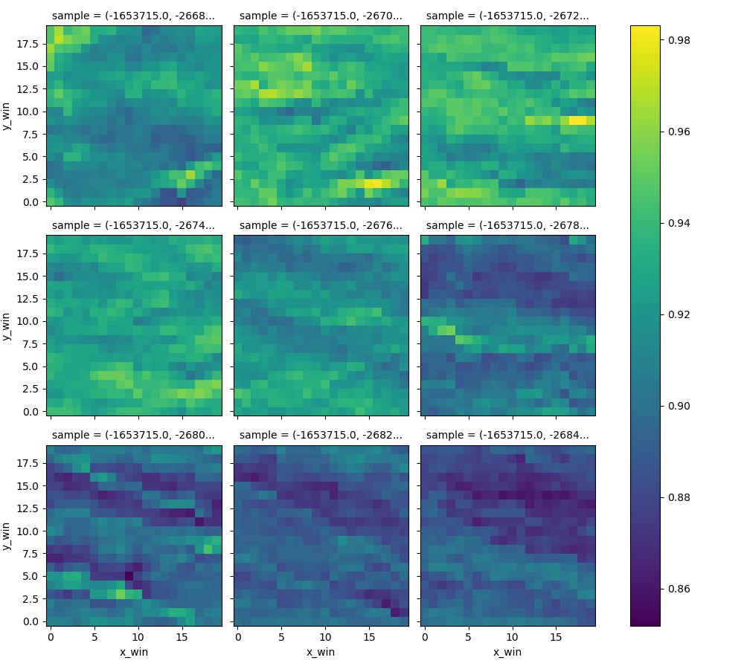
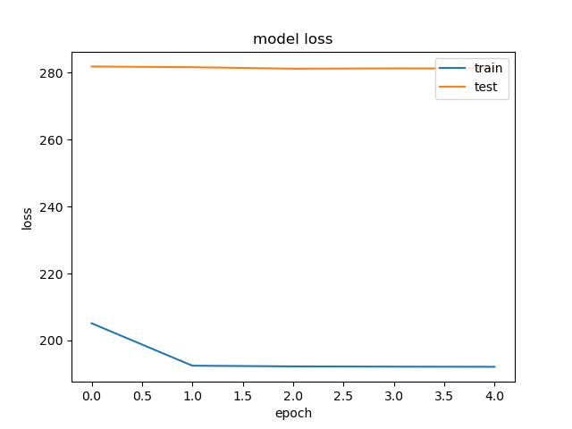
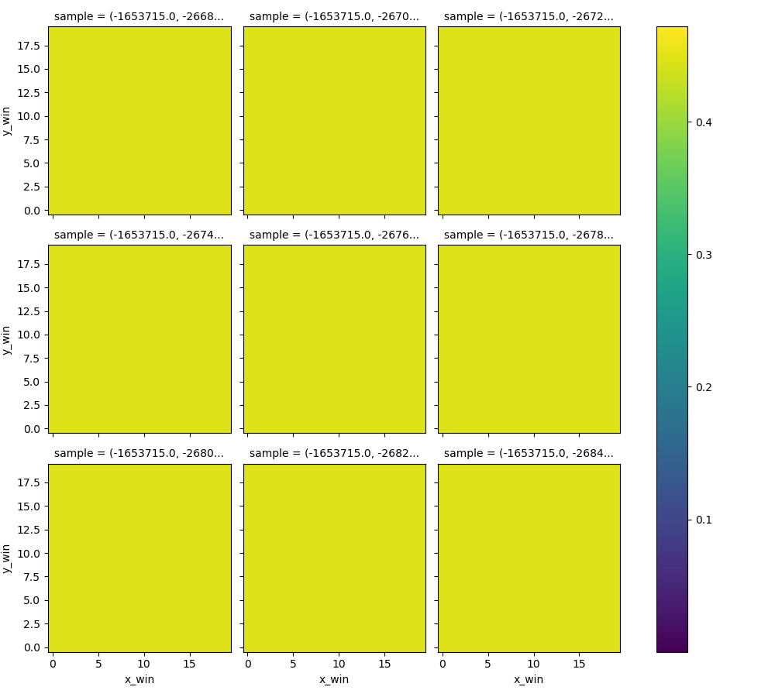
traindata
model_1635951267
‘starting’ settings
Model doesn’t learn anything
data
normalizationThreshold = 20000
# MODELSETTINGS
filter1 = 3
filter2 = 2
kernelSize = 5
denseSize = 16
latentDim = 4
#vae:
alpha = 5
# training
nEpochs = 5
batchSize = 128
validationSplit = 0.3
Latent space
reconstruction

Slide 3
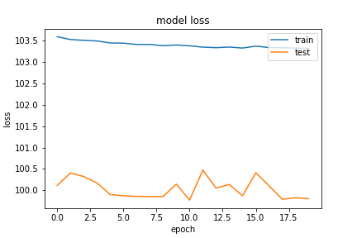
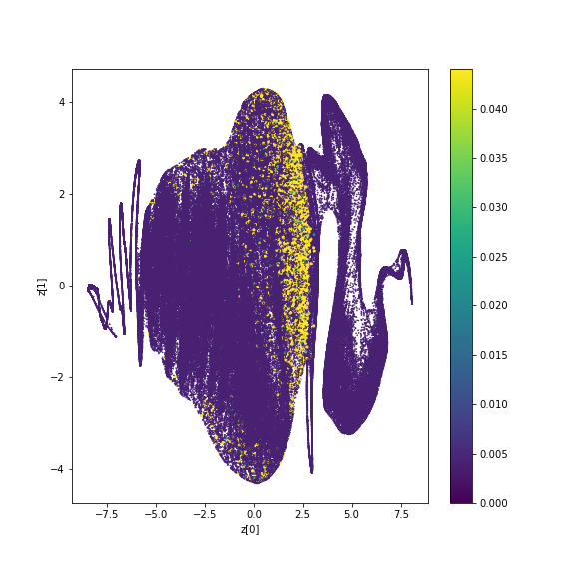
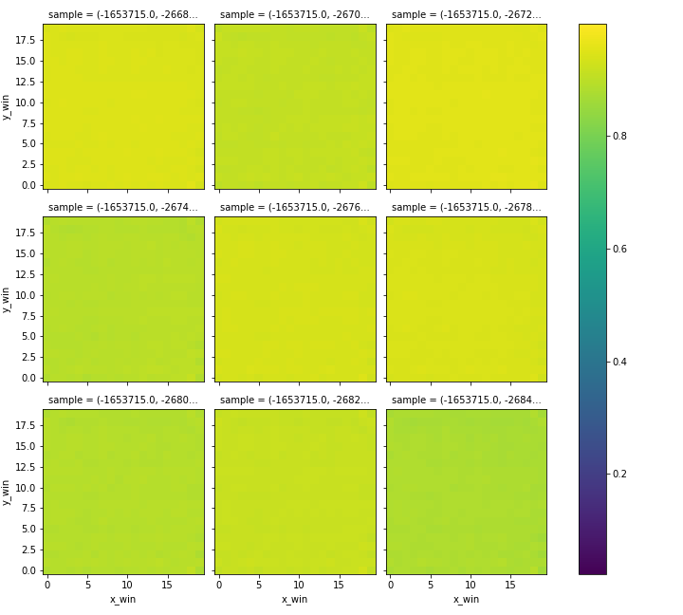
traindata
model_1635936519
Adjust threshold
Increase filter size
→ No convergence
data
normalizationThreshold = 10000
# MODELSETTINGS filter1 = 30
filter2 = 2
kernelSize = 5
denseSize = 16
latentDim = 4
#vae: alpha = 5
# training
nEpochs = 10
batchSize = 128
validationSplit = 0.3
Latent space
reconstruction

Slide 4
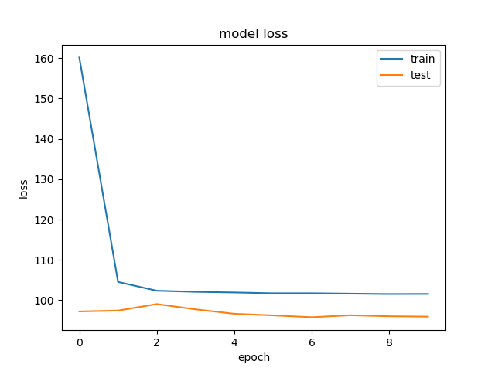
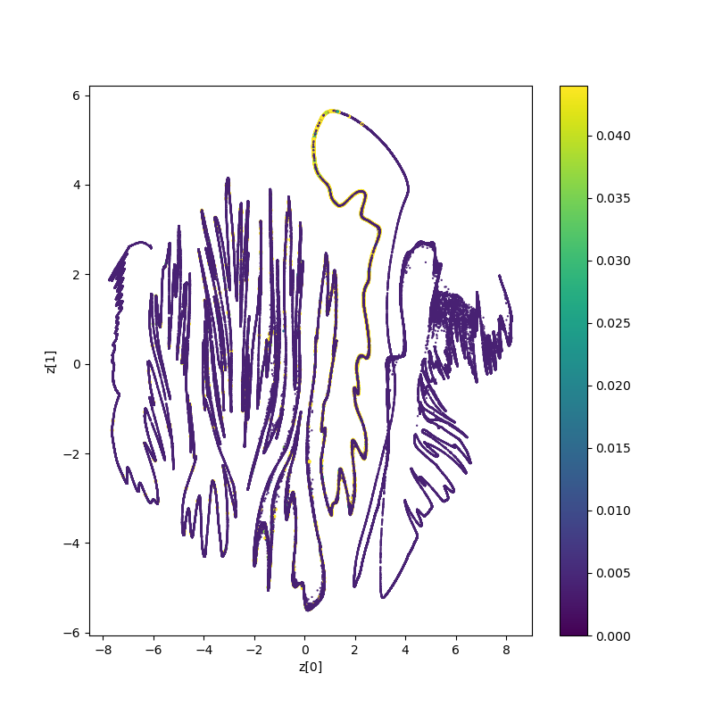
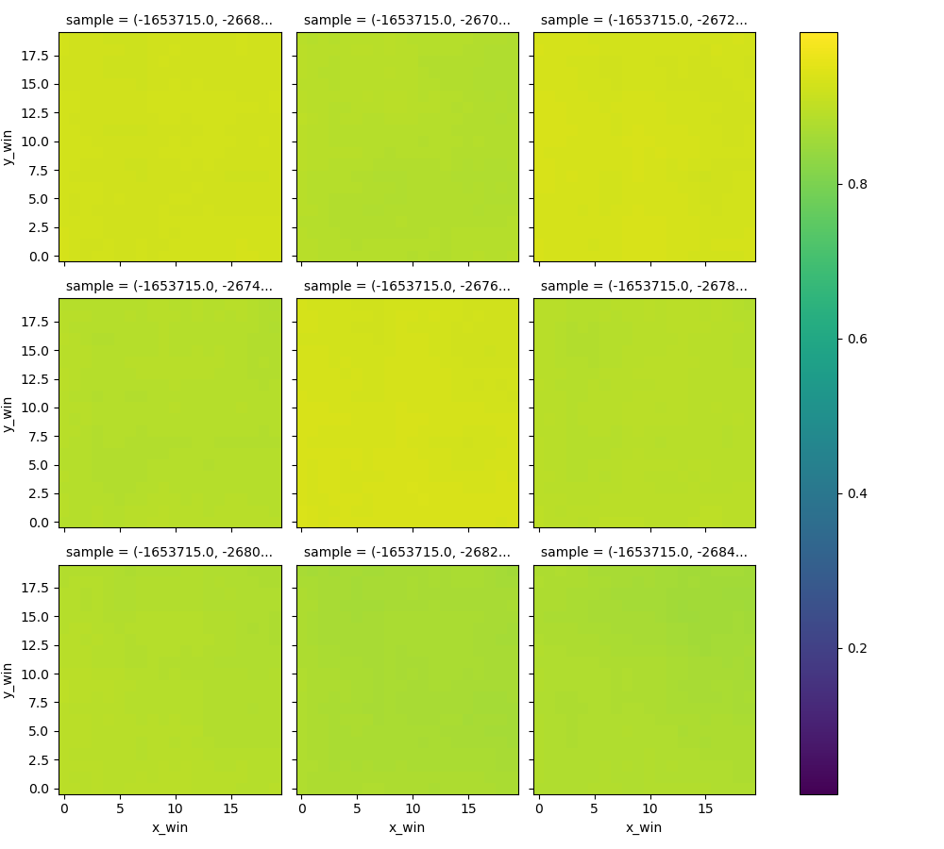
traindata
model_1635956184
Increase filter size
→ Some convergence but not a lot of progress and/or reconstruction
data
normalizationThreshold = 10000
# MODELSETTINGS
filter1 = 64
filter2 = 32
kernelSize = 5
denseSize = 16
latentDim = 4
#vae:
alpha = 5
# training
nEpochs = 10
batchSize = 128
validationSplit = 0.3
Latent space
reconstruction

Slide 5
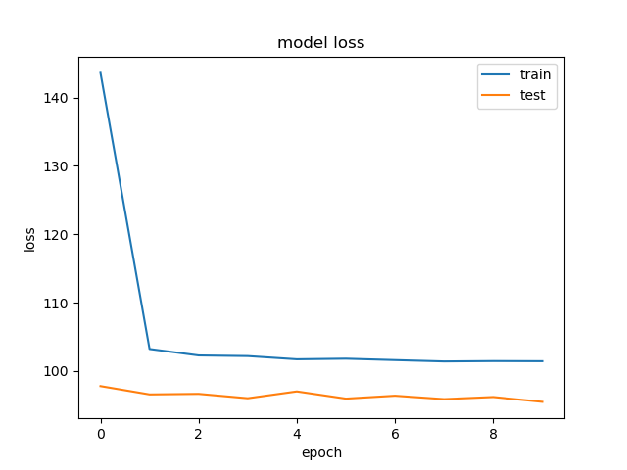
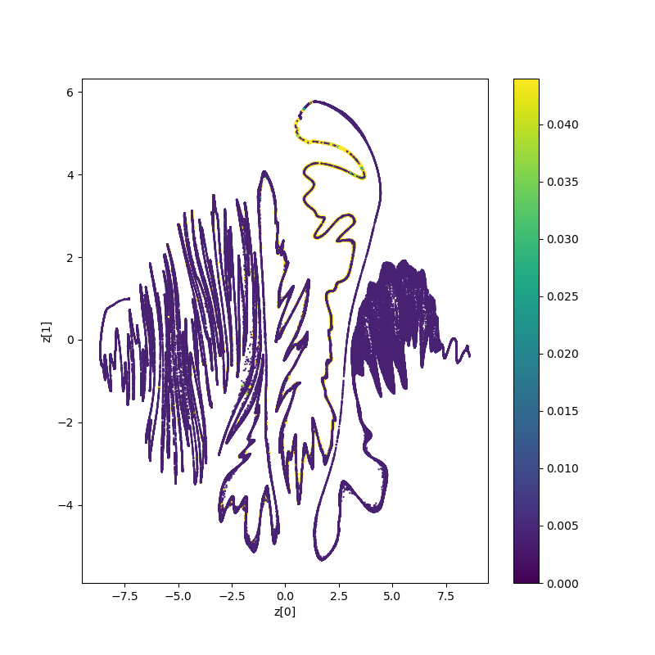
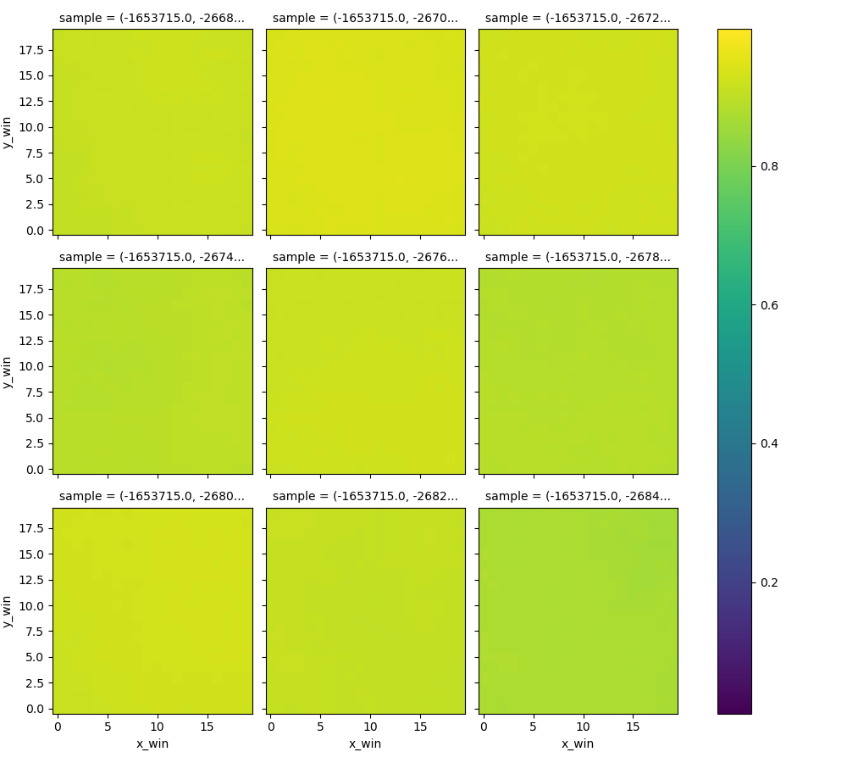
traindata
model_1635959124
Decrease latent-space dimension
→ Not real change w.r.t. L_dim=4 (model_1635956184)
data
normalizationThreshold = 10000
# MODELSETTINGS
filter1 = 64
filter2 = 32
kernelSize = 5
denseSize = 16
latentDim = 20 [implementation error oops]
#vae:
alpha = 5
# training
nEpochs = 10
batchSize = 128
validationSplit = 0.3
Latent space
reconstruction

Slide 6
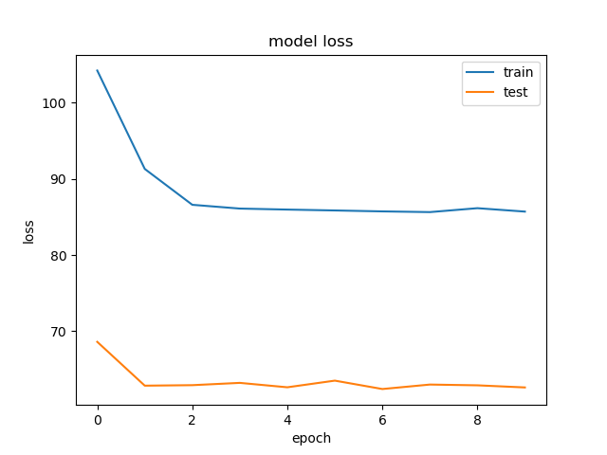
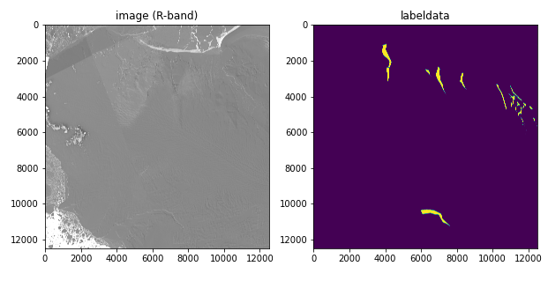
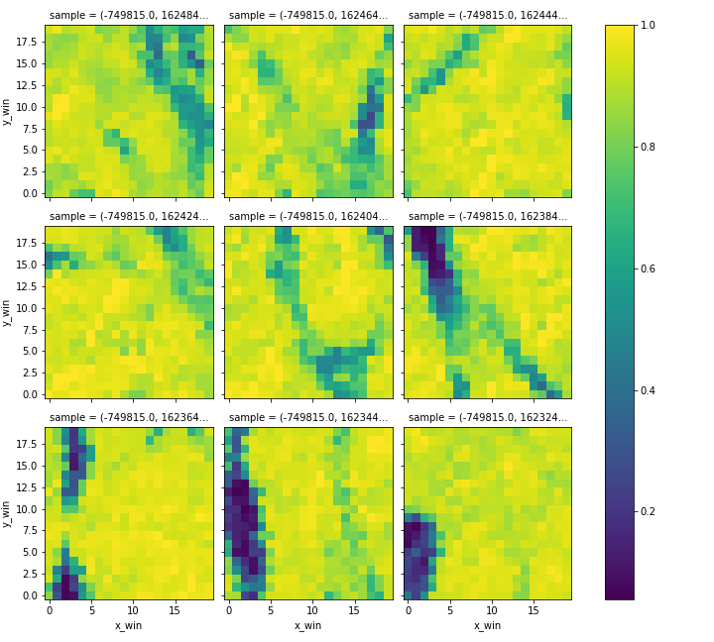
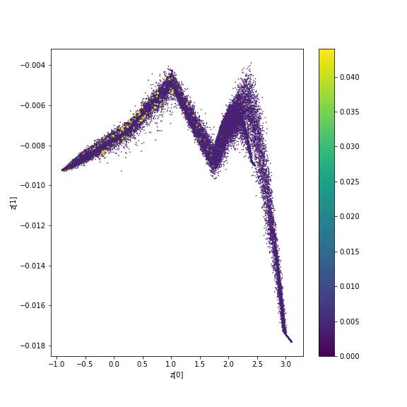
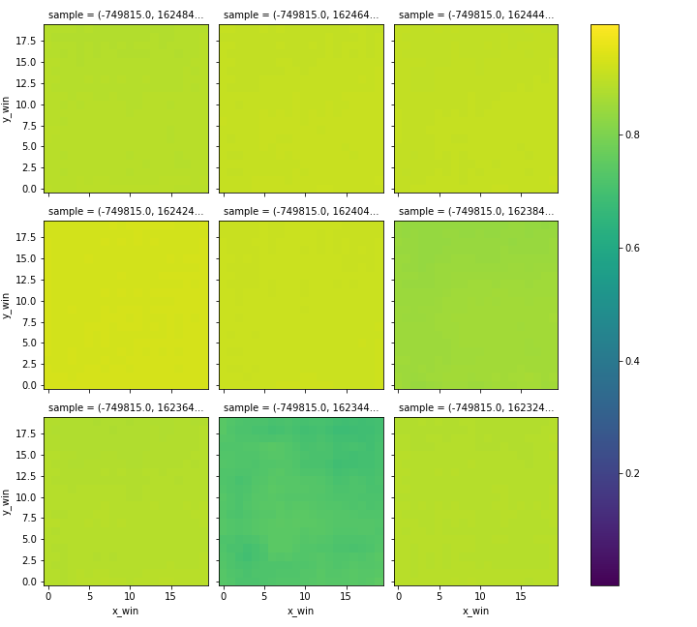
traindata
model_1635959711
Change train data
→ Reconstruction starts to generate somewhat differentiating values; more promising input data
data
normalizationThreshold = 10000
# MODELSETTINGS
filter1 = 64
filter2 = 32
kernelSize = 5
denseSize = 16
latentDim = 2
#vae:
alpha = 5
# training
nEpochs = 10
batchSize = 128
validationSplit = 0.3
Latent space
reconstruction

Slide 7
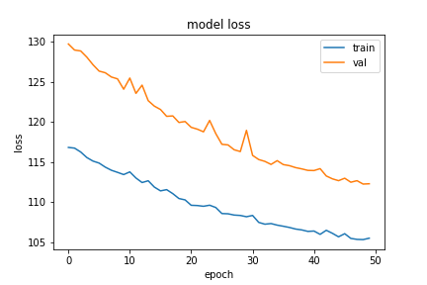
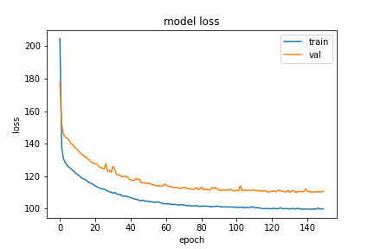
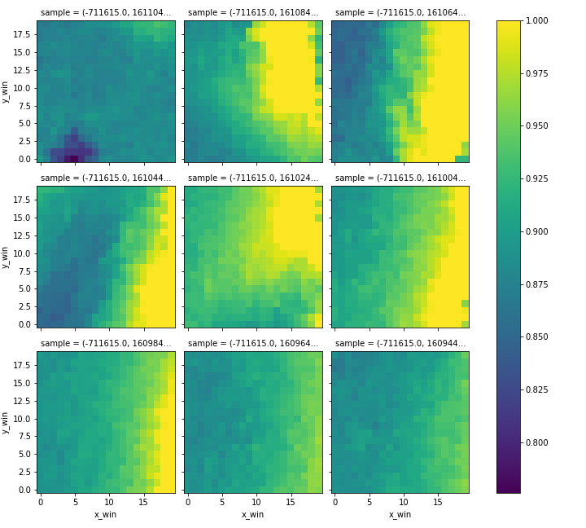
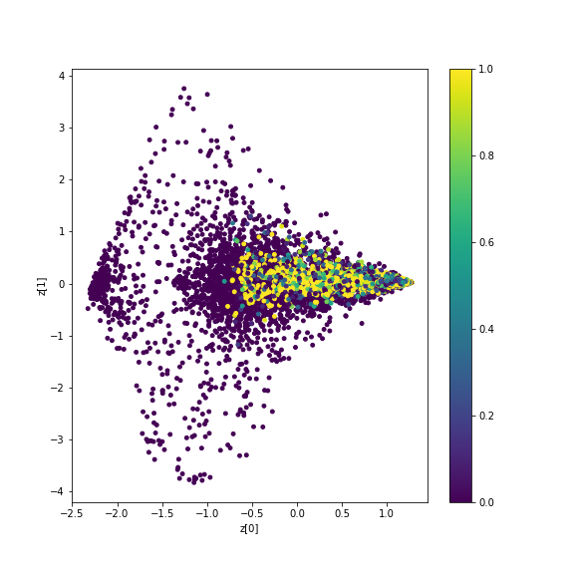
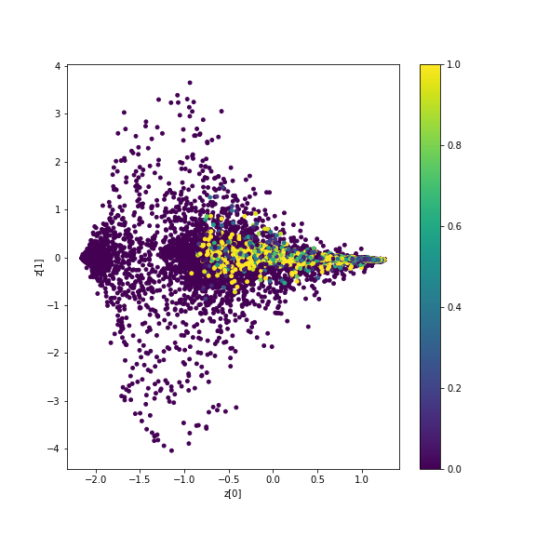
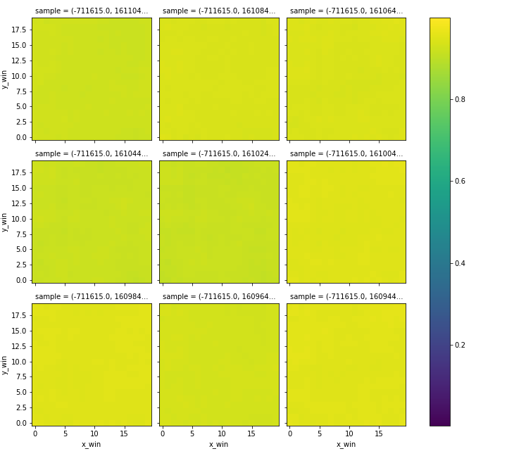
traindata
model_1636032781
Balanced label-data ratio 1:2
→ More epochs
data
balance_ratio = 0.5
normalizationThreshold = 10000
# MODELSETTINGS
filter1 = 64
filter2 = 32
kernelSize = 5
denseSize = 16
latentDim = 2
#vae:
alpha = 5
# training
nEpochs = 50 or 150
batchSize = 128
validationSplit = 0.3
Latent space
reconstruction

Slide 8
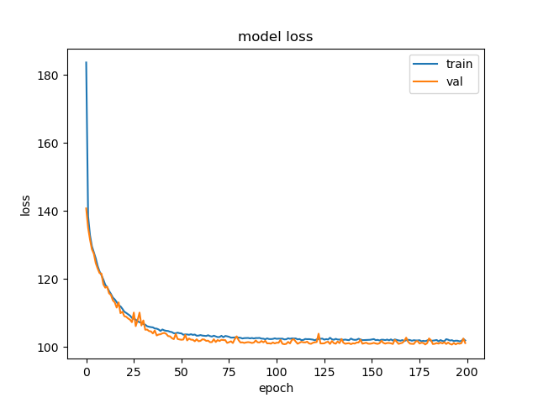
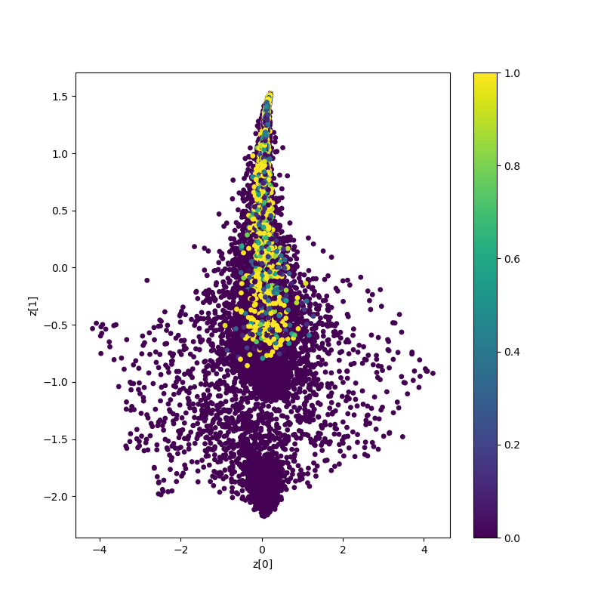
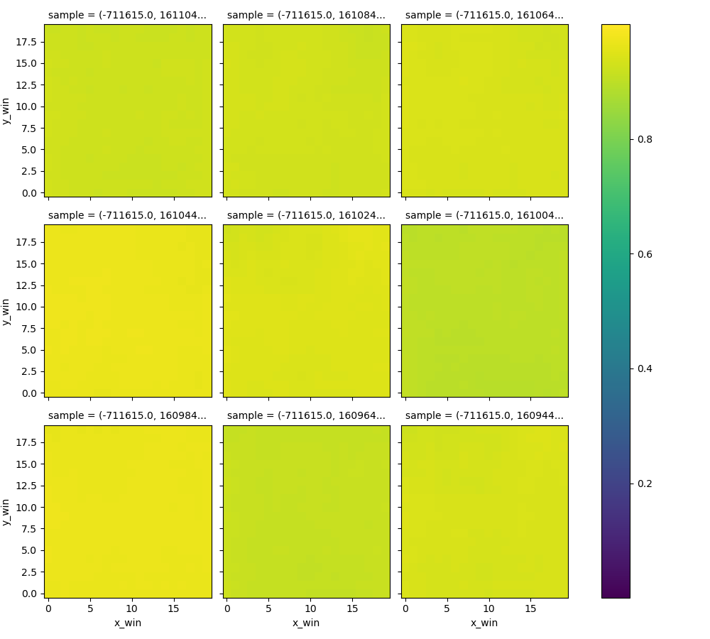
traindata
model_1636101148
Balanced label-data ratio 1:4
Convergence, but not a curve
Still bad reconstruction
→ Increase model complexity
data
balanceRatio = 0.25
normalizationThreshold = 10000
# MODELSETTINGS
filter1 = 64
filter2 = 16
kernelSize = 5
denseSize = 16
latentDim = 2
#vae:
alpha = 5
# training
nEpochs = 200
batchSize = 128
validationSplit = 0.3
Latent space
reconstruction

Slide 9
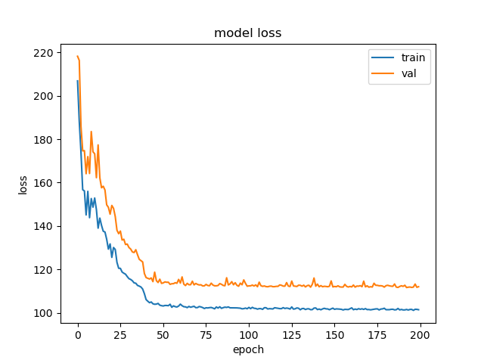
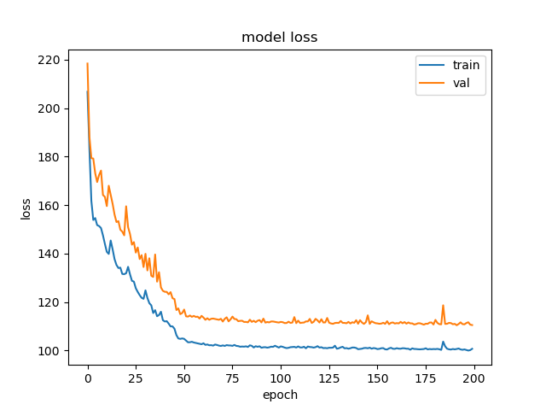
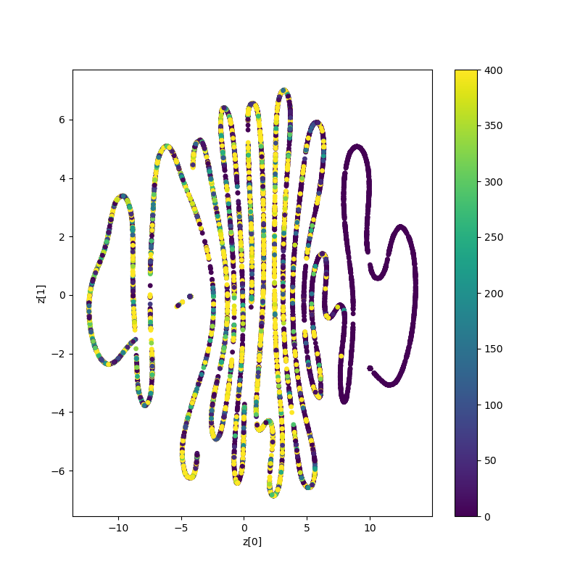
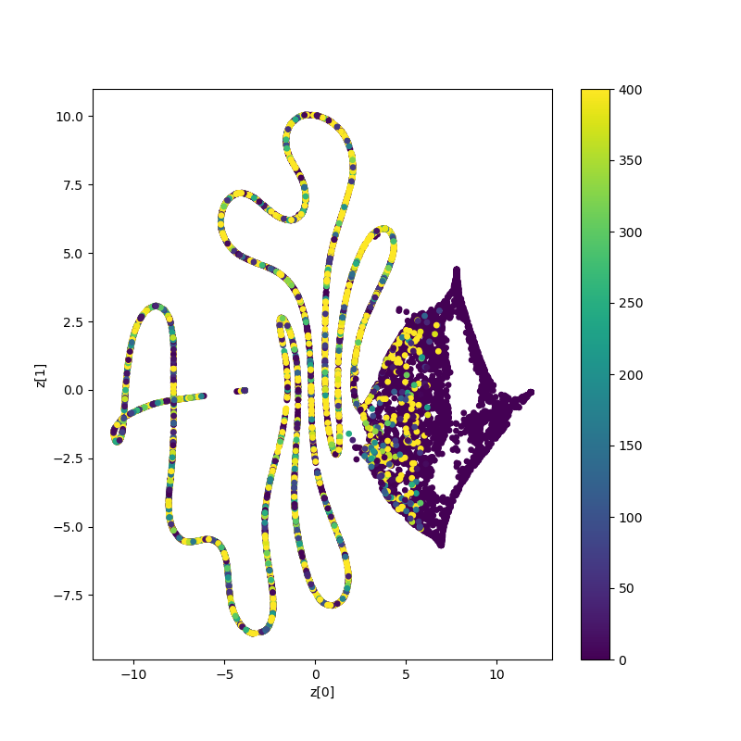
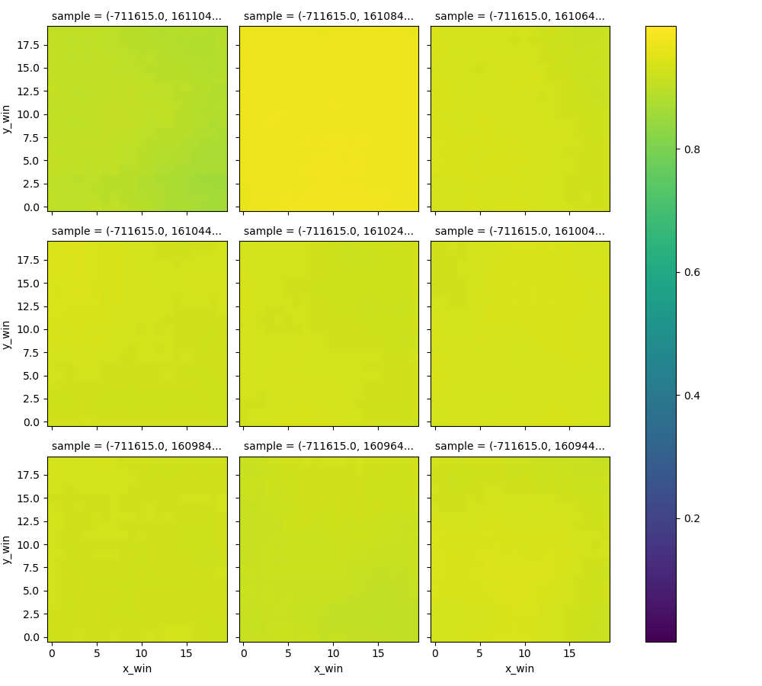
traindata
model_1636042329
Balanced label-data
Balance ratio 1:4 or 1:2 labelled:unlabelled
data
balance_ratio = 0.25 or 0.5
normalizationThreshold = 10000
# MODELSETTINGS
filter1 = 64
filter2 = 32
kernelSize = 5
denseSize = 16
latentDim = 20 (foutje)
#vae:
alpha = 5
# training
nEpochs = 200
batchSize = 128
validationSplit = 0.3
Latent space
reconstruction

Slide 10
Adjusting complexity: questions
Structure ENCODER
encoder_inputs = keras.Input(shape=(cutout_size, cutout_size,n_bands))
x = layers.Conv2D(filter_1, kernel_size, activation="relu", strides=2,
padding="same")(encoder_inputs)
x = layers.Conv2D(filter_2, kernel_size, activation="relu", strides=2,
padding="same")(x)
x = layers.Flatten()(x) # to vector
x = layers.Dense(dense_size, activation="relu")(x) # linked layer
z_mean = layers.Dense(latent_dim, name="z_mean")(x)
z_log_var = layers.Dense(latent_dim, name="z_log_var")(x)
z = Sampling()([z_mean, z_log_var])
encoder = keras.Model(encoder_inputs, [z_mean, z_log_var, z],
name="encoder")

Slide 11
Adjusting complexity: questions
Structure DECODER
latent_inputs = keras.Input(shape=(latent_dim,))
x = layers.Dense(last_conv2d_shape * last_conv2d_shape * filter_2,
activation="relu")(latent_inputs)
x = layers.Reshape((last_conv2d_shape, last_conv2d_shape, filter_2))(x)
x = layers.Conv2DTranspose(filter_2, kernel_size, activation="relu", strides=2,
padding="same")(x)
x = layers.Conv2DTranspose(filter_1, kernel_size, activation="relu", strides=2,
padding="same")(x)
why layers.Conv2Dtranspose if can also do layer.Conv2D?
decoder_outputs = layers.Conv2DTranspose(3, 3, activation="sigmoid",
padding="same")(x) # (1,3) or (3,3)
decoder = keras.Model(latent_inputs, decoder_outputs, name="decoder")
decoder.summary()
return decoder

Slide 12
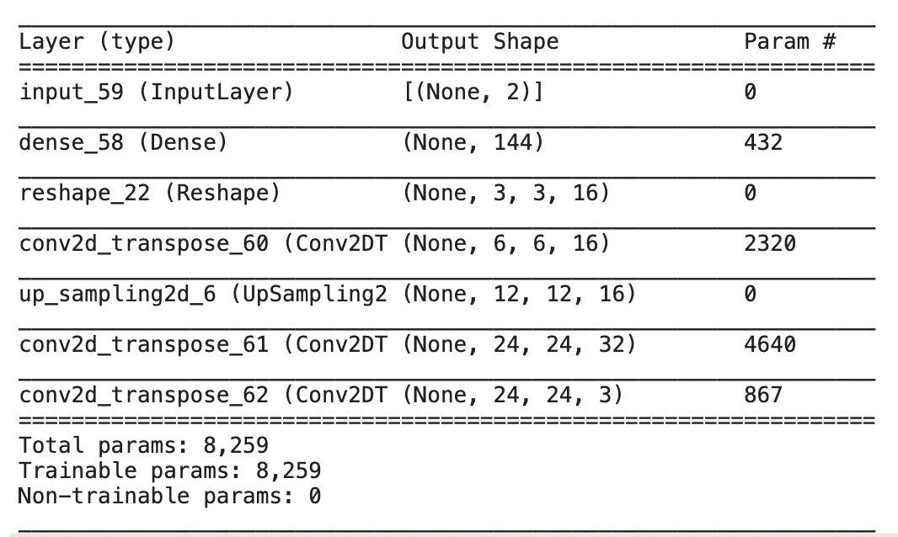
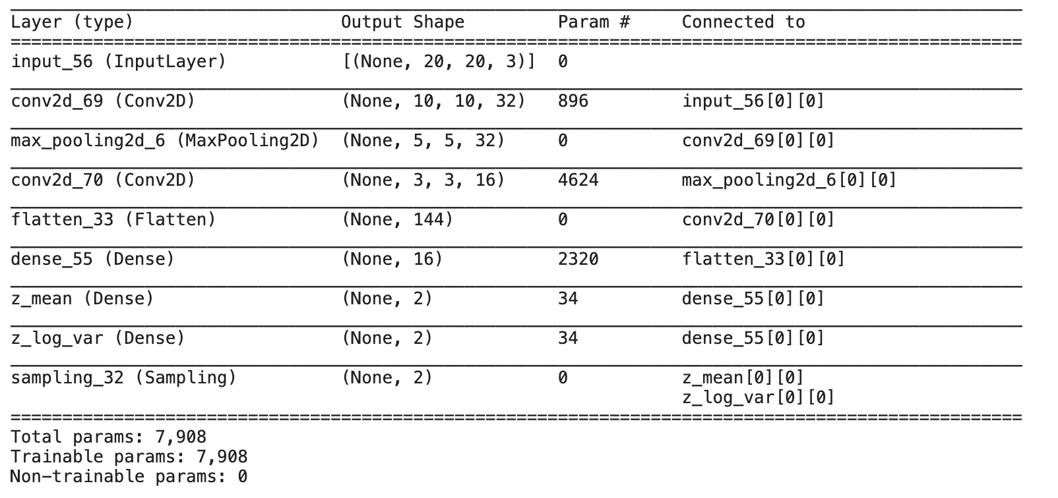
Adjusting complexity: adding maxPooling
Encoder
Decoder
Issue with maxpooling & conv layer:
Shapes in decoder are not similar to encoder
(kernelsize = 3, stride=2)
→ Solved when using stride=1

Slide 13
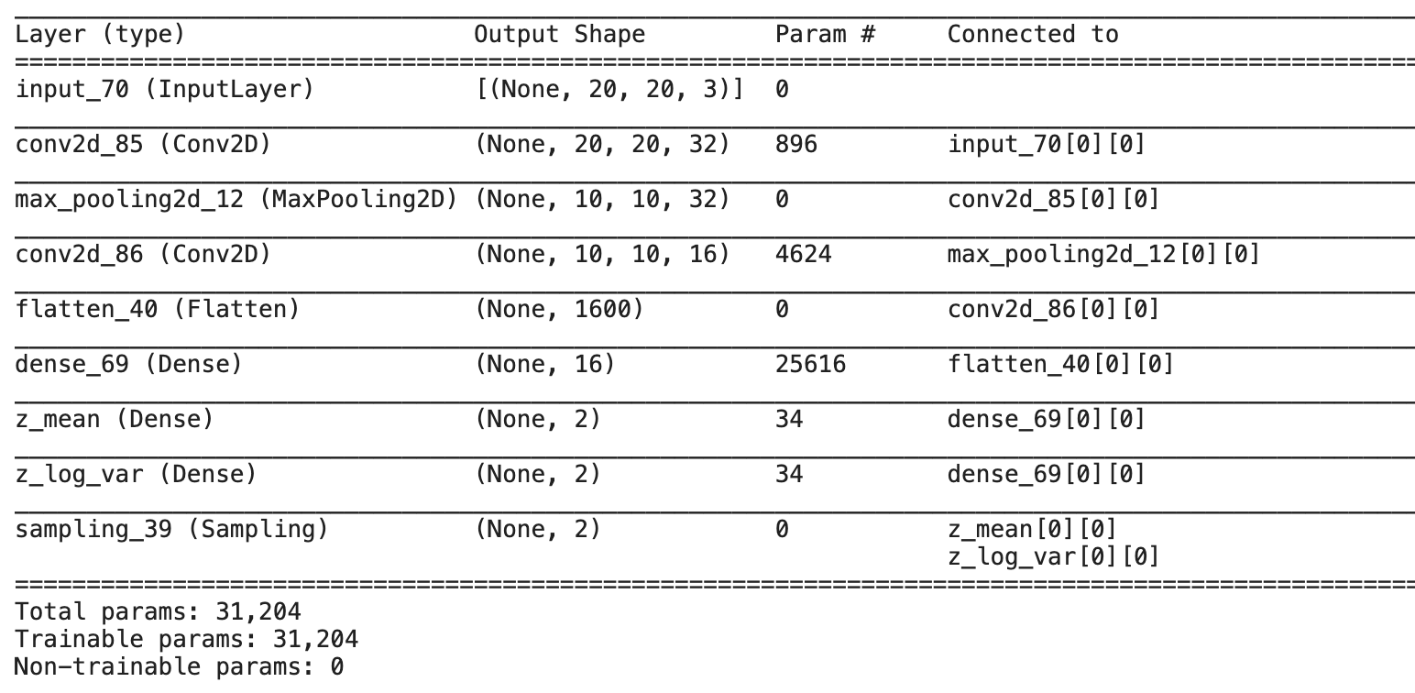
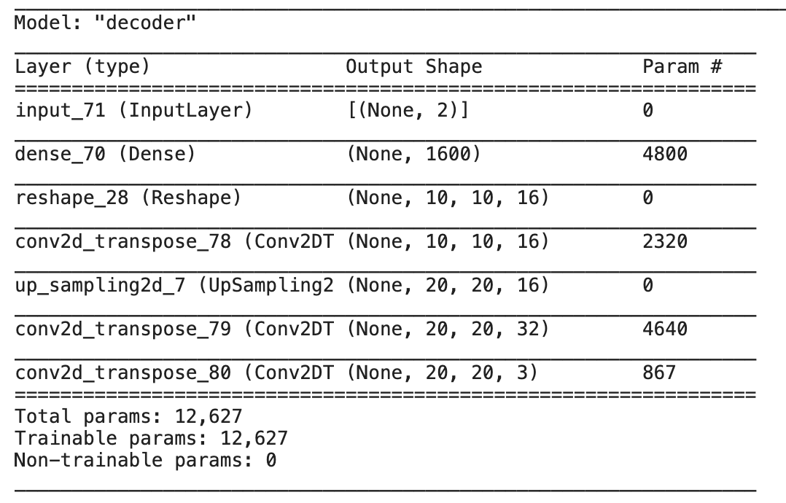
Adjusting complexity: adding maxPooling
Encoder
Decoder
no dim.reduction with stride=1, good/bad?
can add more layers / adjust stride for specific conv layers
How far to reduce before dense/sampling layer?

Slide 14
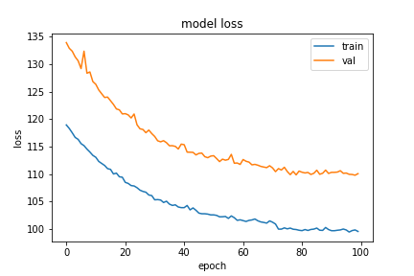
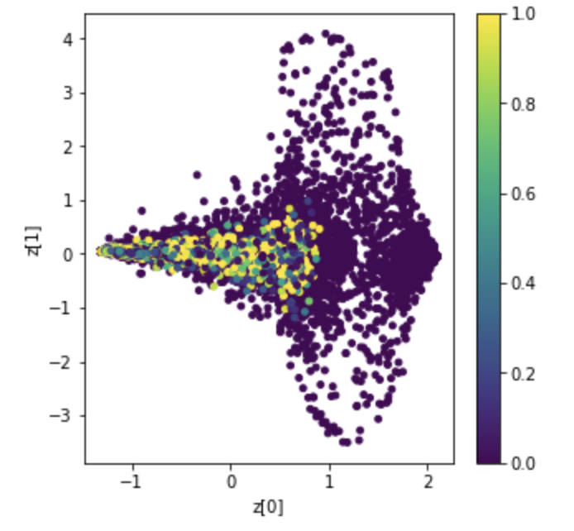
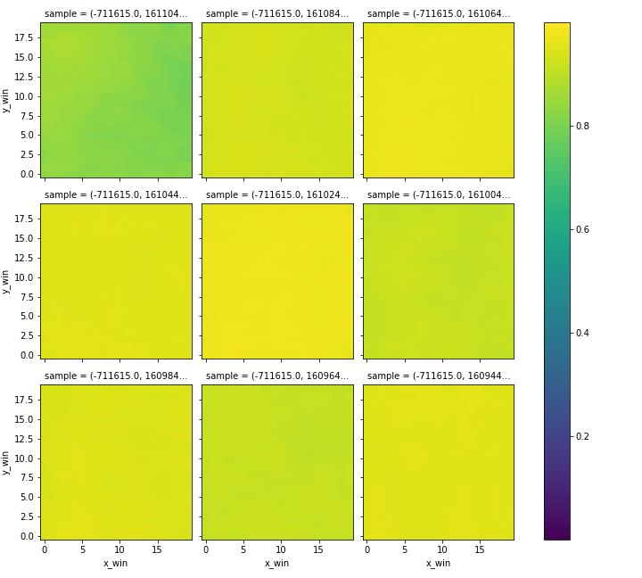
traindata
model_1636100600
NEW MODEL ARCHITECTURE
data
balance_ratio:0.5
epochcounter:1
n_bands:3
filter_1:32
filter_2:16
kernel_size:3
dense_size:16
latent_dim:2
n_epochs:100
alpha:5
Latent space
reconstruction

