Slide 1
Testing VAE Model_v0 2021-11-03
Structure ENCODER
encoder_inputs = keras.Input(shape=(cutout_size, cutout_size,n_bands))
x = layers.Conv2D(filter_1, kernel_size, activation="relu", strides=2,
padding="same")(encoder_inputs)
x = layers.Conv2D(filter_2, kernel_size, activation="relu", strides=2,
padding="same")(x)
x = layers.Flatten()(x) # to vector
x = layers.Dense(dense_size, activation="relu")(x) # linked layer
z_mean = layers.Dense(latent_dim, name="z_mean")(x)
z_log_var = layers.Dense(latent_dim, name="z_log_var")(x)
z = Sampling()([z_mean, z_log_var])
encoder = keras.Model(encoder_inputs, [z_mean, z_log_var, z],
name="encoder")

Slide 2
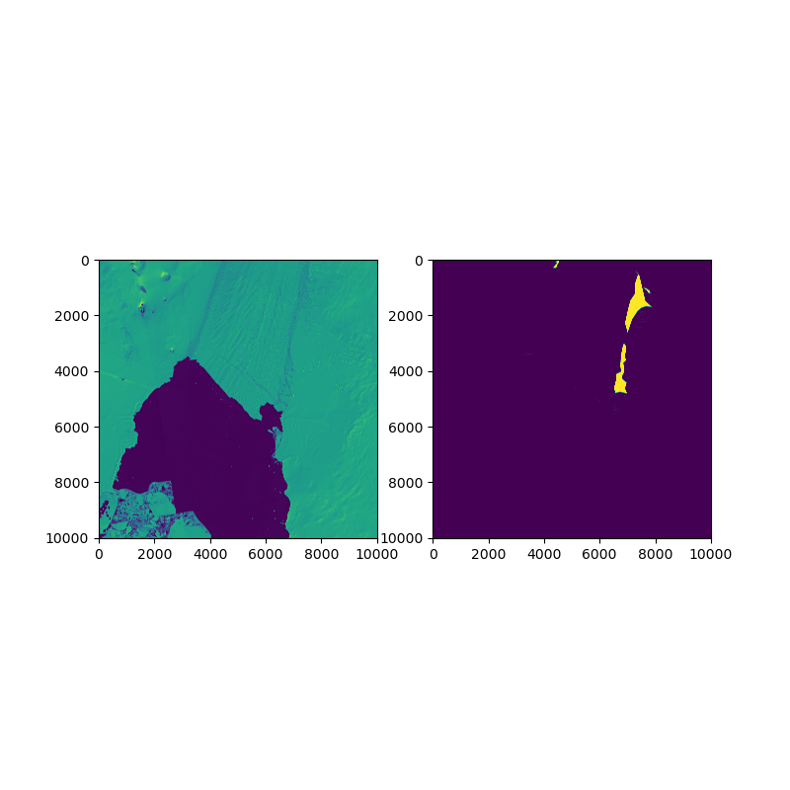
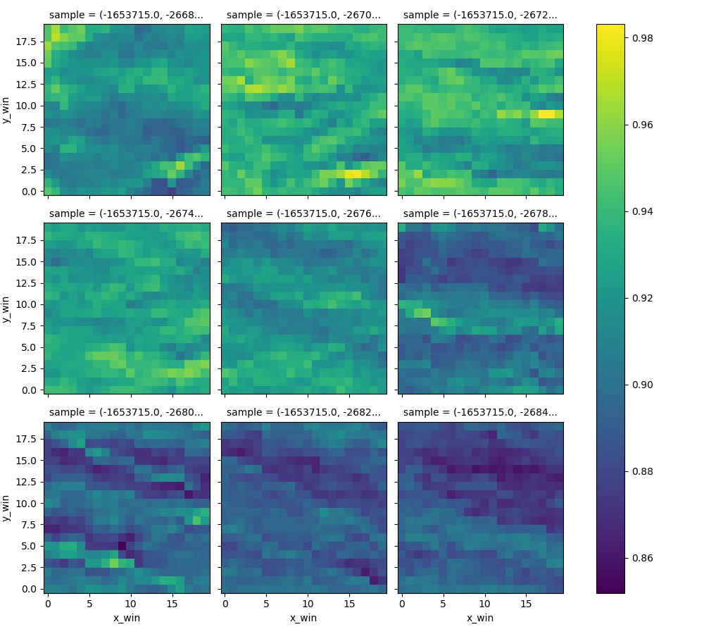
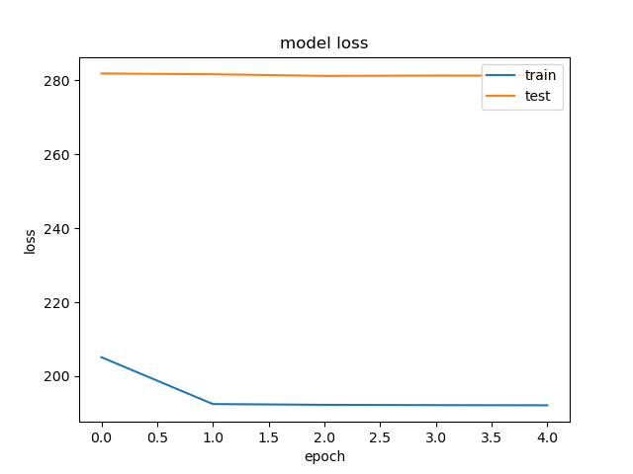
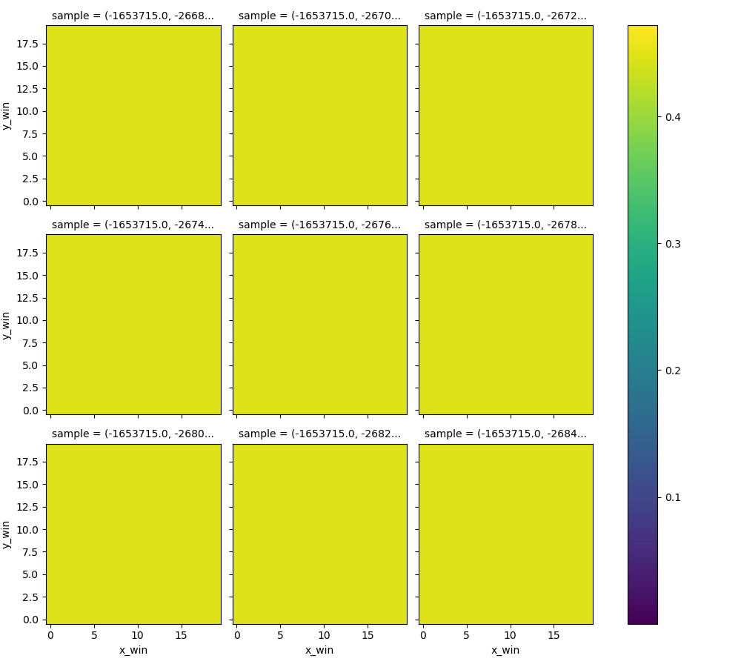
traindata
model_1635951267
‘starting’ settings
Model doesn’t learn anything
data
normalizationThreshold = 20000
# MODELSETTINGS
filter1 = 3
filter2 = 2
kernelSize = 5
denseSize = 16
latentDim = 4
#vae:
alpha = 5
# training
nEpochs = 5
batchSize = 128
validationSplit = 0.3
Latent space
reconstruction

Slide 3
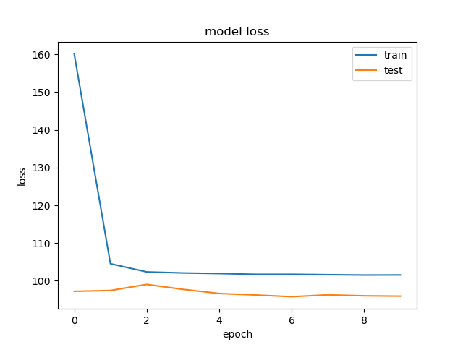
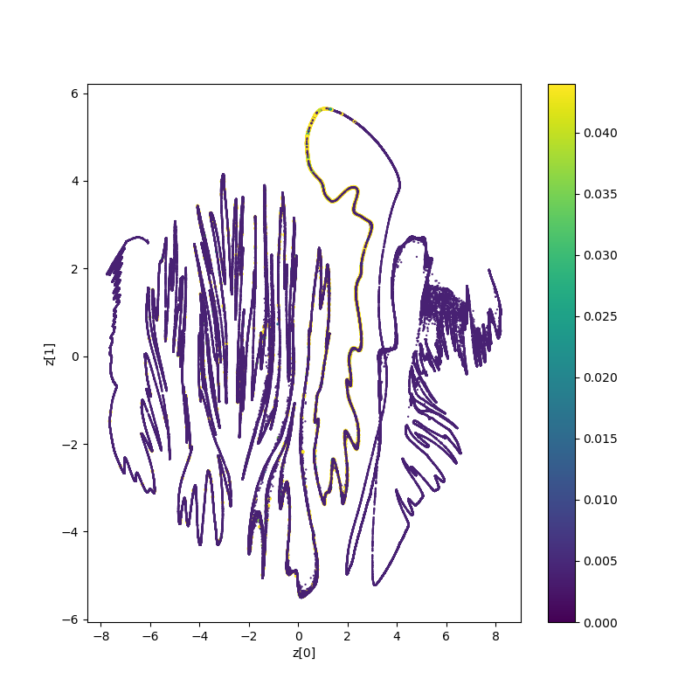
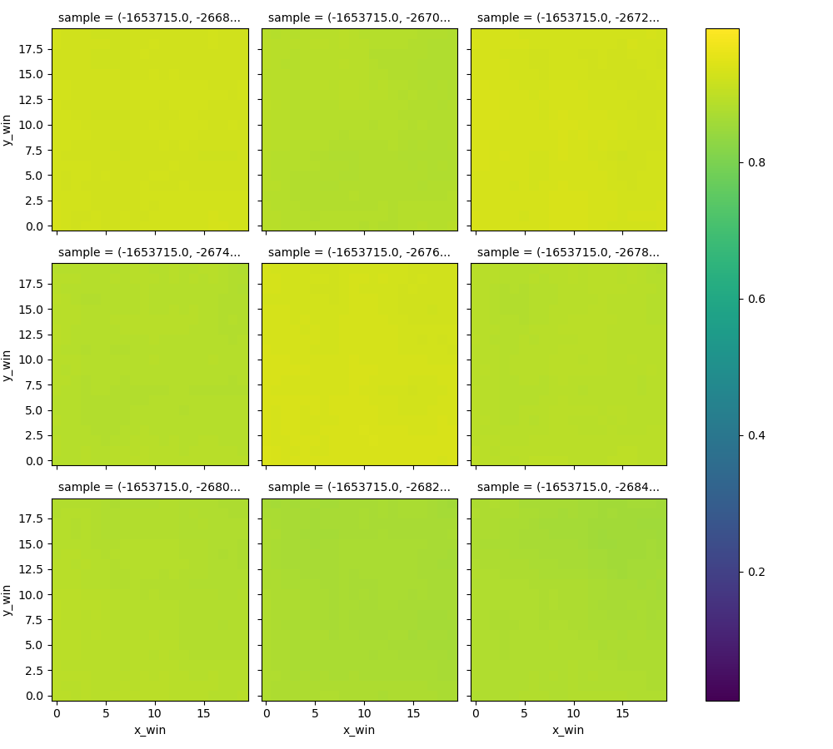
traindata
model_1635956184
Increase filter size
→ Some convergence but not a lot of progress and/or reconstruction
data
normalizationThreshold = 10000
# MODELSETTINGS
filter1 = 64
filter2 = 32
kernelSize = 5
denseSize = 16
latentDim = 4
#vae:
alpha = 5
# training
nEpochs = 10
batchSize = 128
validationSplit = 0.3
Latent space
reconstruction

Slide 4
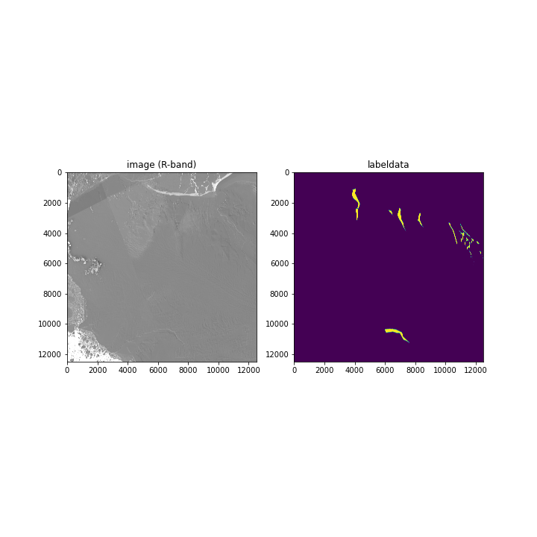
Change training data
previous
Results so far (previous slides) were not good; possibly due to the used example data that contains many open-ocean pixels.
Option 1: remove ocean pixels
Option 2: use another image without this issue
→ I chose option 2 for now (see next slides) as it’s most easy to implement during this phase, but option1 will still need to be implemented at a later stage when using that image / similar images.
next

Slide 5
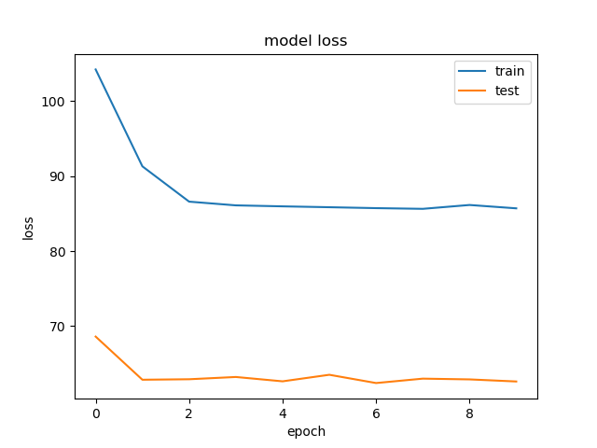
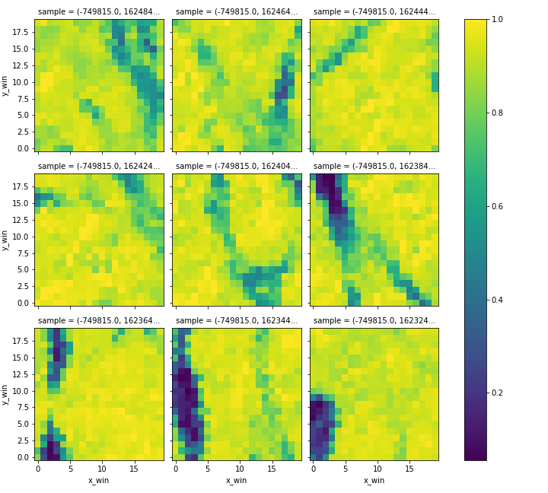
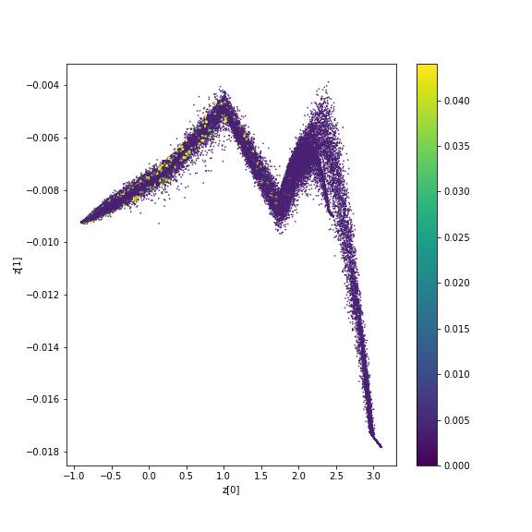
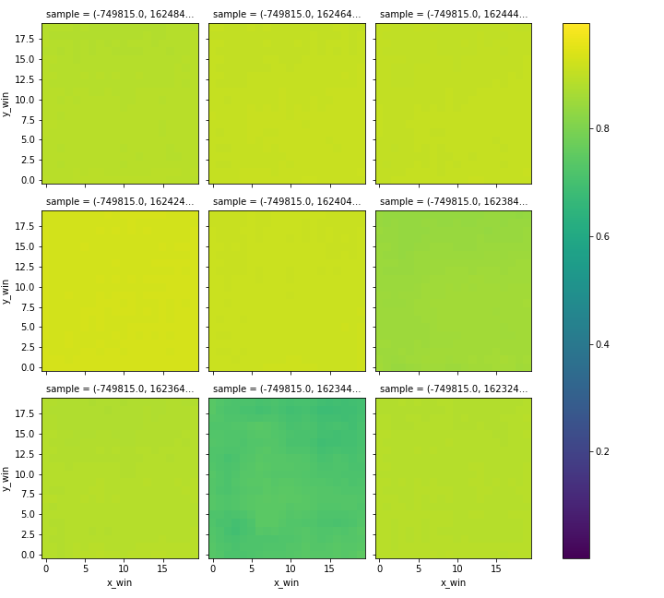
traindata
model_1635959711
Change training data (other image)
Latent dimension to 2
→ Reconstruction starts to generate somewhat differentiating values; more promising input data
data
normalizationThreshold = 10000
# MODELSETTINGS
filter1 = 64
filter2 = 32
kernelSize = 5
denseSize = 16
latentDim = 2
#vae:
alpha = 5
# training
nEpochs = 10
batchSize = 128
validationSplit = 0.3
Latent space
reconstruction

Slide 6
Balanced training data
Select all windows that contain label=1 pixels
Choose ratio of labelled:unlabelled windows
Tested ratio of 1:2 and 1:4
Add number of unlabelled windows to selected data for training

Slide 7
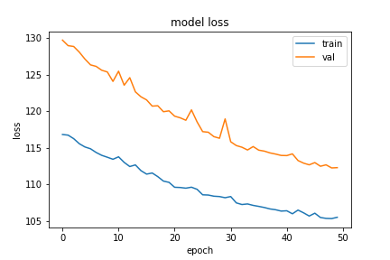
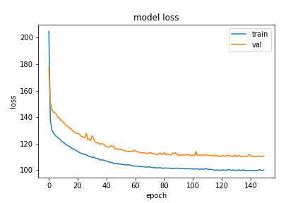
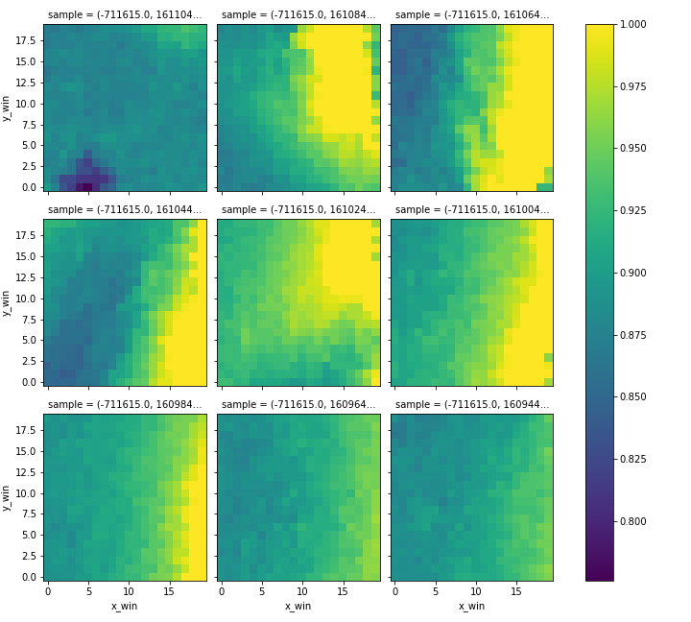
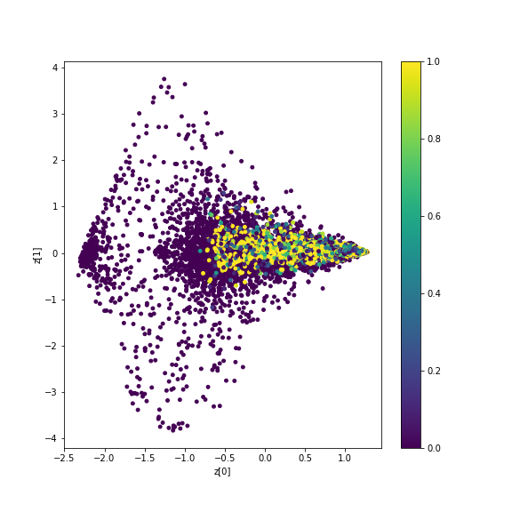
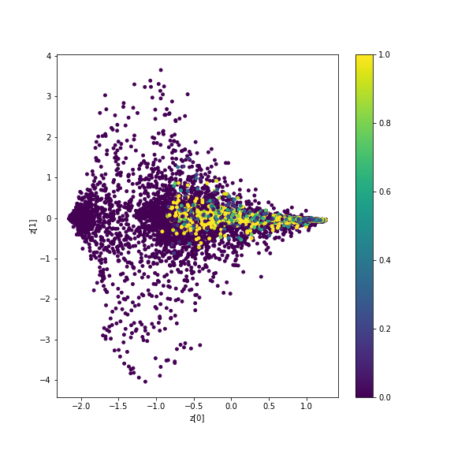
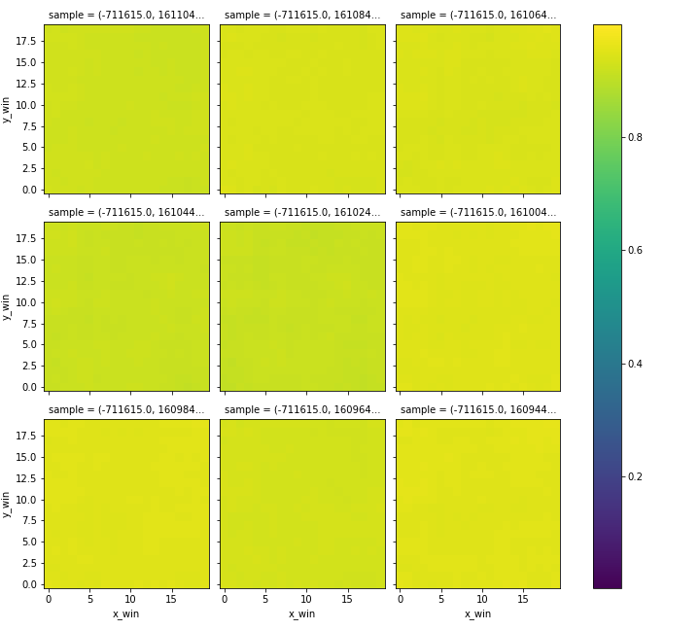
traindata
model_1636032781
Balanced label-data ratio 1:2, labelled:unlabelled
data
balance_ratio = 0.5
normalizationThreshold = 10000
# MODELSETTINGS
filter1 = 64
filter2 = 32
kernelSize = 5
denseSize = 16
latentDim = 2
#vae:
alpha = 5
# training
nEpochs = 50 or 150
batchSize = 128
validationSplit = 0.3
Latent space
reconstruction

Slide 8
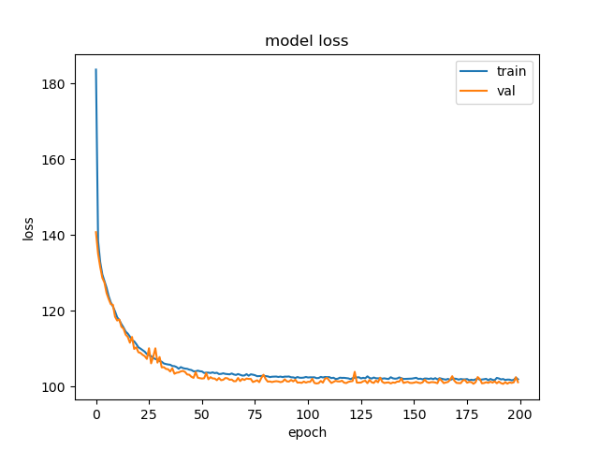
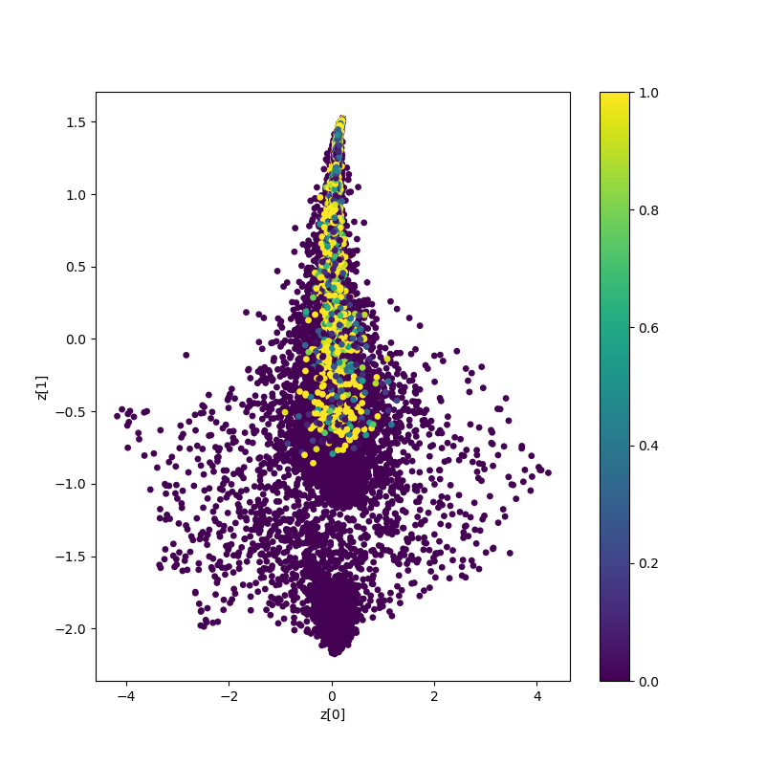
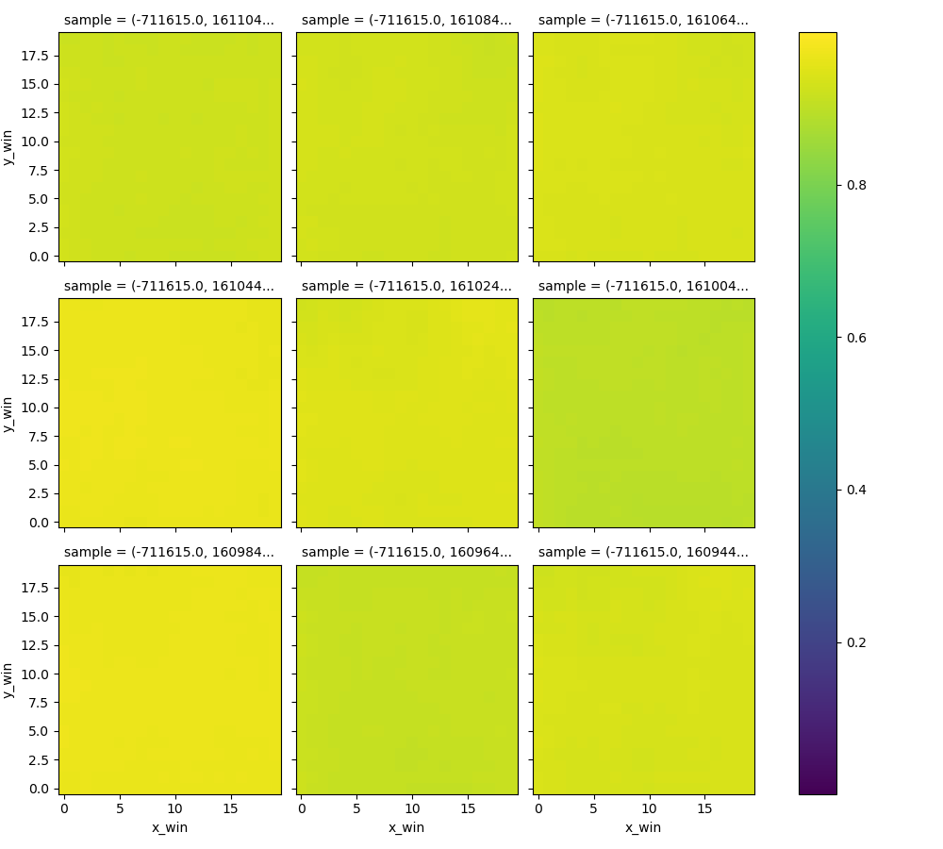
traindata
model_1636101148
Balanced label-data ratio 1:4
Still bad reconstruction
Weird: Validation loss lower than train-loss
→ Increase model complexity next
data
balanceRatio = 0.25
normalizationThreshold = 10000
# MODELSETTINGS
filter1 = 64
filter2 = 16
kernelSize = 5
denseSize = 16
latentDim = 2
#vae:
alpha = 5
# training
nEpochs = 200
batchSize = 128
validationSplit = 0.3
Latent space
reconstruction

Slide 9
Discussed
Result balanced-dataset quite promising
Convergence of loss-function
No reconstruction, but good reconstruction not necessary as long as clustering in latent-space is meaningfull
label-data clustered nicely in latent-space, question is if the un-labelled data in the same cluster represents false-negative windows (i.e. they are also damaged windows but not labelled as damage)
Next steps:
Interpretation of latent space clusters on 2D map
Increase model complexity with different numbers of filters & change in dense layer size (rather than adding max pooling)
Add more data to training

