Slide 1
Testing VAE Model_v0 2021-11-04
Structure ENCODER
encoder_inputs = keras.Input(shape=(cutout_size, cutout_size,n_bands))
x = layers.Conv2D(filter_1, kernel_size, activation="relu", strides=2,
padding="same")(encoder_inputs)
x = layers.Conv2D(filter_2, kernel_size, activation="relu", strides=2,
padding="same")(x)
x = layers.Flatten()(x) # to vector
x = layers.Dense(dense_size, activation="relu")(x) # linked layer
z_mean = layers.Dense(latent_dim, name="z_mean")(x)
z_log_var = layers.Dense(latent_dim, name="z_log_var")(x)
z = Sampling()([z_mean, z_log_var])
encoder = keras.Model(encoder_inputs, [z_mean, z_log_var, z],
name="encoder")

Slide 2
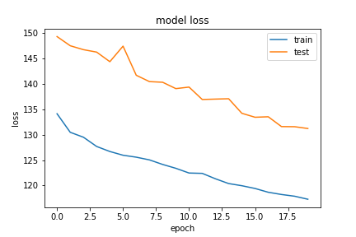
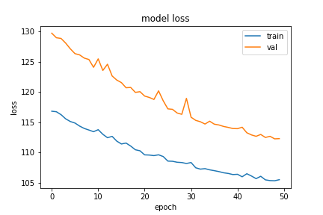
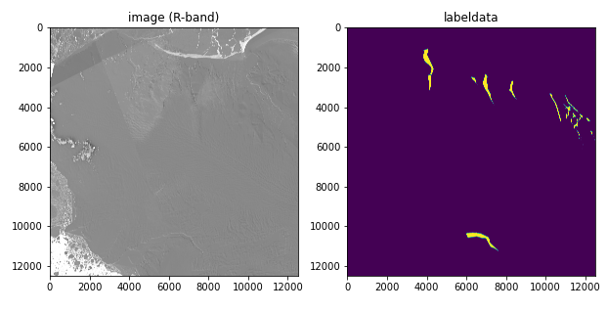
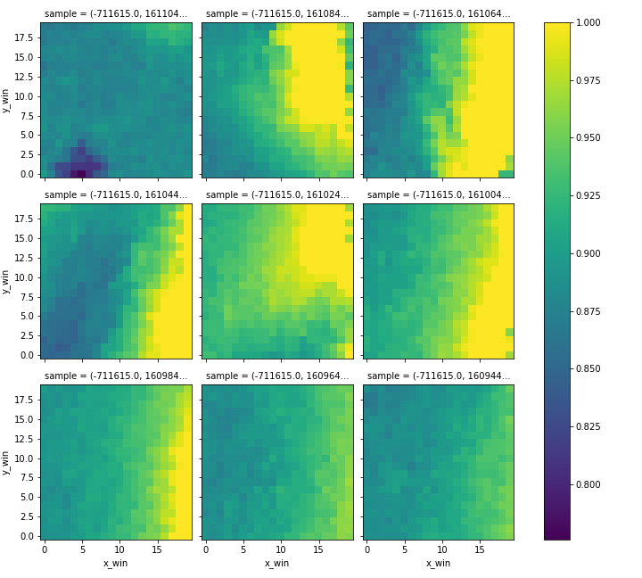
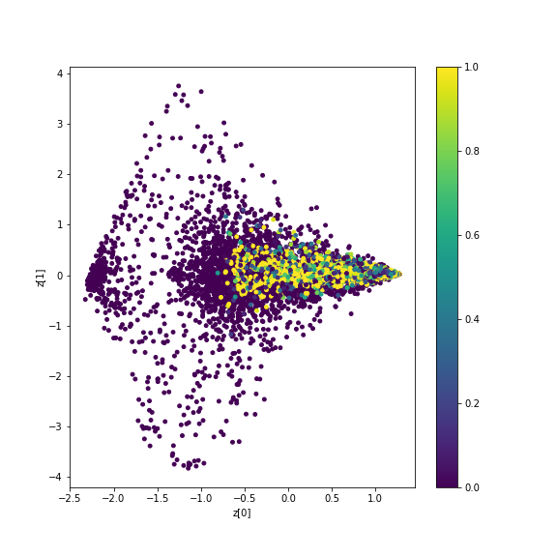
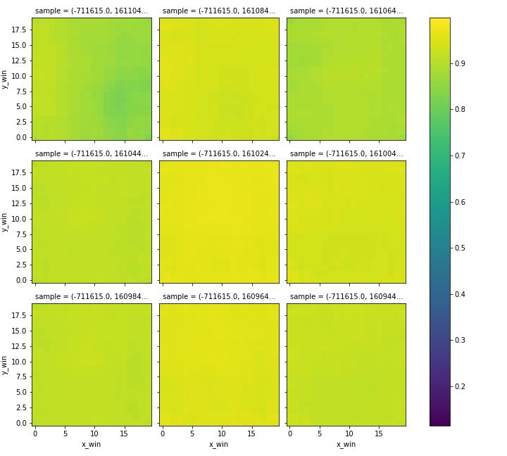
traindata
model_1636032781
Balanced label-data
data
balance_ratio = 0.5
normalizationThreshold = 10000
# MODELSETTINGS
filter1 = 64
filter2 = 32
kernelSize = 5
denseSize = 16
latentDim = 2
#vae:
alpha = 5
# training
nEpochs = 20 or 50
batchSize = 128
validationSplit = 0.3
Latent space
reconstruction

Slide 3
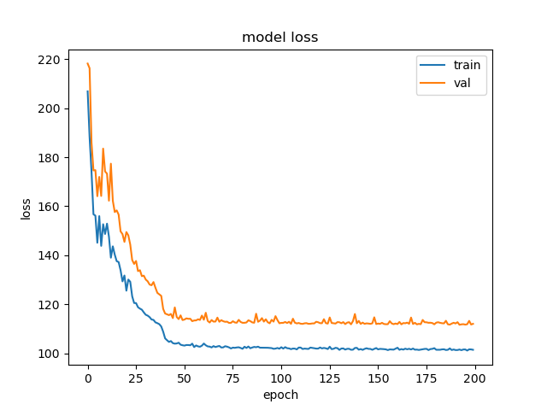
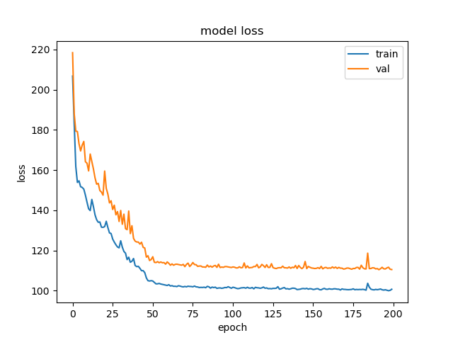
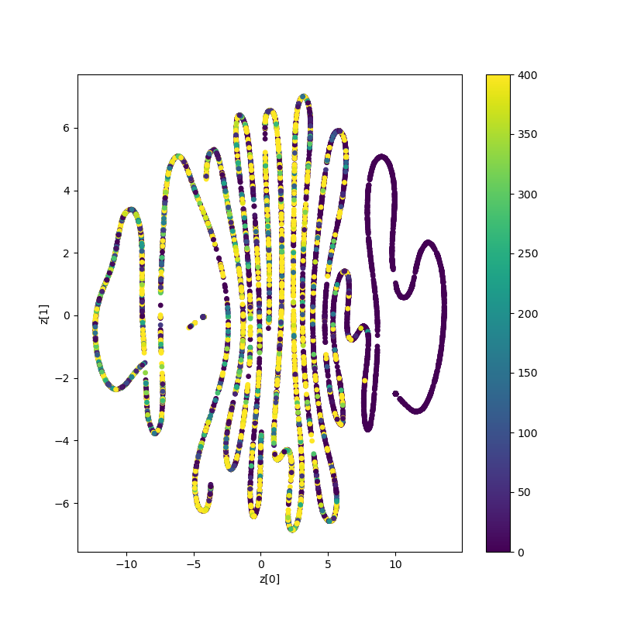
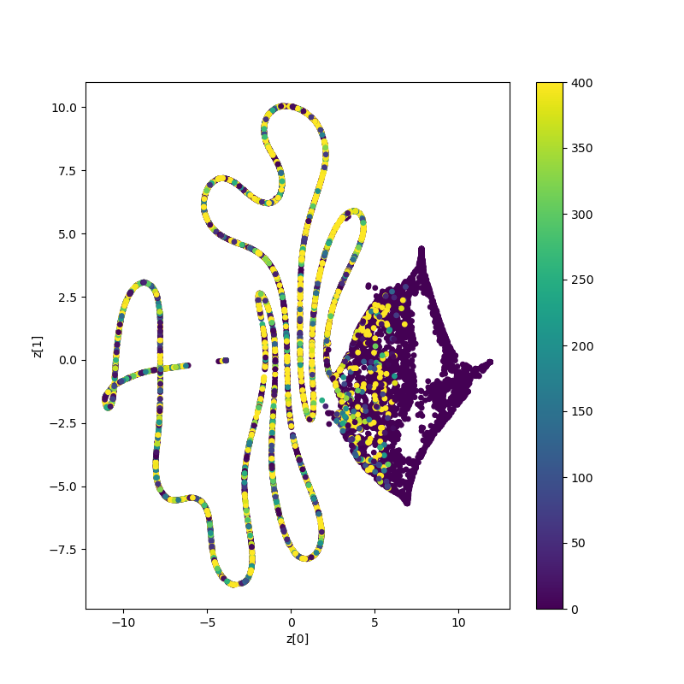
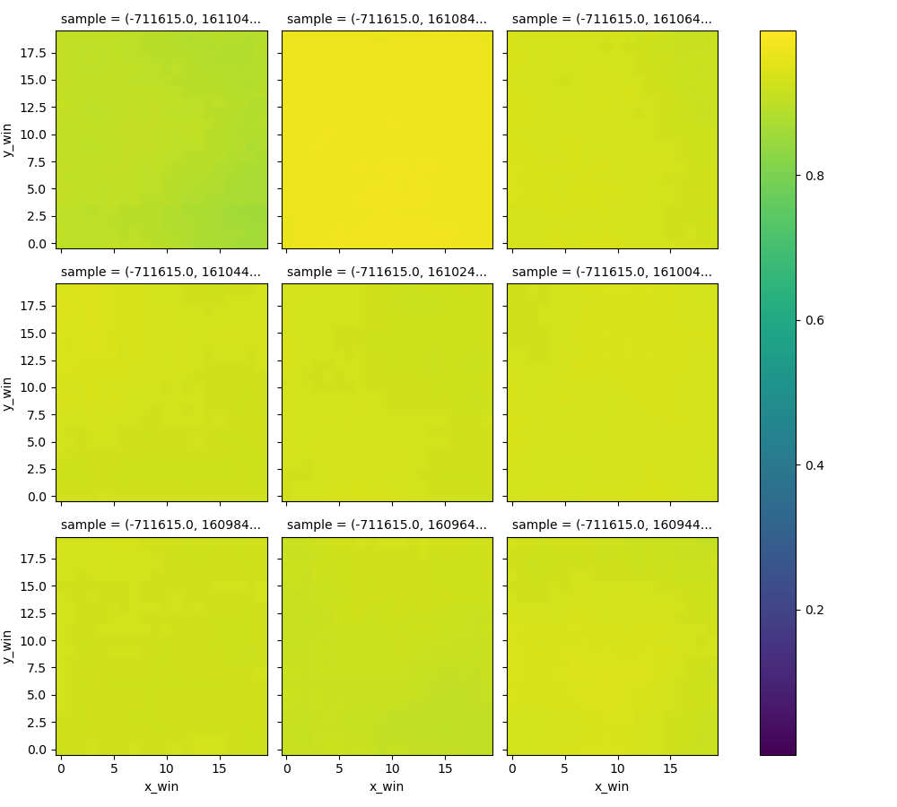
traindata
model_1636042329
Balanced label-data
Balance ratio 1:4 or 1:2 labelled:unlabelled
data
balance_ratio = 0.25 or 0.5
normalizationThreshold = 10000
# MODELSETTINGS
filter1 = 64
filter2 = 32
kernelSize = 5
denseSize = 16
latentDim = 2
#vae:
alpha = 5
# training
nEpochs = 200
batchSize = 128
validationSplit = 0.3
Latent space
reconstruction

