Slide 1
BB Block
Lauren Gao
Comtech

Slide 2
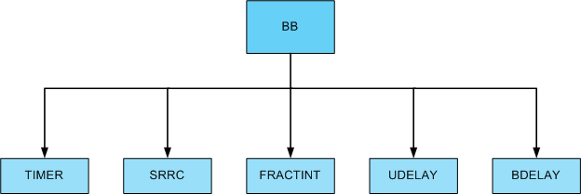
RTL Hierarchy for One BB Block

Slide 3
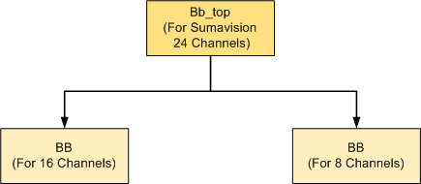
BB Block for Sumavision 24 Channels

Slide 4
SRRC Performance C_SRRC_12

Slide 5
SRRC Performance C_SRRC_18

Slide 6
SRRC Coefficients
There are two sets of filter coefficients for SRRC in the design. One is C_SRRC_12 and the other is C_SRRC_18.
In my opinion, only one of them is enough for Sumavision. Because the coefficients will occupy many SLICEM, it is helpful to select one of them as the final coefficient.
In fact, according to simulation result analysis, only one set of coefficient is used in the design.

Slide 7
SRRC Output Frequency Domai with Blackman window

Slide 8
Delay Unit
BDelay.vhd
UDelay.vhd
Delay.vhd
All the delay unit has the same function. That is to delay the input data with predefined clock period.
The parameter “SIZE” determines the delay taps.
BDelay: input data type => boolean
UDelay: input data type => unsigned
Delay : input data type => std_logic_vector

Slide 9
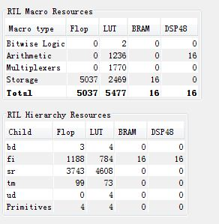
Resource Estimation for One BB Block (In PlanAhead after Elaborate)

Slide 10
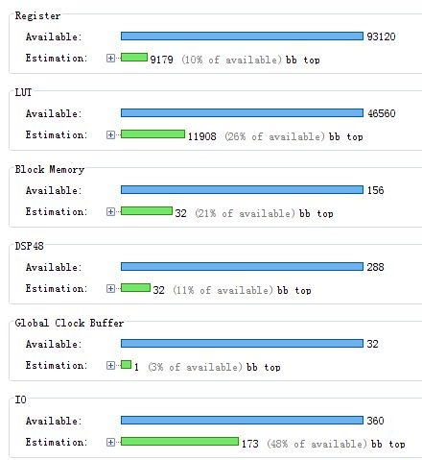
Resource Estimation for Two BB Block (In PlanAhead, After Synthesis)

Slide 11
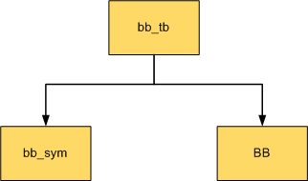
Simulation Hierarchy
bb_sym: Generate Pseudo-random QAM256 Symbol

Slide 12
Timing
For Sumavision 24 Channels with two BB Blocks. One supports 16 channels and the other supports 8 channels. But both have the same architecture.
In PlanAhead, Make pin assignments by auto-place I/O ports.
In ucf, only set global clock period constraint, 2.5 ns (400MHz)
After par, the timing report indicates the timing is closure with 2.5 ns.
Note:
If combine the BB block with the rest blocks, we should make a good pin assignments and area group for the critical blocks to make timing closure.

Slide 13
Resource Utilization after PAR
Number of occupied Slices: 2,122 out of 11,640 18%
Number of DSP48E1s: 32 out of 288 11%
Number of RAMB36E1/FIFO36E1s: 32 out of 156 20%

