Slide 1


Mini Project DE
DSLS 2023
By Ichfan Kurniawan

Slide 2
01
PRODUCT
ANALYSIS
CASE STUDIES OF
Overall Business Trend
Pareto Analysis
Business Anomalies
OVERALL INSIGHTS FROM
Overall business trend is good & increasing over time. There is an anomaly of spike in the Nov ’97 – Apr ’98 period
Based on the Pareto analysis, targeting market & product could be the main focus & priority either in the full-year & in the spike period.
The spike anomaly that happened should be further analyzed to reveal the main factors (e.g. Christmas, New Year, Lunar Year, etc)

Slide 3
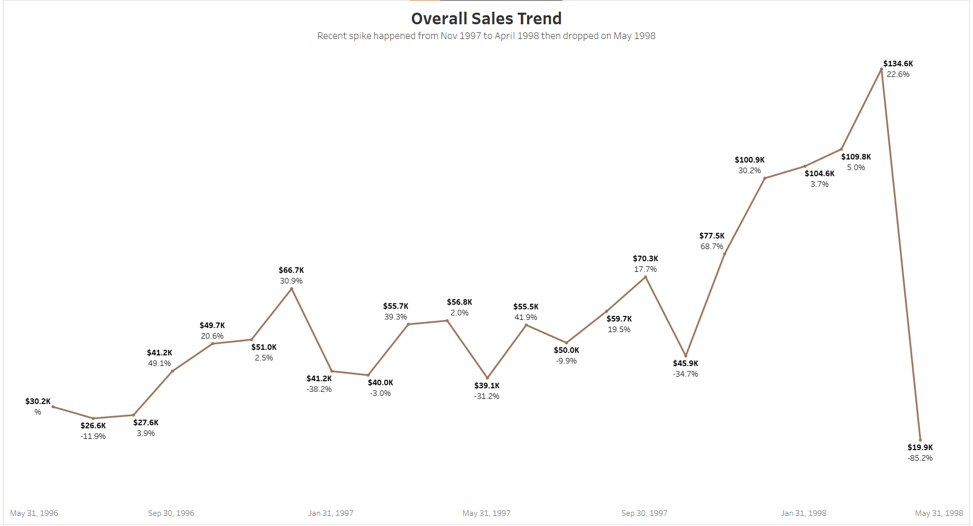
The overall trend of business is good & increasing over the time period of late 1996 to early 1998

Slide 4
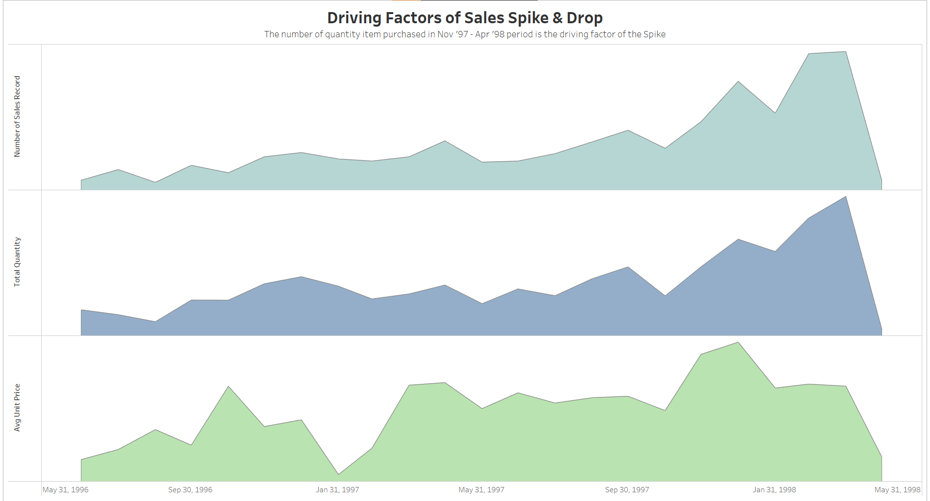
the increase in sales was driven by the increase of number quantities in the purchase

Slide 5
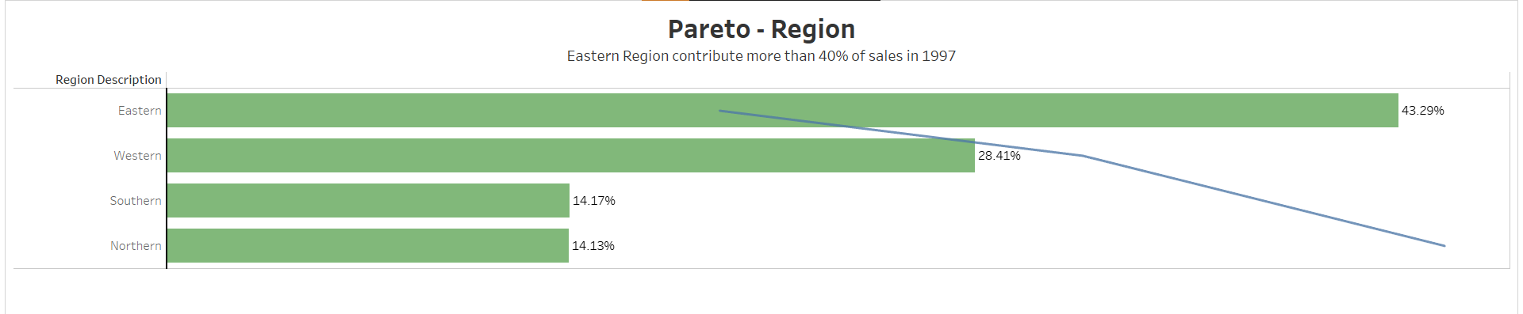
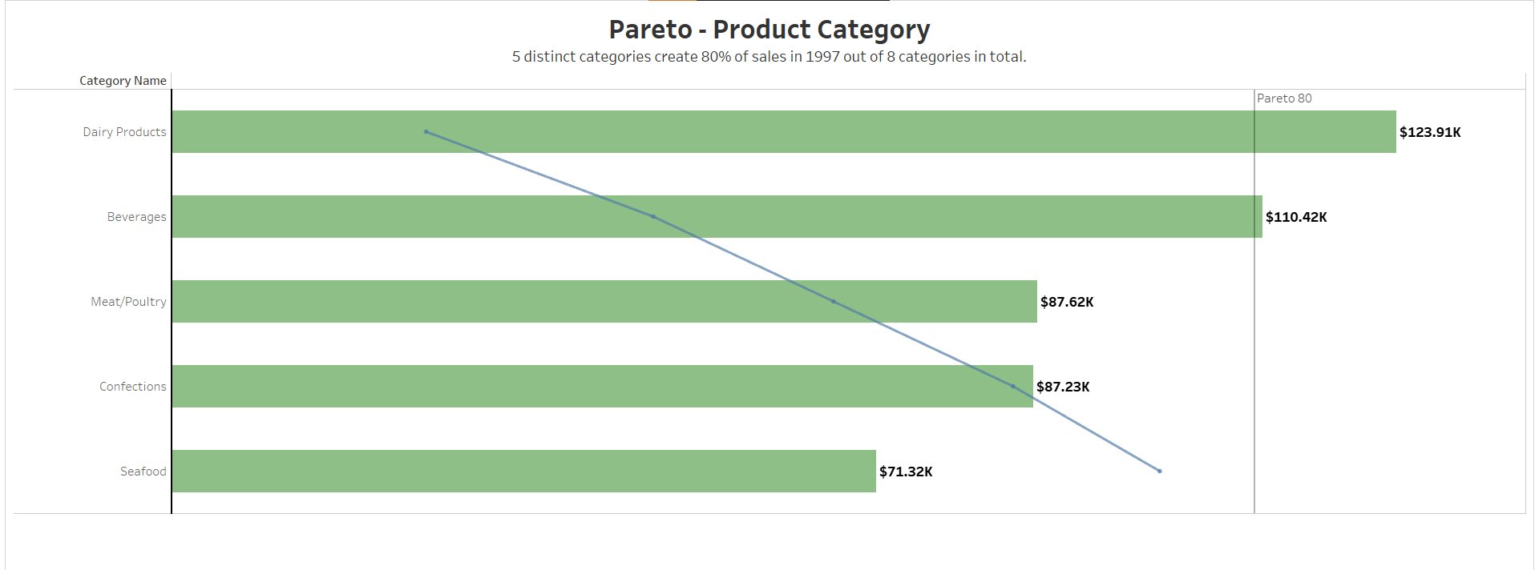
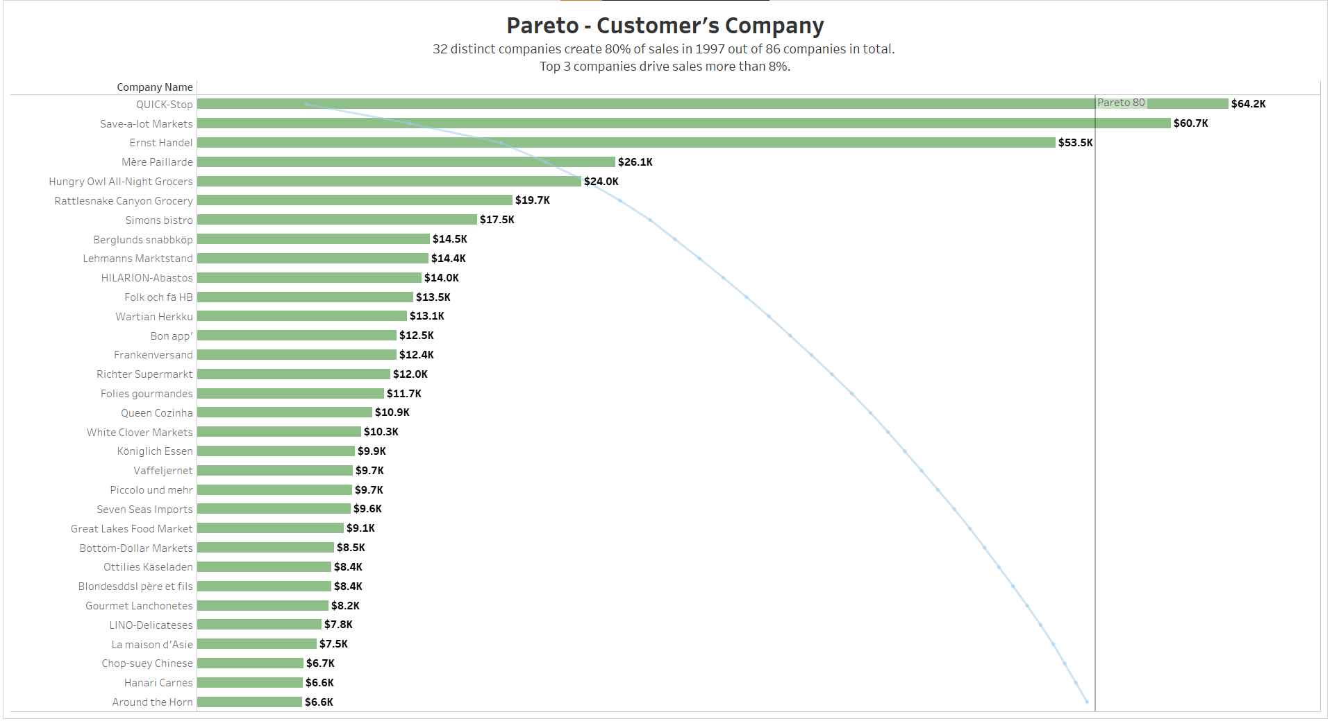
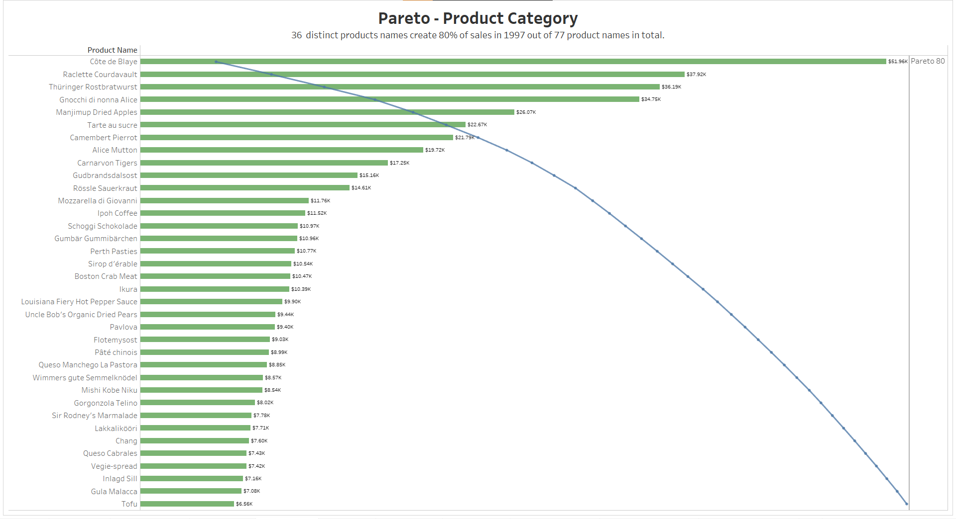
Pareto analysis of the 1997 period that drives sales
(company names, product names, category names, region names)

Slide 6
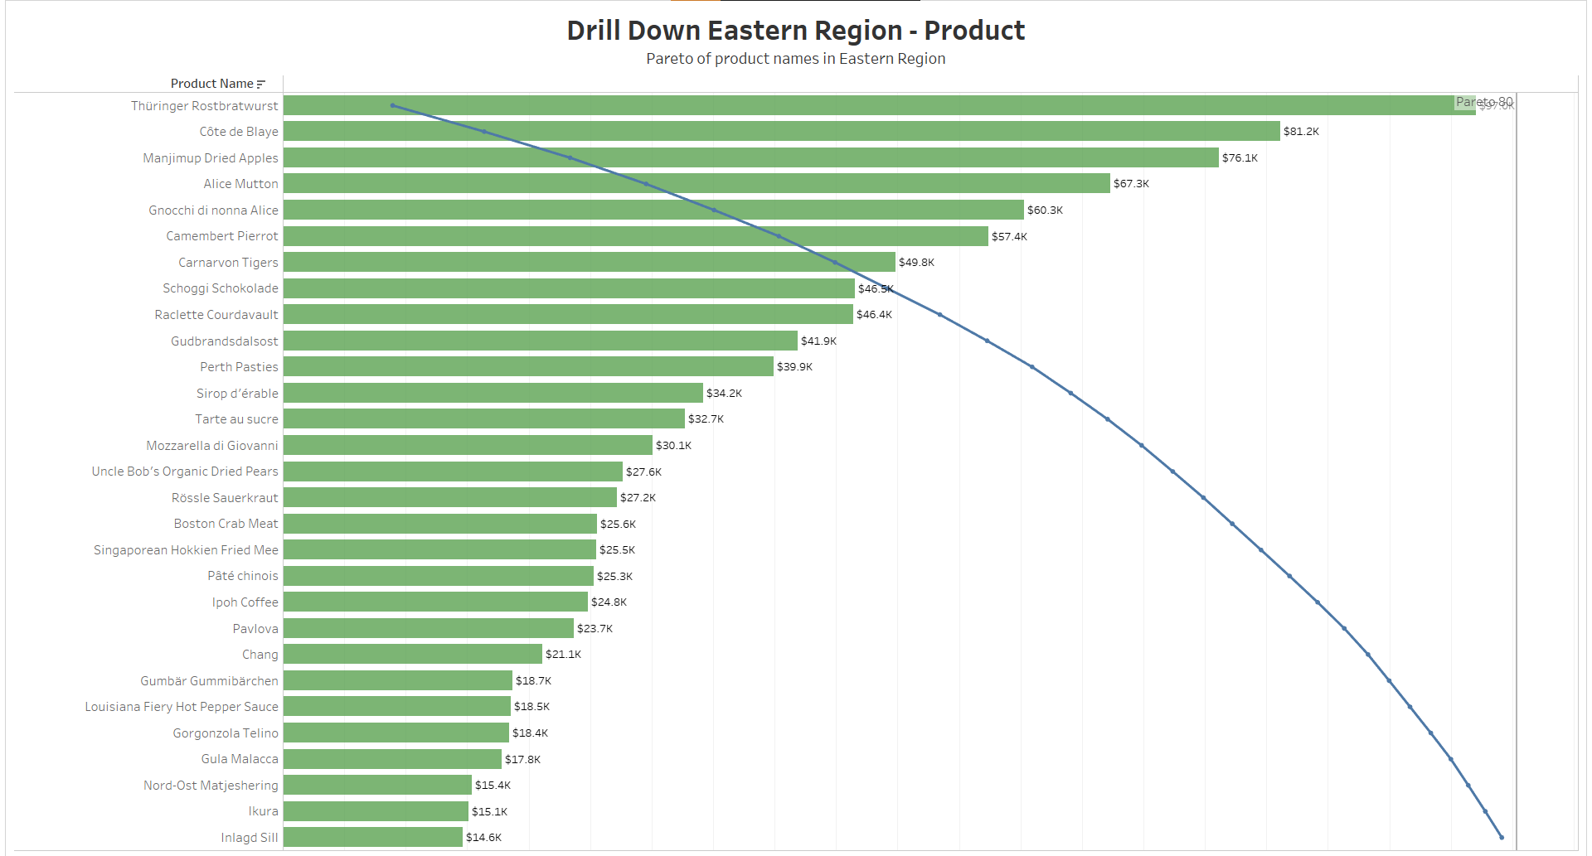
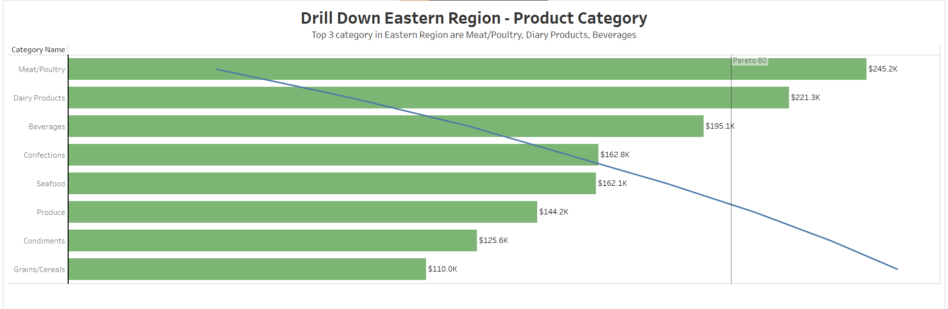
Eastern region is the most contributed region,
Pareto analysis of the 1997 period that drives sales for only eastern region

Slide 7
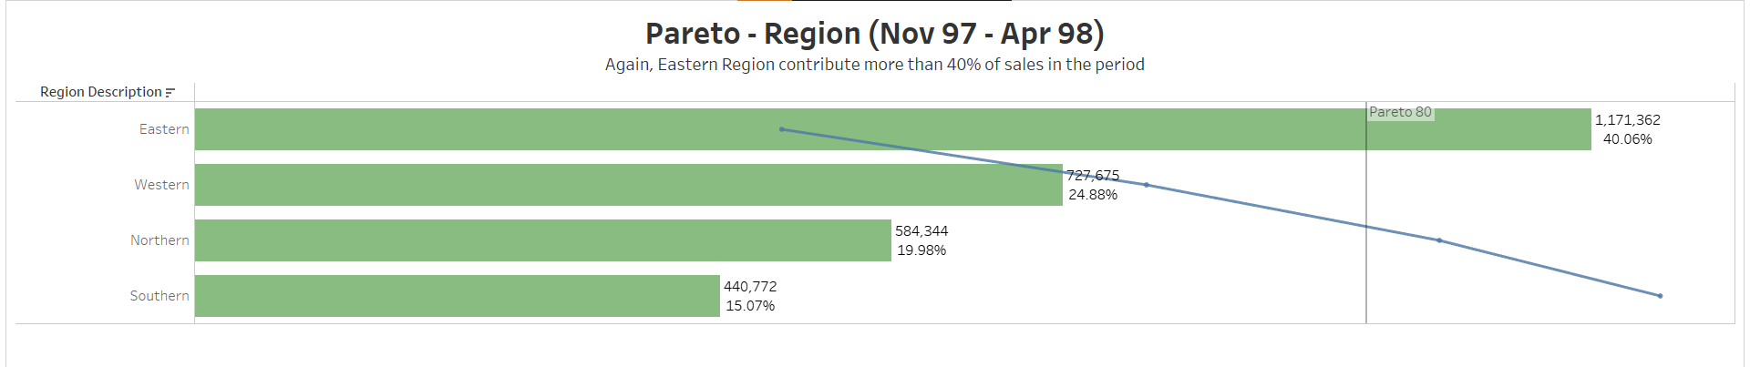
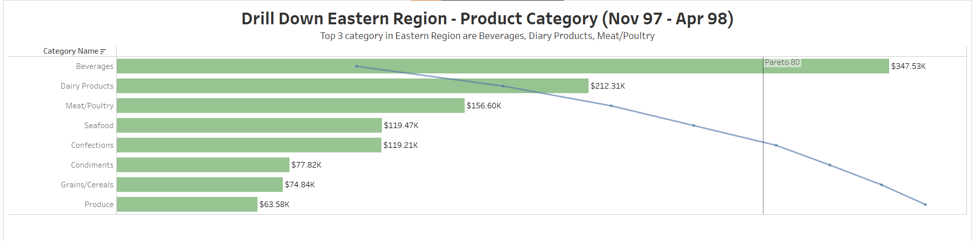
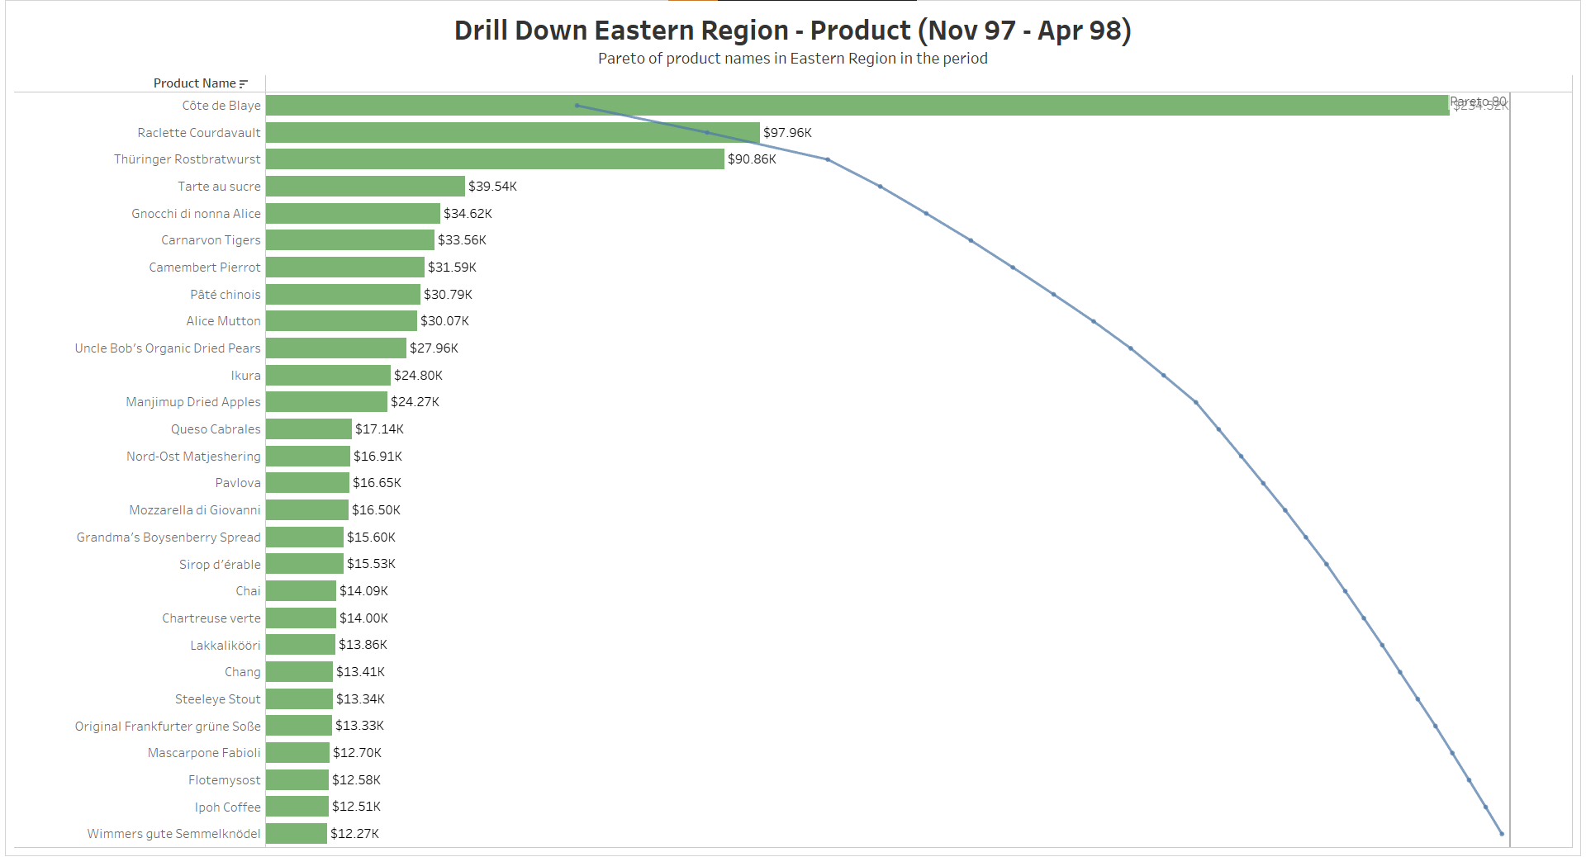
Eastern region is also found to be the most contributed region in the spike period (Nov ‘97 – Apr ‘98),
Pareto analysis of the spike period that drives sales for only eastern region

Slide 8
02
CUSTOMER
ANALYSIS
CASE STUDIES OF
RFM Analysis
(Recency, Frequency, Monetary)
OVERALL INSIGHTS FROM
prioritize our marketing strategies on the champion & loyal customers segments (factors: proportion & monetary value)
Further analysis could be applied to deep dive into a specific region and recent time period

Slide 9
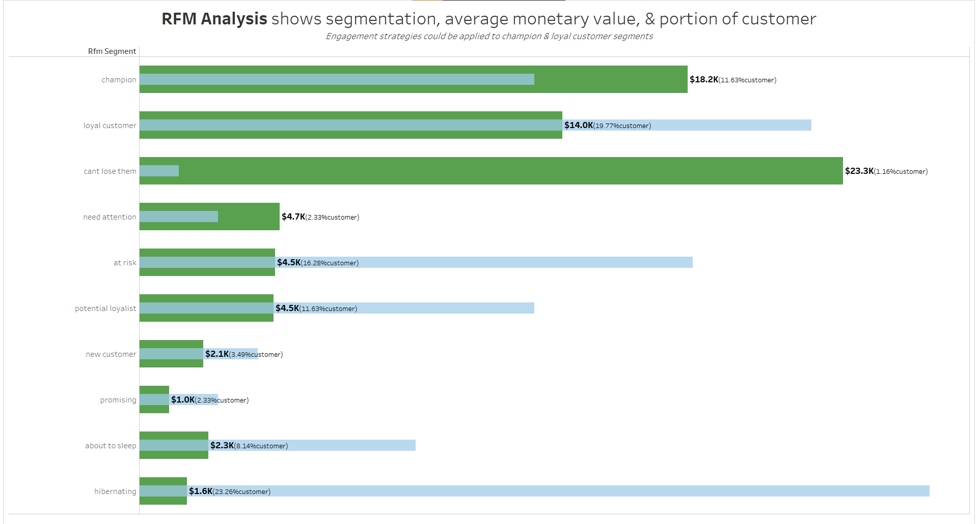
prioritize our marketing strategies on the champion & loyal customers segments, because of:
the proportion of customer from these two segments only is more than 40%
the average monetary is the highest after the cant lose them segment.

Slide 10
03
COHORT
ANALYSIS
CASE STUDIES OF
Retention Rate Analysis
OVERALL INSIGHTS FROM
The context should be employed more in this analysis to assess whether the result below is acceptable or not.
If the result is not acceptable, further analysis, e.g. root cause analysis, should be utilized to do counter action.

Slide 11
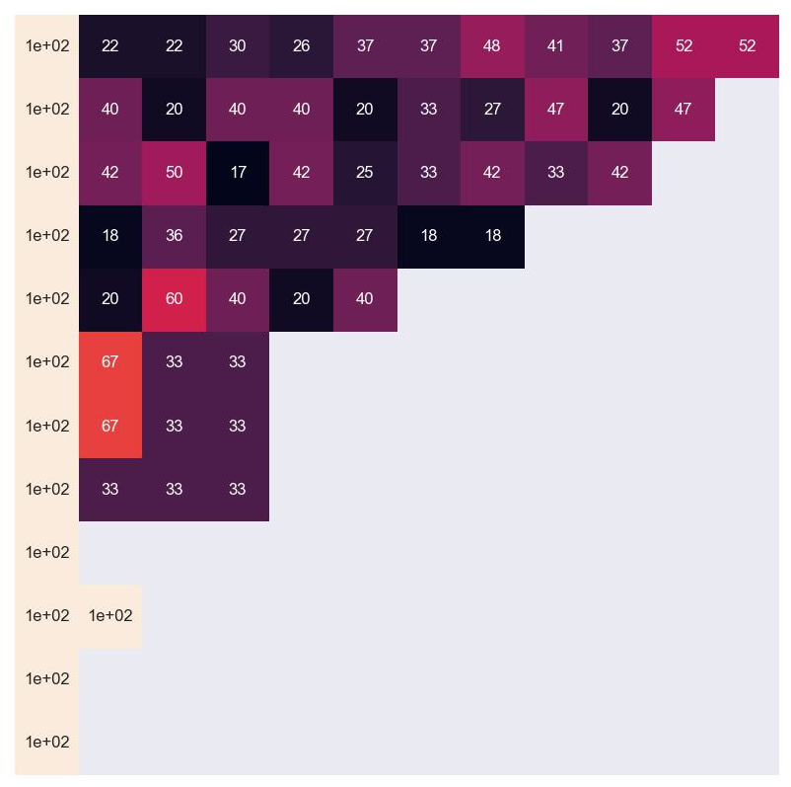
Retention rate (%) of full 1997 period
The context should be employed more in this analysis to assess whether the result below is acceptable or not.

