Slide 1


KBEngine
Just make, well done
Group5
李炳嘉 杜会远 曹相成 周逸帆

Slide 2

01
Development View
02
Contents
Functional View
03
Evolution Perspective
04
Technical Debt

Slide 3

01
Development View

Slide 4
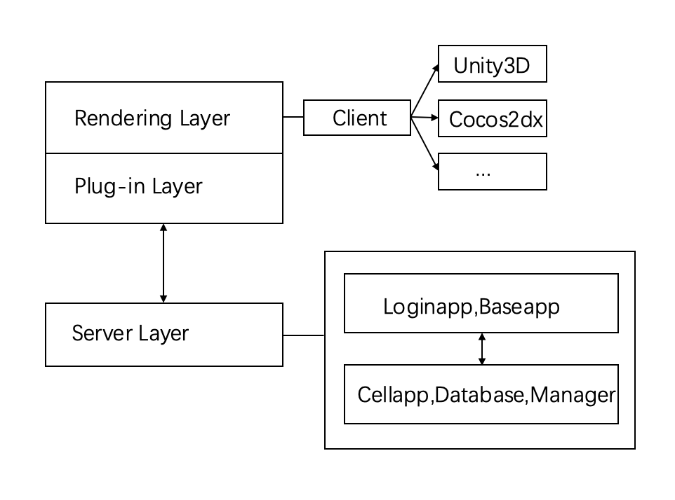
Model Structure
High-level architecture
Rendering Layer
Plug-in Layer
Server Layer
Notes:
The clients. It use the fire/register function to exchange messages/events with the plug-in layer
It sends the messages it gets from the rendering layer to the server
It gets the messages from the plug-in layer and response to the client directly

Slide 5
Model Structure
The clients. It use the fire/register function to exchange messages/events with the plug-in layer
Rendering Layer
Plug-in Layer
It sends the messages it gets from the rendering layer to the server
It gets the messages from the plug-in layer and response to the client directly
Server Layer

Slide 6
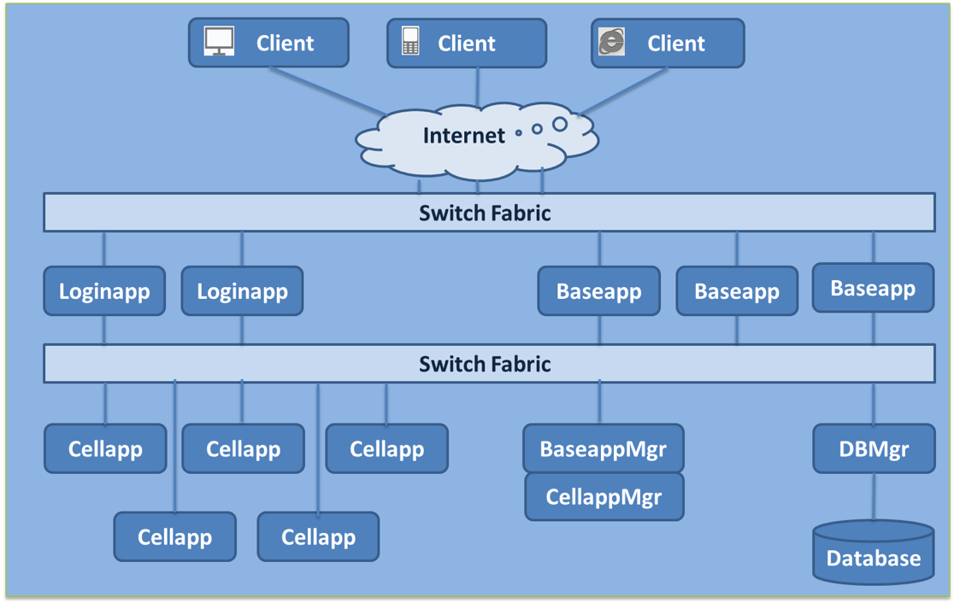
Model Structure
In details
We have discussed about the loaginapps, baseapps, cellapps last time

Slide 7
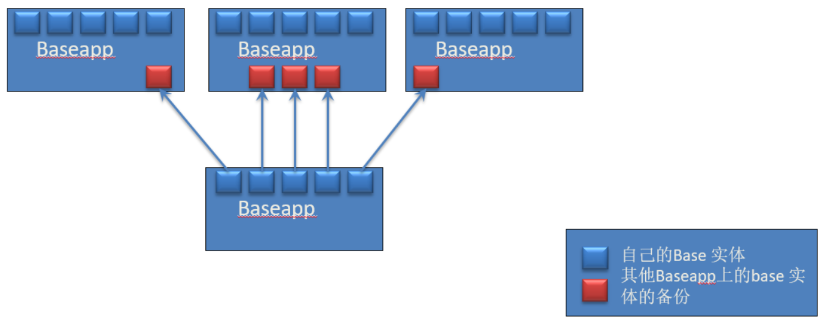
Model Structure
The upper limit of the load can also be continuously increased，here we take the baseapp as an example.
Each CPU can deal with only one Baseapp
Each Baseapp can backup data for others
The BassappMgr will choose the process with the least load to use in order to keep load balance
We can keep different processes on different machines so by increasing the number of CPUs we can increase the upper limit

Slide 8

Codeline Model：
There are three primary directory under the root directory “kbengine”:
The primary directory:
asset:
docs:
The default game project asset library.
Stores the API documentation and a tutorial of the system.
kbe:
The main part about the engine.

Slide 9
Codeline Model：
The main part of kbengine is kbe directory. There are four secondery directories in kbe.
bin:
res:
Engine Source directory, including python script library, server engine configuration and so on.
Contains all executable files after compilation.
KBE
tools:
src:
The engine tools, such as the install, xlsx2py which we have mentioned and so on.
Main source of KBEngine. It includes a server directory which contains loginapp, baseapp, cellapp and so on

Slide 10
Testing Standardization
A convenient GUI and powerful features for the use of online debugging. Note: only for Windows generally used during development.
You can keep watch over users, servers and debug and view logs on a web page. Note: Generally used during operation and maintenance
Another tools similar to WebConsole. But you use Command instead of web page. Note: It’s based on Python.
It can simulate the connection, communication, operation of the client. It is a lightweight client program for the simulation test of the server.
GUIConsole
WebConsole
PyCluster
Bots

Slide 11
02
Functional View

Slide 12
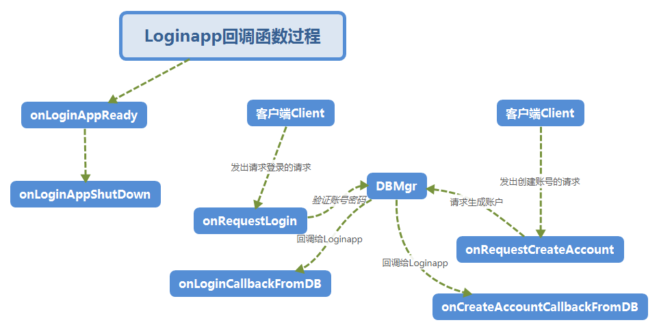
Functional View

Slide 13
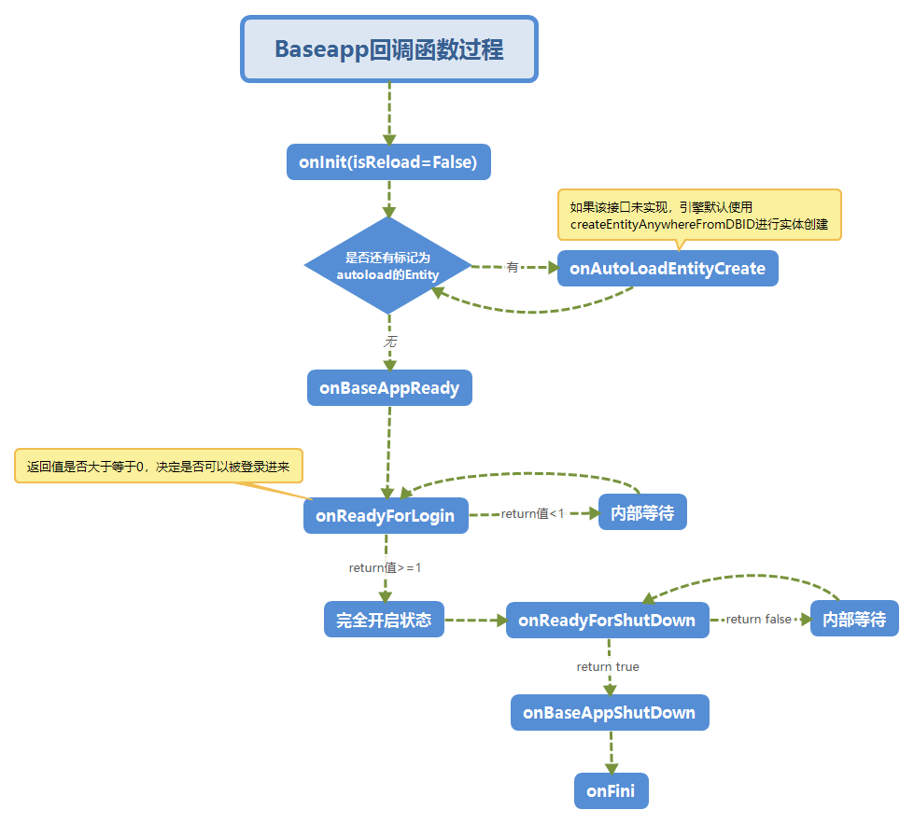
Functional View
Notes:
Handling entities without space

Slide 14
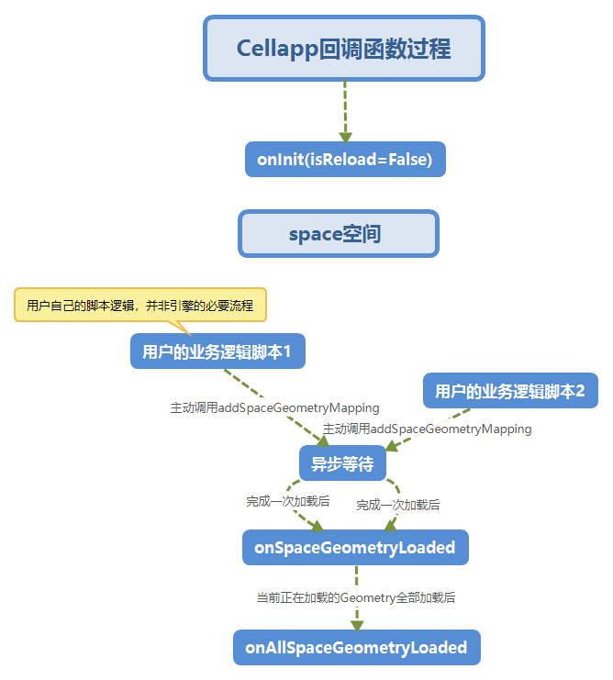
Functional View
Notes:
Handling logics about game, space and location, such as a room or a scene.

Slide 15
03
Evolution Perspective

Slide 16
Evolution Perspective：
The value of evolution perspective is to help us understand the process of the development and perfection of KBEngine.
Here we'll talk about some typical but not all releases of the project in detail. And in these typical releases, we draw a picture of the some important changes.

Slide 17
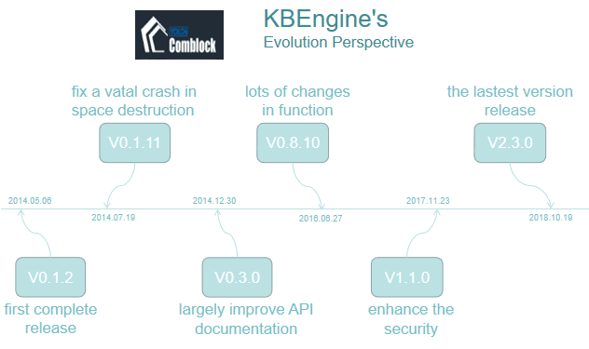
Evolutionary Perspective

Slide 18
04
Technical Debt

Slide 19

Technical Debt
Analysis Tools
Maintainability
SonarQube? CodeFactor !
Maintainability is the most fierce issue. 838 unsolved warning comments !
UDP support
Complexity
Discussion in community acquires positive feedback.
Over 100 too complex methods detected.

Slide 20
Thanks
Group5
李炳嘉 杜会远 曹相成 周逸帆

