Slide 1

DUMB-OS
Prepared By :
Student Name: Satvik Parihar Enrollment no: 23002170510039 Batch:A-1 Branch: AIDS
Student Name: Devpriya Morkhiya Enrollment no: 23002170410014 Batch:A-1 Branch:AIML
Student Name: Dhruvish Patel Enrollment no: 23002171410034 Batch:A-1 Branch: CS&IT
Student Name: Yug Dandawala Enrollment no: 23002170510005 Batch:A-1 Branch:AIDS
Student Name: Kavya Pandya Enrollment no: 23002170510016 Batch:A-1 Branch: AIDS

Slide 2
Purpose
The purpose of the "Dumbos" project is to create a suite of basic console-based applications, including a calculator, clock, and game zone, using Java. The project aims to demonstrate the integration of core programming concepts, database management with MySQL via XAMPP, and system-level operations. It serves as a practical exercise in developing command-line tools that operate efficiently at the root level of an operating system, showcasing the ability to manage data, perform calculations, track time, and offer simple gaming experiences without the need for a graphical user interface.

Slide 3
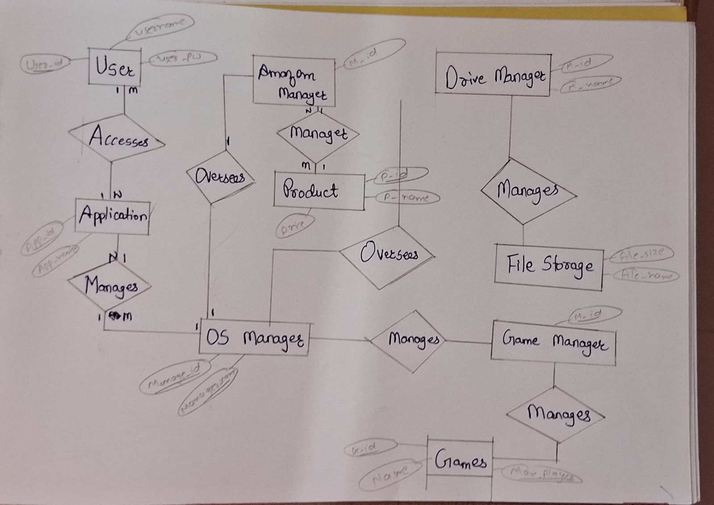
ER diagram

Slide 4
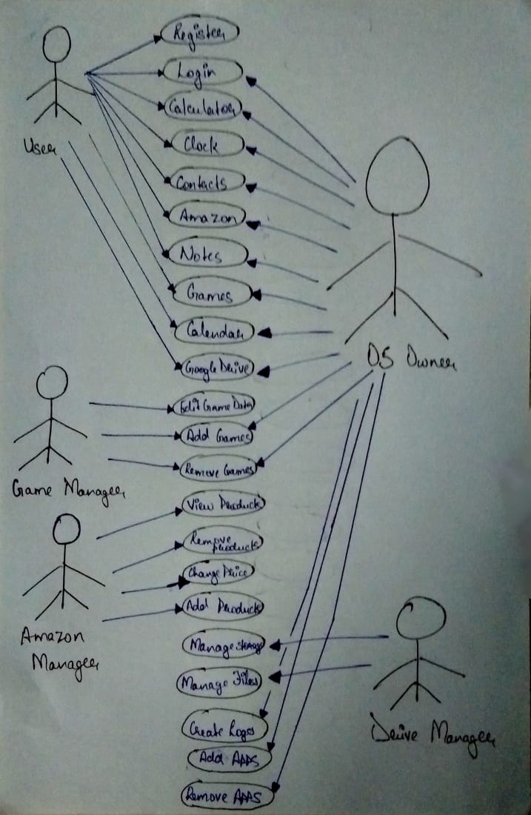
Use case Diagram

Slide 5
Functionalities
1. Calculator:
Basic Arithmetic Operations: Perform addition, subtraction, multiplication, and division.
Error Handling: Manage errors such as division by zero.
Operation Logging: Store each operation's details in the database for future reference.
2. Clock:
Real-Time Display: Show the current time continuously.
Stopwatch: Start, pause, and reset a stopwatch with time tracking.
Timer: Set countdown timers with alerts upon completion.
3. GameZone:
Game Options: Provide simple console-based games like Tic-Tac-Toe or Number Guessing.
Score Tracking: Record and display scores for each game session.
Session Logging: Save game session data, including start time, duration, and outcomes, to the database.
4. Database Management (DBMS):
Data Storage: Use MySQL to store user data, operation logs, and game session details.
Data Retrieval: Fetch and display stored information from the database.
Data Integrity: Ensure data consistency and handle relational data effectively.
5. System-Level Operations:
Root-Level Execution: Operate at the root level of the OS, enabling deeper integration with system resources.
No UI Dependency: Function purely through the console without requiring a graphical interface, focusing on core functionality and performance.

Slide 6
Development Setup
JDK: Install for Java development and running applications.
IDE: Use Visual Studio Code for coding and debugging.
XAMPP: Provides Apache, MySQL, and PHP for database management.
MySQL: Configure within XAMPP for data storage.
Project Structure: Organize Java files and SQL scripts in a clear directory layout.
CLI: Develop and test applications via the command line.

Slide 7
Merits
Efficiency and Performance:
The console-based nature of the project ensures fast execution with minimal resource usage, making it efficient and lightweight.
Focus on Core Java Concepts:
The project effectively reinforces key Java concepts, such as object-oriented programming (OOP), exception handling, and multithreading, providing a strong foundation in Java development.
Practical Database Integration:
Demonstrates the practical use of MySQL for managing data, integrating smoothly with the applications to store and retrieve information effectively.
Modularity and Maintainability:
The modular design, with separate components for the calculator, clock, and game zone, makes the project easier to maintain and expand in the future.
System-Level Operation:
Running at the root level of the OS provides deep interaction with system resources, offering insights into lower-level programming and system operations.
No Dependency on External Libraries:
By avoiding graphical interfaces and sticking to console-based operations, the project remains free from external dependencies, ensuring greater portability.

Slide 8
Demerits
Limited User Interaction:
The absence of a graphical user interface (GUI) can make the applications less intuitive and user-friendly, especially for non-technical users.
Basic Functionality:
The simplicity of the applications may not meet the needs of users who expect more advanced features, such as a scientific calculator or more complex games.
Scalability Limitations:
The current design may face challenges when scaling to include more complex features or additional applications, requiring significant architectural changes.
Security Concerns:
Operating at the root level introduces potential security risks, as improper handling of system-level operations can lead to vulnerabilities.
Error Handling Complexity:
Managing errors at the root level requires robust and complex error handling mechanisms, which can be difficult to implement and maintain.
Reduced Appeal for Broader Audiences:
The lack of a visual interface may limit the project's appeal, particularly in environments where user experience and aesthetics are important.

Slide 9
Future Scope
GUI Development:
Integrate a graphical user interface (GUI) for a more intuitive user experience.
Advanced Features:
Enhance applications with advanced functionalities, such as scientific calculator functions and more complex games.
Cross-Platform Support:
Adapt the project for different operating systems and platforms.
Cloud Integration:
Implement cloud storage for data and session management.
Mobile Version:
Develop mobile versions of the applications for broader accessibility.
Security Enhancements:
Improve security features, especially for root-level operations and data management.
Flow and Tracking:
Better hovering through apps and track records for the user.

Slide 10
Functionalities of project Related with particular subject
DATA STRUCTURES USING JAVA | JAVA-II | DATABASE MANAGEMENT
Linked List | File-IO | Filestorage
Binary Search Tree | Exception Handling | Login data
Stack , Queue | Multi-Threading | File Data
Hashmap | OOP | Game data

Slide 11
Thank You

