Slide 1


WeatherScape
A weather analysis tool that processes weather data of Ahmedabad City and analyses it and helps visualizing it using different graphs .
Prepared By :-
Name : - Satvik Parihar
Enrolment No. :- 23002170510039
Batch : - A1
Branch :- AIDS

Slide 2
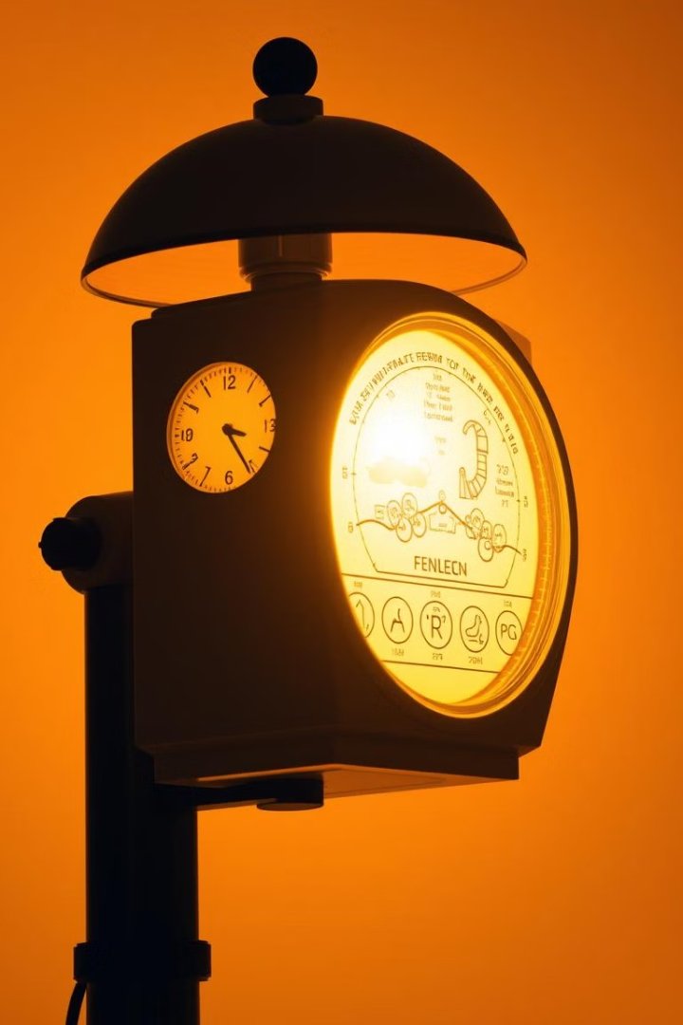




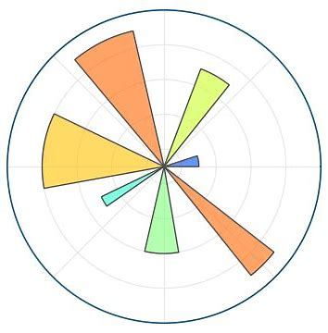

Tools and Libraries
1.
The whole code is written in python and all the analysis and visualisation is done using different libraries of python
2.
Xampp server is use to connect MySQL database to store data and fetch it for processing
3.
Jupyter Notebook is used to write the code , establish connection and display output
4.
Pandas (library in python) is used to create DataFrames and to store the data fetched from Database
5.
Matplotlib is used for data visualisation and for plotting different graphs – bar graph , line chat and histogram
6.
Requests library is used to integrate openweathermap API
NumPy is used to create arrays

Slide 3
Working and Features
Current Weather
An Api is used to connect the program to OpenWeatherMap and fetch current weather data of Ahmedabad city into a DataFrame .
Current Week
References are taken from OpenWeatherMap and Accuweather to create a table for the data of current week including , date , max and min temperature , humidity and wind speed and pandas(DataFrame and NumPy(arrays) are used to store these data and eventually plot graphs using matplotlib .
January 2025
The weather data of January 2025 is stored in the database and different analysis and visualization tools are used to display respective output for this data .
Stats of 2024
Using OpenWeatherMap and Accuweather different tables are created to store max and min temp of each day in 2024 . The tables are created month-wise . It has 2 features :
Particular Month – Gets the data and plots for all the days of a single month decided by taking user input for month number .
Yearly – Fetches , analyses and plots data of each month and stores in a table ‘weather_2024’ - name of the month , average max and min temperatures , average humidity and the average wind speed .

Slide 4

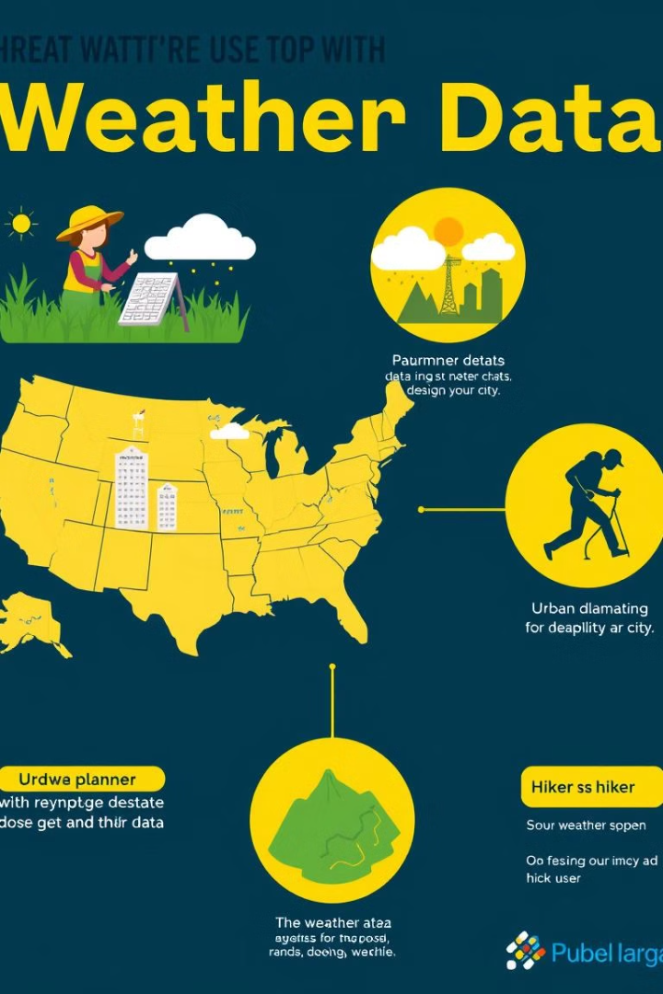


Use Cases
Agriculture
Weather analysis can help making plant watering
and growing schedules
Weather Predictions
Historic data can be used to predict future weather
Conditions and be prepared for the unseen
Research
The analysis can be used to study the causes of
Frequent weather changes and its effect in the
nature
Travel
4
The analysis can be used by various transportation
Departments to schedule the facilities accordingly
Individual
5
On an individual level it can be used to study the
Conditions of a place before visiting or shifting there

Slide 5
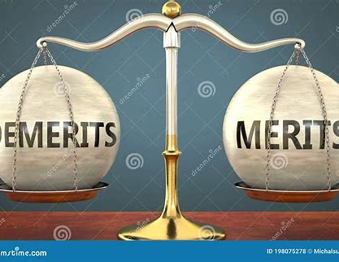
Merits and Demerits
Merits
Demerits
Varied Practical applications
In depth historic data for 2024
Real – time weather update
Various Visualisation
Different parameters for analysis
Console based output
Dependency on API
Limited historic data
Limited to Ahmedabad city

Slide 6

Future Scope
Global Coverage
Scaling the geographical area to a global level
2
Improved Datasets
Availability of more real time and past data for analysis
1
Improved Interface
Integrating a more user friendly and appealing interface
3
5
Machine Learning
4
Depth Analysis
Machine Learning processes for future predictions
More aspects and a deeper analysis on various factors affecting weather

Slide 7
Thank
You

