Slide 1


PROYECTO 2
Aprendizaje no supervisado sobre perfiles de una red de contactos
Icia Carro Barallobre Karen Salazar Gutiérrez Laura Llorente Sanz

Slide 2
31
Dataset
Exploración de los datos I
59946
age | status | sex | orientation | Body-type | diet | … | offspring | pets | religion | sign
 |  |  |  |  |  | …
 |  |  |  |  |  | …
 |  |  |  |  |  | …
 |  |  |  |  |  | …
essay0 | … | essay9
 | …
 | …
 | …
 | …
Metodología
1º Procesamiento del texto libre: PLN
2º Preprocesamiento
3º Clustering

Slide 3
PLN: Ingeniería de características
Nueva columna
essay0 | essay1 | essay2 | essay3 | essay4 | essay5 | essay6 | essay7 | essay8 | essay9
all_essays
essay0 + essay1 + … + essay9
drop

Slide 4


PLN: algoritmo LDA
Nueva columna
all_essays
essay0 + essay1 + … + essay9
4 temas

Slide 5
PLN: algoritmo LDA
topic_matrix | n_top 1 | n_top 2 | n_top 3 | n_top 4
n_topics 1 | 'friends' | 'family' | 'food’ | 'music’
n_topics 2 | 'read' | 'reading' | 'books' | 'movies’
n_topics 3 | 'music' | 'food' | 'movies' | 'books’
n_topics 4 | 'home' | 'movie' | 'friends' | 'family'
‘Social’
‘Book’
‘Music’
‘Movie’

Slide 6
Exploración de los datos
Nueva columna
age | status | sex | orientation | … | smokes | speaks
labels
‘Social’
‘Music’
‘Reader’
‘Cuisine’
22
59946
Dataset

Slide 7
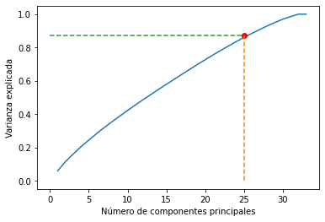
CLUSTERING
AGRUPAMIENTO
K-MEANS
DBSCAN
0.88 %

Slide 8
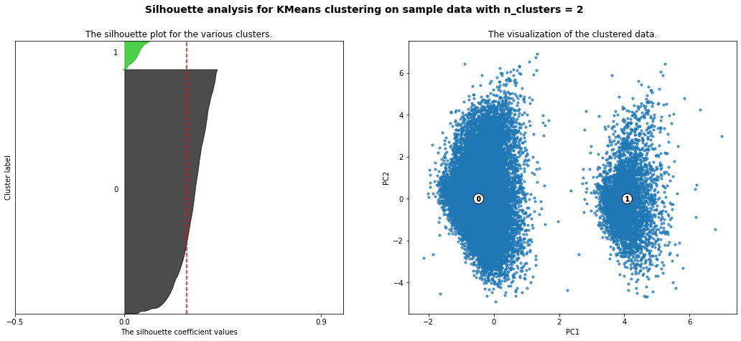
K-MEANS
Cluster 2 For n_clusters = 2
The average silhouette_score is : 0.28604261867957104

Slide 9
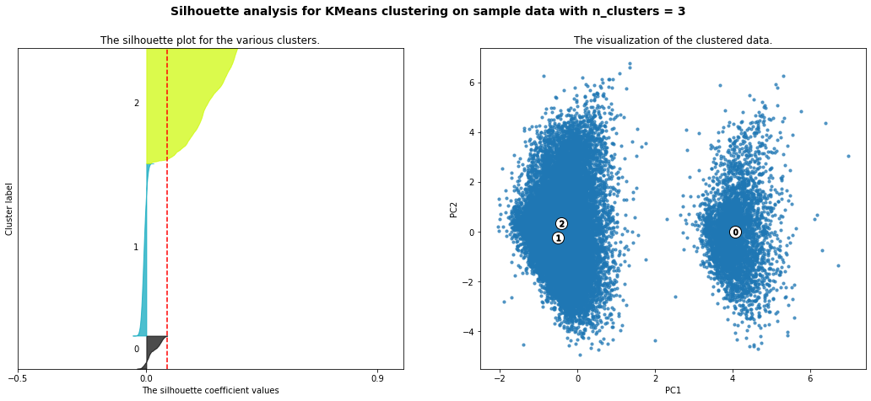
Cluster 3 For n_clusters = 3
The average silhouette_score is : 0.08119408591634569

Slide 10
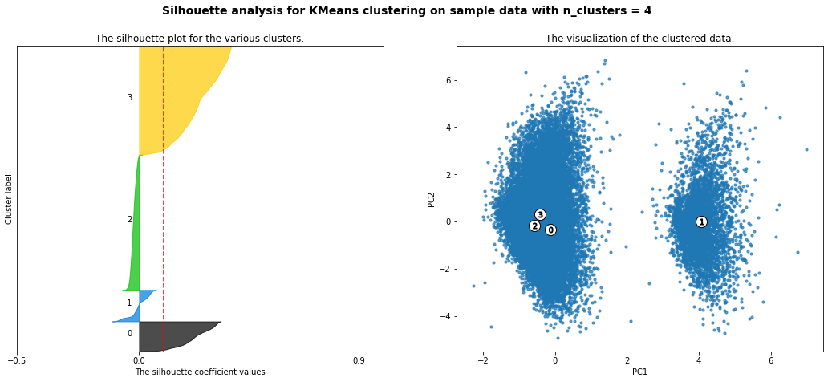
Cluster 4 For n_clusters = 4
The average silhouette_score is : 0.10060530643949009

Slide 11
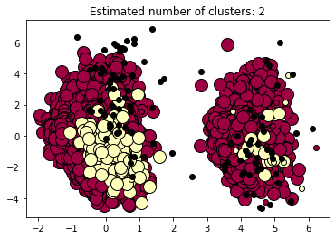
DBSCAN
(eps, min_samples=100)
Estimated number of clusters: 2.
Estimated number of noise points: 108.
Silhouette Coefficient: 0.523.

Slide 12

¿Alguna pregunta?

