Slide 1
A Federated Learning Approach for Green and Resilient IoMT Networks
Group 21
Team Members:
2020BCS0127 CHALUVADI MARUTHI PHANENDRA
2020BCS0148 JAIN MARIA JUSTINE
2020BCS0175 AMAN KUMAR SRIVASTAVA
2020BCS0152 SABAVATH VIKAS NAIK
Guided By,
Dr.RAGESH G K
Assistant Professor
Indian Institute of Information Technology, Kottayam
Notes:
offline internship students : meet.google.com/vmv-uqhd-sqp

Slide 2
Flow of Presentation :
INTRODUCTION
INTRODUCTION TO IOMT
INTRODUCTION TO FEDERATED LEARNING
SIGNIFICANCE OF THE RESEARCH AREA
LITERATURE REVIEW
PROBLEM STATEMENT
PROJECT OBJECTIVES
ENERGY MODEL
SYSTEM MODEL
EXPERIMENTAL SETUP

Slide 3
Flow of Presentation :
DEMONSTRATION
DECISION TREE MODEL
SIMPLE NEURAL NETWORK MODEL
RANDOM FOREST MODEL
SUPPORT VECTOR MACHINE
RESULTS
COMPARISON - ACCURACY
COMPARISON - ENERGY CONSUMPTION
CONCLUSIONS
FUTURE WORK
REFERENCES

Slide 4
Introduction
The Internet of Medical Things (IoMT) is crucial in healthcare, but optimizing energy efficiency is a challenge due to limited resources. A federated learning framework is being developed to address this issue, aiming to extend IoMT devices operational lifespans, reduce energy consumption, and contribute to cost savings and sustainability in the healthcare industry. This research aims to enhance IoMT role in healthcare.

Slide 5
Introduction to Federated Learning
Introduction to IOMT
Federated learning is a way to train AI models without anyone seeing or touching your data, offering a way to unlock information to feed new AI applications.
A machine learning technique that trains an algorithm via multiple independent sessions, each using its own dataset.
Federated Learning offers several key benefits are privacy-preserving,efficient Data Usage,security,decentralization
Internet of Medical Things (IoMT) refers to medical devices and applications with Internet connectivity. It’s a subset of Internet of Things (IoT) and, for this reason, is often referred to as IoT in healthcare.

Slide 6
Significance of the Research Area
Patient-Centric Healthcare
Optimized Healthcare Services
Sustainability
Resource Conservation
Economic Impact

Slide 7
Literature Review

Slide 8
Literature Review
S.NO | Authors | year | Summary | Merits
1 | Ali Hassan Sodhro , Lei Wang, Noman Zahid, Kashif Nisar[1] | 2021 | The paper proposes an adaptive Energy Efficient algorithm to improve energy efficiency, battery lifetime, and throughput in IoMT-based medical devices, compared to the addressing challenges like increased chronic diseases and medical expenses. | They proposed algorithm focuses on improving data transmission connectivity and reducing interruptions during information transmission.
2 | Sandeep Pirbhulal, Wanqing Wu*, Guanglin Li, Subhas Chandra Mukhopadhyay[2] | 2018 | The study introduces an energy-efficient ON-OFF algorithm (EEOOA) for medical data transmission in IoMT-based frameworks | Outperforming traditional methods and addressing energy drain issues in medical devices.
3 | Mohammed S. Al-Abiad, Md. Zoheb Hassan, Md. Jahangir Hossain[3] | 2021 | Local models are trained at the fog access points and the centralized cloud server. | Proposed resource allocation scheme minimizes energy consumption of FL in IoT networks.

Slide 9
Literature Review
S.NO | Authors | year | Summary | Merits
4 | Fatima Alshehri, Ghulam Muhammad[4] | 2021 | This comprehensive survey explores IoT and IoMT-based edge-intelligent smart health care, focusing on research areas, challenges, and future directions, predicting billions in revenue in the near future. | Offer a formal classification and specific comparative context for IoT, IoMT, AI, edge and cloud computing, privacy and security in smart health care.
5 | Xiaopeng Mo, Jie Xu[5] |  | The paper discusses a federated edge learning system, enhancing energy efficiency through joint communication and computation design, transmission protocols, and proposing efficient energy minimization algorithms. | The system's energy efficiency is improved through joint communication and computation design.
6 | Jiaxiang Zhang, Yiming Liu, Xiaoqi Qin, Xiaodong Xu[6] | 2021 | The proposed framework decreases greatly energy consumption compared with the static framework while satisfying the convergence rate of federated learning for IoT devices. | The framework achieves this by letting IIoT devices choose different training methods based on the dynamic environment status.

Slide 10
Literature Review
S.NO | Authors | year | Summary | Merits
7 | Ahmed A. Al-Saedi, Emiliano Casalicchio, Veselka Boeva[7] | 2021 | The paper introduces an Energy-aware Multi-Criteria Federated Learning model for edge computing, which reduces energy consumption by aggregating locally trained models in edge nodes. | The presented work is an approach to control and optimize communication of FL in the wireless network.
8 | A. Salh, R. Ngah, L. Audah,K.S.Kim,azwan Abdullah,Y.M.Al-Moliki ,Khaled Aljaloud, Hairul Nizam Talib[9] | 2023 | The proposed Alternative Direction Algorithm can adapt the central processing unit frequency and power transmission control to reduce energy consumption | It reduces energy consumption and network traffic by processing data locally.
9 | JXue Zhao , Xiaohui Li * , Shuang Sun and Xu Jia[9] | 2023 | The article introduces a gradient-boosting decision tree algorithm using horizontal federated learning to address issues like information leakage, model accuracy, and high communication costs in traditional GBDTs. | The algorithm uses locality sensitive hashing to collect similar data without exposing original data, improving accuracy by 2.53% and reducing communication costs.

Slide 11
Research gap
There is a significant gap in the development of federated learning (FL) algorithms in the dynamic domain of the Internet of Medical Things (IoMT), especially with regard to healthcare applications. The difference highlights the necessity for customized approaches that make good use of FL in healthcare settings. Furthermore, there is an urgent need to address the energy efficiency of IoMT devices in order to support sustainable healthcare systems.

Slide 12
Problem Statement
A Federated Learning Approach for Green and Resilient IoMT Networks
The healthcare industry depends heavily on the Internet of Medical Things (IoMT), but because of resource constraints, optimising energy efficiency is difficult. In order to improve device longevity, lower energy consumption, and advance sustainability in healthcare while also taking privacy and security into consideration, we are concentrating on developing a federated learning framework specifically tailored for IoMT.

Slide 13
Project Objectives
Energy Efficiency Improvement: Develop and implement strategies to optimise the energy efficiency of IoMT devices by reducing energy consumption.
Federated Learning Framework: Develop a customised federated learning framework tailored for IoMT devices that emphasises energy-efficient model training.

Slide 14
Scope of work
The Internet of Medical Things (IoMT) faces energy efficiency challenges due to the limited power resources of devices.
Federated Learning (FL) can address these challenges by optimizing data transmission, reducing computational load, and extending device battery life.
FL also allows on-device model updates, minimizing data transfer, and enabling real-time processing while maintaining data privacy.
It's particularly valuable for battery-powered IoMT devices and resource-constrained environments.
The scope of FL in IoMT applications is significant, offering solutions for energy-efficient healthcare solutions and improved patient care.

Slide 15
Energy Optimization in IoMT
(i). Energy Model
The energy consumed by the device i in a time interval t for sending and receiving (Et) is
Et(i) = Es(i) + Er(i) = Ps(i) × ts + Pr(i) × tr
ts → time needed to send the data
tr → time needed to receive the data
Es(i) → Energy consumed for sending the data
Er(i) → Energy consumed for receiving data
The power required for transmission (pt) is
Pt(i) = Ps(i) + Pr(i)
ps →power required for sending
pr → power required for receiving

Slide 16
Energy Optimization in IoMT
(i). Energy Model
The battery capacity or energy budget of an IOMT device is B(i) Joule(J)
Then the Battery lifetime in seconds is,
L(i) = B(i) / Pt(i)
At one point in time T it is useful to express the available energy budget or battery lifetime as percentage La_i(T)
La_i(T) = 1 / B(i) (B(i) - Σ Et(i))
Assuming Σ Et(i) is always less than or equal to B(i).
If ΣEt(i) >= B(i) the node cannot be selected to send or receive data.

Slide 17
Energy Optimization in IoMT
(i). Energy Model
Assume the size of the model parameters is s bytes, the network bandwidth for device i is bi bytes per second Round trip network latency experienced in communication with node i is li , the transmission time T(i) is,
T(i) = 2 × (s / bi ) + li
Assuming Ps(i) = Pr(i) = P(i) , The equation for the energy for transmission will be
Et(i) = Pi × ( 2 × (s / bi ) + li )

Slide 18
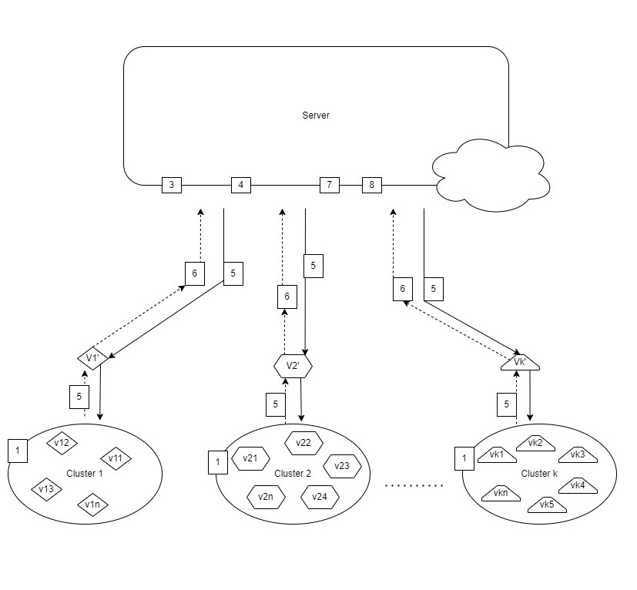
Energy Optimization in IoMT
(ii). System Model - Schematic Illustration

Slide 19
Energy Optimization in IoMT
(ii). System Model - Algorithm
Initial Clustering
Applying K medoid clustering , to group IoMT devices based on the similarity of their data or updates.
Dynamic Device Re-clustering Based on Silhouette Index
calculate the Silhouette Index of each devices.
Define a threshold value.
A device is considered to be poorly matched to its current cluster and may be closer to another cluster if its Silhouette index becomes significantly negative.
So the threshold value will be a negative value.
- If Silhouette Index of a device is less than the threshold we will start reclustering.
- If the above condition is not met we will continue with the initial clusters.

Slide 20
Energy Optimization in IoMT
(ii). System Model - Algorithm
3. Evaluation of Edge Devices
- Done on the global server.
- We will evaluate the edge scores of each device i in each cluster.
- To calculate the edge scores, we will consider three parameters.
→ Model Performance, I(i)
→ Battery life percentage, La_i(T)
→ Energy for transmission, Et(i)
Edge Scores ,
S(i) = w1 × I(i) + w2 × La_i(T) + w3 × ( E*(i)-Et(i) ) / E*(i)
wj 𝜖 [0,1] , w1 + w2 + w3 = 1
E*(i) → upper bound of the energy consumed by the edge node i
Et(i) = Pi × ( 2 × (s / bi ) + 1)
Size of the model parameters is s bytes, the network bandwidth for device i is bi bytes per second Round trip network latency experienced in communication with node i is li and here li=1.

Slide 21
Energy Optimization in IoMT
(ii). System Model - Algorithm
4. Selection of Representative Workers
Select the best representative worker from each cluster based on edge scores.
Suppose we have k clusters,
C= {C1, C2, C3, . . . . , Ck}
In each cluster Cj the edge devices are,
Cj = {Vj1, Vj2, Vj3, . . . . , Vj}
For each cluster Cj select the highest scored device V’j for which La_i(T) >0
Selected set of workers,
V’ = {V1’,V2’....Vn’}

Slide 22
Energy Optimization in IoMT
(ii). System Model - Algorithm
5. Updating Local models
At each round t, each worker trains its local model by iterating the local update multiple times before sending the next local model mv(t+1) to the server.
Each worker v’ ∈ V’ receives the global model Mt−1 and optimizes its parameters locally.
Local update,
mv(t+1) = mv(t) - ηg(t)
g(t) → updated weights on its local data at the current model mv(t)
η → learning rate
- Update the learning rate dynamically based on energy consumption.
- defined a learning rate scheduling strategy that takes energy consumption into account.
- use a learning rate that decreases as the available energy decreases.

Slide 23
Energy Optimization in IoMT
(ii). System Model - Algorithm
6. Data compression
- Using MessagePack, a binary serialization format we will do data compression on local model
updates.
- After that we will send that to our global model.
7. Building Global Model
- Decompress the local model updates.
- Mt is built by aggregating the local model updates received at round t.
- In this proposed model we assume it is evaluated by federated averaging.
Global Model,
M(t+1) = Σ (n’/n) × mv(t+1)
n → sum of all data points
n’ → number of local data points.

Slide 24
Energy Optimization in IoMT
(ii). System Model - Algorithm
8. Update Clustering Model
- Periodically reviewing and potentially changing the clustering model
9. Repeat Steps 2-8
- The entire process is repeated iteratively until convergence
- Convergence criteria
a) maximum number of rounds (T) is reached
b) The difference between current accuracy and previous accuracy is minimal.
Evaluation Metrics
Sum of energy consumed per round
Average of energy budget per round
Number of rounds to converge

Slide 25
Experimental setup
We are using MHEALTH (Mobile HEALTH) dataset , It contains vital sign and body motion data collected from ten participants as they engaged in different types of physical activity.
Dataset summary :
Activities: 12
Sensor devices: 3
Subjects: 10
We assumed that each edge device before training will have same energy.
And energy consumption for each iteration is 0.01
Power of edge device is 1

Slide 26
Input:
Column 1: acceleration from the chest sensor (X axis),
Column 2: acceleration from the chest sensor (Y axis),
Column 3: acceleration from the chest sensor (Z axis),
Column 4: electrocardiogram signal (lead 1) ,
Column 5: electrocardiogram signal (lead 2)
,Column 6: acceleration from the left-ankle sensor (X axis),Column 7: acceleration from the left-ankle sensor (Y axis)
Column 8: acceleration from the left-ankle sensor (Z axis)
Column 9: gyro from the left-ankle sensor (X axis)
Column 10: gyro from the left-ankle sensor (Y axis)
Column 11: gyro from the left-ankle sensor (Z axis)
Column 13: magnetometer from the left-ankle sensor (X axis)
Column 13: magnetometer from the left-ankle sensor (Y axis)
Column 14: magnetometer from the left-ankle sensor (Z axis)
Column 15: acceleration from the right-lower-arm sensor (X axis)
Column 16: acceleration from the right-lower-arm sensor (Y axis)
Column 17: acceleration from the right-lower-arm sensor (Z axis)
Column 18: gyro from the right-lower-arm sensor (X axis)
Column 19: gyro from the right-lower-arm sensor (Y axis)
Column 20: gyro from the right-lower-arm sensor (Z axis)
Column 21: magnetometer from the right-lower-arm sensor (X axis)
Column 22: magnetometer from the right-lower-arm sensor (Y axis)
Column 23: magnetometer from the right-lower-arm sensor (Z axis)
Column 24: Label (0 for the null class)

Slide 27
Output:
L1: Standing still (1 min)
L2: Sitting and relaxing (1 min)
L3: Lying down (1 min)
L4: Walking (1 min)
L5: Climbing stairs (1 min)
L6: Waist bends forward (20x)
L7: Frontal elevation of arms (20x)
L8: Knees bending (crouching) (20x)
L9: Cycling (1 min)
L10: Jogging (1 min)
L11: Running (1 min)
L12: Jump front & back (20x)

Slide 28
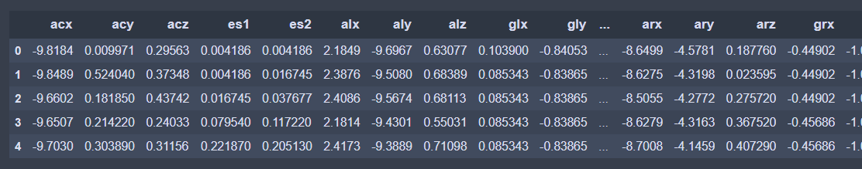
Demonstration
Data preview

Slide 29
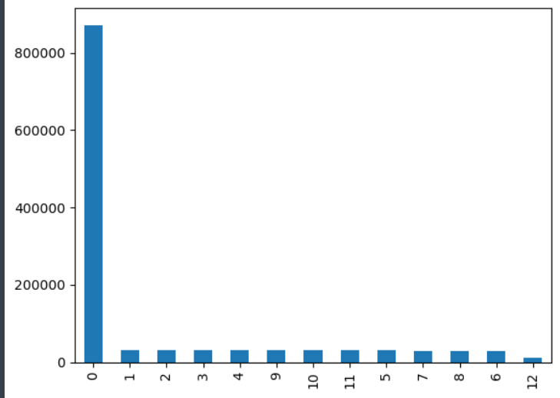
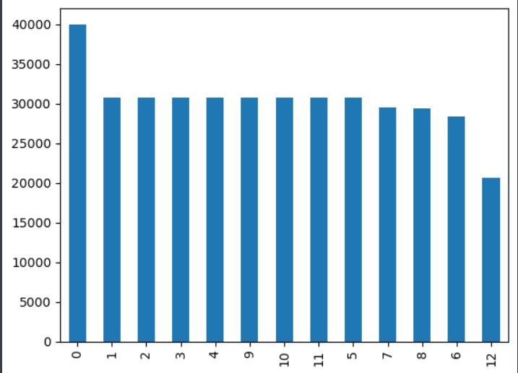
Demonstration
Output Frequency Graph
for mhealth Dataset
Dataset contains
unbalanced data.
so resampling dataset.

Slide 30
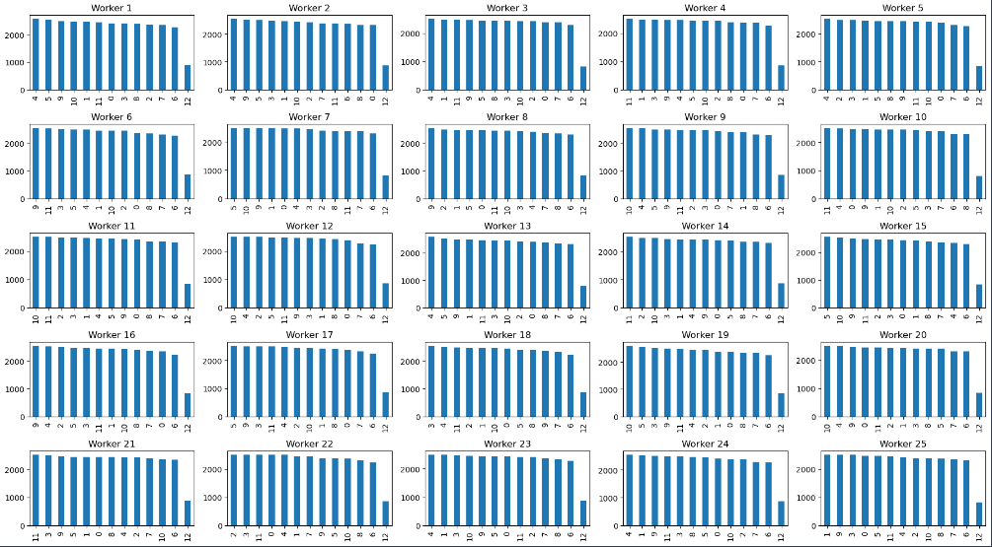
Demonstration
Now creating 5 clusters and each cluster will have 5 workers .Each work
will be assigned randomly 30000 data samples.

Slide 31
Decision tree Model
Colab link: https://colab.research.google.com/drive/1h9KKEpr4kGLB8c-7bvPM71kuB-l5GVtb?usp=sharing
Simplicity and Interpretability: Decision tree model's intuitive decision-making process and feature importance analysis facilitate interpretability, which is crucial in medical applications. The simplicity of decision trees leads to lower computational complexity during both training and inference, resulting in energy-efficient processing.
Robustness to Noise: Decision tree models are robust to noisy data, which is prevalent in IoMT environments due to sensor inaccuracies. The ability to handle noisy data effectively contributes to reliable performance without significant energy overhead.
Low Memory Footprint: Decision trees have a relatively low memory footprint. This characteristic is advantageous in resource-constrained IoMT devices, where minimizing memory usage is essential for energy efficiency.

Slide 32
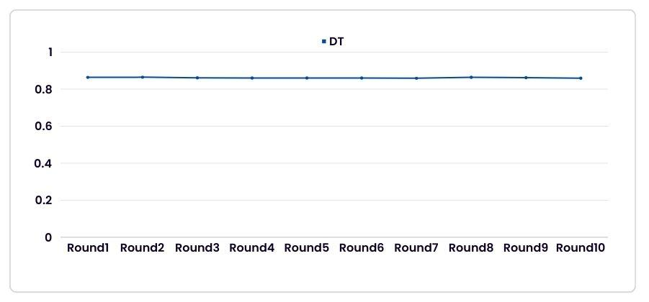
Decision tree Model
Accuracy Vs Rounds

Slide 33
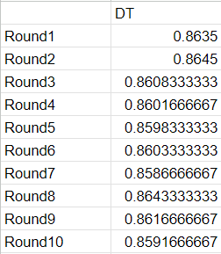
Decision tree Model
Accuracy Vs Rounds

Slide 34
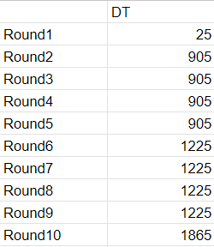
Decision tree Model
Energy Consumption Vs Rounds

Slide 35
Simple Neural Network Model
Colab link: https://colab.research.google.com/drive/1qUbnWByD4EhkFGj07klxFYZy4POXpxYi?usp=sharing
The simple neural network model we used - Multilayer Perceptron Model
Efficiency in Inference: While training simple neural network model can be computationally intensive, their inference phase is generally more efficient. In IoMT scenarios, where real-time processing is crucial, simple neural network models offer a balance between accuracy and energy efficiency during inference.
Feature Representation Learning: simple neural network models excel at learning complex feature representations, which is beneficial in capturing intricate relationships within medical data. By efficiently representing data, simple neural network models reduce the computational burden during inference, leading to improved energy efficiency.
Adaptability to Resource Constraints: simple neural network model architectures can be tailored to accommodate resource constraints in IoMT devices. Techniques such as model compression and quantization enable the deployment of lightweight simple neural network models, optimizing energy efficiency without compromising performance significantly.

Slide 36
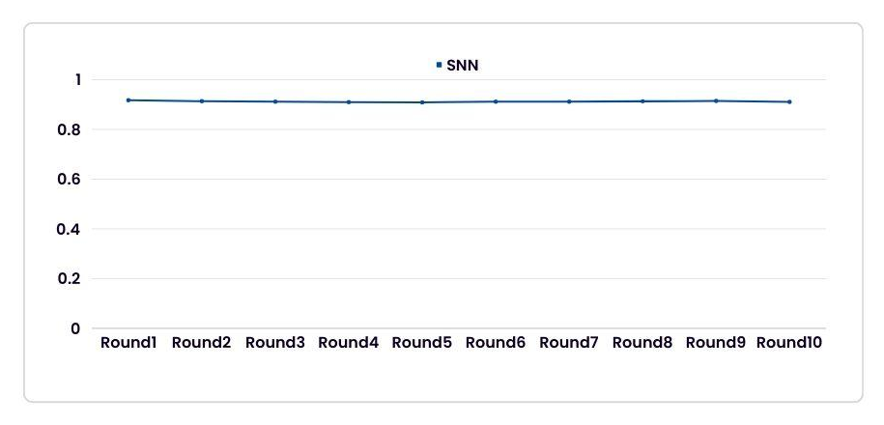
Simple Neural Network Model
Accuracy Vs Rounds

Slide 37
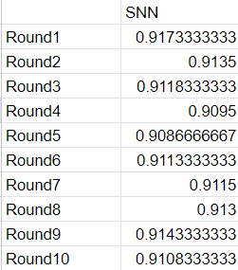
Simple Neural Network Model
Accuracy Vs Rounds

Slide 38
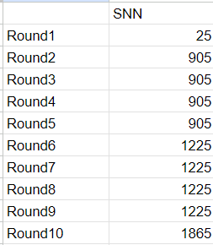
Simple Neural Network Model
Energy Consumption Vs Rounds

Slide 39
Support Vector Machine-SVM
Colab link: https://colab.research.google.com/drive/1I4vTdeOuHo0t_TH8sKN-Lrb2fNKfwqqF
Margin Maximisation: Support vector machines (SVMs) aim to maximize the margin between data points near decision boundaries, enhancing generalization and robustness but increasing vulnerability to outliers, which can cause misclassifications and affect model accuracy due to incorrectly recognized outliers.
Sensitivity to Outliers: SVM's focus on class margin maximization can be significantly impacted by erroneous outlier identification, potentially shifting the decision border and resulting in incorrect classifications and reduced accuracy.
Energy Consumption: Depending on the dataset's complexity and the amount of computing power needed for margin optimisation, the energy used for SVM training and inference can vary.

Slide 40
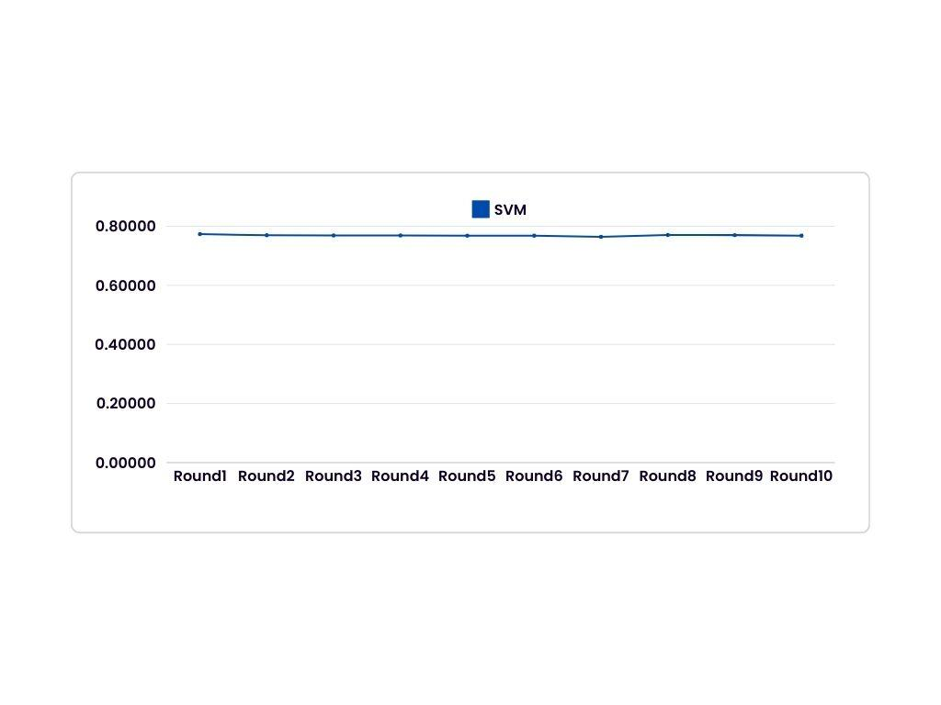
Support Vector Machine-SVM

Slide 41
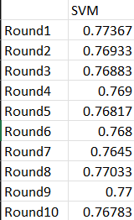
Support Vector Machine-SVM
Accuracy Vs Rounds

Slide 42
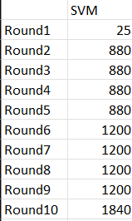
Support Vector Machine-SVM
Energy Consumption Vs Rounds

Slide 43
Random Forest Model
Colab link: https://colab.research.google.com/drive/17bk8xCc-OW70KkKLaHSvXV7dI8lYkXWS?usp=sharing
Ensemble Learning: Random forest model combines multiple decision trees, which enhances robustness and generalization while reducing overfitting. This ensemble approach contributes to efficient energy utilization by distributing computational load across multiple trees, thereby reducing individual computational demands.
Efficient Inference: Random forest model inference phase is generally more efficient compared to training, making it suitable for real-time decision-making in energy-constrained IoMT devices. The ensemble nature of Random forest model allows for parallelized evaluation of trees, further improving computational efficiency.
Scalability: Random forest model can be trained and evaluated in parallel, enabling scalability to large datasets commonly encountered in medical applications. This parallelization capability enhances energy efficiency by leveraging distributed computing resources effectively.

Slide 44
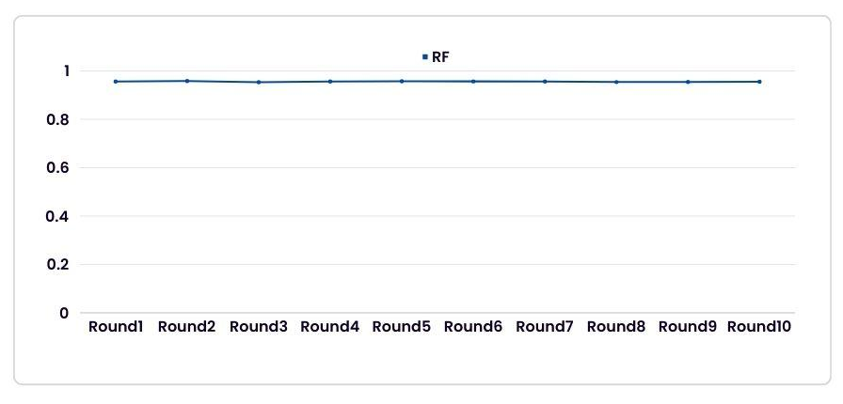
Random Forest Model
Accuracy Vs Rounds

Slide 45
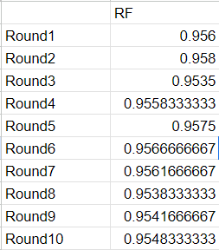
Random Forest Model
Accuracy Vs Rounds

Slide 46
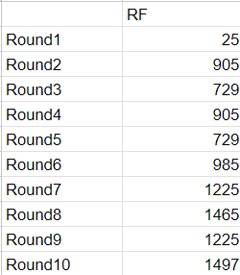
Random Forest Model
Energy Consumption Vs Rounds

Slide 47
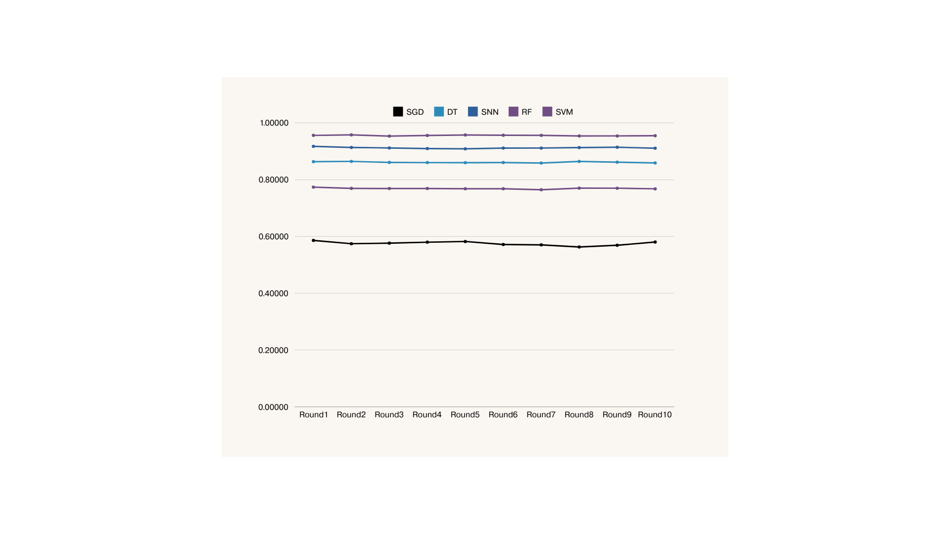
Comparison - Accuracy

Slide 48
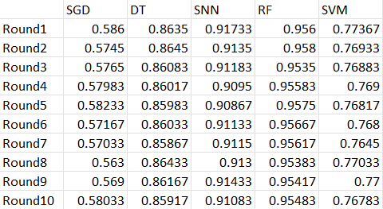
Comparison - Accuracy

Slide 49
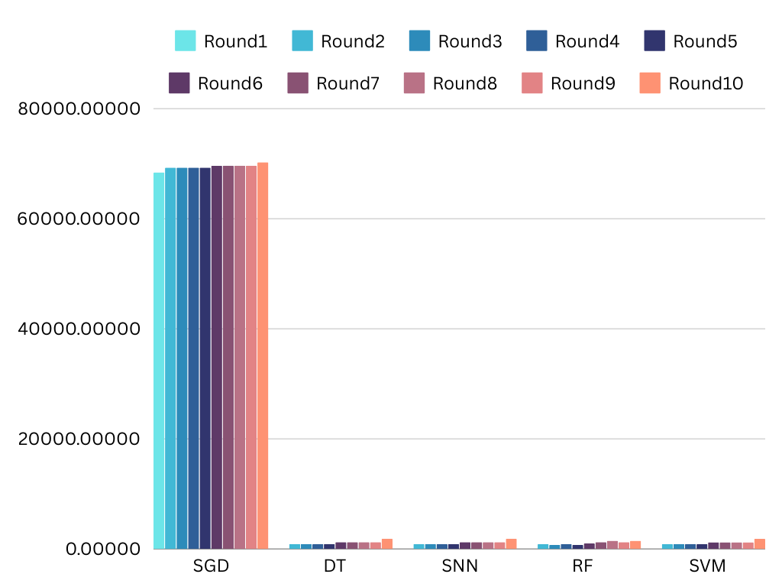
Comparison - Energy Consumption

Slide 50
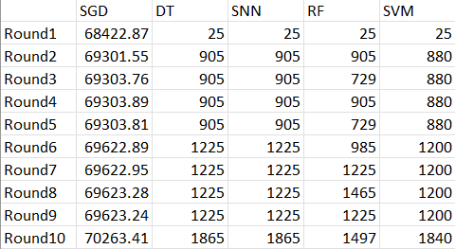
Comparison - Energy Consumption

Slide 51
Conclusion
Decision Trees and Simple Neural Network when integrated within the federated learning setup demonstrate consistent and predictable energy consumption patterns, making them suitable for resource-constrained IoMT devices.
Random Forest integrated within the federated learning setup, despite occasional energy spikes, maintains relatively low and manageable energy consumption levels, offering a balance between accuracy and efficiency.
Stochastic Gradient Descent, while offering comparable accuracy, exhibits significantly higher energy consumption, making it less suitable for IoMT applications where energy conservation is critical.
Support Vector Machine (SVM) integrated within the federated learning setup shows promising accuracy performance while maintaining moderate energy consumption levels, making it a viable option for IoMT applications.
In IoMT scenarios where energy efficiency is prioritized, Decision Trees and Simple Neural Network integrated within the federated learning setup emerge as preferable options due to their consistent and relatively low energy consumption profiles.

Slide 52
Conclusion
But,
When considering both accuracy and energy efficiency in IoMT scenarios, Random Forest integrated within the federated learning setup emerges as the best choice, offering a balance between accuracy and energy conservation.
Decision trees and simple neural networks integrated within the federated learning setup are still good choices as well, especially in applications where consistent energy use is crucial.
Therefore, Decision Trees, Simple Neural Network, and Support Vector Machine integrated within the federated learning setup are viable options, but Random Forest integrated within the federated learning setup emerges as the optimal choice for IoMT applications, providing a balance between accuracy and energy efficiency.

Slide 53
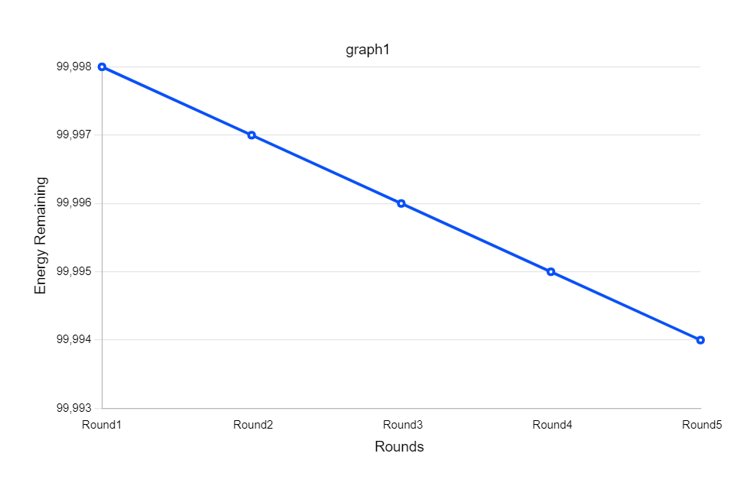
When using WIFI (BandWidth-100 Mbps)
Colab link: https://colab.research.google.com/drive/1Pj5LZInNcmnaWbn1mQEsj_YsyIgUs_zw?usp=sharing

Slide 54
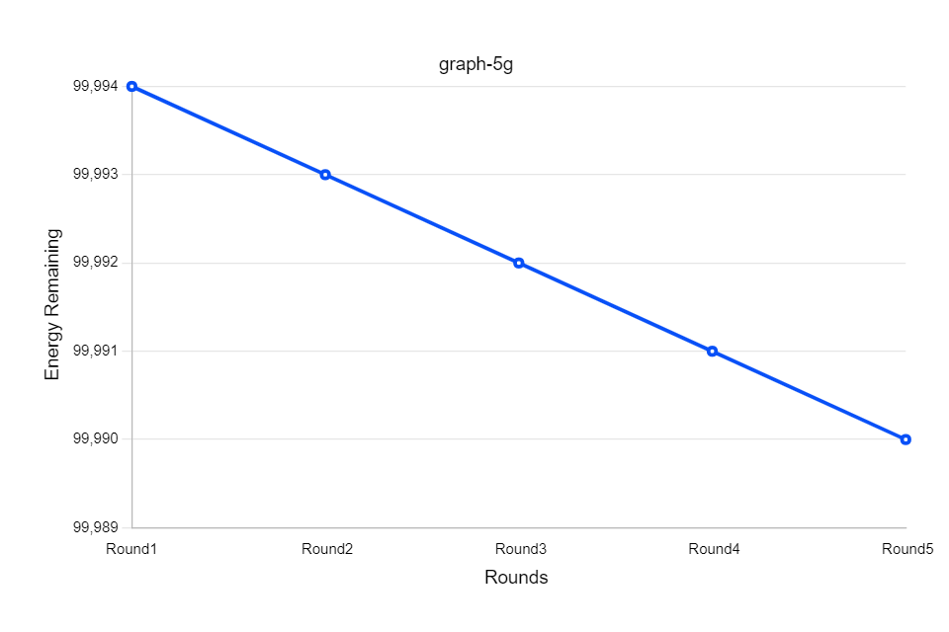
When using 5G (BandWidth-500 Mbps)
Colab link: https://colab.research.google.com/drive/1sw-G3JqWHOMjMYwrEiZb3VzfSsg1FAZw?usp=sharing

Slide 55
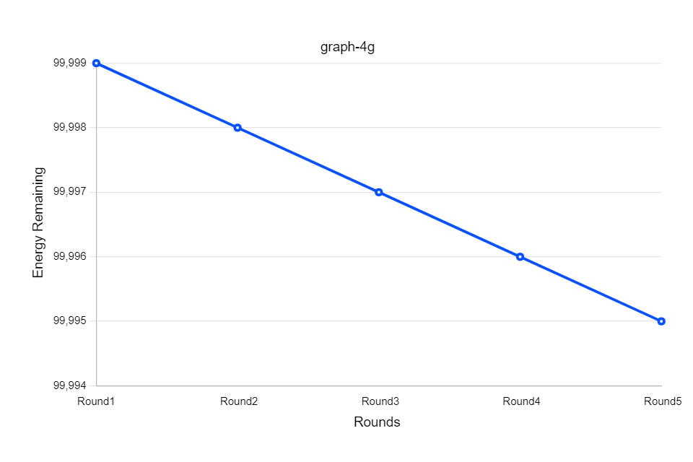
When using 4G (BandWidth-20 Mbps)
Colab link: https://colab.research.google.com/drive/1abtwJPq6vBrEOc3YQrjWPfyYJBYnKST1?usp=sharing

Slide 56
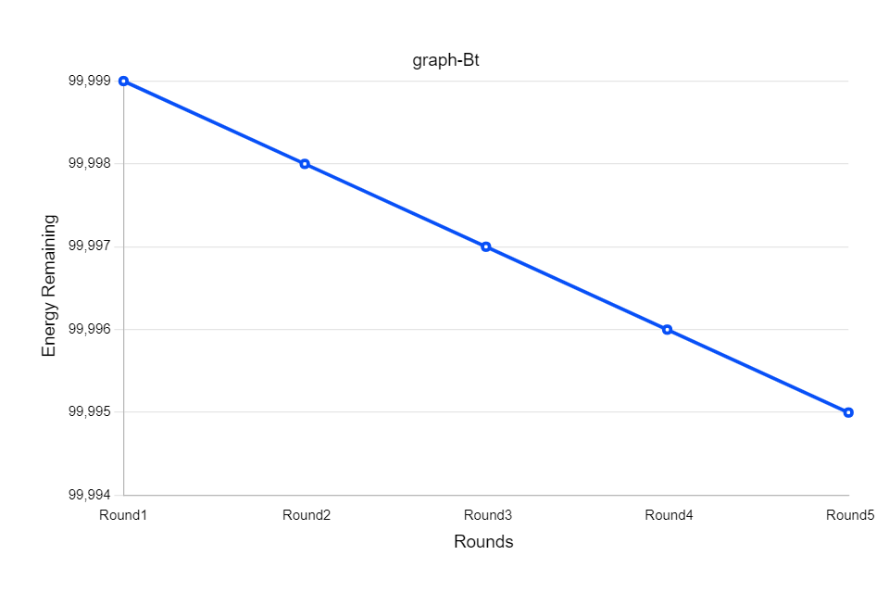
When using Bluetooth (BandWidth-2 Mbps)
Colab link: https://colab.research.google.com/drive/1cxsxvSzJl4-uHTZKa4Kg3l5gQiCJD-B_?usp=sharing

Slide 57
Conclusion
Across rounds and different communication technologies (WiFi, 5G, 4G, Bluetooth), the energy remaining for Workers remains relatively stable.
Despite variations in bandwidth and transmission protocols, the energy consumption pattern remains consistent, showcasing the adaptability and efficiency of federated learning across diverse communication technologies.
Federated learning with Random Forest demonstrates resilience to fluctuations in network conditions, ensuring consistent energy utilization irrespective of the communication technology employed.
By maintaining stable energy usage across different communication technologies, federated learning optimizes resource allocation, enabling efficient utilization of device resources without sacrificing performance.
The consistent energy usage observed across rounds and communication technologies highlights the scalability and sustainability of federated learning in IoMT scenarios, promoting long-term viability and effectiveness in resource-constrained environments.

Slide 58
Future work
Although the present study utilized mHealth data, further research should validate on other medical datasets to achieve more generalizability.
The current implementation ran locally on a single computer. Subsequent research efforts could include evaluating this technology in a distributed computing context with several machines.

Slide 59
References
[1] A. H. Sodhro, et al., "Decentralized energy efficient model for data transmission in IoT-based healthcare system," in 2021 IEEE 93rd Vehicular Technology Conference (VTC2021-Spring), pp. 1-6, IEEE, 2021.
[2] S. Pirbhulal, et al., "A medical-IoT based framework for eHealth care," in 2018 International Symposium in Sensing and Instrumentation in IoT Era (ISSI), pp. 1-5, IEEE, 2018.
[3] V. K. Prasad, et al., "Federated learning for the internet-of-medical-things: A survey," Mathematics, vol. 11, no. 1, pp. 1-17, 2022.
[4] F. Alshehri and G. Muhammad, "A comprehensive survey of the Internet of Things (IoT) and AI-based smart healthcare," IEEE Access, vol. 9, pp. 3660-3678, 2021.
[5] X. Mo and J. Xu, "Energy-efficient federated edge learning with joint communication and computation design," Journal of Communications and Information Networks, vol. 6, no. 2, pp. 110-124, 2021.
[6] J. Zhang, et al., "Energy-efficient federated learning framework for digital twin-enabled industrial internet of things," in 2021 IEEE 32nd Annual International Symposium on Personal, Indoor and Mobile Radio Communictions (PIMRC), pp. 1-6, IEEE, 2021.
[7] A. A. Al-Saedi, E. Casalicchio, and V. Boeva, "An Energy-Aware Multi-Criteria Federated Learning Model for Edge Computing," in 2021 8th International Conference on Future Internet of Things and Cloud (FiCloud), pp. 1-8, IEEE, 2021.
[8] A. Salh, et al., "Energy-Efficient Federated Learning with Resource Allocation for Green IoT Edge Intelligence in B5G," IEEE Access, vol. 11, pp. 16353-16367, 2023.
[9]Zhao, Xue, et al. "Secure and Efficient Federated Gradient Boosting Decision Trees." Applied Sciences 13.7 (2023): 4283.

Slide 60
Thank you

