Slide 1
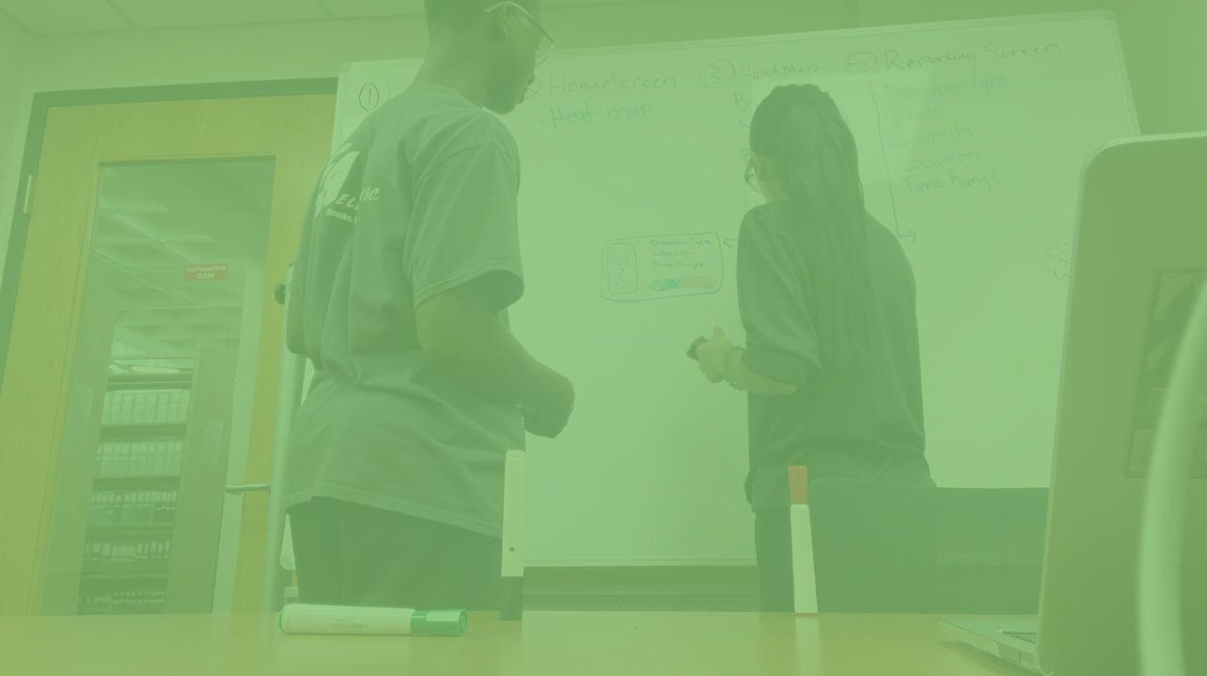
Sentry
E
C
O
Maryam and Ibrahima

Slide 2
A G E N D A
1
2
3
4
PROBLEM STATEMENT
FORMULATION
SOLUTION
IMPLEMENTATION

Slide 3
Problem
Statement
Background
Mission
During natural disasters, victim are not connected with accurate and precise information that would keep them safe.
Coastal states like Florida and Third World Countries with limited resources receive limited attention.
How can we connect people, first responders, and insurance companies during trivial times in natural disasters?

Slide 4
E
Mission statement
People
People
People
Assurant
People
First Responders

Slide 5
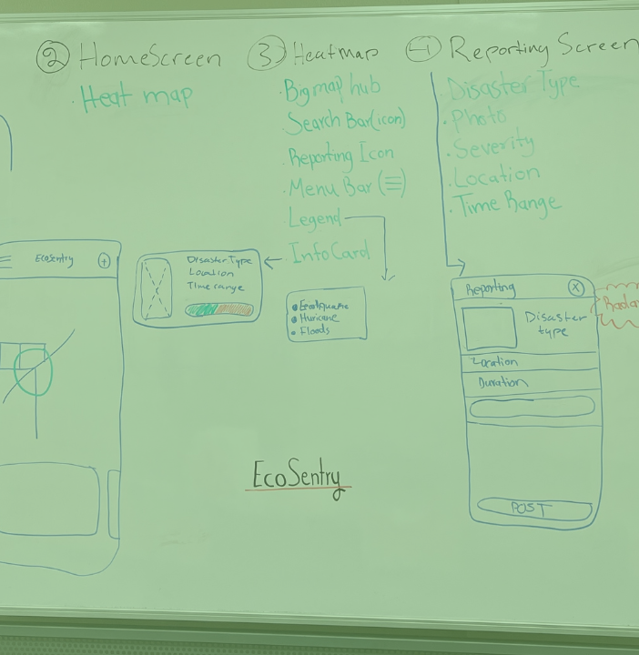
Formulation
Concept
Connect people to make the world a safer place
Tech stack
React
Material UI
GitLab
API
Minimum Viable product
Artifacts

Slide 6
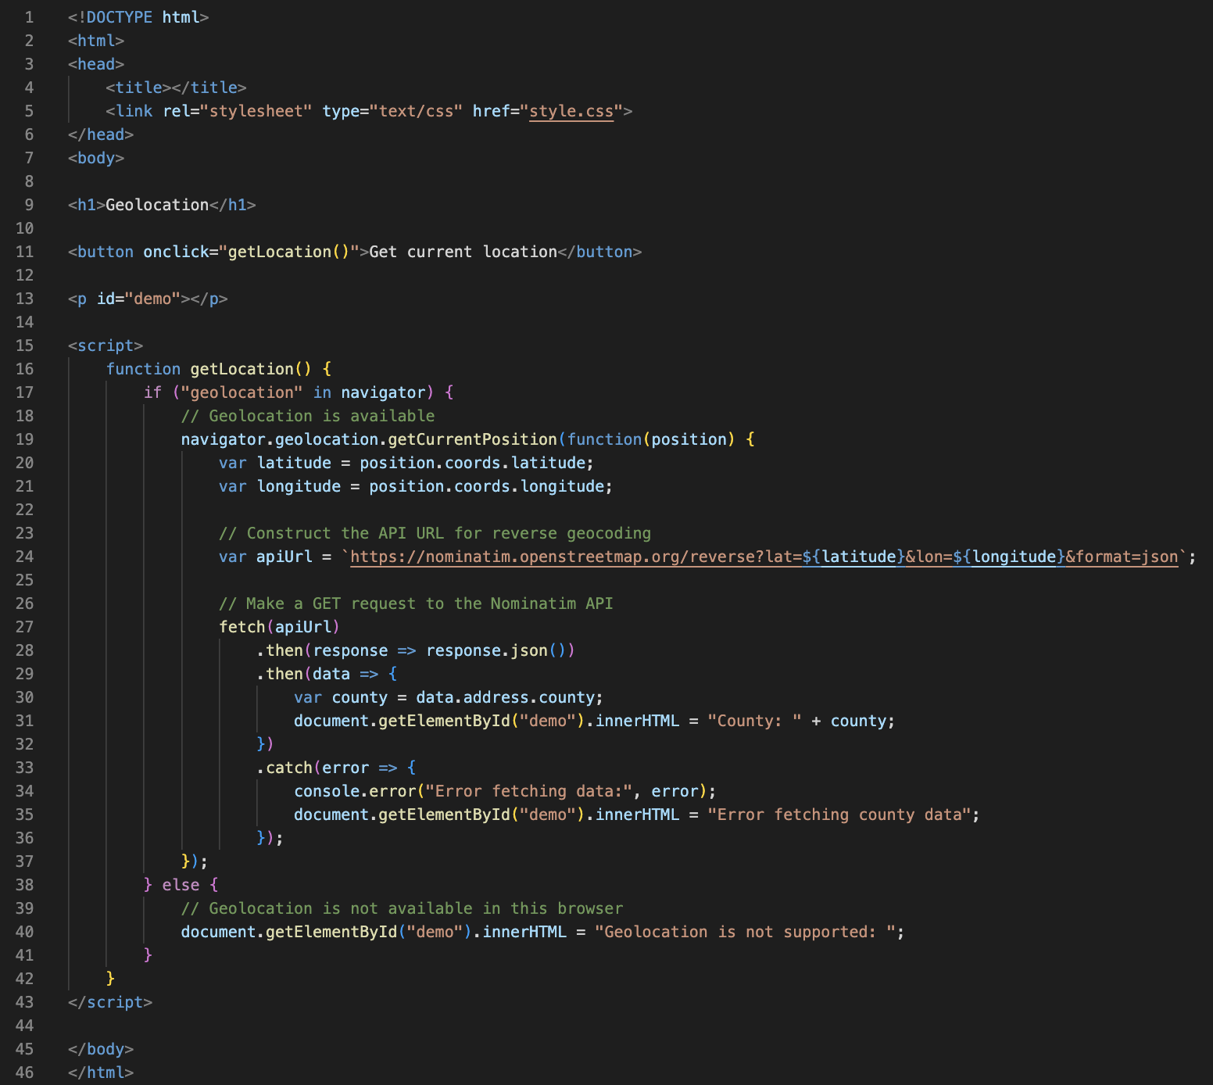
z
Geolocation

Slide 7
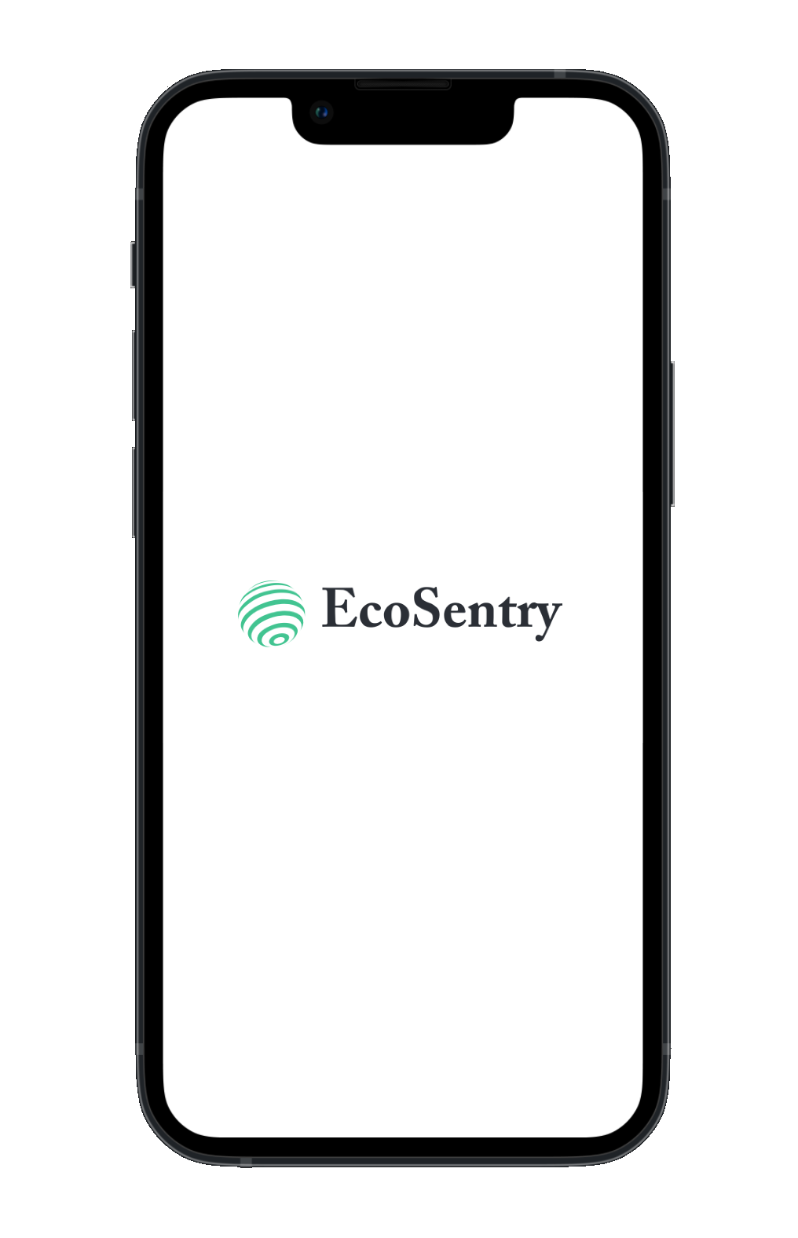
Solution
Close the gap
World-wide connection
Target audience
Victims of natural disasters
Easy to use
A few clicks away

Slide 8
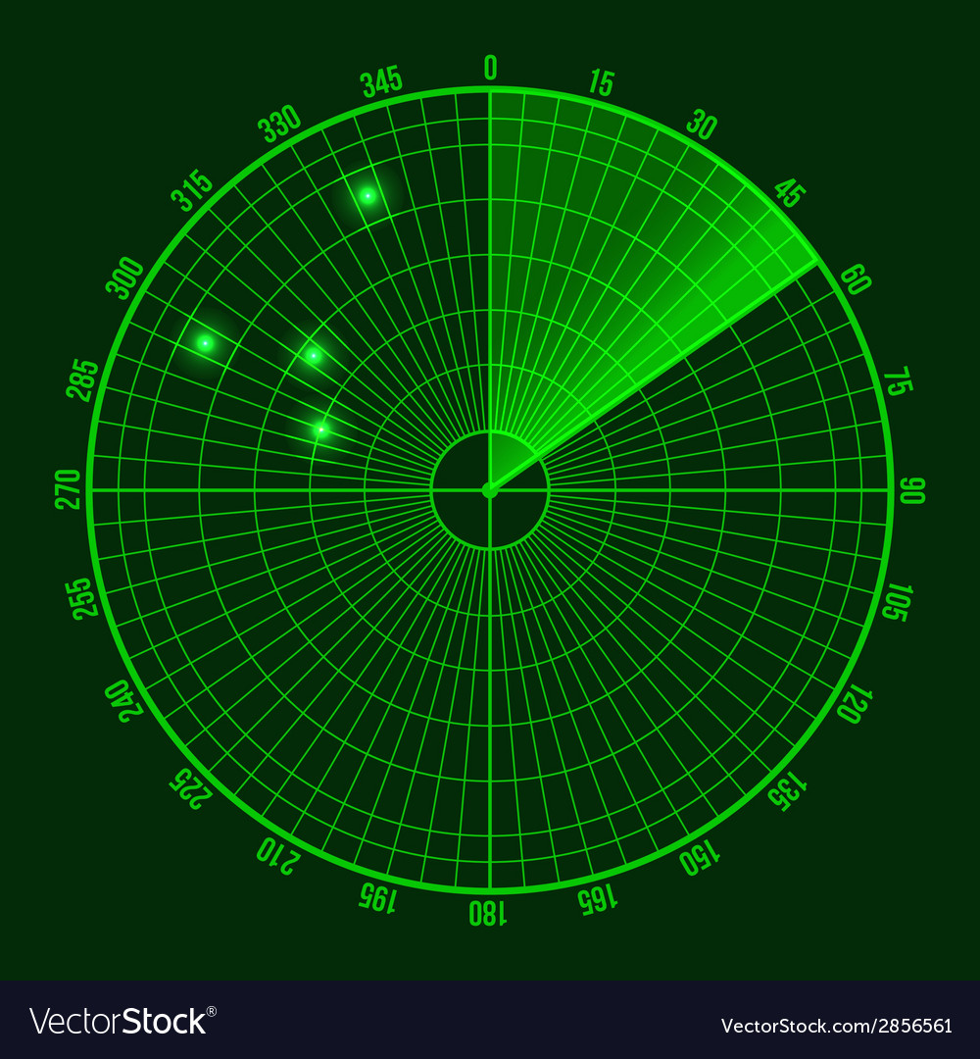
EcoSentry

