Slide 1
CYBERMIND: analyst decision support
Alerts describe events. Analysts still need context
to decide what to inspect next.
Observed network → future risk → sensitivity comparison
The local console connects the forecast to its input graph,
model explanation and checkpoint lineage.
Prototype demonstration • Synthetic verification data
Notes:
Sources: docs/SIH26153_CYBERMIND_Master_Plan.md, docs/TRACK_B_ANALYST_UI_AUDIT.md. Proposed workflow; operational benefit is not yet measured.

Slide 2
Temporal graph architecture
60-second graph windows
Hosts form nodes; flows and packet telemetry describe edges.
A 30-second stride preserves overlap across 16 observed windows.
Edge-aware GATv2 → temporal Transformer
Latent dynamics produce risk rollouts and stage emissions.
The CRF constrains decoded transitions to the reviewed policy.
Packet-complete preparation remains a prerequisite for the production run.
Notes:
Sources: configs/gb10_full.yaml; src/cybermind/models/world_model.py; src/cybermind/models/stage_decoder.py. Production configuration uses 60-second windows, 30-second stride, history16. Synthetic verification uses its separate fixture configuration.

Slide 3
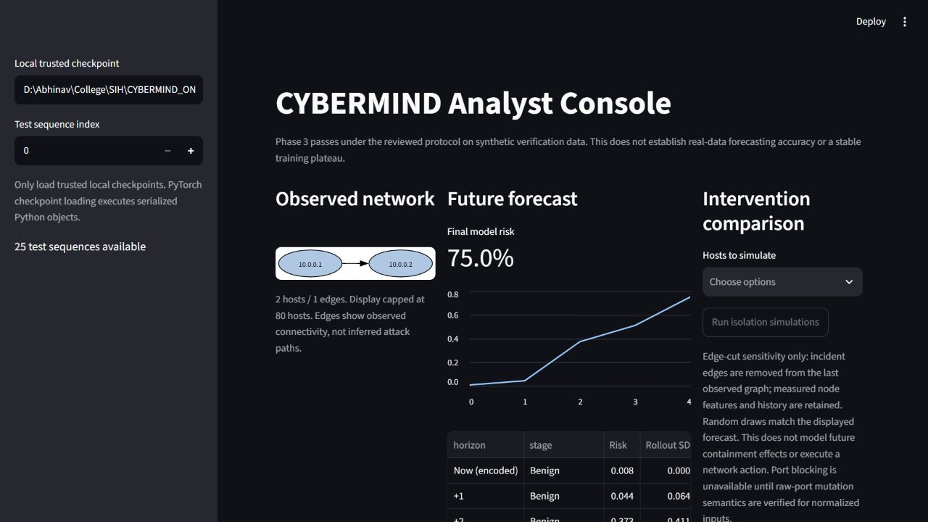
Analyst console: actual local inference
Observed topology, named forecast steps, uncertainty and case lineage
Notes:
Source image: artifacts/track_e/video/01-overview.png, captured from locally running scripts/app.py. Reviewed epoch185 checkpoint, synthetic test sequence0; no real-data accuracy is implied.

Slide 4
Isolation probe: no measured risk reduction
74.96% → 74.96%
Baseline risk Edge-cut probe
The corrected probe removes incident edges while retaining
measured node features, history and random draws.
This case supplies no evidence of a helpful action.
The comparison measures model sensitivity, not causality.
Notes:
Sources: current scripts/app.py; src/cybermind/analyst/view.py; root Track E corrected isolation verification. Same checkpoint, observed history and random draws. Incident-edge removal preserves measured node features. Earlier feature scaling increased risk and was an intervention-semantics defect, not evidence that physical isolation worsens security.

Slide 5
Evidence and the next gate
Phase 3 passes under the reviewed protocol
on synthetic verification data
Epoch 185 passes all four steps; epochs 98 and 200 fail step 1.
The result is a narrow selected checkpoint, not a stable plateau.
Feature-matched baseline and world model tie: F1 1.00, FPR 0.00.
Real-data accuracy and superiority remain unmeasured.
Next gate: validate the one-day packet/flow join and labels
before a separately authorized production training run.
Notes:
Sources: PHASE3_FINAL_AUDIT.md; docs/TRACK_A_BENCHMARK_AUDIT.md; examples/track_a_benchmark/selected185/comparison.json; current Phase4 and Track C/D audit status. Synthetic table covers25 targets(19 negatives,6 positives), one-step infiltration threshold0.5. Feature-matched logistic baseline ties the selected world model: F1=1,FPR=0. Epoch98 and200 fail step1 whereas selected185 passes. No superiority or real-data kill-chain accuracy claim.

