Slide 1
login

Slide 2
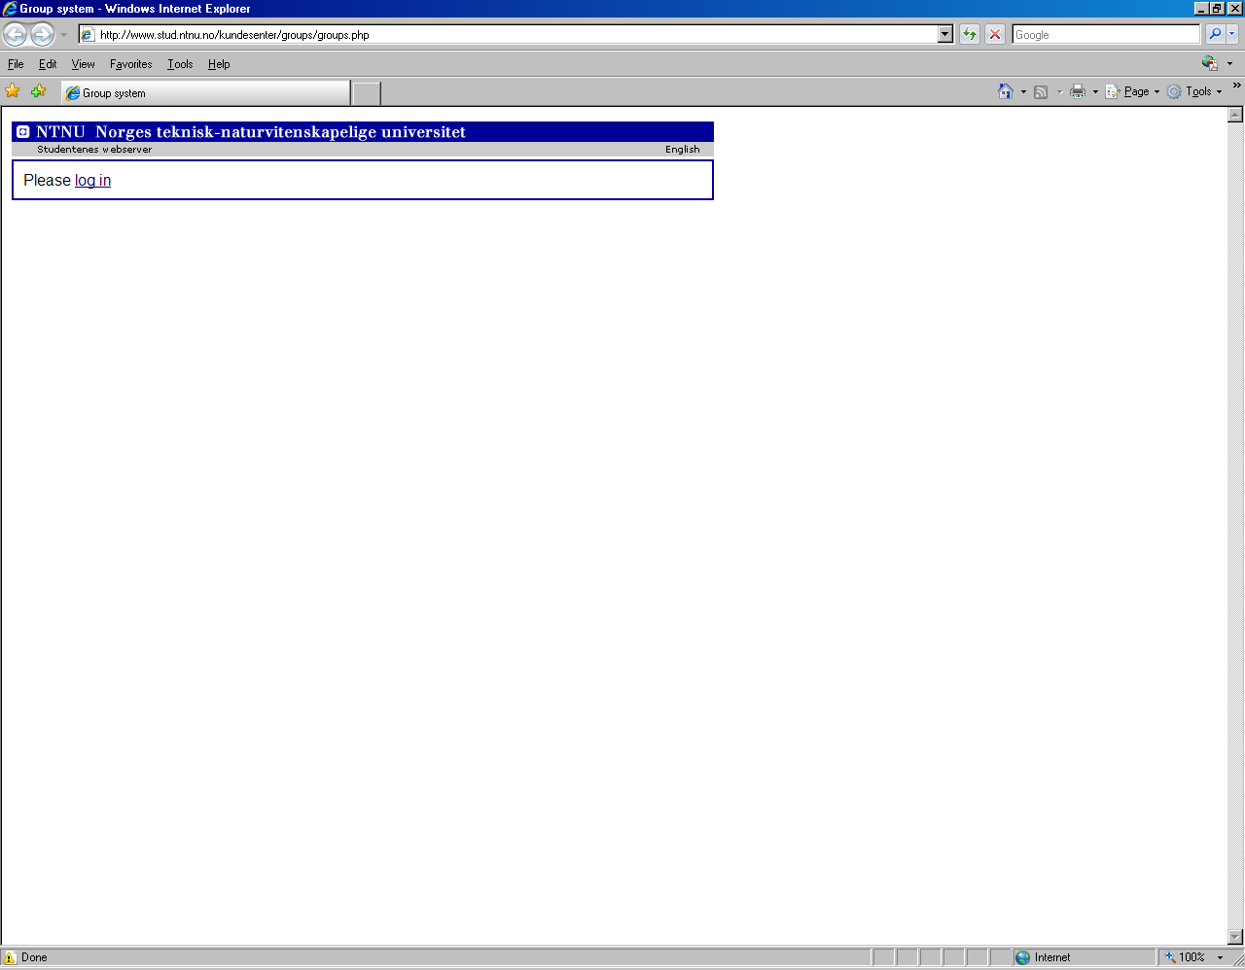
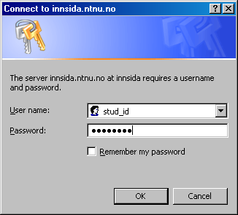
http://www.stud.ntnu.no/kundesenter/groups/groups.php

Slide 3
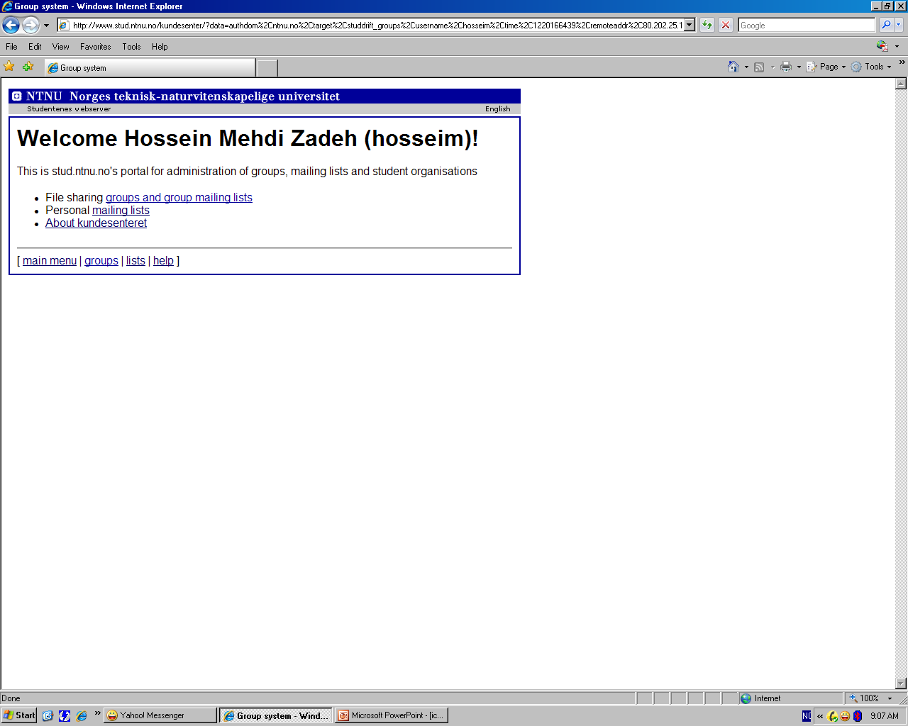
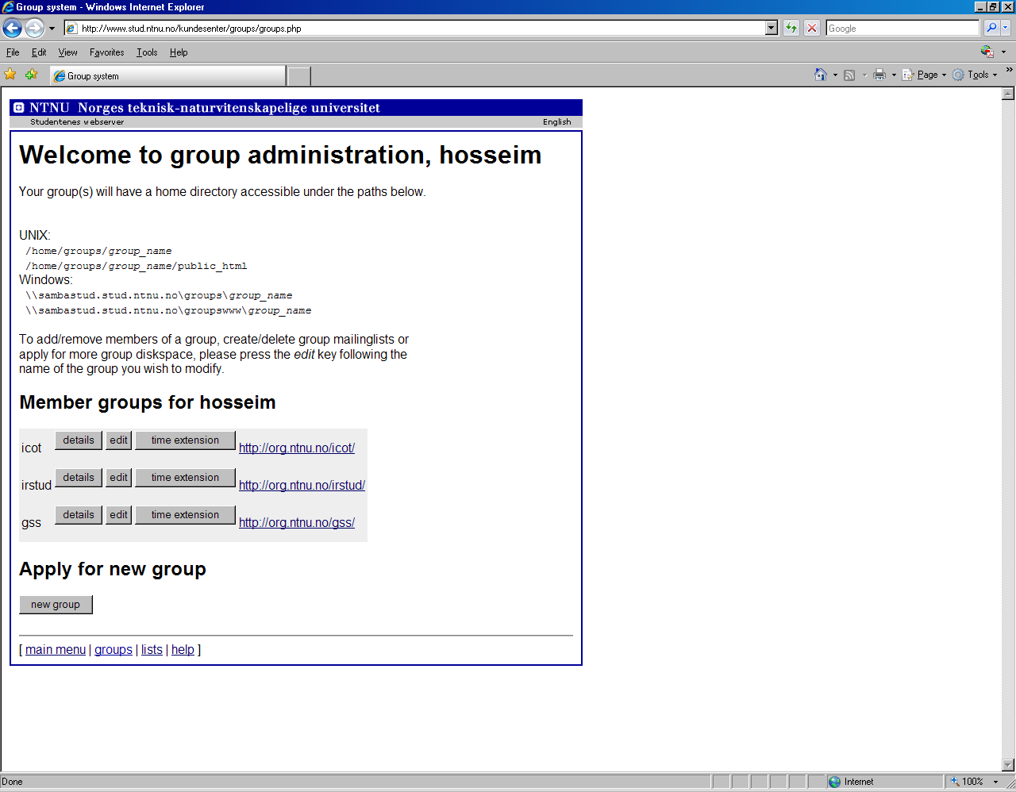
First family name (username)!
username
Website links
Group name
username
Edit managers and/or members

Slide 4
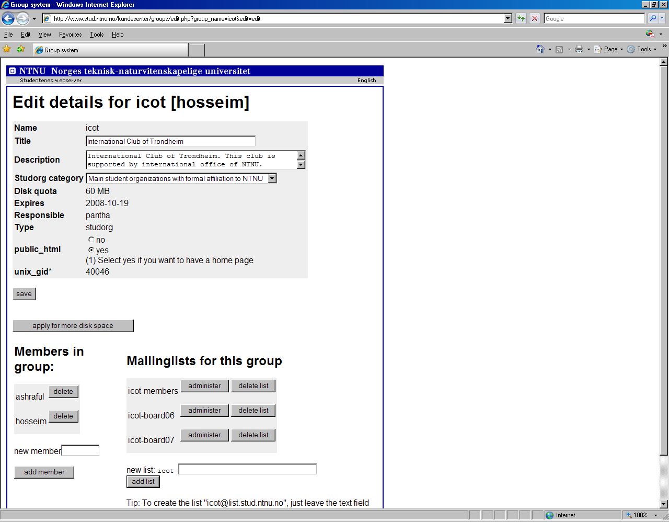
Managers
Add new managers
Delete old managers
Delete old list
Add new list
Adminstrator
Create new mail list

Slide 5
Add new list

Slide 6


Slide 7
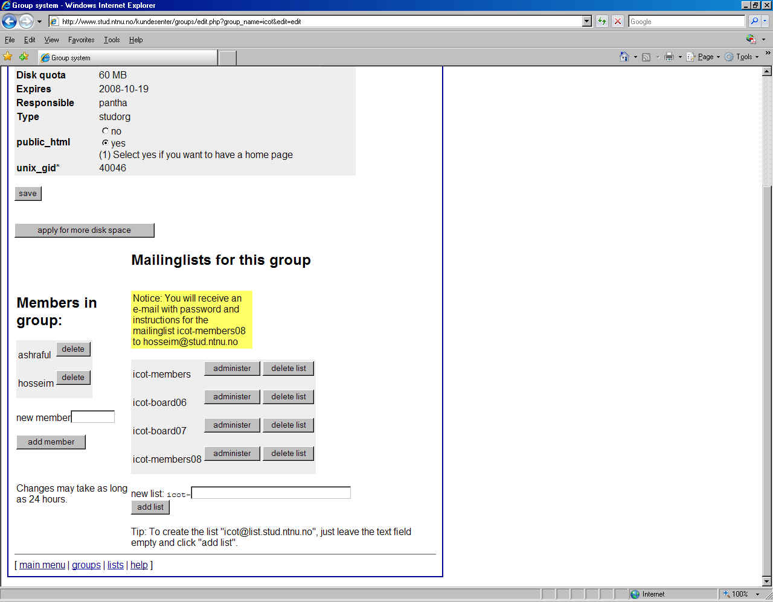

Slide 8
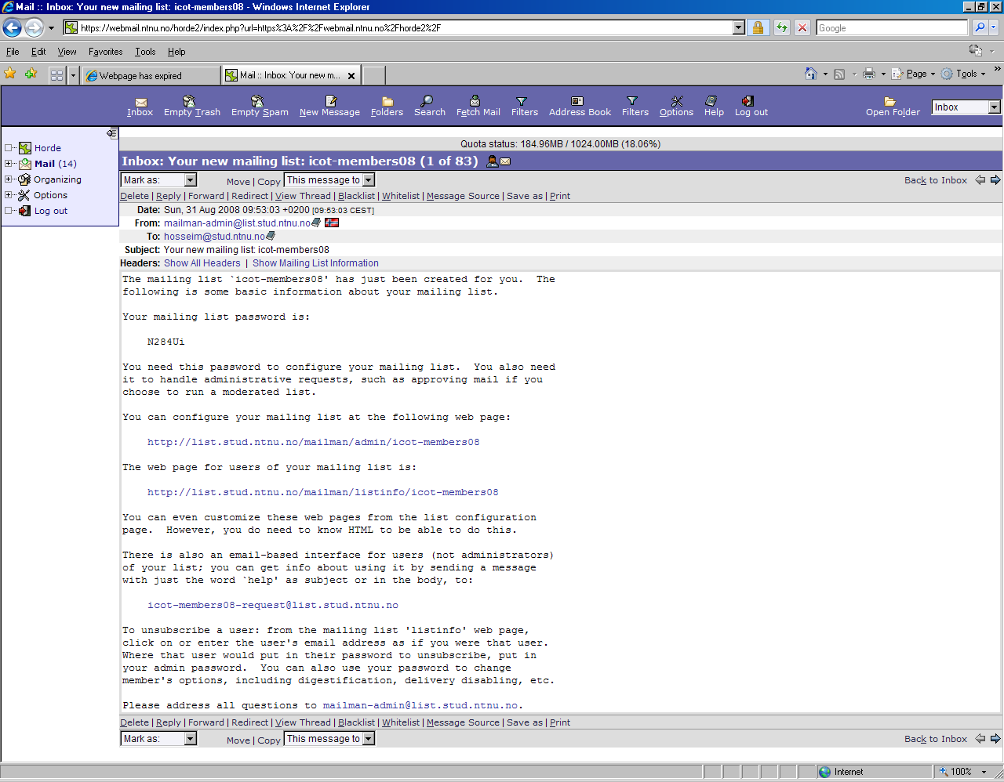

Slide 9
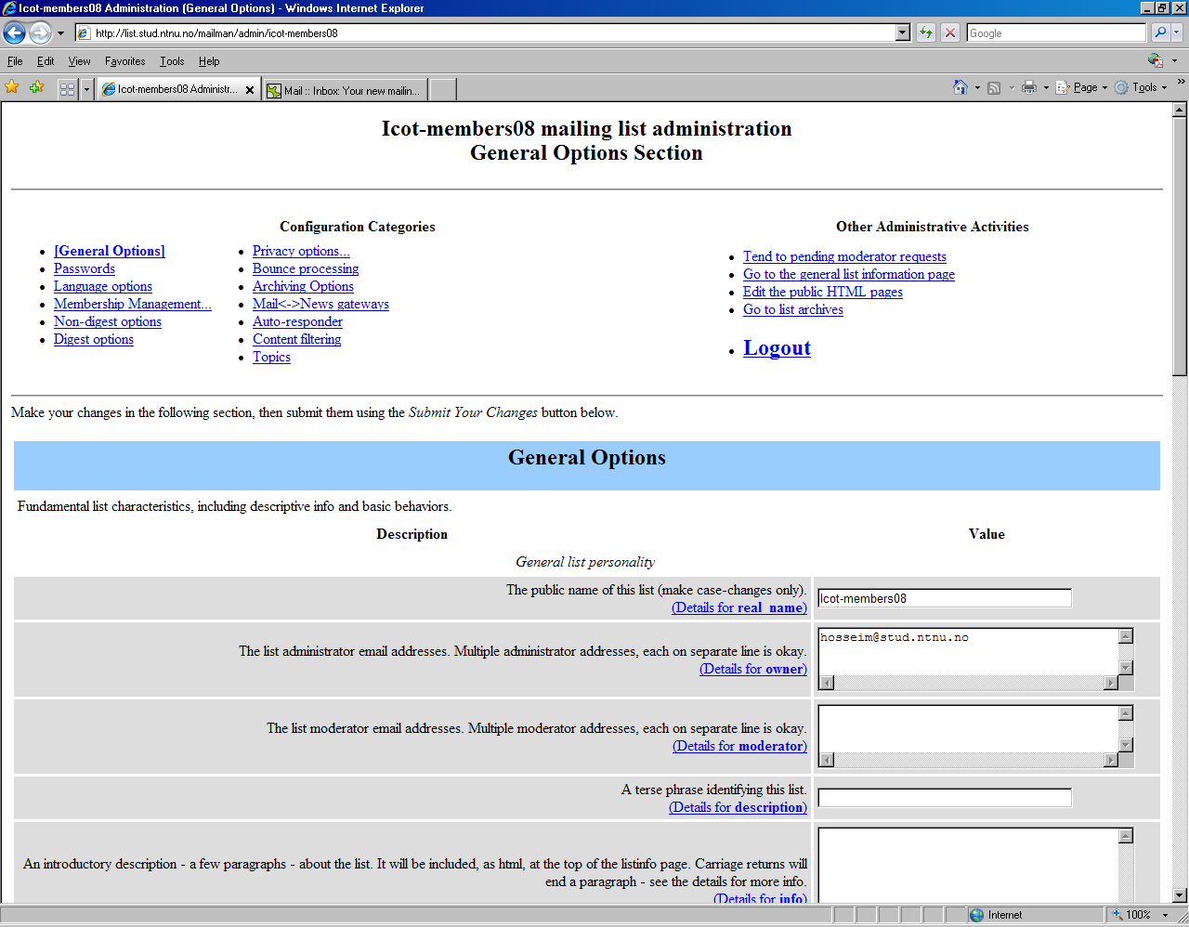
Add new members
List adminstrator
Remeber to click ”submit your changes” at the end of the page, see next slide.

Slide 10
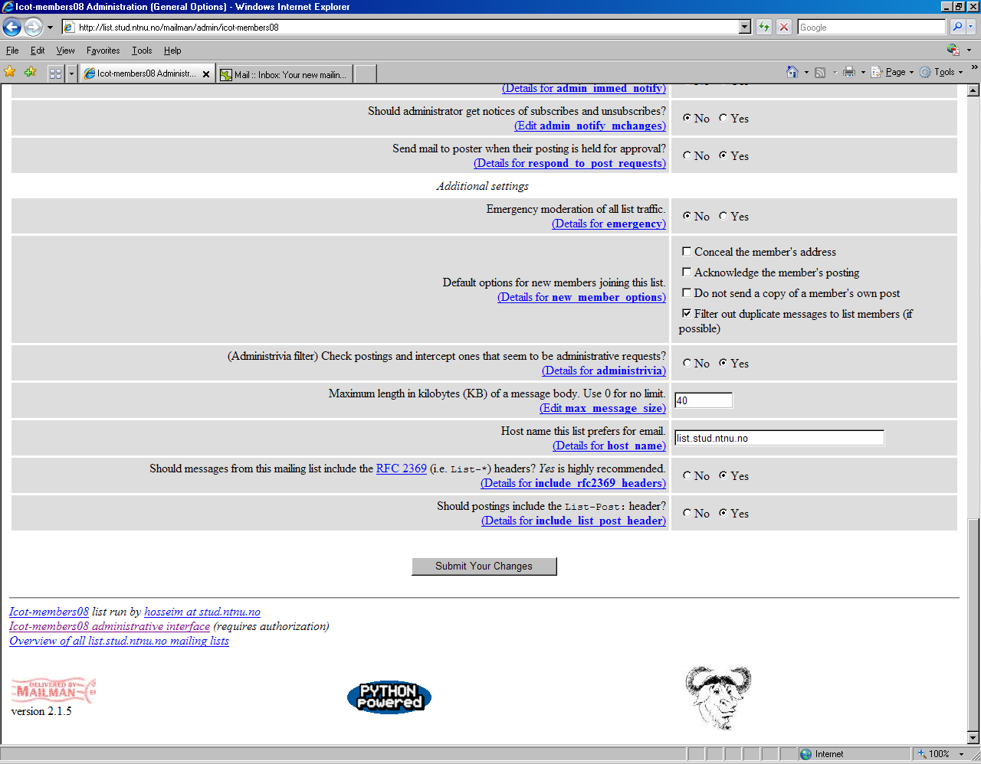

Slide 11
Add members to list
After login

Slide 12
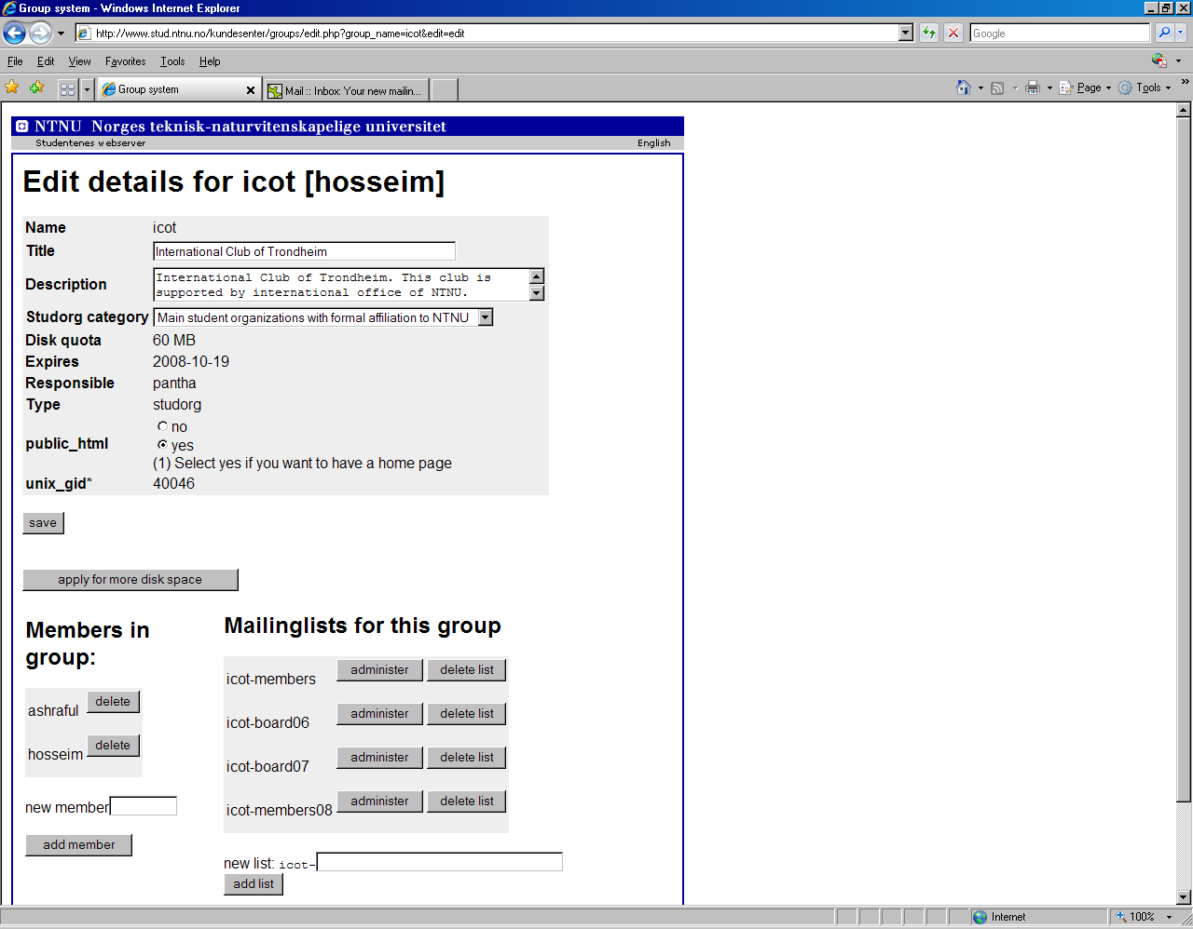
Click adminstrator of corresponding list

Slide 13

Membership managment

Slide 14
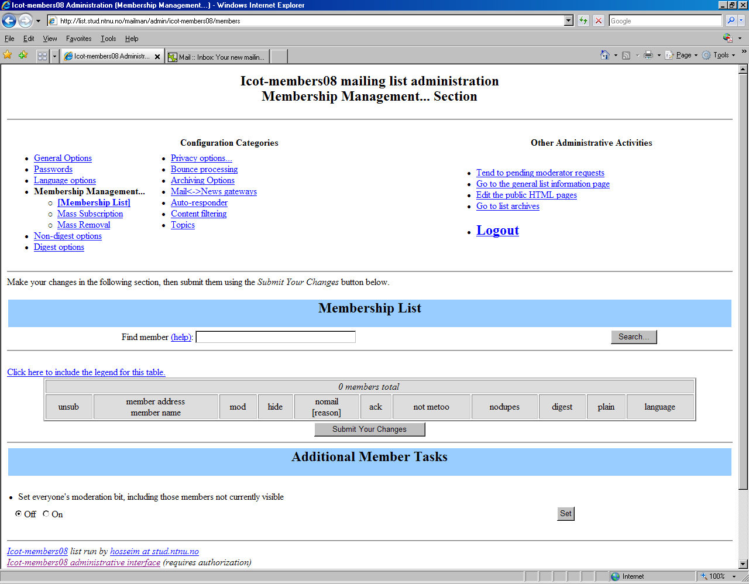
Mass subscription

Slide 15
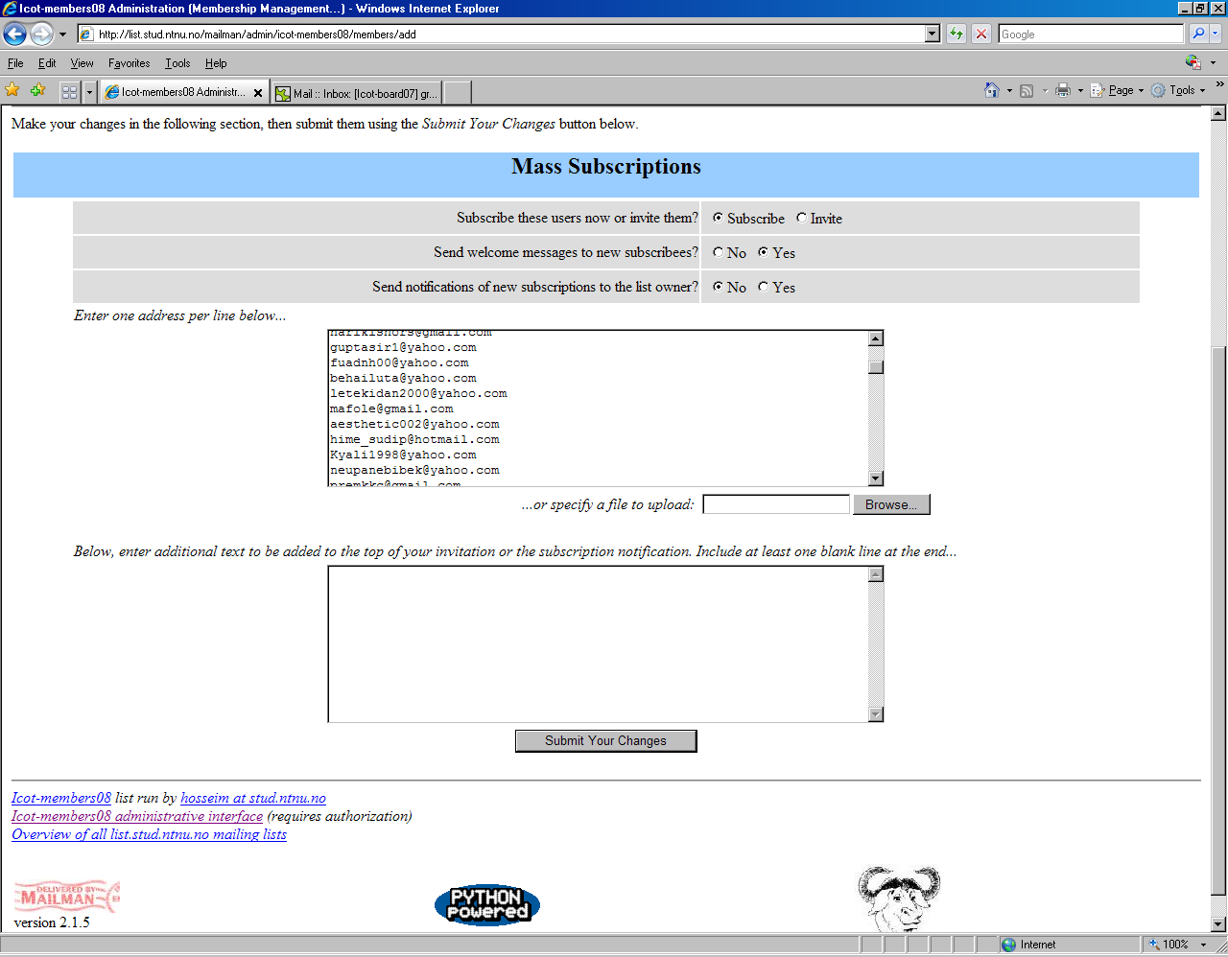
1- Add members
2- click ’submit your changes’

Slide 16
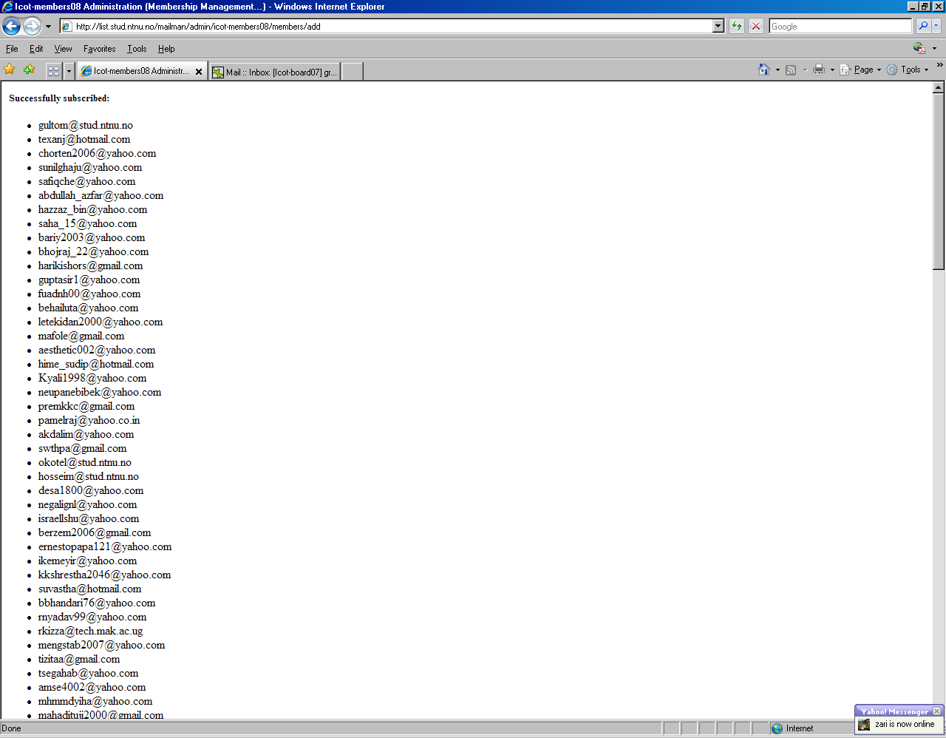

Slide 17
Email approval
If you receive an email regarding approval for emails

Slide 18
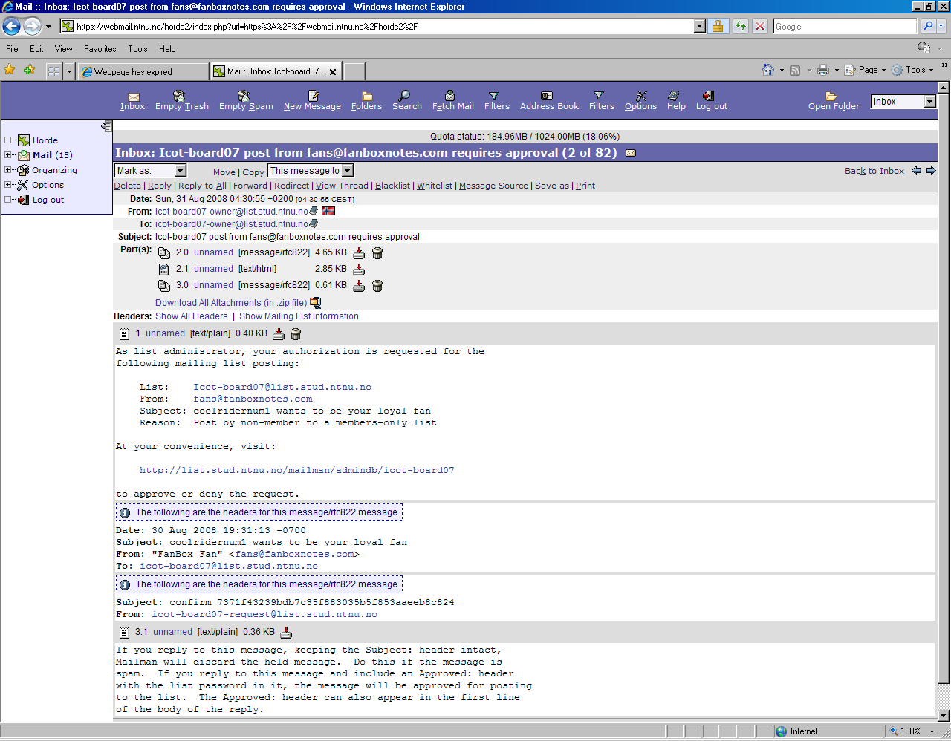
Click the link
Example

Slide 19
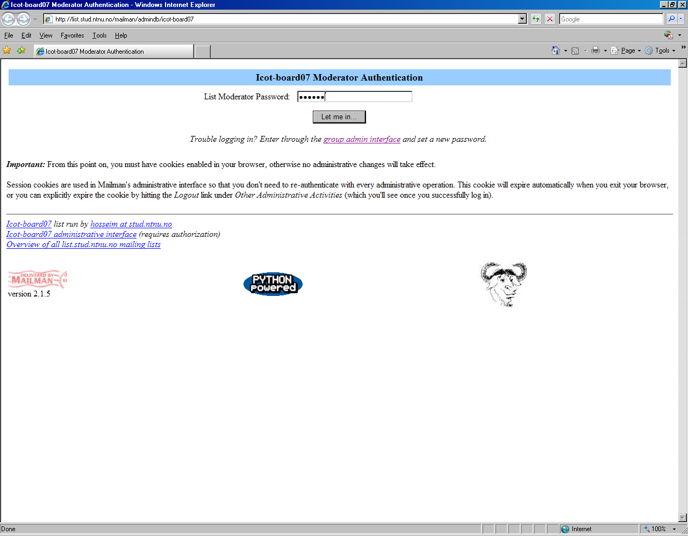
Enter pass: ar2004

Slide 20
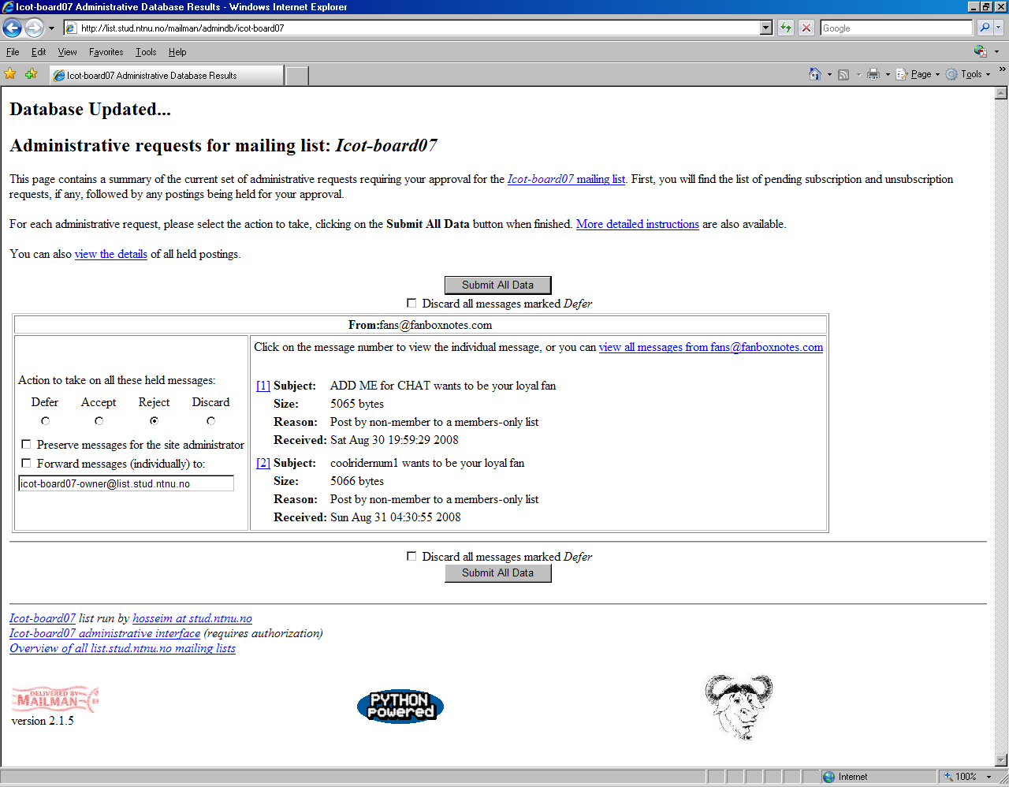
1-choose the proper action
2-submit

Slide 21
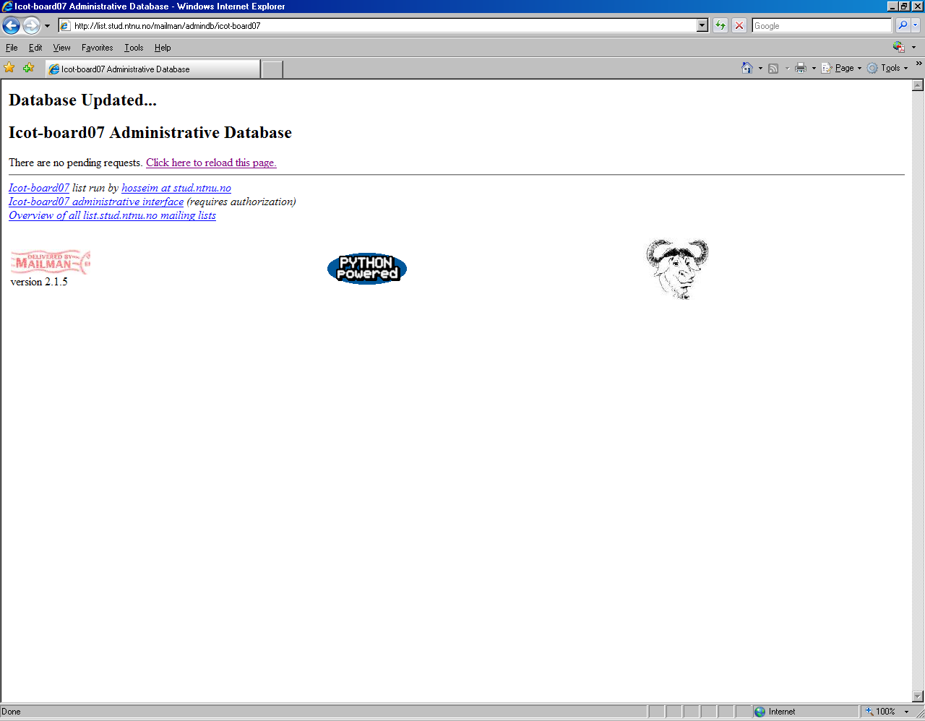

Slide 22
