Slide 1






Input Data
Input Layer
Hidden Layer
Output Layer
. . . . . .
$$ℒ$$
Sigmoid
$$W_{1}, b_{1}$$
$$W_{2}, b_{2}$$
$$σ$$
$$σ$$
$$σ$$
Gradient Descent

Slide 2
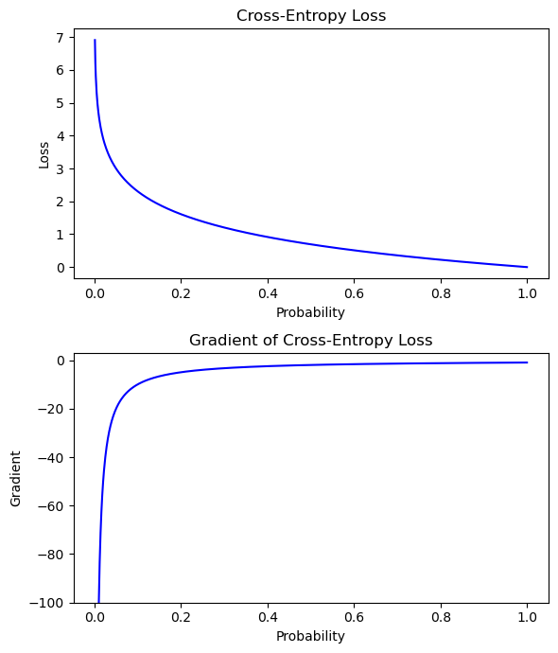
High penalty to those sample with low confidence
Low penalty to those sample with high confidence
Small gradient contribution from hight confident samples
High gradient contribution from low confident samples

