Slide 1










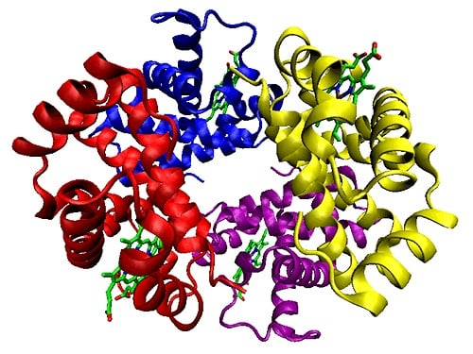












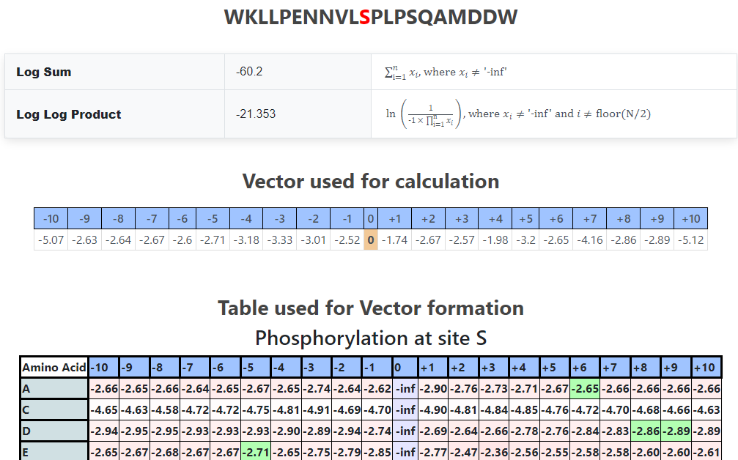
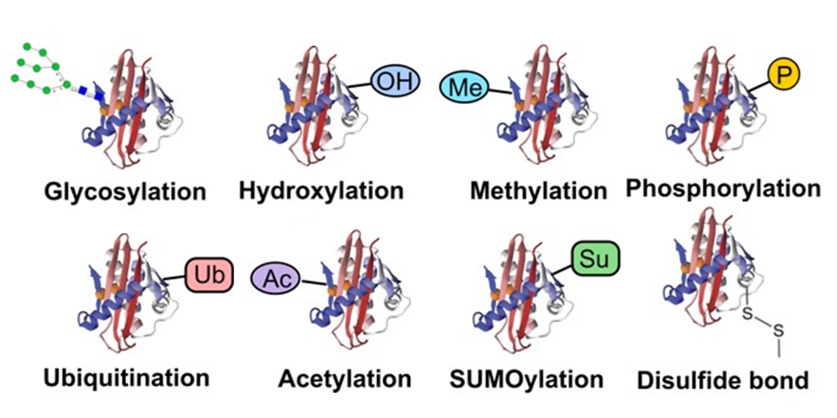

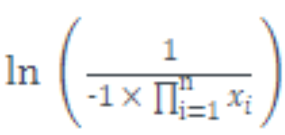



PTMKB – Protein Post-Translational Modification (PTM) Analyser and Site Scorer
Data Wrangling
Glycosyl
Phosphoryl
Butyryl
Methyl
…
Web Scraping
PTM Data Analysis
Data Cleaning and Matrices Formation
Processed Data
2. PTMKB Search Pipeline
Protein Identifier Query
Protein PTMs Lookup
Information Extraction
Protein PTM Details
3. PTMKB Propensity Scoring Pipeline
POSITION
…HKSKKKNKGAIAGKS…
RESIDUE
PTM & Subsequence Query
PTM Matrix Lookup
Propensity Scoring
Display Propensities

