Slide 1











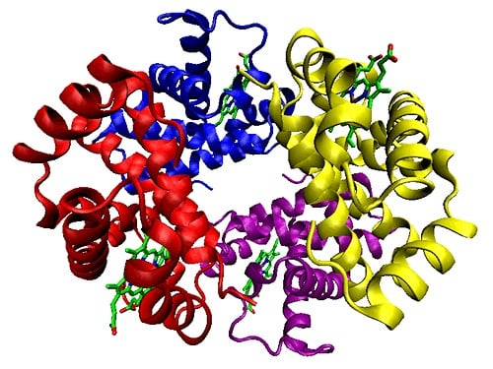








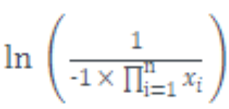
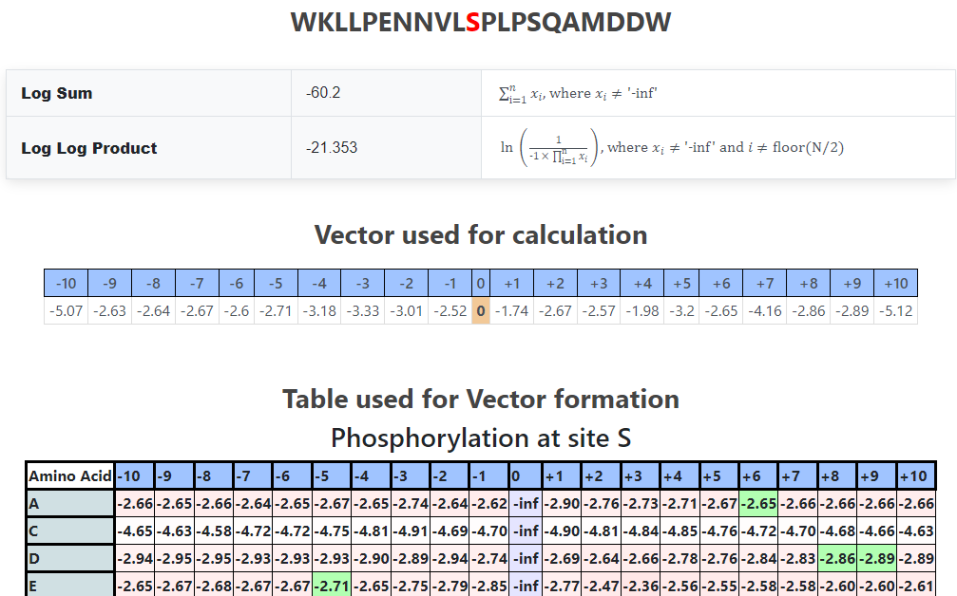
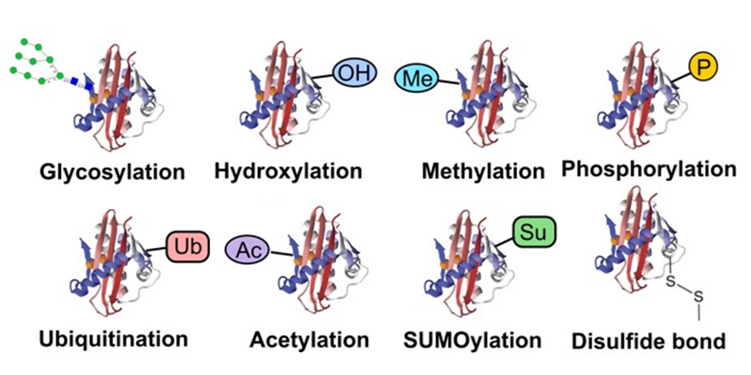



PTMKB – Protein Post-Translational Modification (PTM) Analyser and Site Scorer
Data Wrangling
Glycosyl
Phosphoryl
Butyryl
Methyl
…
Web Scraping
PTM Data Analysis
Data Cleaning & Matrices Formation
Clean Data
2. PTMKB Search Pipeline
AlphaFoldDB
RCSB PDB
UniProt
PIR RESID
Jpred4
Protein Identifier Query
Protein PTMs Lookup
Information Extraction
Protein PTM Details
3. PTMKB Propensity Scoring Pipeline
…HKSKKKNKGAIAGKS…
POSITION
-2.66
-2.65
-2.62
-4.72
-4.81
-4.69
RESIDUE
-2.94
-2.89
-2.74
-2.65
-2.68
-2.85
PTM & Subsequence Query
PTM Matrix Lookup
Propensity Scoring
Propensity Results

