Slide 1
Extracting Breast Cancer Phenotypes from Clinical Notes: Comparing LLMs with Classical Ontology Methods
Abdullah Bin Faiz, Arbaz Khan Shehzad, Asad Afzal, Momin Tariq, Muhammad Siddiqi, Muddassar Farooq
22nd International Conference of Artificial Intelligence in Medicine (AIME), 2024
Salt Lake City, Utah, United States
6/24/2024

Slide 2
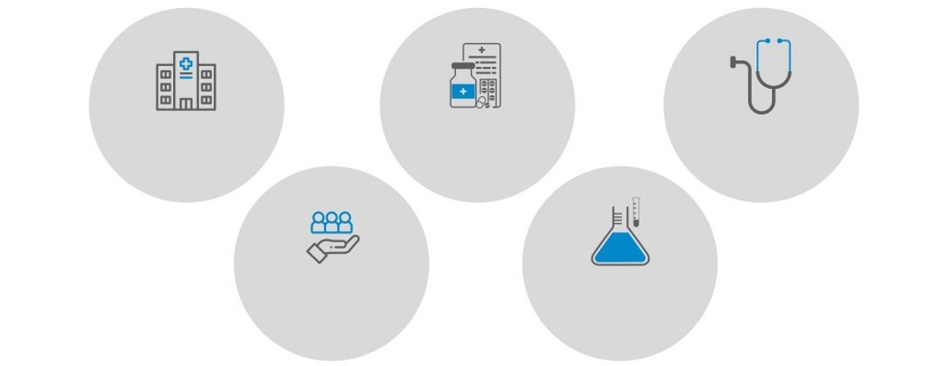
CureMD
A global, integrated healthcare products & services company
3500+
locations
32
specialties
12000+
Providers
24 million
patients
2000+
integrations
6/24/2024

Slide 3
Motivation
97% of oncological notes contain useful information in unstructured format
Costly and time consuming to extract phenotypes from notes
Ontology system fails to pick semantics from notes, and is dependent on NCBO’s NCIt API
An in-house LLM-centric Notes Processing system that not only rectifies the semantic relationship issue, but also provides faster processing and increase security and privacy
6/24/2024
3

Slide 4
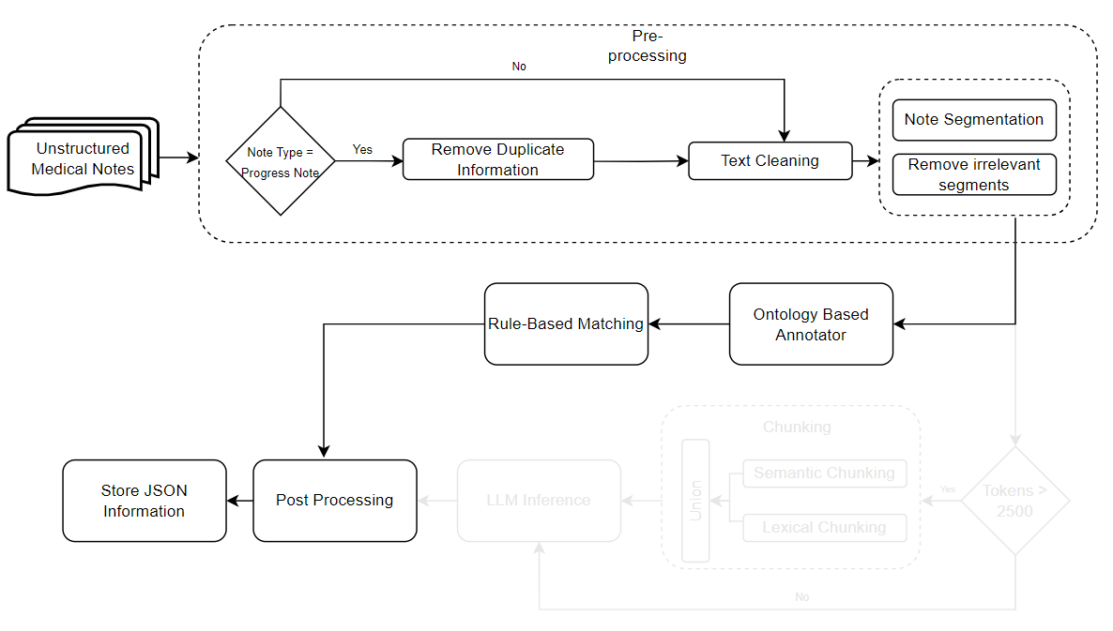
Ontology System – Flow Chart
6/24/2024

Slide 5
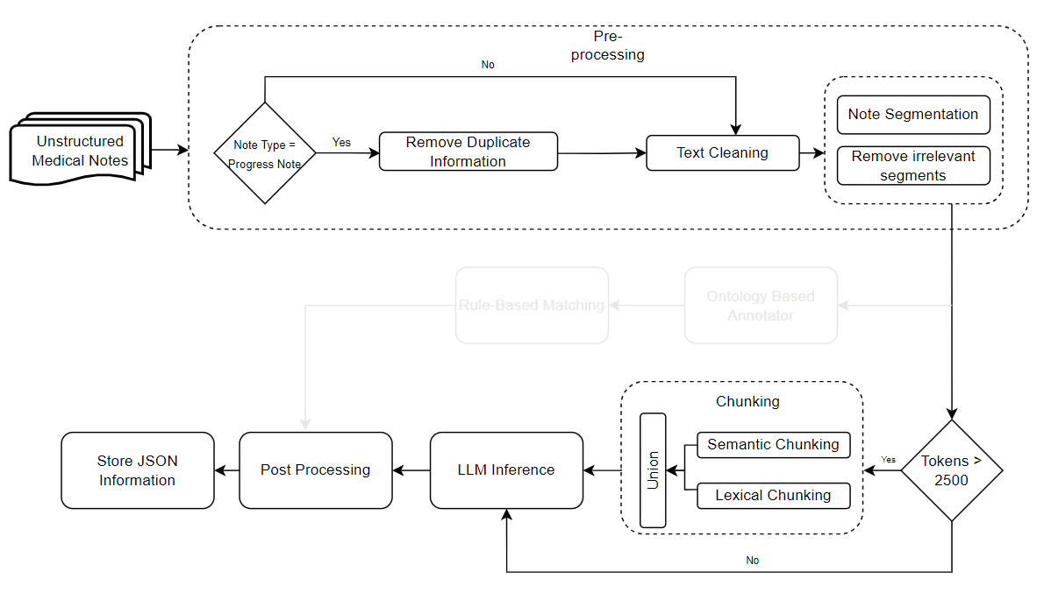
LLM System – Flow Chart
6/24/2024

Slide 6
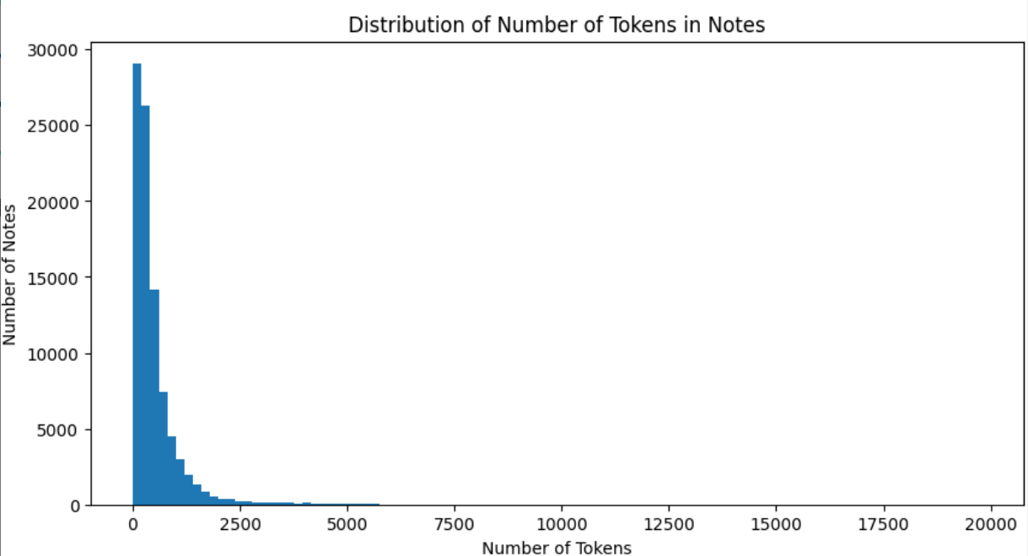
Pre-processing of Text
LLMs have limited context window
Need for trimming of oncological notes
6/24/2024

Slide 7
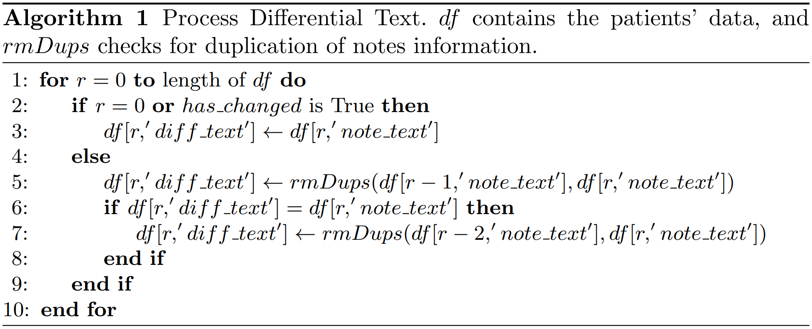
Pre-processing of Text
Pick notes containing valuable information and perform removal of
irrelevant sections
repetitive text
bloated ASCII text
6/24/2024

Slide 8
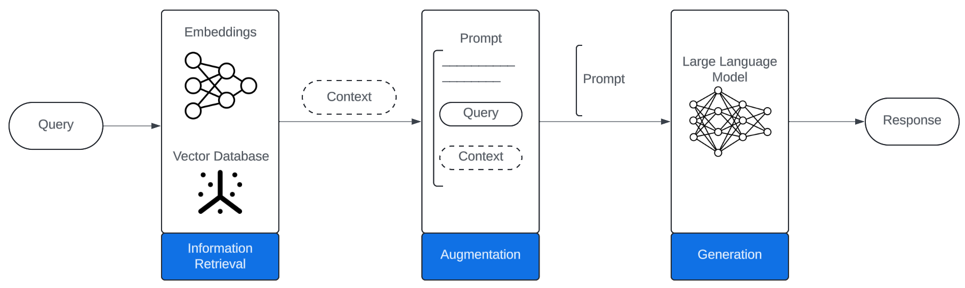
Retrieval Augmented Generation
6/24/2024

Slide 9
Pre-processing of Text
Steps to RAG:
Chunking – Recursive Text Splitter applied.
Re-ranking – Retrieve top k chunks with respect to query. Two algorithms applied:
Semantic Re-ranking – mxbai-embed-large-v1 paired with Cosine-Similarity.
Lexical Re-ranking –Pyserini’s Lucene Searcher paired with BM25 algorithm based on frequency distribution of query terms within each chunk.
Union – Union operation on both re-ranking sets to obtain optimal set of k chunks.
6/24/2024

Slide 10
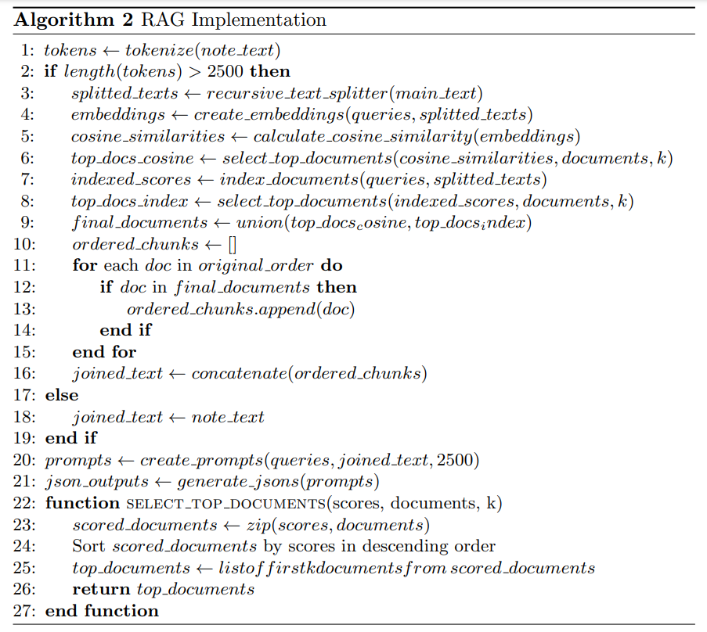
Retrieval Augmented Generation
6/24/2024

Slide 11
Response Generation
Augmented prompt from RAG sent to hosted LLM
LLM optimized by using TensorRT-LLM by Nvidia for faster inference
Prompt engineering done to only generate JSON from the note
JSON validated through post-processing pipeline
Dates, Tumor size units, Boolean values standardized
Mismatched brackets in generated response fixed
Manipulate key-value pairs to make the JSON conform to schema
6/24/2024

Slide 12
Cancer Phenotypes (Breast Cancer)
Extract information related to following:
Stage
TNM
Tumor Information
Findings
Size
Body part/organ
Laterality
Grade
Performance
ECOG
KARNOFSKY
Biomarkers
HR (Estrogen, Progesterone Receptors)
HER2
6/24/2024

Slide 13
Evaluation Methodology
150 notes randomly sampled (Admit and Progress)
4 inferences were made for each note
Overall Stage and TNM Staging
Tumor
Grade and Performance
Biomarkers
Responses from LLAMA-3 8B, Mistralv 0.2-7B and Ontology system were manually evaluated
6/24/2024

Slide 14
Results
Model | Result | Phenotype
 |  | Biomarkers | Grade & Perf | Stage | TNM | Tumor
LLaMA 3 | Correct | 133 | 140 | 124 | 123 | 126
 | Incorrect | 17 | 10 | 26 | 27 | 24
Mistral | Correct | 125 | 115 | 117 | 107 | 130
 | Incorrect | 25 | 35 | 33 | 43 | 20
Ontology* | Correct | 82 | 102 | 121 | 107 | 111
 | Incorrect | 41 | 21 | 2 | 16 | 12
* - The total numbers sum up to 615 instead of 750. Out of 150 API calls, 27 times, no response was provided by the NCBCO Annotator
6/24/2024

Slide 15
Results
Model | Accuracy | Precision | Recall | F-1 Score
LLaMA 3 | 86.13 % | 87.90 % | 94.95 % | 91.29 %
Mistral | 79.20 % | 81.35 % | 91.98 % | 86.34 %
Ontology | 85.04 % | 100.0 % * | 83.80 % | 91.19 %
* - Since the ontology-based system does not inherently hallucinate, its precision is reported to be 100%
6/24/2024

Slide 16


Comparison of Two Systems
LLMs
Ontology
Hallucination
Mismatched pairs of braces
Key value pair instead of values
Resource intensive
Fails to pick semantics within note
Does not generalize to additional phenotypes and disease
Dependent on NCBO API
6/24/2024

Slide 17
Contributions
Notes Processing system built on the ontology system that:
Resolves the semantic relationship and dependency issues in the system
Is able to process the notes much faster than the ontology system
Provides security and privacy by being bound to in-house resources
6/24/2024

Slide 18
Conclusions
Results show that on-premises LLMs provide two benefits:
Security and privacy of patient’s data
GPT-4 Performance can be achieved using larger models like Mixtral 8x7B or LLaMA 3 70B
LLM System and Ontology System can be combined to get promising results
6/24/2024

