Slide 1
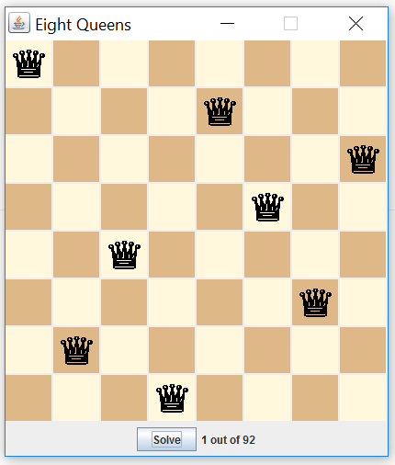
Algorithms and Data Structures
Learn the concept of recursion
When to use recursion/iteration
Call stack
Fractals
Backtracking

Slide 2
Motivation
"cultural experience" - A different way of thinking of problems
Can solve some kinds of problems better than iteration
Leads to elegant, simplistic, short code (when used well)
Some programming languages ("functional" languages such as Scheme, ML, and Haskell) use recursion exclusively (no loops)

Slide 3
What is it?
recursion: The definition of an operation in terms of itself.
-Solving a problem using recursion depends on solving smaller occurrences of the same problem.
recursive programming: Writing methods that call themselves to solve problems recursively.
-An equally powerful substitute for iteration (loops)
-Particularly well-suited to solving certain types of problems

Slide 4
Base Case
A recursive method must have a
stop condition/ base case. Recursive calls will continue until
the stop condition is met.

Slide 5
Recursive Case
A more complex occurrence of the problem that cannot be directly answered but can instead be described in terms of smaller occurrences of the same problem.

Slide 6
Make Stars
public String makeStars(int n){
return n == 0 ? "" : "*" + makeStars(n-1);
}
// test code in client class
out.println(makeStars(4));
OUTPUT
****

Slide 7
Factorial
public long fact(long n){
return n == 1 ? 1L : n * fact(n-1);
}
// test code in client class
out.println(fact(20));
OUTPUT
2432902008176640000

Slide 8
Think Recursively
public static boolean isPalindrome(String s) {
if (s.length() <= 1) // Base case
return true;
if (s.charAt(0) != s.charAt(s.length() - 1)) // Base case
return false;
return isPalindrome(s.substring(1, s.length() - 1));
}

Slide 9
Helper Methods
public static boolean isPalindrome(String s) {
return isPalindrome(s, 0, s.length() - 1);
}
private static boolean isPalindrome(String s, int low, int high) {
if (high <= low) // Base case
return true;
if (s.charAt(low) != s.charAt(high)) // Base case
return false;
return isPalindrome(s, low + 1, high - 1);
}
Notes:
This method is more efficient by not creating a new String each time.

Slide 10
Stack
When you call a method, an
activation record for that method call is put on the stack with spots for all parameters/arguments being passed.

Slide 11
Tracing Code
AR3
x y
4 -1 return 4
AR2
x y
1 return AR3 + 4
AR1
x y
4 3 return AR2 + 4
int fun( int x, int y)
{
if( y < 1)
return x;
else
return fun( x, y - 2) + x;
}
//test code in client class
out.println(test.fun(4,3));
8
12
Notes:
An iterator allows movement from one reference to the next.
When the next() method is called, the next reference in the list is returned and the iterator moves to the next reference.
The next methods movement is based on the data structure that the iterator is working on.

Slide 12
Code Tracing
public int mystery(int n){
return n < 10 ? n : mystery(n/10 + n%10);
}
// test code in client class
out.println(mystery(648));

Slide 13
Code Tracing
mystery(648):
int a = 648 / 10; // 64
int b = 648 % 10; // 8
return mystery(a + b); // mystery(72)
mystery(72):
int a = 72 / 10; // 7
int b = 72 % 10; // 2
return mystery(a + b); // mystery(9)
mystery(9):
return 9;

Slide 14
Code Tracing
public int mystery(int n){
if(n < 10)
return n * 10 + n;
int a = mystery(n/10), b = mystery(n % 10);
return 100 * a + b;
}
// test code in client class
out.println(mystery(348));

Slide 15
Code Tracing
mystery(348)
int a = mystery(34);
int a = mystery(3);
return (10 * 3) + 3; // 33
int b = mystery(4);
return (10 * 4) + 4; // 44
return (100 * 33) + 44; // 3344
int b = mystery(8);
return (10 * 8) + 8; // 88
return (100 * 3344) + 88; // 334488
What is this method really doing?

Slide 16
Reverse Lines
Write a recursive method reverseLines that accepts a file Scanner and prints the lines of the file in reverse order.
Roses are red, Are belong to you.
Violets are blue. All my base
All my base Violets are blue.
Are belong to you. Roses are red,
What are the cases to consider?
How can we solve a small part of the problem at a time?
What is a file that is very easy to reverse?

Slide 17
Reversal Solution
public void reverseLines(Scanner in) {
if (in.hasNextLine()) {
// recursive case
String line =in.nextLine();
reverseLines(input);
System.out.println(line);
}
}

Slide 18
Code Tracing
public static void reverseLines(Scanner input) {
if (input.hasNextLine()) {
String line = input.nextLine(); // "Roses are red,"
reverseLines(input);
System.out.println(line);
}
}
call stack: The method invocations running at any one time.
reverseLines(new Scanner("poem.txt"));
public static void reverseLines(Scanner input) {
if (input.hasNextLine()) {
String line = input.nextLine(); // "Violets are blue."
reverseLines(input);
System.out.println(line);
}
}
public static void reverseLines(Scanner input) {
if (input.hasNextLine()) {
String line = input.nextLine(); // "All my base"
reverseLines(input);
System.out.println(line);
}
}
public static void reverseLines(Scanner input) {
if (input.hasNextLine()) {
String line = input.nextLine(); // "Are belong to you."
reverseLines(input);
System.out.println(line);
}
}
public static void reverseLines(Scanner input) {
if (input.hasNextLine()) { // false
...
}
}
input file:
output:
Roses are red,
Violets are blue.
All my base
Are belong to you.
Are belong to you.
All my base
Violets are blue.
Roses are red,

Slide 19
File Crawler
Write a method that accepts a File parameter and prints information about that file.
If the File object represents a normal file, just print its name.
If the File object represents a directory, print its name and information about every file/directory inside it, indented.
CSIII
labs
recursion
anagram
factorial
8 queens
slides
number systems
recursion

Slide 20
File Objects
Constructor/method | Description
File(String) | creates File object representing file with given name
canRead() | returns whether file is able to be read
delete() | removes file from disk
exists() | whether this file exists on disk
getName() | returns file's name
isDirectory() | returns whether this object represents a directory
length() | returns number of bytes in file
listFiles() | returns a File[] representing files in this directory
renameTo(File) | changes name of file

Slide 21
Private Helper Method
We cannot vary the indentation without an extra parameter:
public void crawl(File f, String indent)
Often the parameters we need for our recursion do not match those the client will want to pass.
In these cases, we instead write a pair of methods:
1) a public, non-recursive one with the parameters the client wants
2) a private, recursive one with the parameters we really need

Slide 22
Crawl Solution
public void crawl(File f) {
crawl(f, "");// calls private helper
}
private void crawl(File f, String tab){
out.println(tab + f.getName();
if(f.isDirectory()){ // recursive case
for(File sub: f.listFile())
crawl(sub, tab + "\t");
}

Slide 23
Recursive Backtracking
A general algorithm for finding solution(s) to a computational problem by trying partial solutions and then abandoning them ("backtracking") if they are not suitable.
a "brute force" algorithmic technique (tries all paths; not clever)
often (but not always) implemented recursively
Applications:
producing all permutations of a set of values
parsing languages
games: anagrams, crosswords, word jumbles, 8 queens
mazes
combinatorics and logic programming

Slide 24
General Pseudo-Code
explore(choices):
if there are no more choices to make: stop.
else:
Make a single choice C from the set of choices.
Remove C from the set of choices.
explore the remaining choices.
Un-make choice C.
Backtrack!

Slide 25
Eight Queens
May only have one queen on each row, column and diagonal.
92 unique solutions exist.

Slide 26
Fractals
A fractal is a geometric figure that can be generated from a pattern repeated recursively.
The figure is modified by recursively applying the pattern to each segment of the original figure.
Fractals have a self-similar property—when subdivided into parts, each resembles a reduced-size copy of the whole.
Many fractals yield an exact copy of the original when a portion of the fractal is magnified—such a fractal is said to be strictly self-similar.

Slide 27
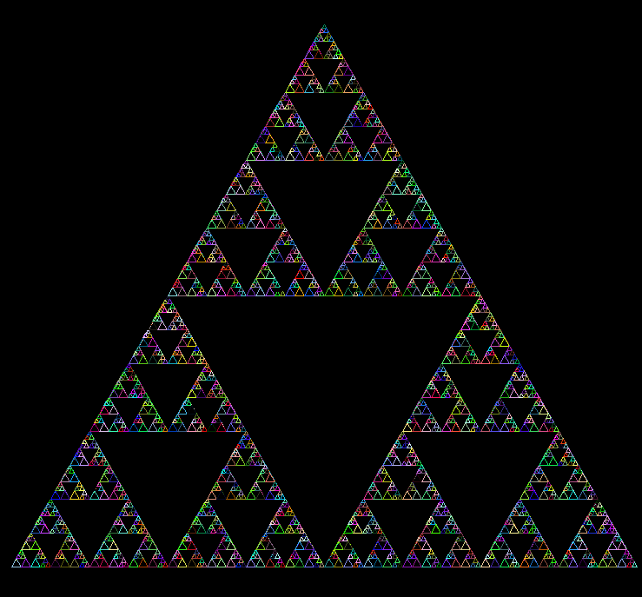
Fractals

Slide 28

Fractals

Slide 29
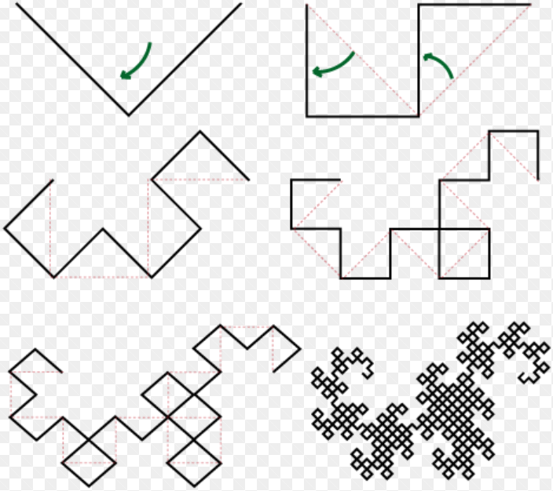
Fractals
Notes:
axiom FX
F =
X = -FX++FY-
Y = +FX--FY+

Slide 30
L - Systems
An L-system or Lindenmayer system is a parallel rewriting system and a type of formal grammar. An L-system consists of an alphabet of symbols that can be used to make strings, a collection of production rules that expand each symbol into some larger string of symbols, an initial "axiom" string from which to begin construction, and a mechanism for translating the generated strings into geometric structures.
axiom Y
Y -> XYX
Notes:
From Wikipedia
A grammar is a powerful tool for describing and analyzing languages. It is a set of rules by which valid sentences in a language are constructed.

Slide 31
L - Systems
axiom B
A → AB
B → A
If you write the first 8 orders of this system you’ll get B, A, AB, ABA, ABAAB, ABAABABA, ABAABABAABAAB and ABAABABAABAABABAABABA. Notice a pattern? If not, look closely at the length of each of these strings: 1, 1, 2, 3, 5, 8, 13, 21. Can you see why the strings produced by this system are called Fibostrings? Fibonacci number sequence shows up often in the natural world, most famously in the way that leaves and scales are arranged on plants (phyllotaxis).
Notes:
From Christopher Jennings

Slide 32

Turtle Graphics
axiom F
F = F+F--F+F
F Moves the turtle forward 1
G Moves the turtle forward 1(pen up)
+ Turns left by angle
Turns right by angle
Koch Curve with angle 60

Slide 33
UIL problems
import java.util.*;
import java.io.*;
public class Junk {
public Junk(){
this();
}
public static void main(String[] args) {
new Junk();
System.out.println("you know nothing John Snow");
}
}
Output
Compile error -
error: recursive constructor invocation

Slide 34
UIL problems
import java.util.*;
import java.io.*;
public class Junk {
Junk(){
new Junk();
}
public static void main(String[] args) {
new Junk();
System.out.println("you know nothing John Snow");
}
}
Output
java.lang.StackOverflowError

Slide 35
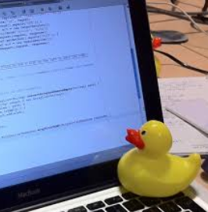
Words of Wisdom
Don’t fall behind.
Visualize and comprehend the problem before writing any code.
Stress test your code thoroughly.
Be patient and take a break
if you’ve been stuck for a while.
Break out the rubber duck.

